Slide 1
First General Session April 20 | 9:15-10:30

Slide 2
Agenda
Call to Order
Land Acknowledgement
Adoption of Procedures
Presentation of Minutes
2022-23 Budget Update
Foundation Report
State of the Academic Senate
Ginni May, ASCCC President
Cheryl Aschenbach, ASCCC Vice President
Manuel Vélez, ASCCC Area D Representative, ASFCCC President
Ginni May, ASCCC President

Slide 3
Land Acknowledgement
We acknowledge that this important work is taking place throughout the unceded territory of California, home to nearly 200 tribal nations. We acknowledge and honor the original inhabitants of our various regions. A land acknowledgment is a critical step towards working with native communities to secure meaningful partnership and inclusion in the stewardship and protection of their cultural resources and homelands.
We begin today by acknowledging that we are holding our gathering on the land of the Tongva (Gabrieleño) Nations who have lived and continue to live here. We recognize the Tongva (Gabrieleño) Nations and their spiritual connection to the ocean and the land as the first stewards and the traditional caretakers of this area we now call Orange County. As we begin, we thank them for their strength, perseverance, and resistance.
We also wish to acknowledge the other Indigenous Peoples who now call Orange County their home, for their shared struggle to maintain their cultures, languages, worldview, and identities in our diverse City.

Slide 4
Actions
Adoption of Procedures
for 2023 Spring
Plenary Session
Procedures can be found on the Spring 2023 Resolutions Page, linked in the Resolutions tab of the 2023 Spring Plenary Session webpage
Adoption of Minutes
from 2022 Fall
Plenary Session
2022 Fall Plenary Session Minutes OR under Resources tab on 2023 Spring Plenary Session webpage
Also, please review the ASCCC Treasurer's Report (2/28/2023)
available on the 2023 Spring Plenary Session Event webpage

Slide 5
Supporting the Work of the Academic Senate for California Community Colleges
ASCCC Spring Plenary Report
April 20th - 22nd
Doubletree Anaheim - Orange County

Slide 6
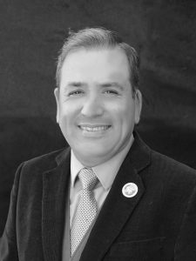
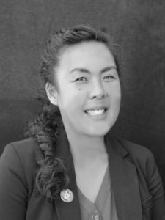
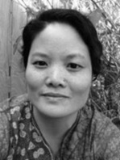
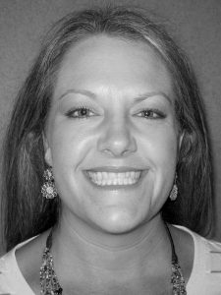
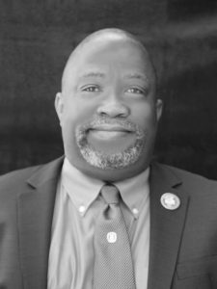
2022-2023 Board of Directors
 | President: Manuel J. Vélez San Diego Mesa College mvelez@sdccd.edu |  | Executive Director: Krystinne Mica Academic Senate for California Community Colleges krystinne@asccc.org
 | Secretary: Karen Chow De Anza College chowkaren@deanza.edu |  | Treasurer: Carrie Roberson Butte College robersonca@butte.edu
 | Director: Robert L. Stewart Jr. Los Angeles Southwest College stewarrl@lasc.edu |  | Director: Vacant

Slide 7
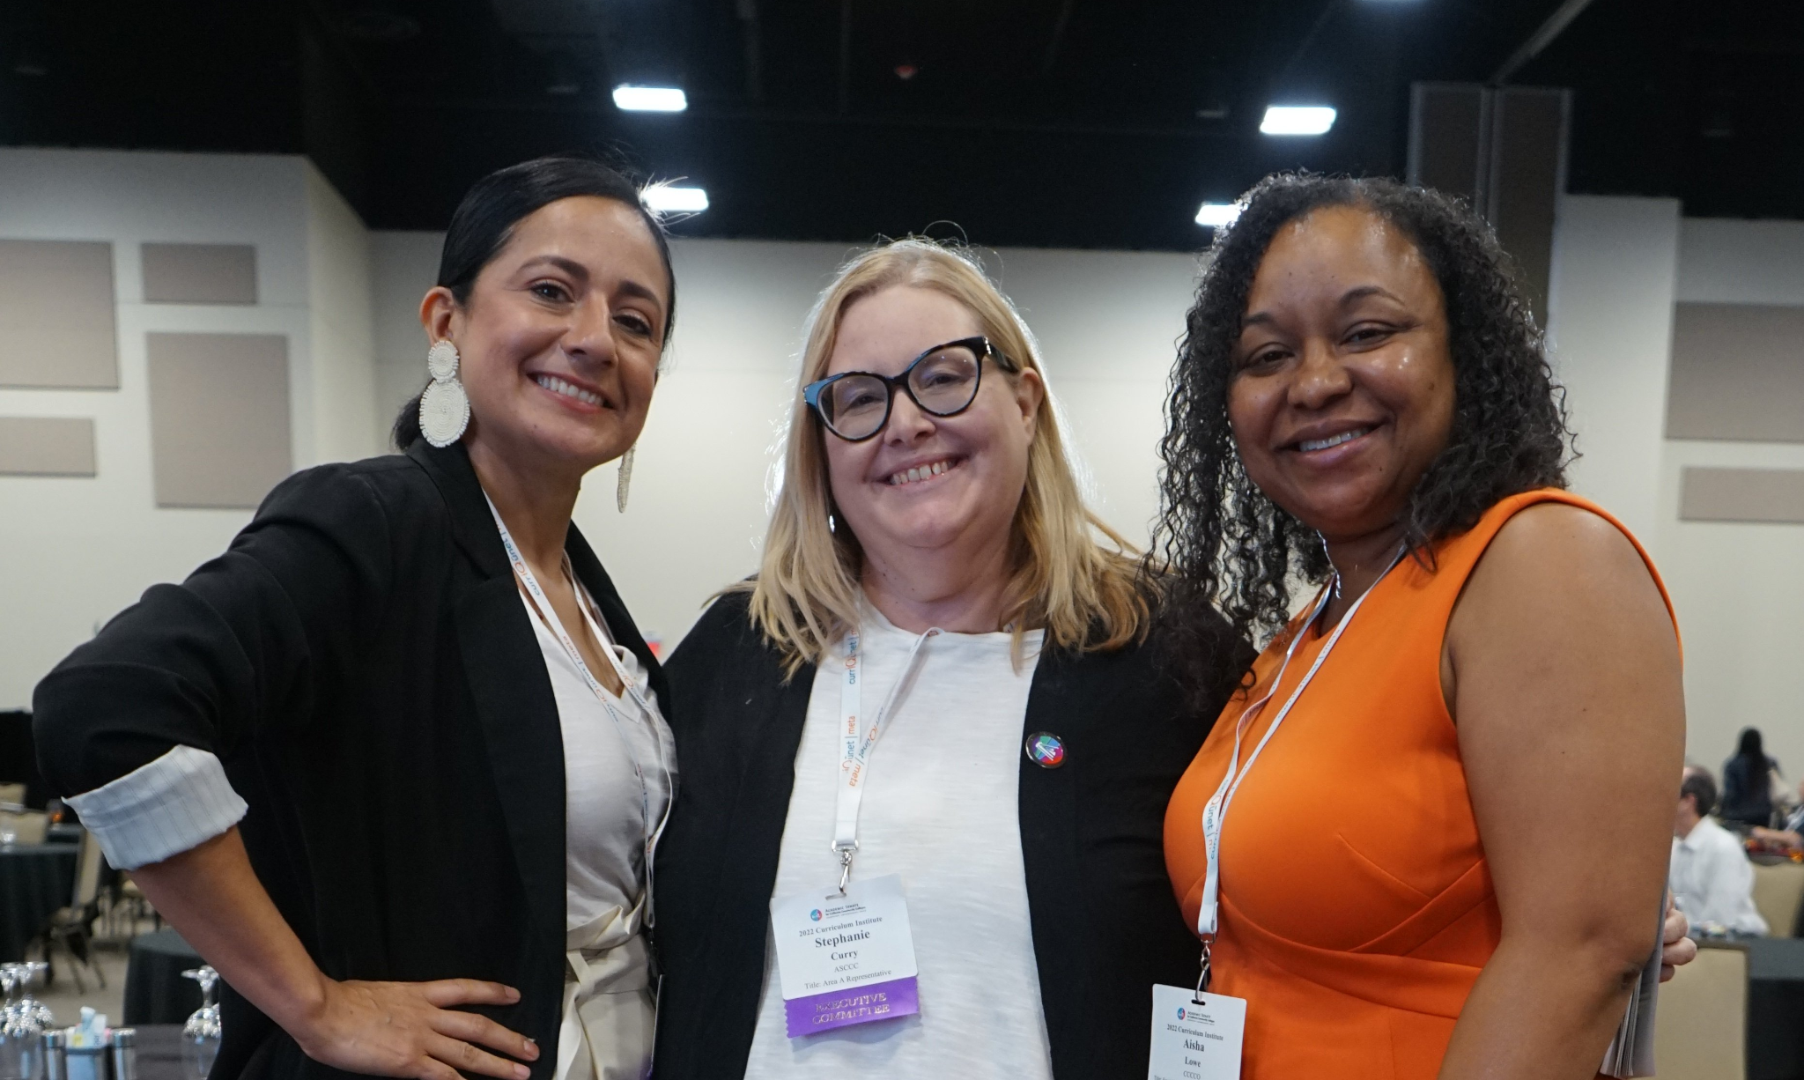
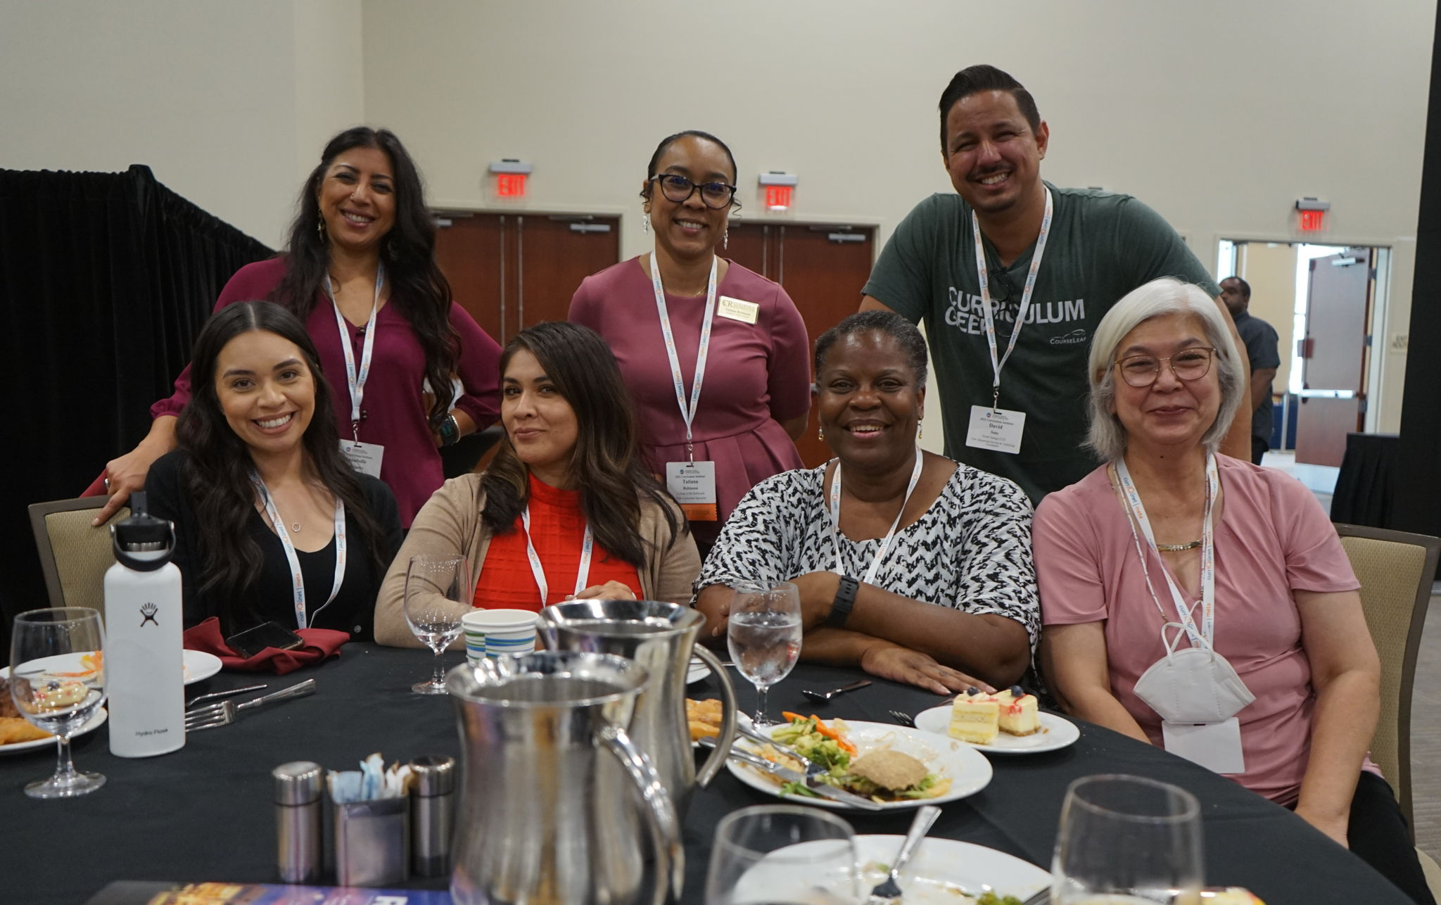
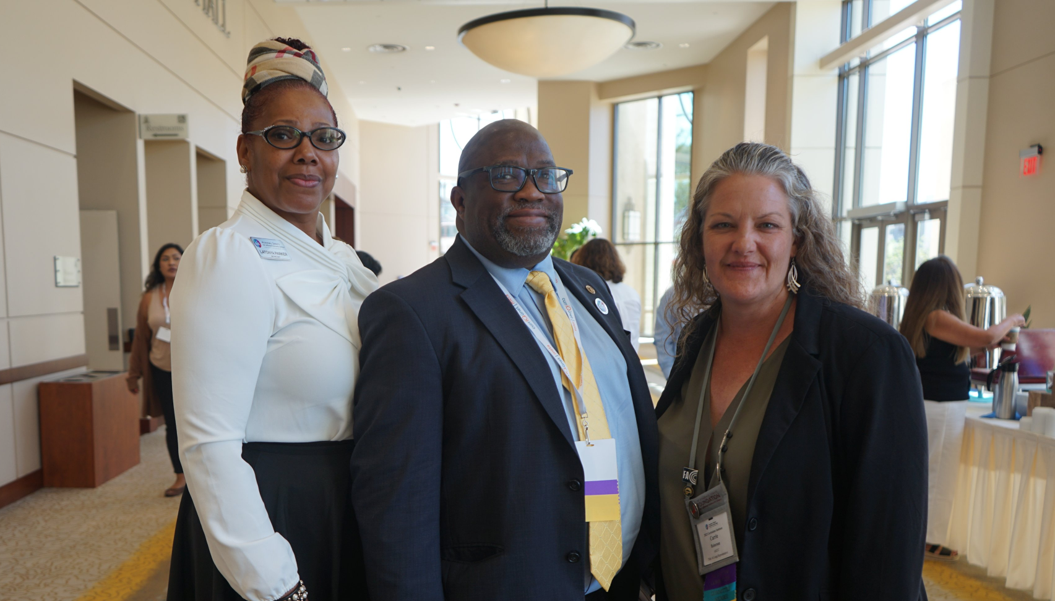
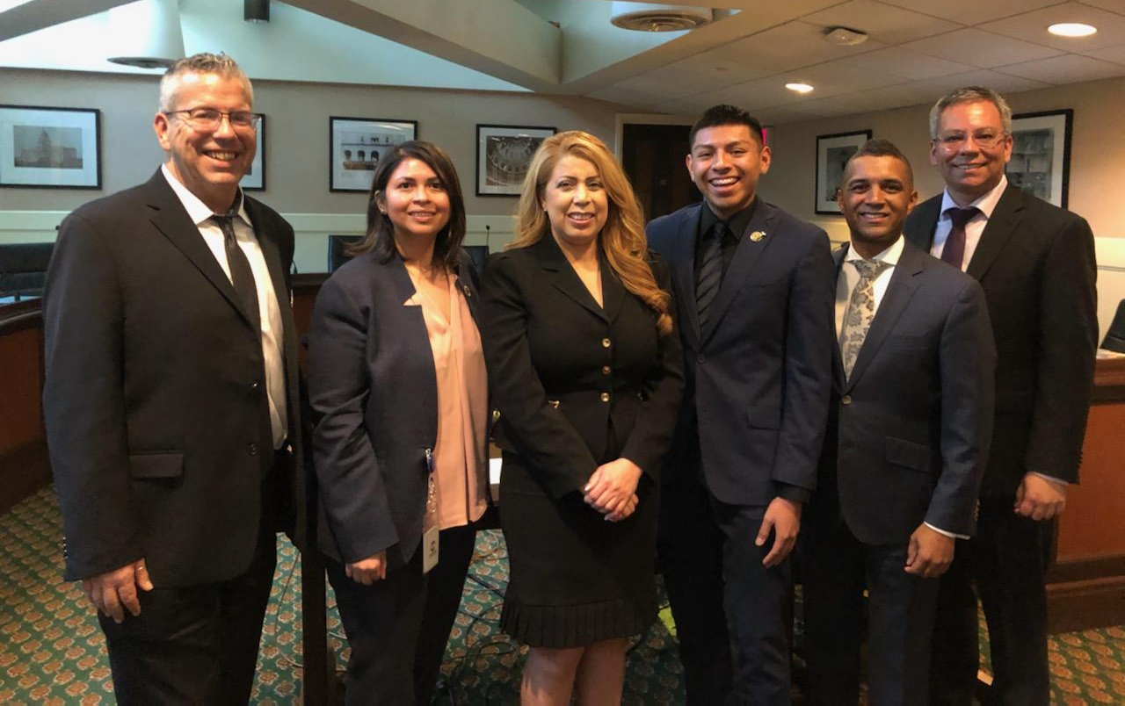
Our Mission and (Revised) Purpose
Mission
The mission of the Academic Senate Foundation for California Community Colleges (ASFCCC) is to enhance the excellence of the California community colleges by sustained support for professional development of our diverse faculty in the furtherance of effective teaching and learning practices.
Revised Purpose
The specific purposes of this corporation are to benefit, support, and enhance the excellence of California community colleges through fundraising efforts towards professional learning for faculty and to promote innovative activities and strategies to advance teaching and learning.
Notes:
This Fall the foundation decided to look over its Mission and Purpose statement and revise it in order to more accurately reflect the work that we do:
Original Purpose: The specific purposes of this corporation are to benefit, support, and enhance the excellence of California community colleges; to support, design and implement professional development for California community college faculty; to research, develop and communicate effective practices to promote effective teaching and learning in the California community colleges; and to promote a variety of activities and strategies to advance teaching and learning.

Slide 8
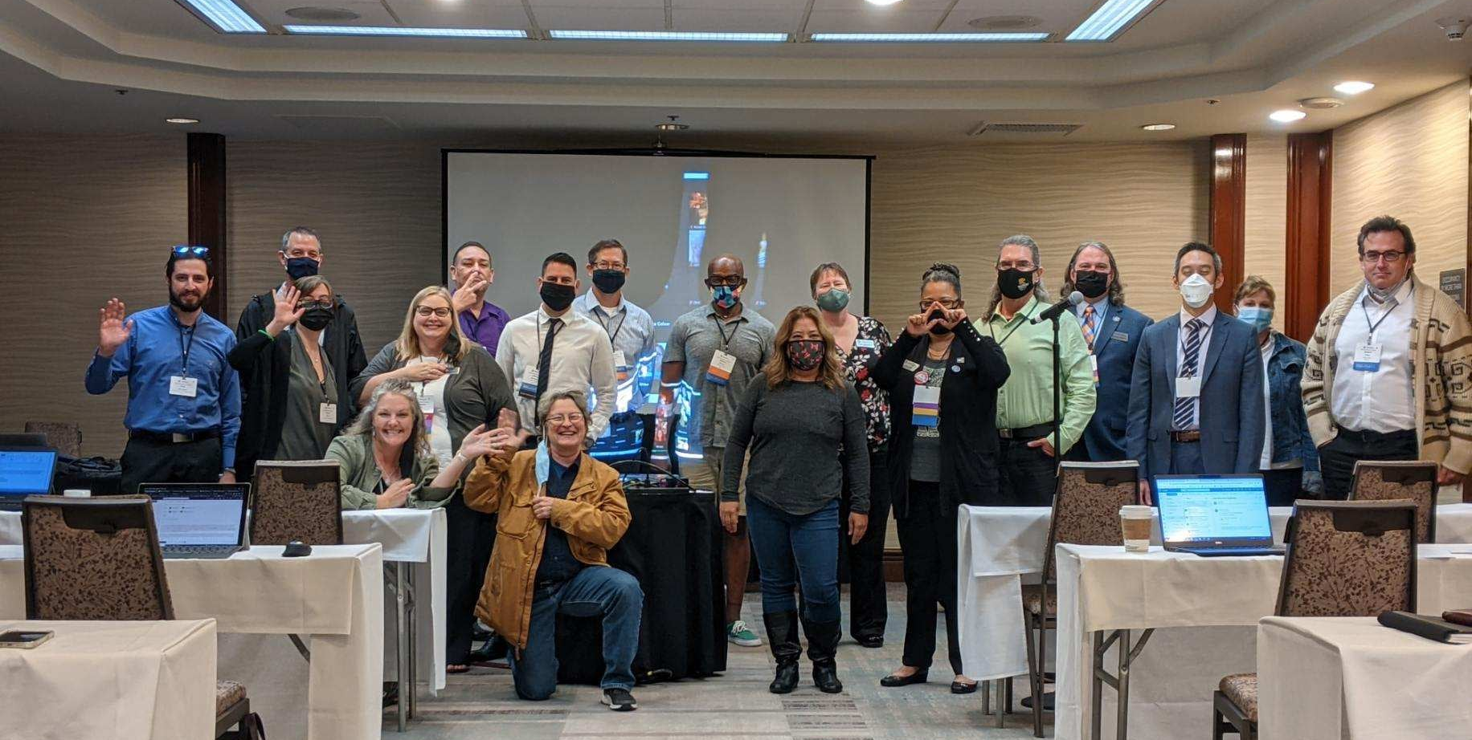
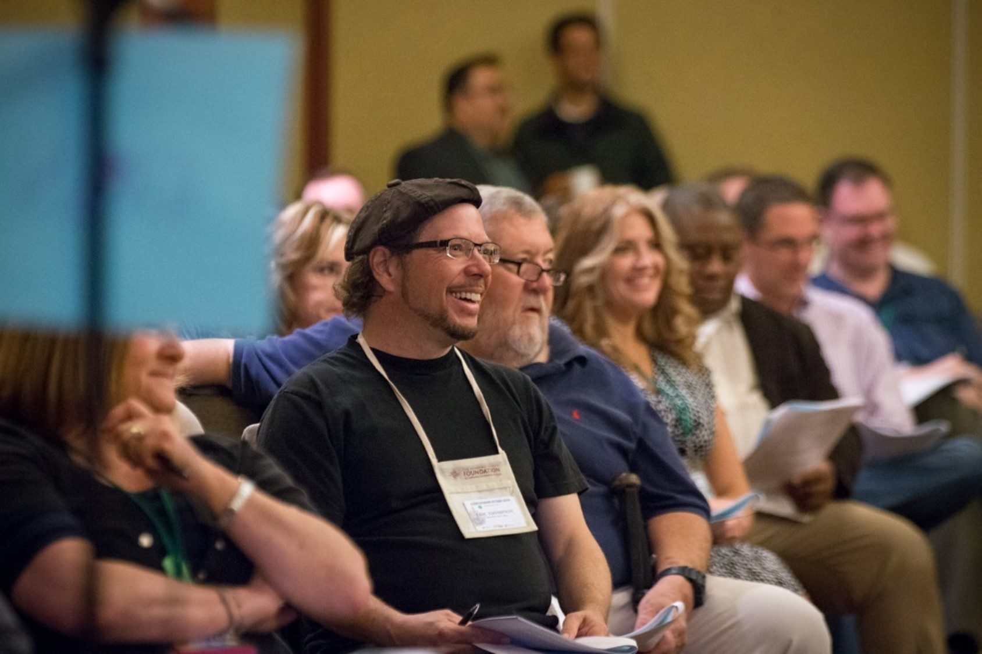
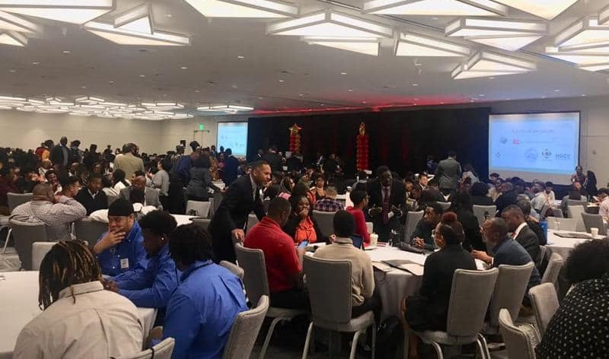
Supporting Professional Development
ASCCC Plenary/Institute Scholarships
The Academic Senate Foundation offers scholarship opportunities to Senate Institutes and Plenary Sessions throughout the year to faculty members.
Last year we offered a total of 30 scholarships to full and part-time faculty to attend our Fall and Spring plenaries.
This year we have offered
13 scholarships for the Fall Plenary
4 scholarships for A2Mend 16th Annual Summit
Innovation Scholarships
Innovation Scholarships provide faculty with funding to attend ASCCC events as well as external events and conferences to expand their understanding of best practices and apply them to their local college and share those results with the field at large. Special consideration will be given to grants that promote and enhance Diversity, Equity, Inclusion, and Anti-racism.
Faculty can apply for a grant of up to $1,500 to participate in professional development (workshops, classes, webinars, institutes and conferences).
This year so far we have awarded 2 Innovation Scholarships for a total of $3,000.

Slide 9
How Can You Support the ASFCCC?
General Donations Donations made at Academic Senate events and through the link HERE are used for scholarships, events, and additional Academic Senate Foundation activities. Donors can also choose to donate directly to our Innovation Scholarships. | 10+1 Campaign Contribute monthly to the 10 + 1 program to support the professional development of part-time faculty, the Professional Development College, and research in the area of academic and professional Matters

Slide 10
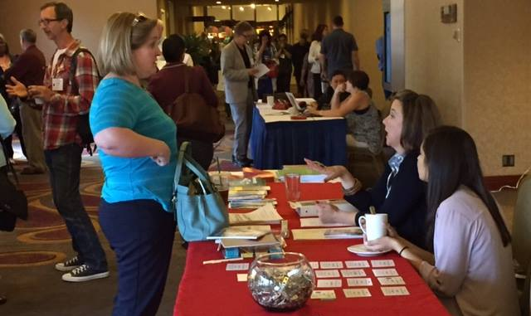
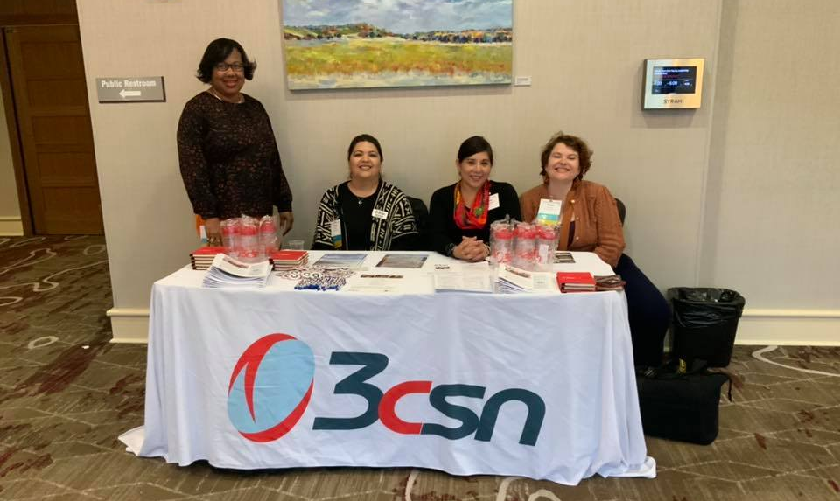
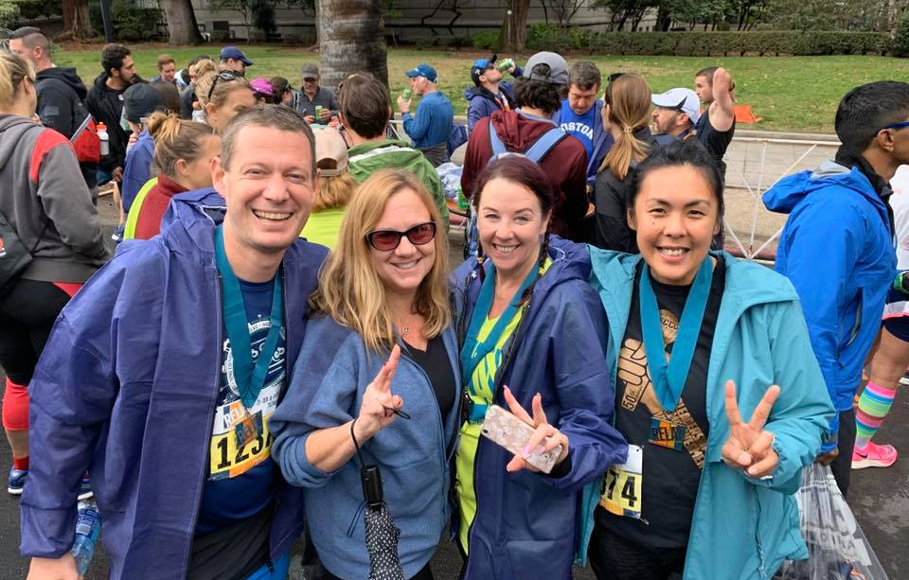
ASFCCC College and Area Fundraising Competition
Area Fundraising Competition: Every Spring Plenary since 2013, we’ve held our Area Fundraising competition where the four Areas compete against each other to raise the most amount of money during the Spring Plenary, aside from being awarded the coveted Area Trophy, winners of the Area Competition will also win a small party at the upcoming Faculty Leadership Institute!
College Fundraising Competition: This year we’ve decided to add a little more excitement to our competition by including a college fundraising competition to the challenge! Now individual colleges can compete against each other to become the top donors of the state! Winners of this competition will be recipients of the first official College Champion Trophy and gain bragging rights for an entire year!

Slide 11
ASFCCC Dine Out - April 20
For this Spring Plenary the ASFCCC has partnered with several restaurants in Anaheim to offer you more variety and flexibility in your dinner plans while still supporting the foundation. On Thursday, April 20th make sure to present a flier (hard copy or digital) at BJ’s Restaurant and Brewhouse, California Pizza Kitchen, or Dave and Busters any time between 4:00 and 10:00PM. These restaurants will donate a percentage of your purchase to the foundation.

Slide 12
Get Your ASFCCC Gear and
Support a Great Cause!
Make sure to stop by our ASFCCC table during the Spring Plenary to get your hands on some merchandise featuring our new logo!
Donate to the foundation and get tickets for a chance to spin our Prize Wheel and win some merchandise!
T-shirts, water bottles, notepads and other merchandise featuring our new logo will also be available for a small donation.
What an excellent way to support your colleagues and look cool in the process!

Slide 13
Financial Statement (as of March ‘23)
Revenues
Sponsorships $17,500
Donations Revenue $12,069.26
Other Revenue $32.54
Total Revenue $29,601.80
Expenditures
Scholarships $13,327.46
LGBTQ+ Summit Sponsor $2,500
Other Sponsorships $1,546.30
Other Expenses $20,898.10
Total Expenditures $38,271.86
Notes:
Total number of dollars spent on scholarships and sponsorships = $17,373.76
Other Expenses = Professional Fees, Dues/Subscriptions, and office supplies
Important to consider that our fiscal year ends in June, so these numbers will certainly change by then. Also, important to remember that our biggest fundraiser is the Area competitions so our Donations Revenue should see an increase after Spring Plenary as long as the Area competition is robust!

Slide 14
Thank you!
On behalf of the AS Foundation Board of Directors, thank you for your generous support and contributions!
Visit us at asfccc.com for more information on our scholarships and how you can support our work!

Slide 15
State of the Academic Senate

Slide 16
Welcome!

Slide 17
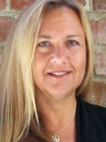
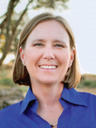
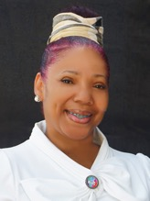
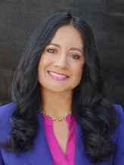
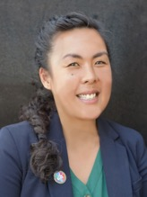
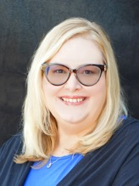
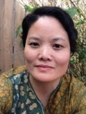
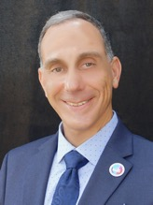
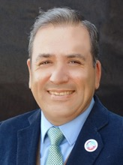
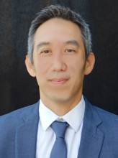
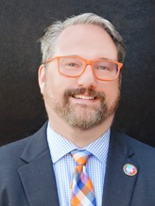
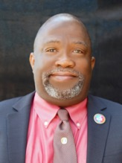
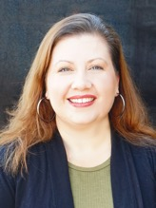
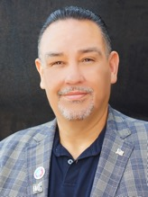
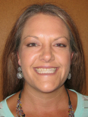
2022-23 Executive Committee Members
President
Ginni May
Vice President
Cheryl Aschenbach
Secretary
LaTonya Parker
Treasurer
Michelle Bean
Executive Director
Krystinne Mica
Area A Rep
Stephanie Curry
Area B Rep
Karen Chow
Area C Rep
Erik Reese
Area D Rep
Manuel Vélez
North Rep
Eric Wada
North Rep
Christopher Howerton
South Rep
Robert L. Stewart Jr.
South Rep
Amber Gillis
At-large Rep
Juan Arzola
At-Large Representative
Carrie Roberson
17

Slide 18
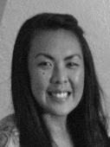
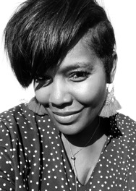
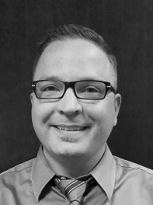
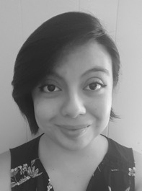
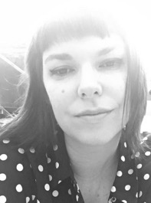
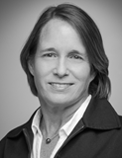
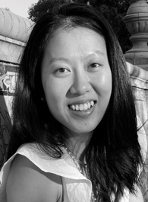
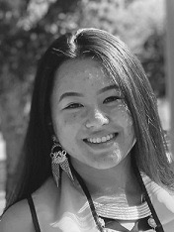
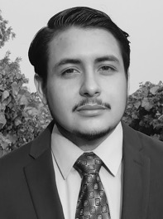
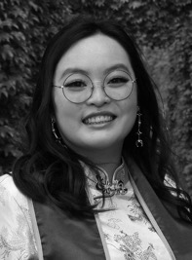
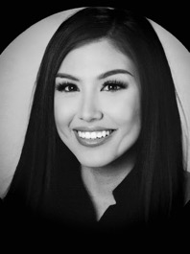
ASCCC Office Staff
Executive Director
Krystinne Mica
Director of Administration
Tonya Davis
Director of Finance
Alice Hammer
Administrative Assistant
Kyoko Hatano
C-ID Program Manager
Miguel Rother
Program Manager
Selena Silva
Program Coordinator
Megan Trader
Visual Designer
Katie Nash
Communications Coordinator
Emily Nicol
Research Associate
Gina Lam
Events Planner
Kayla Vue
Accounting Clerk
Brando Jimenez
Administrative Assistant
Amy Liao
Executive Assistant
Patricia Carrillo
18

Slide 19
Recognizing You

Slide 20
Overview of the 2023 Spring Plenary Session
Making Space for Connection and Belonging as
We Center Authentic Voices and Lived Experiences in the 10+1
Program: QR Code for full program; printed at-a-glance program
7 General Sessions: all hybrid
3 Breakouts Sessions: Each block has 4 in-person and 2 online
Thursday lunch: nominations for Executive Committee
Thursday evening: Academic Senate Foundation Restaurant Dine-out
Friday morning: Candidate Speeches
Friday Keynote Speaker: Ben Chida from the Governor’s Office
Friday afternoon: Officer Candidate Forum
Friday President’s Reception and Dance: 7:30-10:00
Saturday Elections and Resolution voting

Slide 21
Breakout Topics to Look for…
New delegates or new to academic senate
Understanding Resolutions
General Education
Legislation and Advocacy
Academic Freedom
Accreditation
Attendance Accounting
Strategic Enrollment Management
Collegiality in Action
Common Course Numbering
DEIA in Evaluations
Brown Act
Technology for Teaching
Curriculum Design
Statewide Service
Minimum Qualifications
Leadership and Governance: Cultivating Belonging
Noncredit
Faculty Using Data

Slide 22
Upcoming Events
2023 Faculty Leadership Institute
June 14-17
Westin San Francisco Airport and Zoom Events Virtual Platform
Partnering with the Student Senate for California Community Colleges on Wednesday afternoon and Thursday morning
2023 Curriculum Institute
July 12-15
Riverside Convention Center
Hybrid Event
ASCCC Events

Slide 23
Awards in 2022-23
Hayward Award
Excellence in Education
Recipients honored at March Board of Governors meeting:
Angeli Francois, part-time at nominating college: College of the Canyons
Jane Le Scaife, part-time at Sierra College
Kenneth Chairprasert, full-time at East Los Angeles College
Tamara Chesire, full-time at Folsom Lake College
Exemplary Program Award
Established by the Board of Governors in 1991 to recognize outstanding community college programs.
2022-23 Theme: Walk a Mile in Someone Else’s Shoes: An Ethnic Studies Approach to California Community Colleges Curriculum
Regina Stanback Stroud Diversity Award – tomorrow at 12:45

Slide 24
Faculty Empowerment Leadership Academy (FELA)
Revitalized and updated
Focus on the development of faculty from historically underrepresented groups in higher education.
One-on-one mentoring experience:
connections,
empowerment,
guidance
The 2022-23 cohort is about to complete their experience
Applications for the 2023-24 cohort open.
Webpage and Application

Slide 25
ASCCC in 2022-23
Strides toward transformational systemic and IDEAA work:
Reimagining with Purpose 2023-2026 Strategic Planning
ASCCC Strategic Plan Directions 2023-2026
Invested in Extended Cultural Humility Training through next year
Papers
Enrollment Management Revisited Again: Post Pandemic
Effective and Equitable Online Education: A Faculty Perspective
Changes to Assessment, Placement, and Instruction in Mathematics
Legislative Advocacy
January Meet and Greet for Legislators and Staff
February Legislative Day: 27 visits
College Visits
Collegiality in Action – 14 visits by June 2023
Local Academic Senate – 33 visits by May 2023

Slide 26
ASCCC with CCCCO and other System Partners in 2022-23
Implementing Initiatives and Legislation:
AB 928
Intersegmental Implementation Committee
Intersegmental Committee of Academic Senates (ICAS)
AB 1111: Common Course Numbering Task Force
AB 89: Modern Policing Degree Task Force
Equitable Student Experience: Burden-free Instructional Materials Task Force
Rising Scholars Network
Open Educational Resources Initiative (OERI)
DEIA in Evaluations and Tenure Review
C-ID
AB 927: CCC Baccalaureate Degree Program
AB 1187: Supervised Tutoring – regulations out for public vetting process
There’s more…but that’s enough for now

Slide 27
Legislation 2022-23
Bills to Watch
AB 811 (Fong) – Repeating Credit Courses
ASCCC Positions: F11 09.05, F11 09.07, F11 09.08
Course Repetition and Repeatability – A Rostrum Article, 2019
Another Look at Course Repetition and Repeatability – A Rostrum Article, 2014
Repeatability: Dealing with New Regulations – A Rostrum Article, 2012
AB 1749 (McCarty) – ADT for UC
Students would need 3.0 GPA (CSU requires 2.0 GPA)
Would all ADTs have to meet UC standards?
Learn more in the Legislative and Advocacy Update session today at 10:45

Slide 28
Legislation 2022-23
Legislative Priorities – Watch Trailer Bills
Academic Freedom – Session today at 10:45
Support for the protection of academic freedom for faculty and students through legislative action
Open Educational Resources Initiative – See the OERI table
Supports Zero Textbook Cost programs
Key for creating student-centered institutions and unconditional belonging

Slide 29
Embracing the Consultative Process
Record number of Collegiality in Action visits and requests for coaching or assistance
AB 1725 (Vasconcellos, 1988) Landmark legislation that:
Decoupled the CCCs from the K-12 system
Defined the CCC Mission
Provided for CCC Governance:
Academic senates have primary responsibility for making recommendations in the areas of curriculum and academic standards
Faculty, staff, and students have the right to participate effectively in college/district governance
Informed Title 5 Regulations on Effective Participation vs. Collegial Consultation
Rostrum Article from April 2013: 10+1 Myths?...
Notes:
BoG Standing Orders Section 332: https://www.cccco.edu/-/media/CCCCO-Website/docs/procedures-standing-orders/december-2022-procedures-standing-ordersv2-a11y.pdf?la=en&hash=FF692A0AE8ACC8FE6BB2A4D75018302005A8A4D6
10+1 Myths: https://www.asccc.org/content/10-1-myths-misrepresentations-and-uninformed-perspective-robert-shireman-and-California

Slide 30
Embracing the Consultative Process
Collegial Consultation: Rely Primarily or Reach Mutual Agreement
Academic Senates and Unions to consult before negotiations commence
Consultation:
State level: ASCCC and other constituency organizations, 5C, Consultation Council, Board of Governors and Standing Orders
District level/College level: Academic Senate and other constituency groups, Curriculum Committee, Shared Governance Council, Board of Trustees
It takes time
When done with care, it builds trust, community, and a better outcome
Notes:
BoG Standing Orders Section 332: https://www.cccco.edu/-/media/CCCCO-Website/docs/procedures-standing-orders/december-2022-procedures-standing-ordersv2-a11y.pdf?la=en&hash=FF692A0AE8ACC8FE6BB2A4D75018302005A8A4D6
10+1 Myths: https://www.asccc.org/content/10-1-myths-misrepresentations-and-uninformed-perspective-robert-shireman-and-California

Slide 31
Embracing the Consultative Process
Consultation:
Not sitting through presentations about decisions already made. That is information.
Being provided with an issue or proposal and discussing the opportunities and challenges that arise.
Engaging with college, district, and system partners seeking broad feedback: Faculty, Administrators, Classified Professionals, Students, Trustees
Not dismissing those with a different view point or that challenge the status quo or current trend.
Includes transparency, respect, and collaboration

Slide 32
Re-Embracing the Consultative Process
The Time is now, to re-embrace the consultative process
Starting with the Mission of the California Community Colleges
Describes broad educational purposes, types of educational offerings, students served
Baccalaureate Degrees not included
Provision of remedial (or pretransfer) education no longer included
Homework:
Read AB 1725 (Vasconcellos, 1988)
Read California Education Code §66010.4

Slide 33
Remember…
Faculty, in consultation with students and other staff, have worked and continue to work hard meeting students where ‘students are’.
Academic senates have been key in transforming classrooms and colleges into culturally responsive and student-centered learning environments.
Our work continues to be grounded in the tenets and principles of inclusion, diversity, equity, anti-racism, and accessibility (IDEAA).
We are 57,000 strong...you do not have to do this alone:
Work as a team
Take care of yourself
Care for others

Slide 34
Over the next three days…
Take time to:
Make space for connection and belonging
Center on authentic voices and lived experiences in the 10+1,
Thank a colleague for the good work they do,
Thank a student for their advocacy,
Thank your family for letting you be here, and
Enjoy this time with colleagues!
Thank you!

