Slide 1
Collaborating
with your
Statewide Directors

Slide 2
Leading Career Education Strategy
Success Stories
Key Learnings
Reimagining the Role
Facilitators:
Olivia Herriford, CTE Leadership Committee
Lynn Shaw, CTE Leadership Committee

Slide 3
State Director Panel
Alan Braggins, Advanced Manufacturing
Charles Eason, Business and Entrepreneurship
Nancy Gutierrez, Agriculture, Water, Environmental Tech
Joy Hermsen, Retail/Hospitality/Tourism
Ozzie Lopez, Health
Terri Quenzer, Life Sciences/Biotech
Stephen Wright, ICT Digital Media
Notes:
Panel Questions:
1. What is a success story resulting in increased student access and success?
2. What is a key learning about the structure, value and efficacy of the SD role?
2. What are your thoughts about how we sustain that value given the reorganization?

Slide 4
Participant Conversation Starter
How do you envision colleges and/or regions sustaining these partnerships and collaborations?

Slide 5
Thank you!
SD contact info and links to sector-related resources are appended

Slide 6
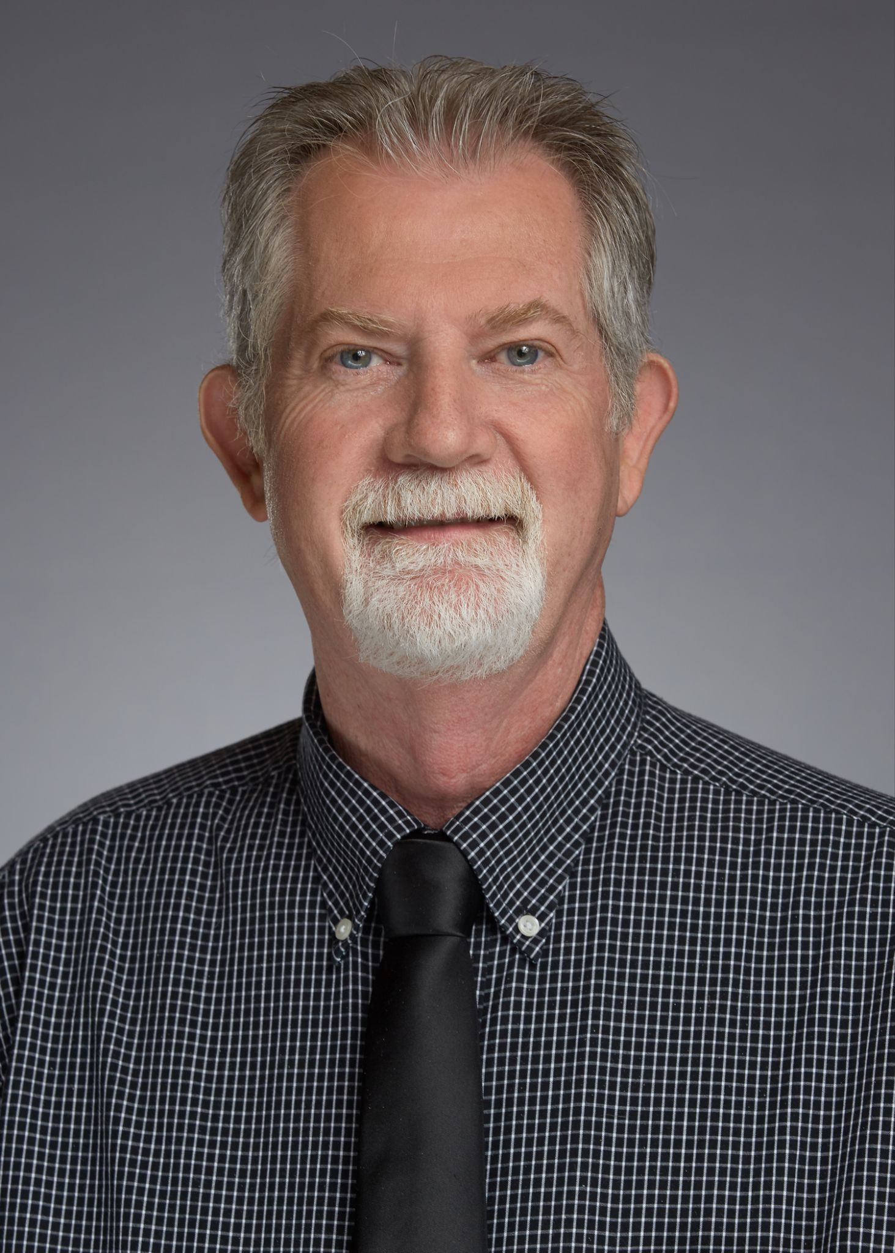
Alan Braggins
Advanced Manufacturing Sector
Statewide Director Employer Engagement
(909) 652-8497
Alan.Braggins@Chaffey.edu
www.cact.org

Slide 7
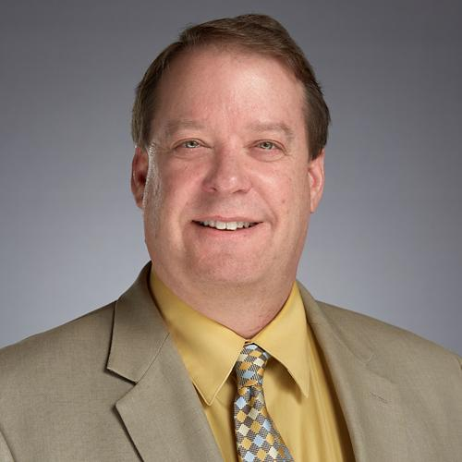
Charles Eason - Business and Entrepreneurship
charles.eason@solano.edu
707.863.7846 (office)
www.businessandentrepreneurship.com

Slide 8
Nancy Gutierrez Agriculture, Water, Environmental Technology
Statewide Director nancy.gutierrez@reedleycollege.edu
http://www.calagcc.org/
http://www.agnrcurriculum.org/

Slide 9
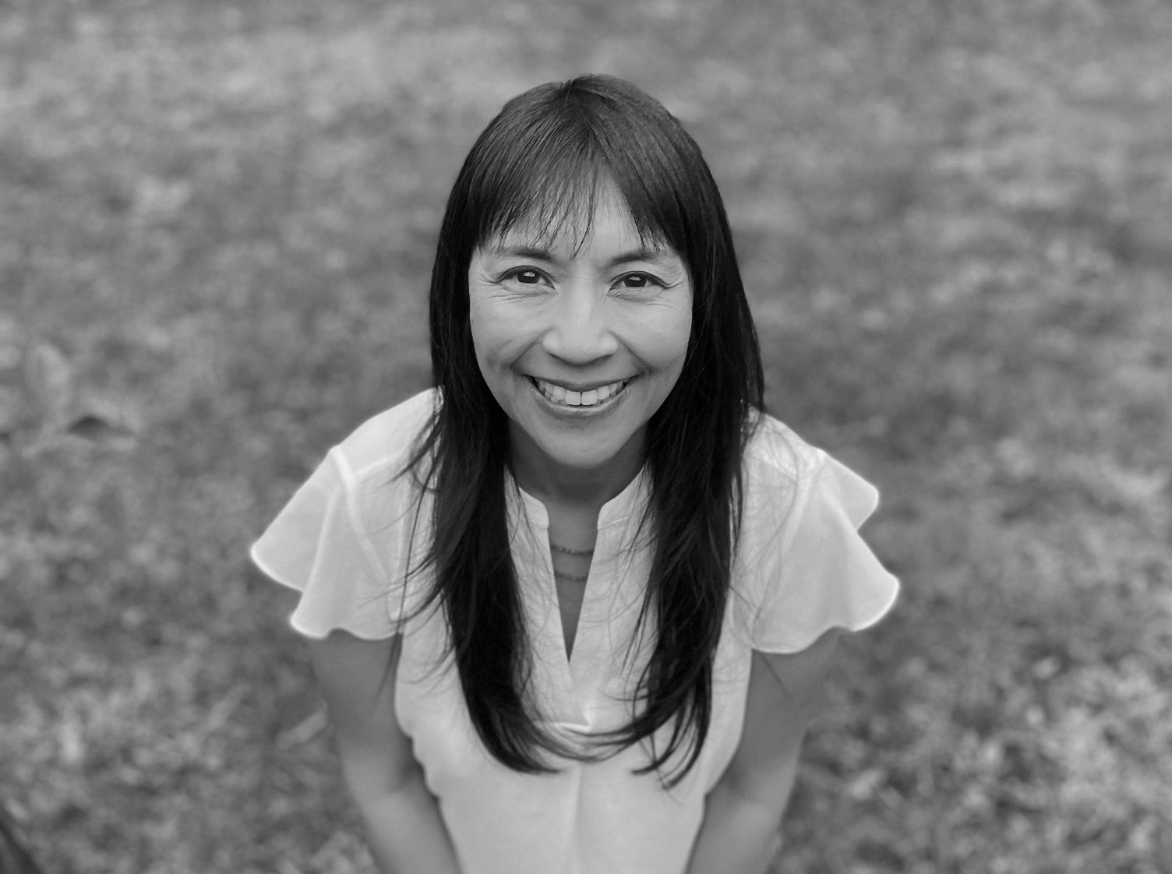
Joy Hermsen, MBA - Retail/Hospitality/Tourism Sector
Every dollar you spend for fun
hermsen_joy@rsccd.edu
707.332.8180 (m)
www.careerreadycalifornia.com
linkedin.com/in/joyhermsen

Slide 10
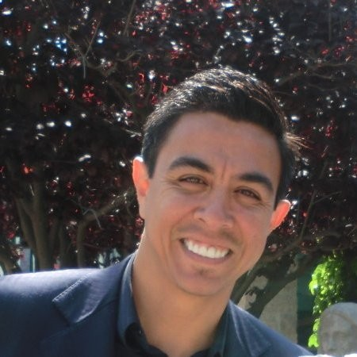
Ozzie Lopez, Ed.D.
Health Workforce Initiative
Regional Director | Employer Engagement | Health | Los Angeles
California Community Colleges | Health Workforce Initiative
Host College | Mt. San Antonio College
E: olopez63@mtsac.edu | P: (909)274-4972 | C: (323) 691-6086
CCC Website: http://cccco.edu/ | Website: http://ca-hwi.org/

Slide 11
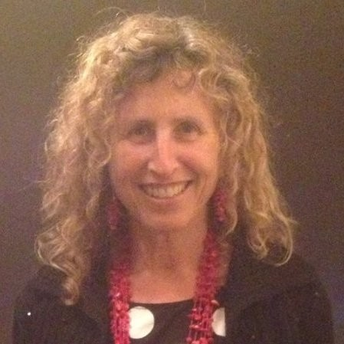
Terri Quenzer, Ph.D.
Statewide Director, Life Sciences/Biotech
Email: tquenzer@sdccd.edu
Cell: (619) 922-0696
LinkedIn: https://www.linkedin.com/in/terri-quenzer-ph-d-a387aa1/

Slide 12
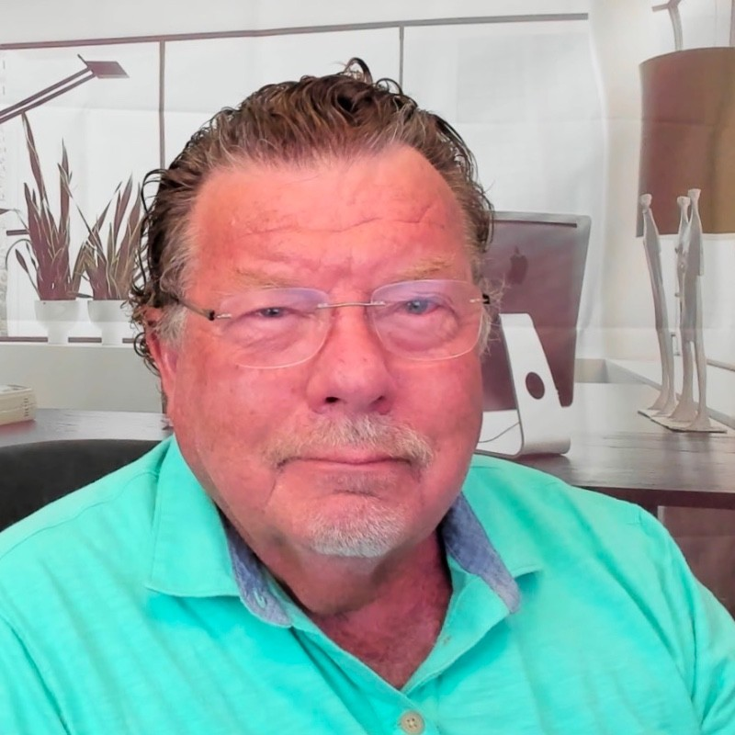
Steve Wright Information Communications Technology and Digital Media (ICT) State Director steve@wrightca.com
The ICT Educator Webinar Series

