Slide 1
SLO Symposium

Slide 2

Jackalope

Slide 3

Unicorn Pegasus

Slide 4

Whitewalkers

Slide 5

Connecting What’s Possible
Data Analytics
Guided
Pathways
SLO Performance Management
Degree Audit
Curriculum Management
ProgramReview
(Program & Course
Rules)
Student
Engagement
Ed Planning
(ePortfolios,
Extended Transcripts,
Badging)
On-line
Catalog

Slide 6
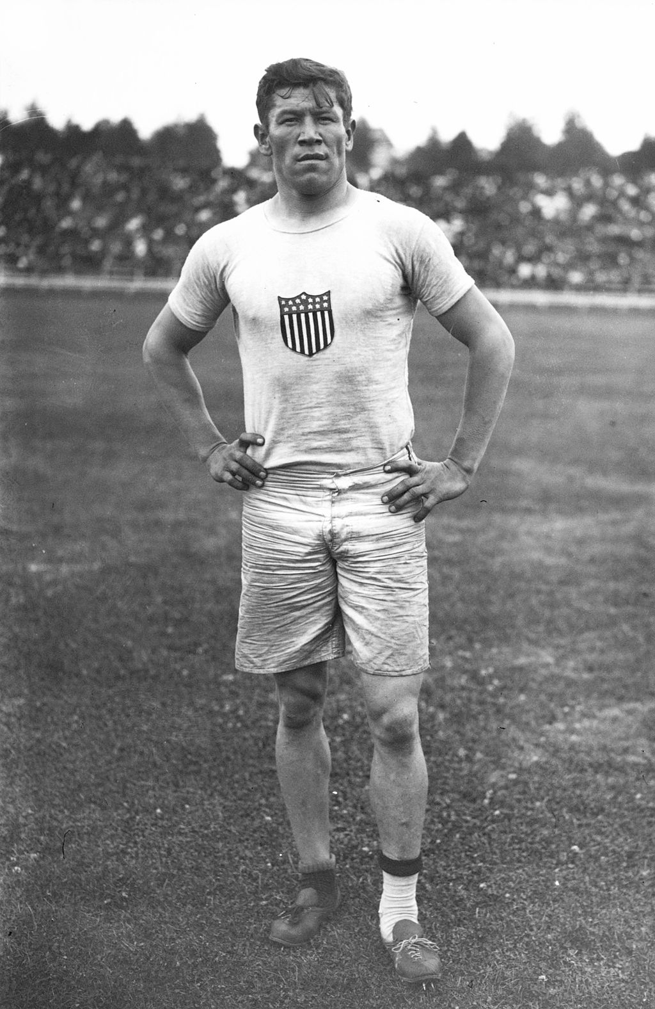
Jim Thorpe

Slide 7
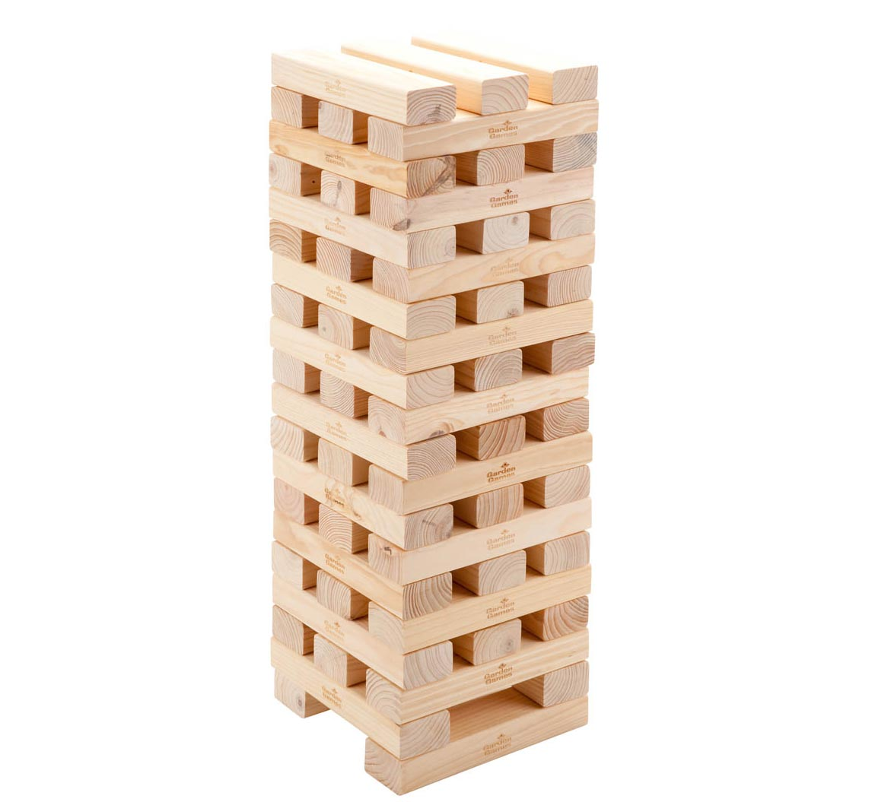
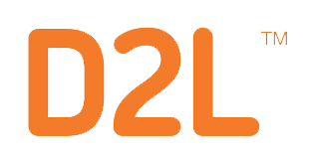


A Clear Picture is Emerging
SIS
SIS Org and Offerings needs to match real life
Curriculum
Course and Program Developed around Competencies/Outcomes.
Assessment
Accreditation, yes: but also badging, workforce, early alert—we need to know how students, not just courses, are doing.
Program Planning & Review
Continuous Improvement needs to become truly continuous to succeed.
Co-Remediation
Assessment connected to directed learning activities and student services
Catalog
Catalog needs to be accurate and reflect Curriculum changes
Ed Planning
Ed Planning system needs to be fed by Curriculum and alert students when decisions or changes affect their plan
Degree Audit
Institution needs to know the what why and how many of Ed Plans and the impact to the institution.
Skills Transcript
Visibility for the student of what has been learned and skills attained

Slide 8

Data Jenga
Faculty assesses SLOs that were changed a year ago

Slide 9
Data Jenga
MIS data reported to the CCCCO is inaccurate because Curricular change was never made in SIS

Slide 10
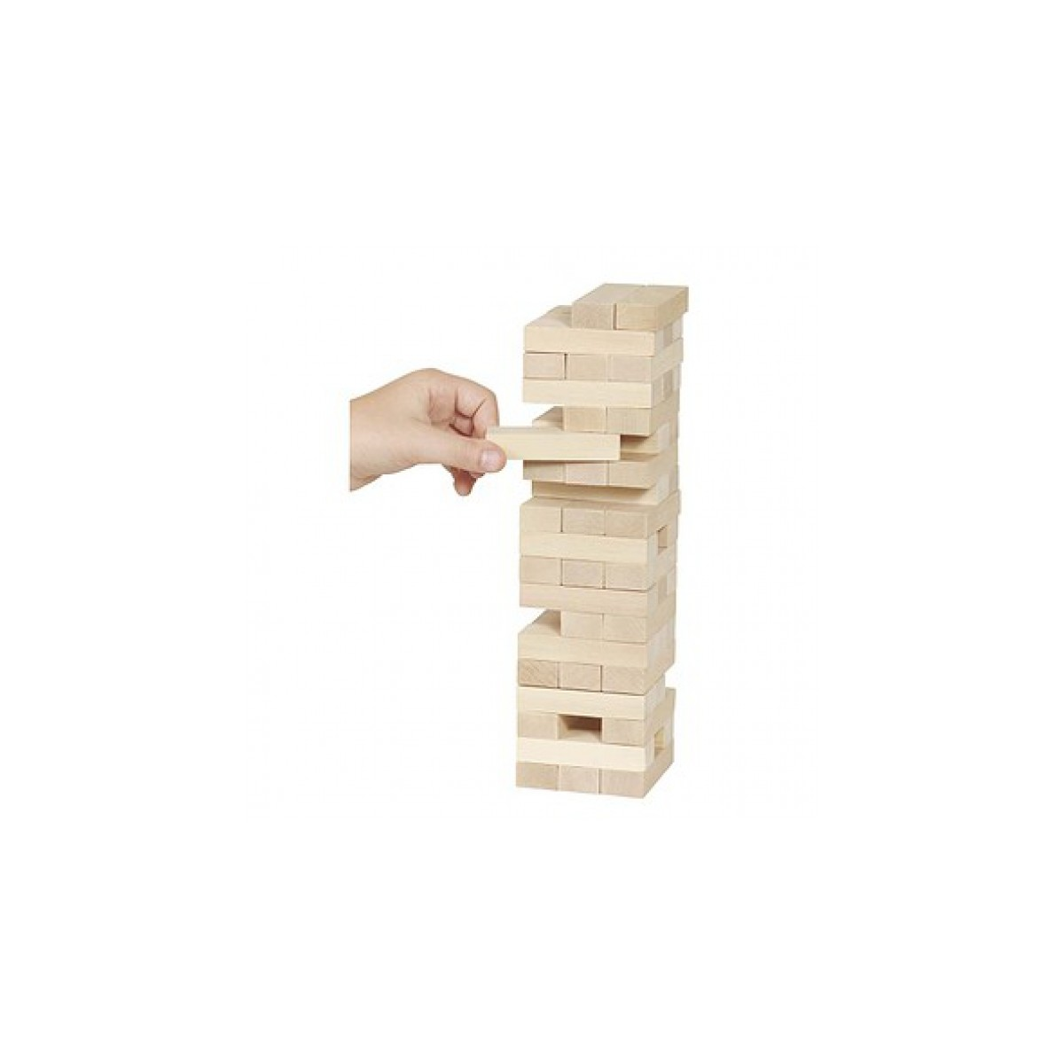
Data Jenga
New program took over 6 years to get through the approval process. The industry requirements have changed.

Slide 11
Data Jenga
Program change did not make it to the Catalog

Slide 12
Data Jenga
Education Planning information hasn’t been updated in over a year

Slide 13
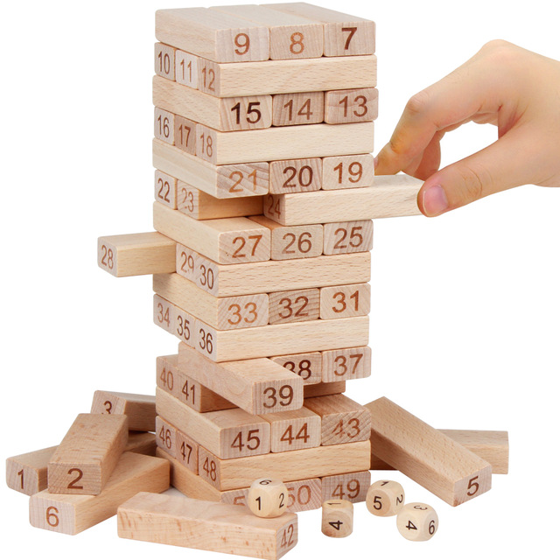
Data Jenga
The data in Curriculum System, COCI and SIS do not match what is actually being offered.

Slide 14
Data Jenga
Program resource requests are not fulfilled for two years and mandates have changed.

Slide 15

Data Jenga
Canvas SLOs and rubrics do not match any departmental SLOs, assessment scales, or descriptors

Slide 16
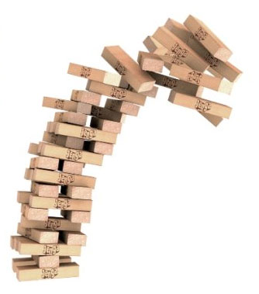
Data Jenga
Guided Pathways effectiveness cannot be tracked or assessed because students weren’t assessed directly

Slide 17
There’s a Better Way to Do This:
Curriculum and Assessment Management are One System
Course-Embedded Assessment is the “Future Present”
Compliance shouldn’t take a front seat to Performance—for either the institution or the student
Notes:
Preface this with an OPPORTUNITY: What eLumen makes possible. THEN add slide showing SIZE of opportunity. And only then show how CCs are the START of the approach.

Slide 18
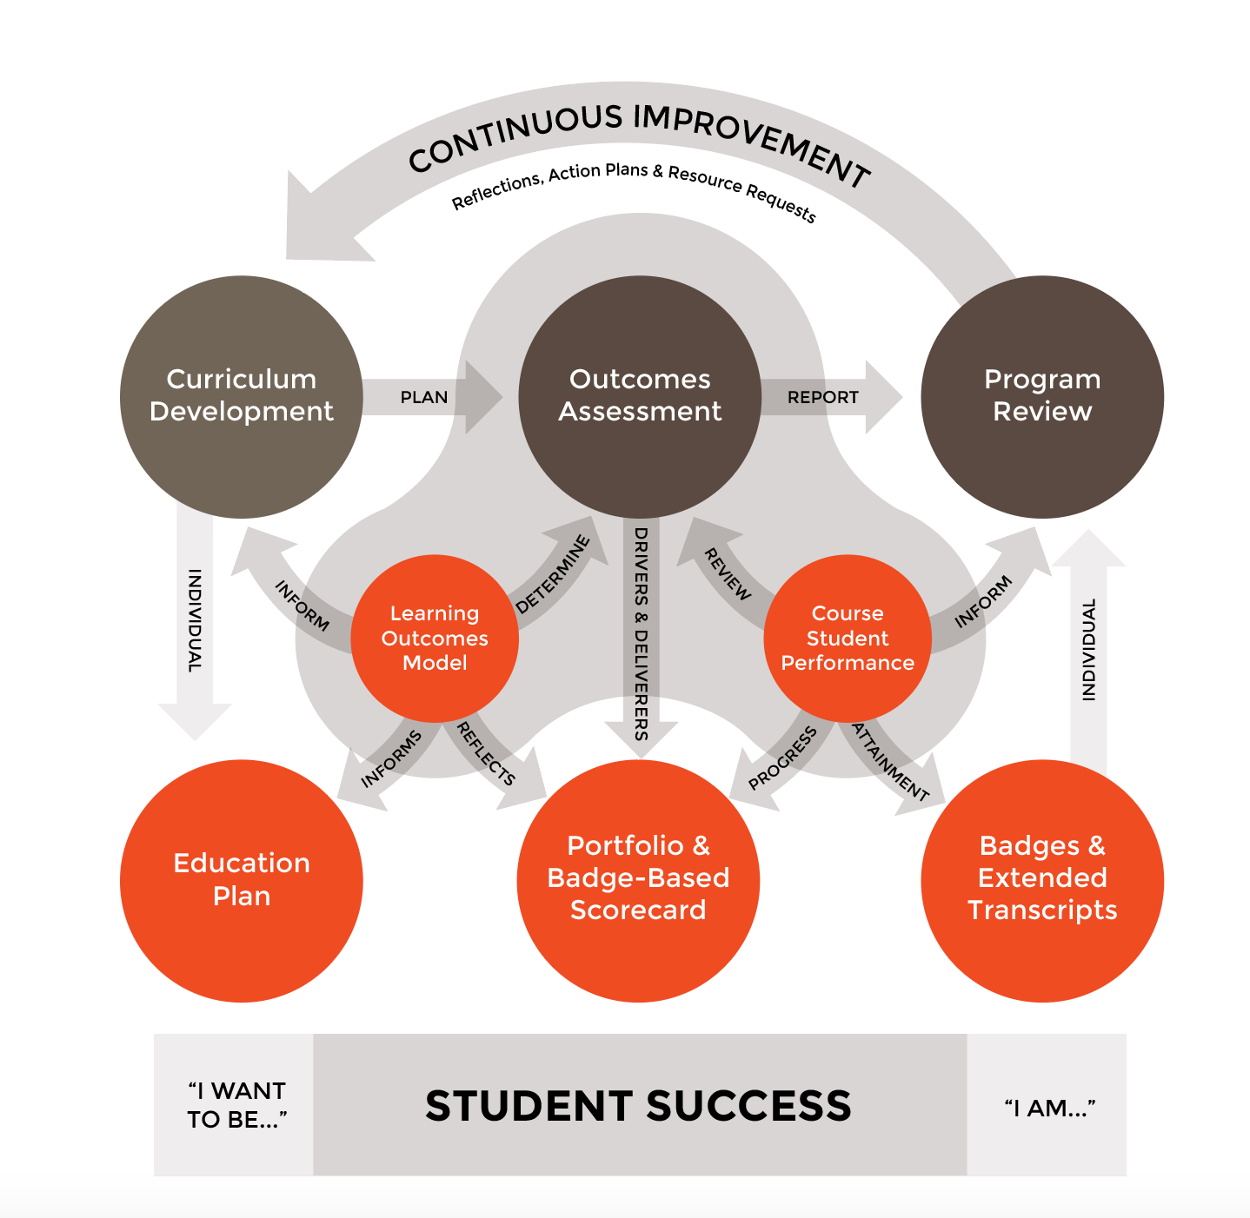
A Clear Picture is Emerging

Slide 19
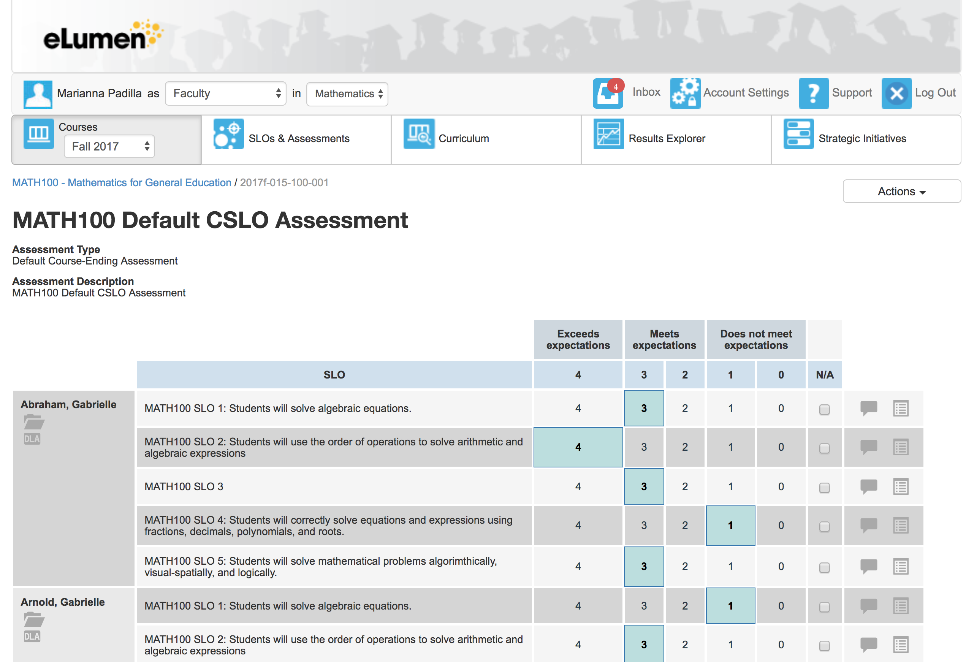
Elumen Assessment Rubrics
<subheading>

Slide 20
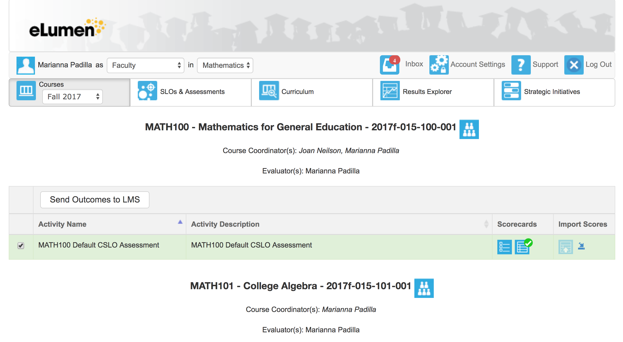
Send SLOs to Canvas
<subheading>

Slide 21
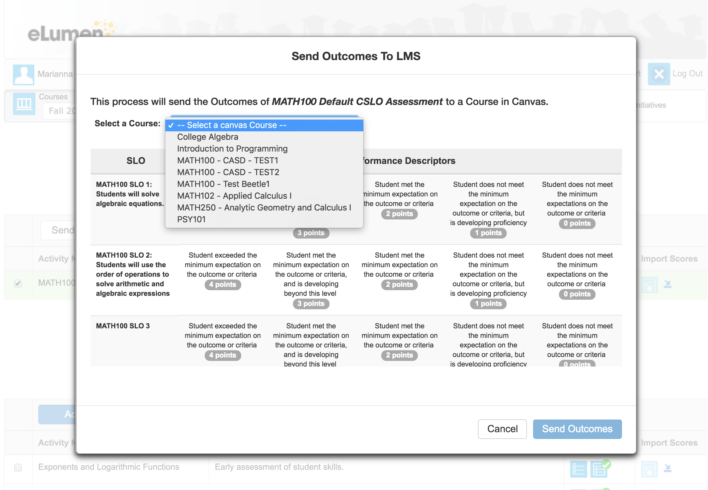
Send SLOs to Canvas
<subheading>

Slide 22
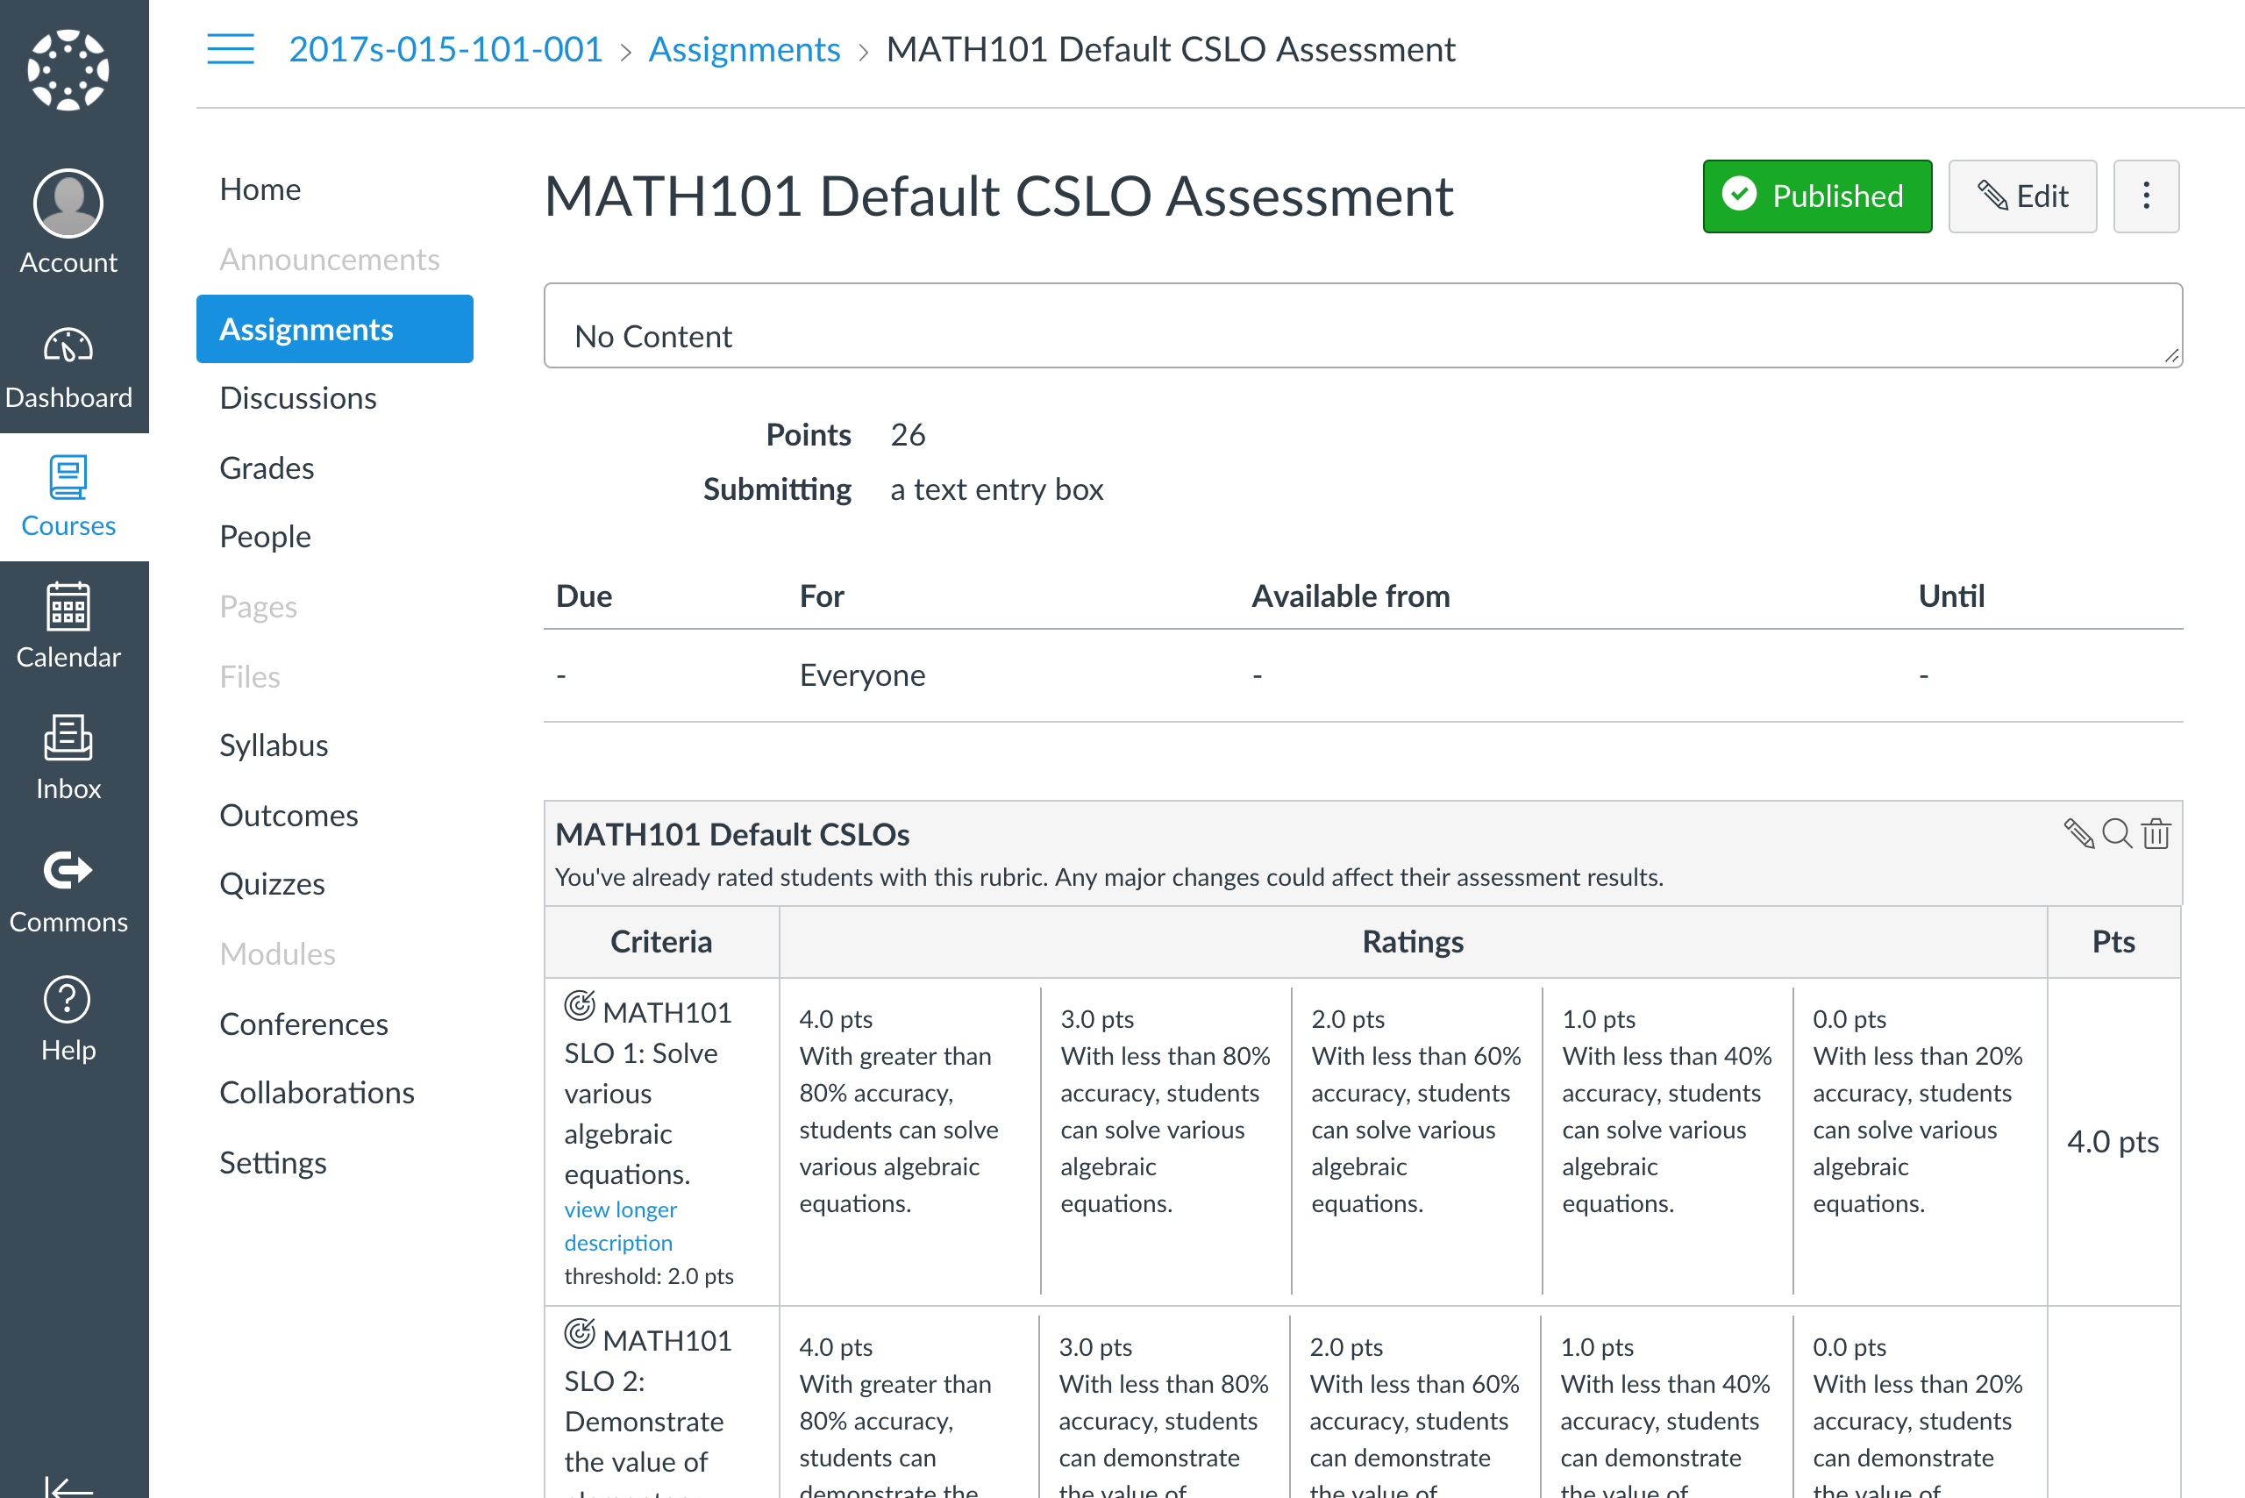
Canvas Rubrics
<subheading>

Slide 23
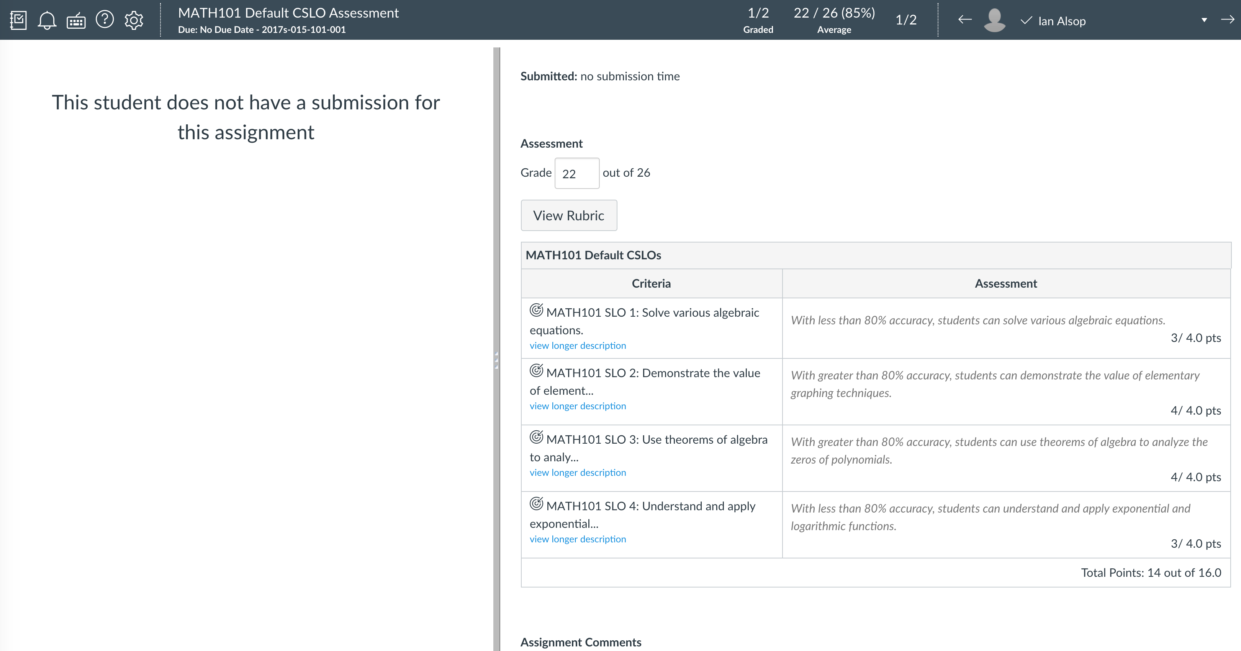
Canvas Speed Grader
<subheading>

Slide 24
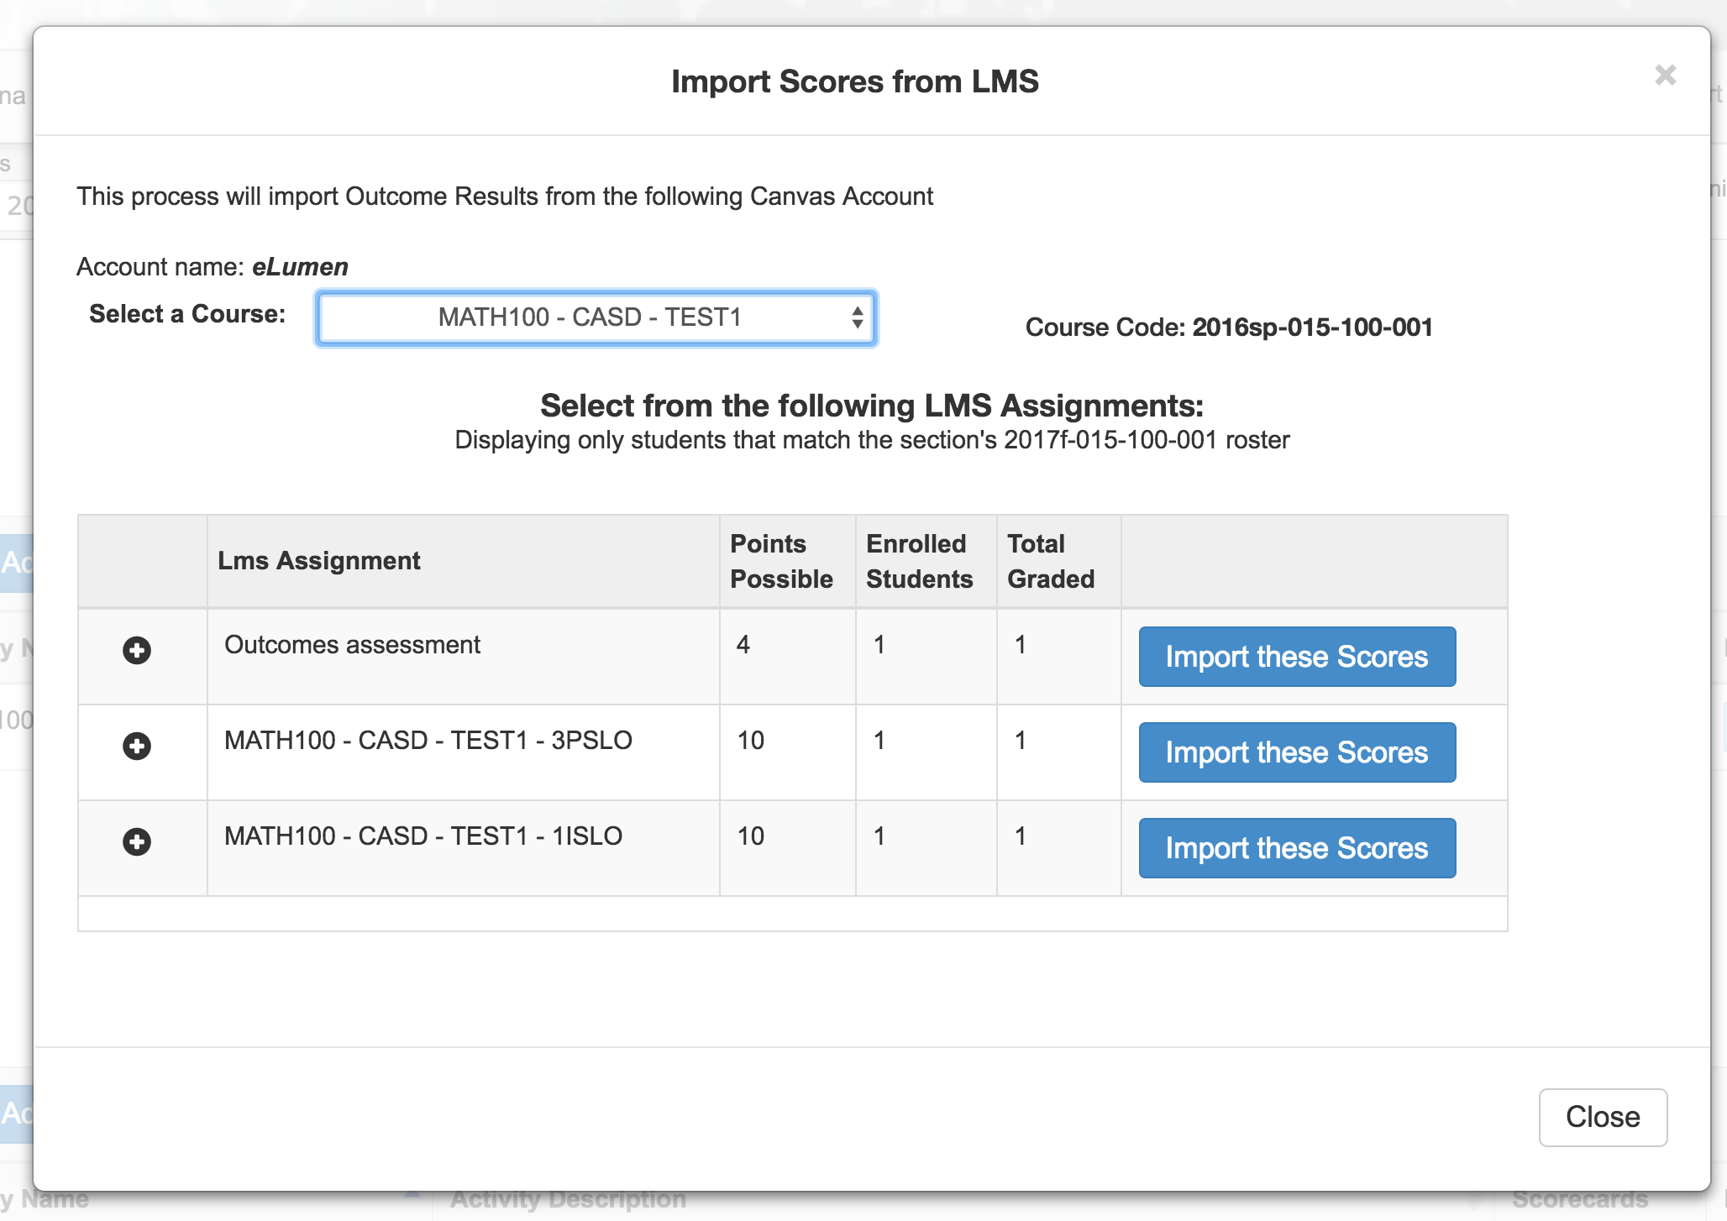
Import Scores back to eLumen
<subheading>

Slide 25
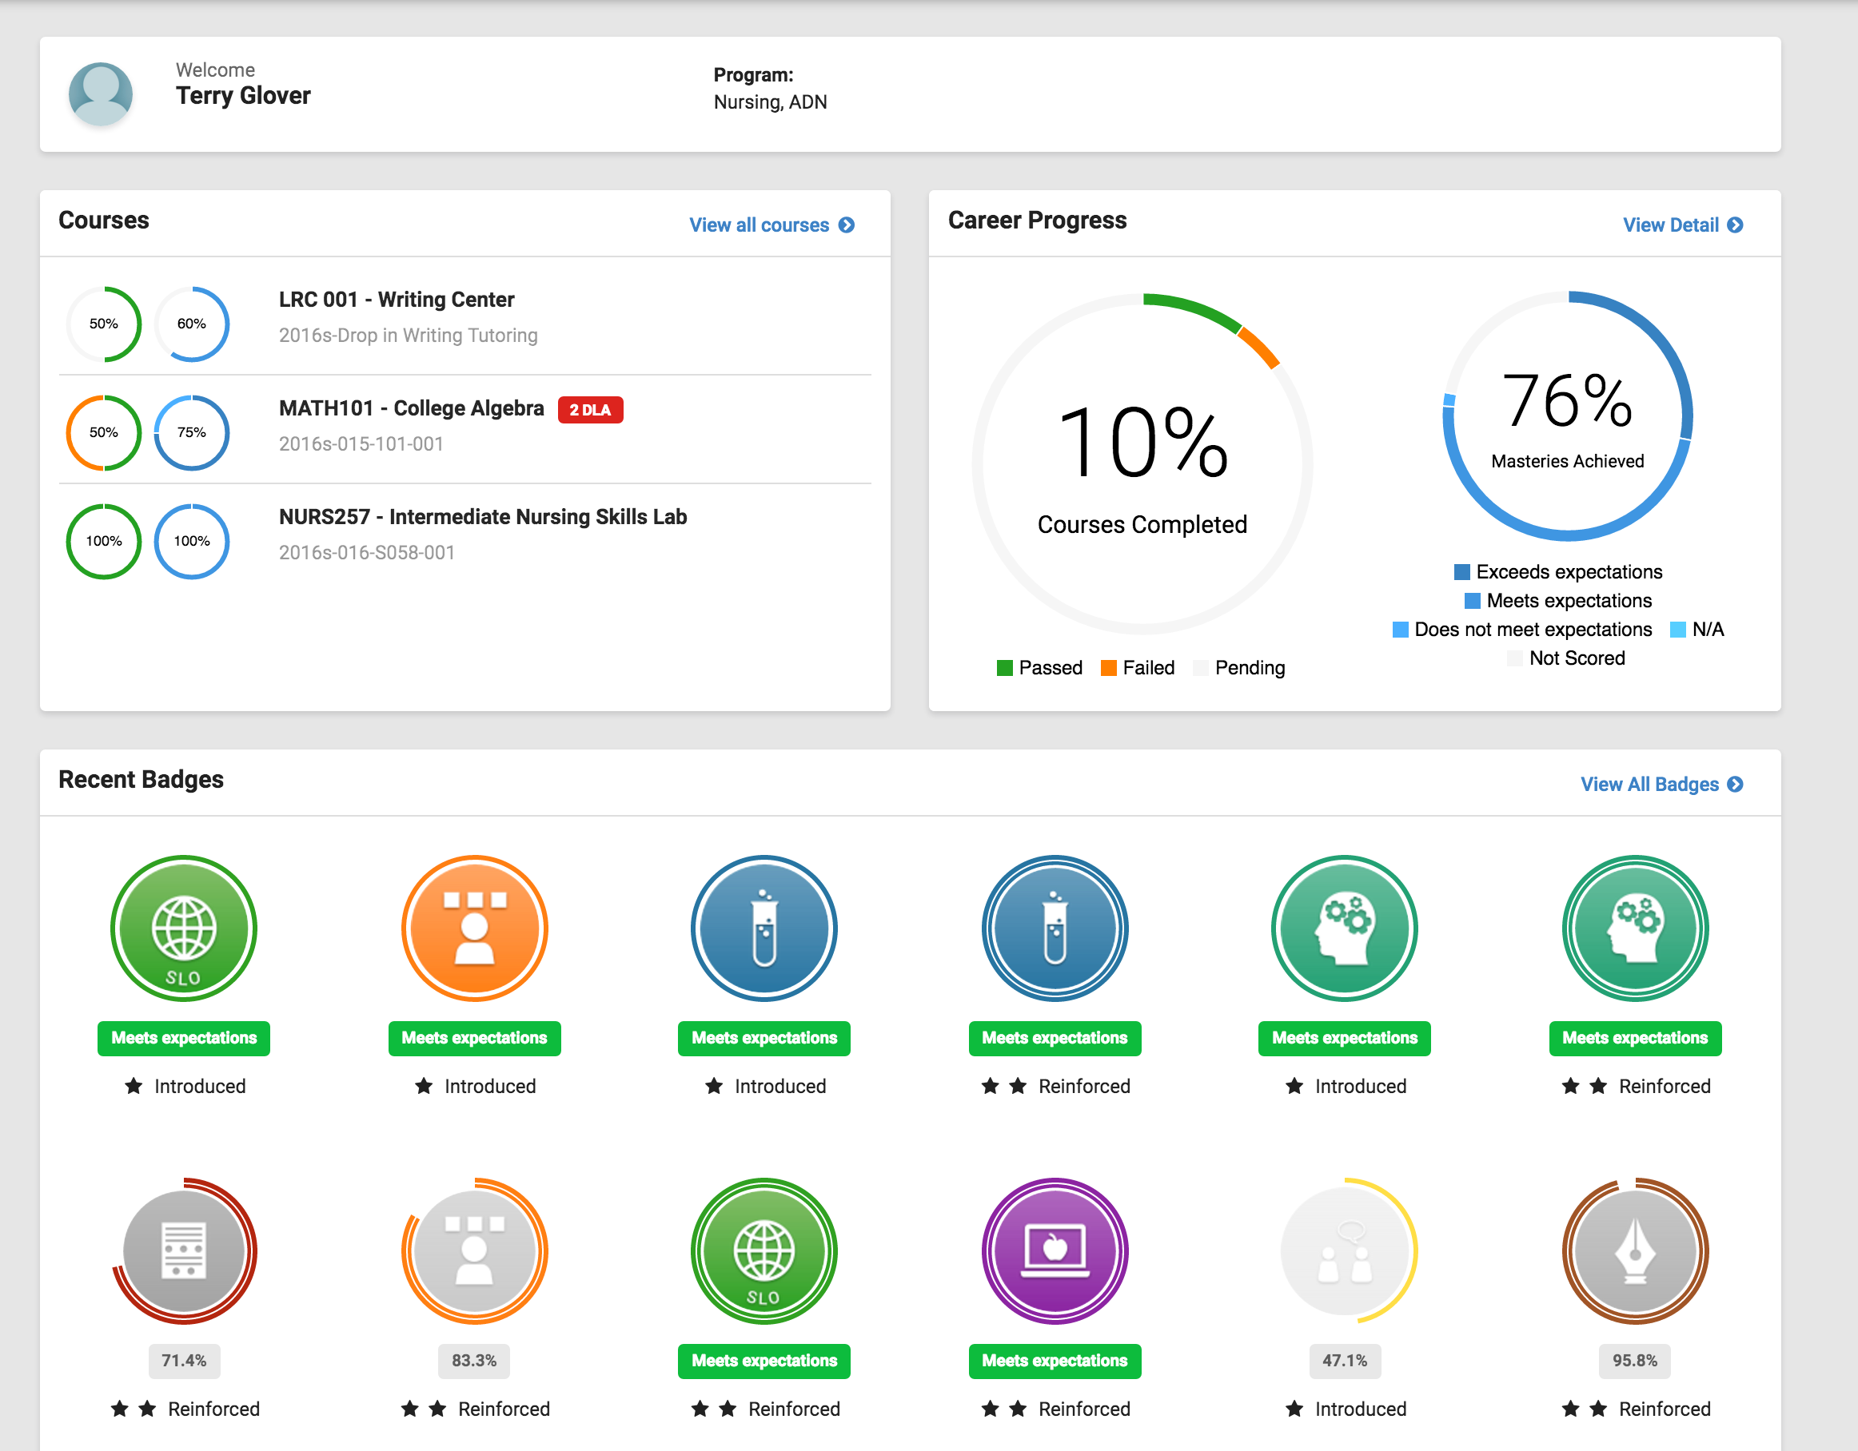
Progress Dashboard
<subheading>

Slide 26
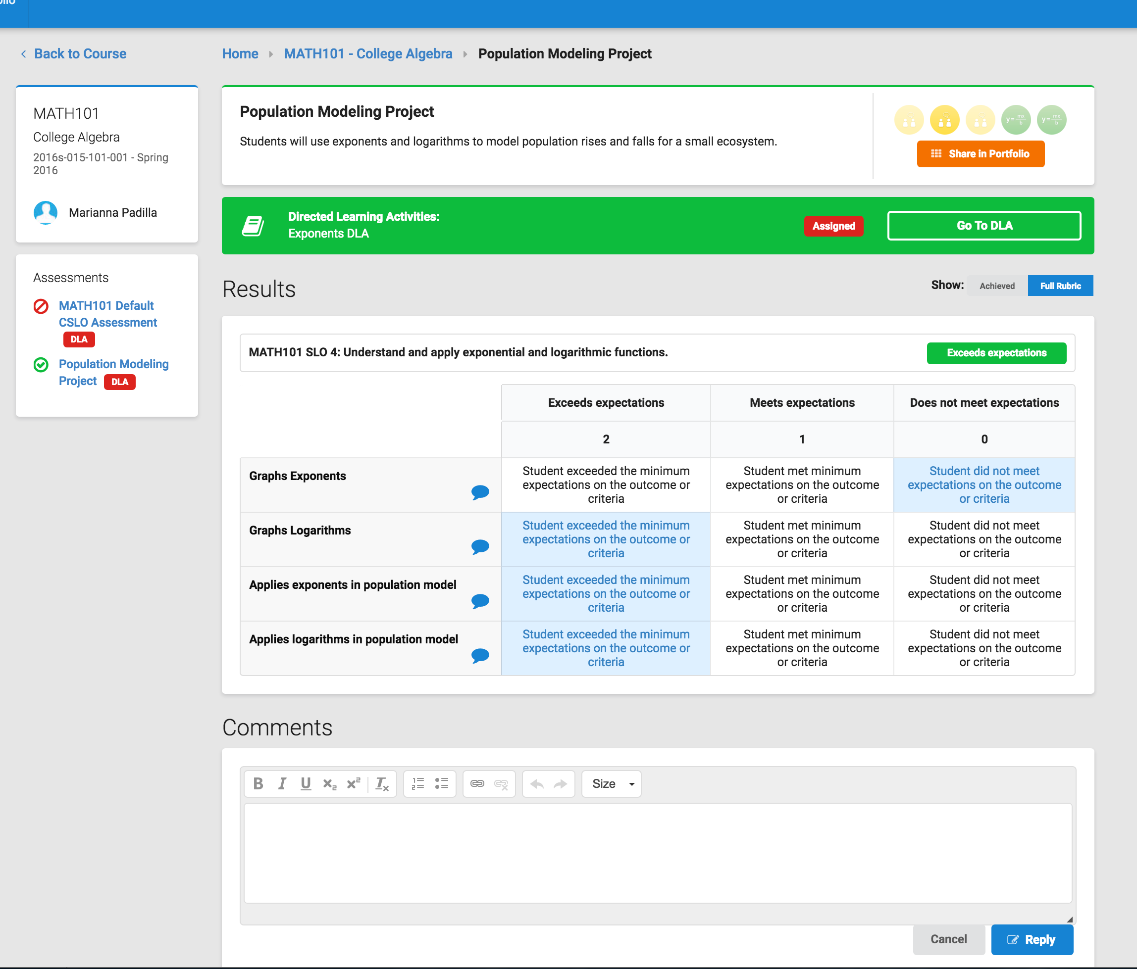
Student Self-Assessment
<subheading>

Slide 27
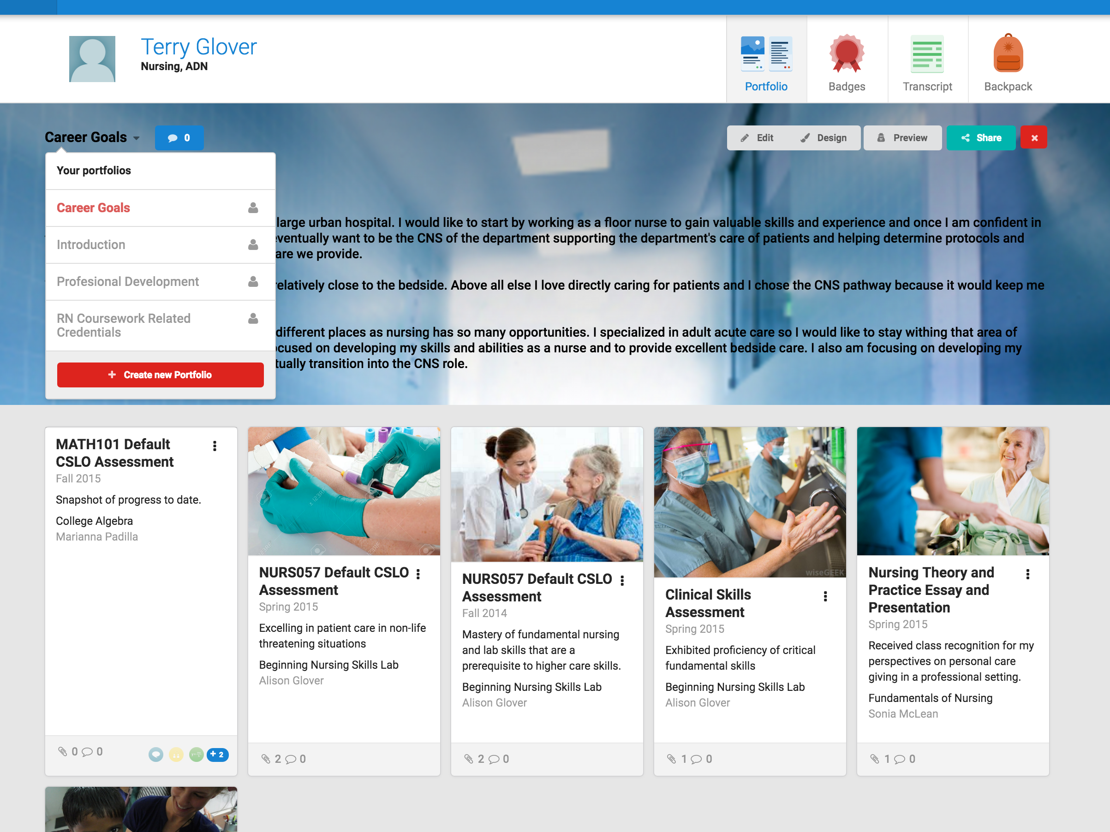
ePortfolio
<subheading>

Slide 28
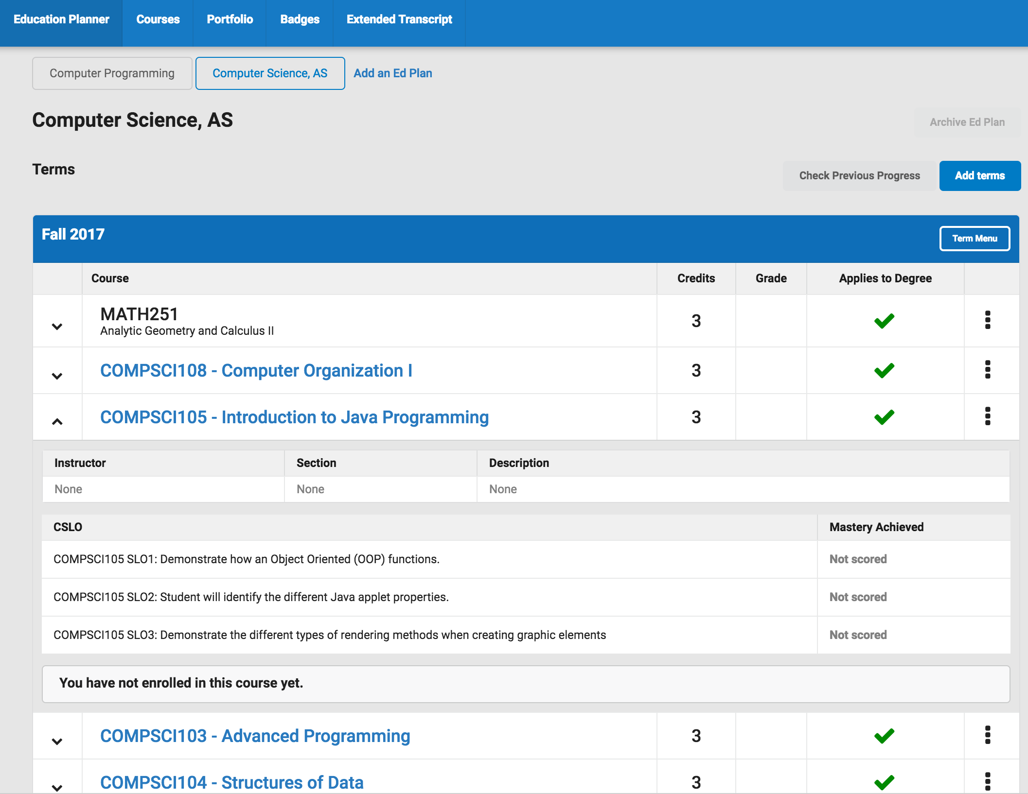

Slide 29
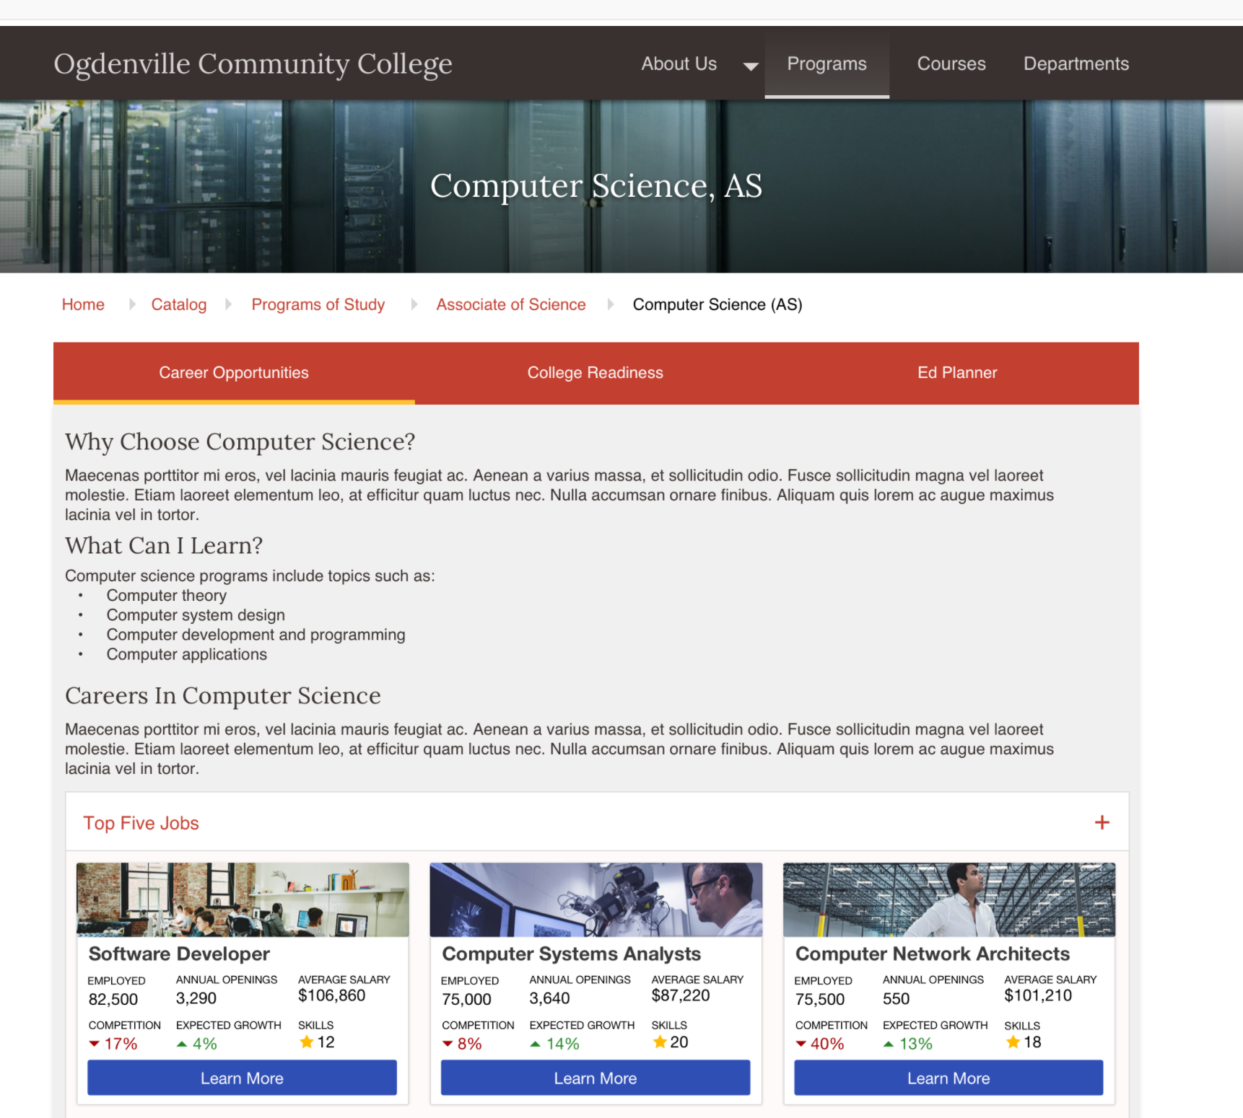
Badge Scorecard
<subheading>

Slide 30
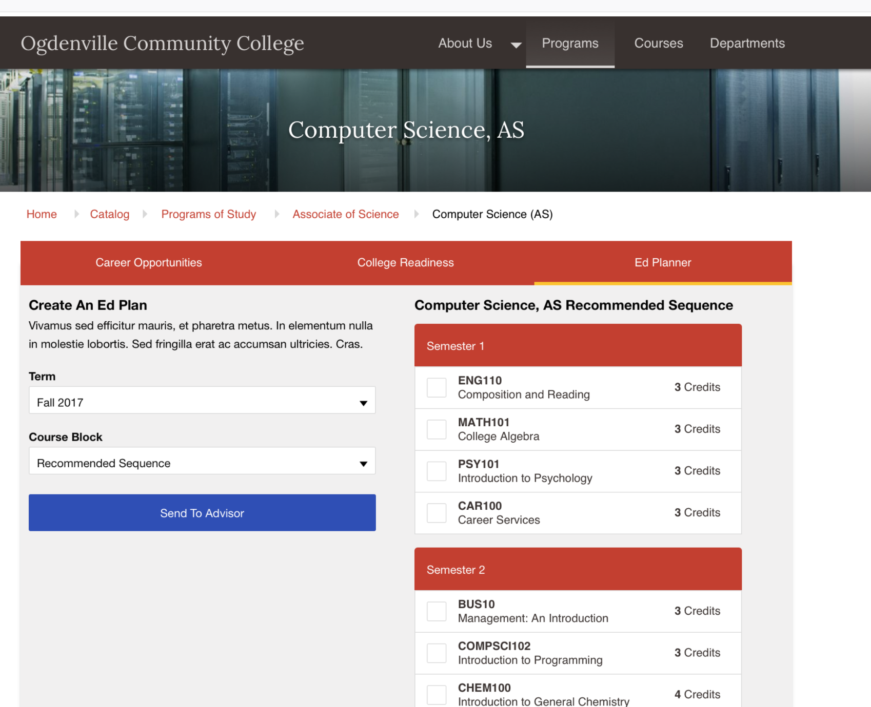
Extended Transcript
<subheading>

Slide 31
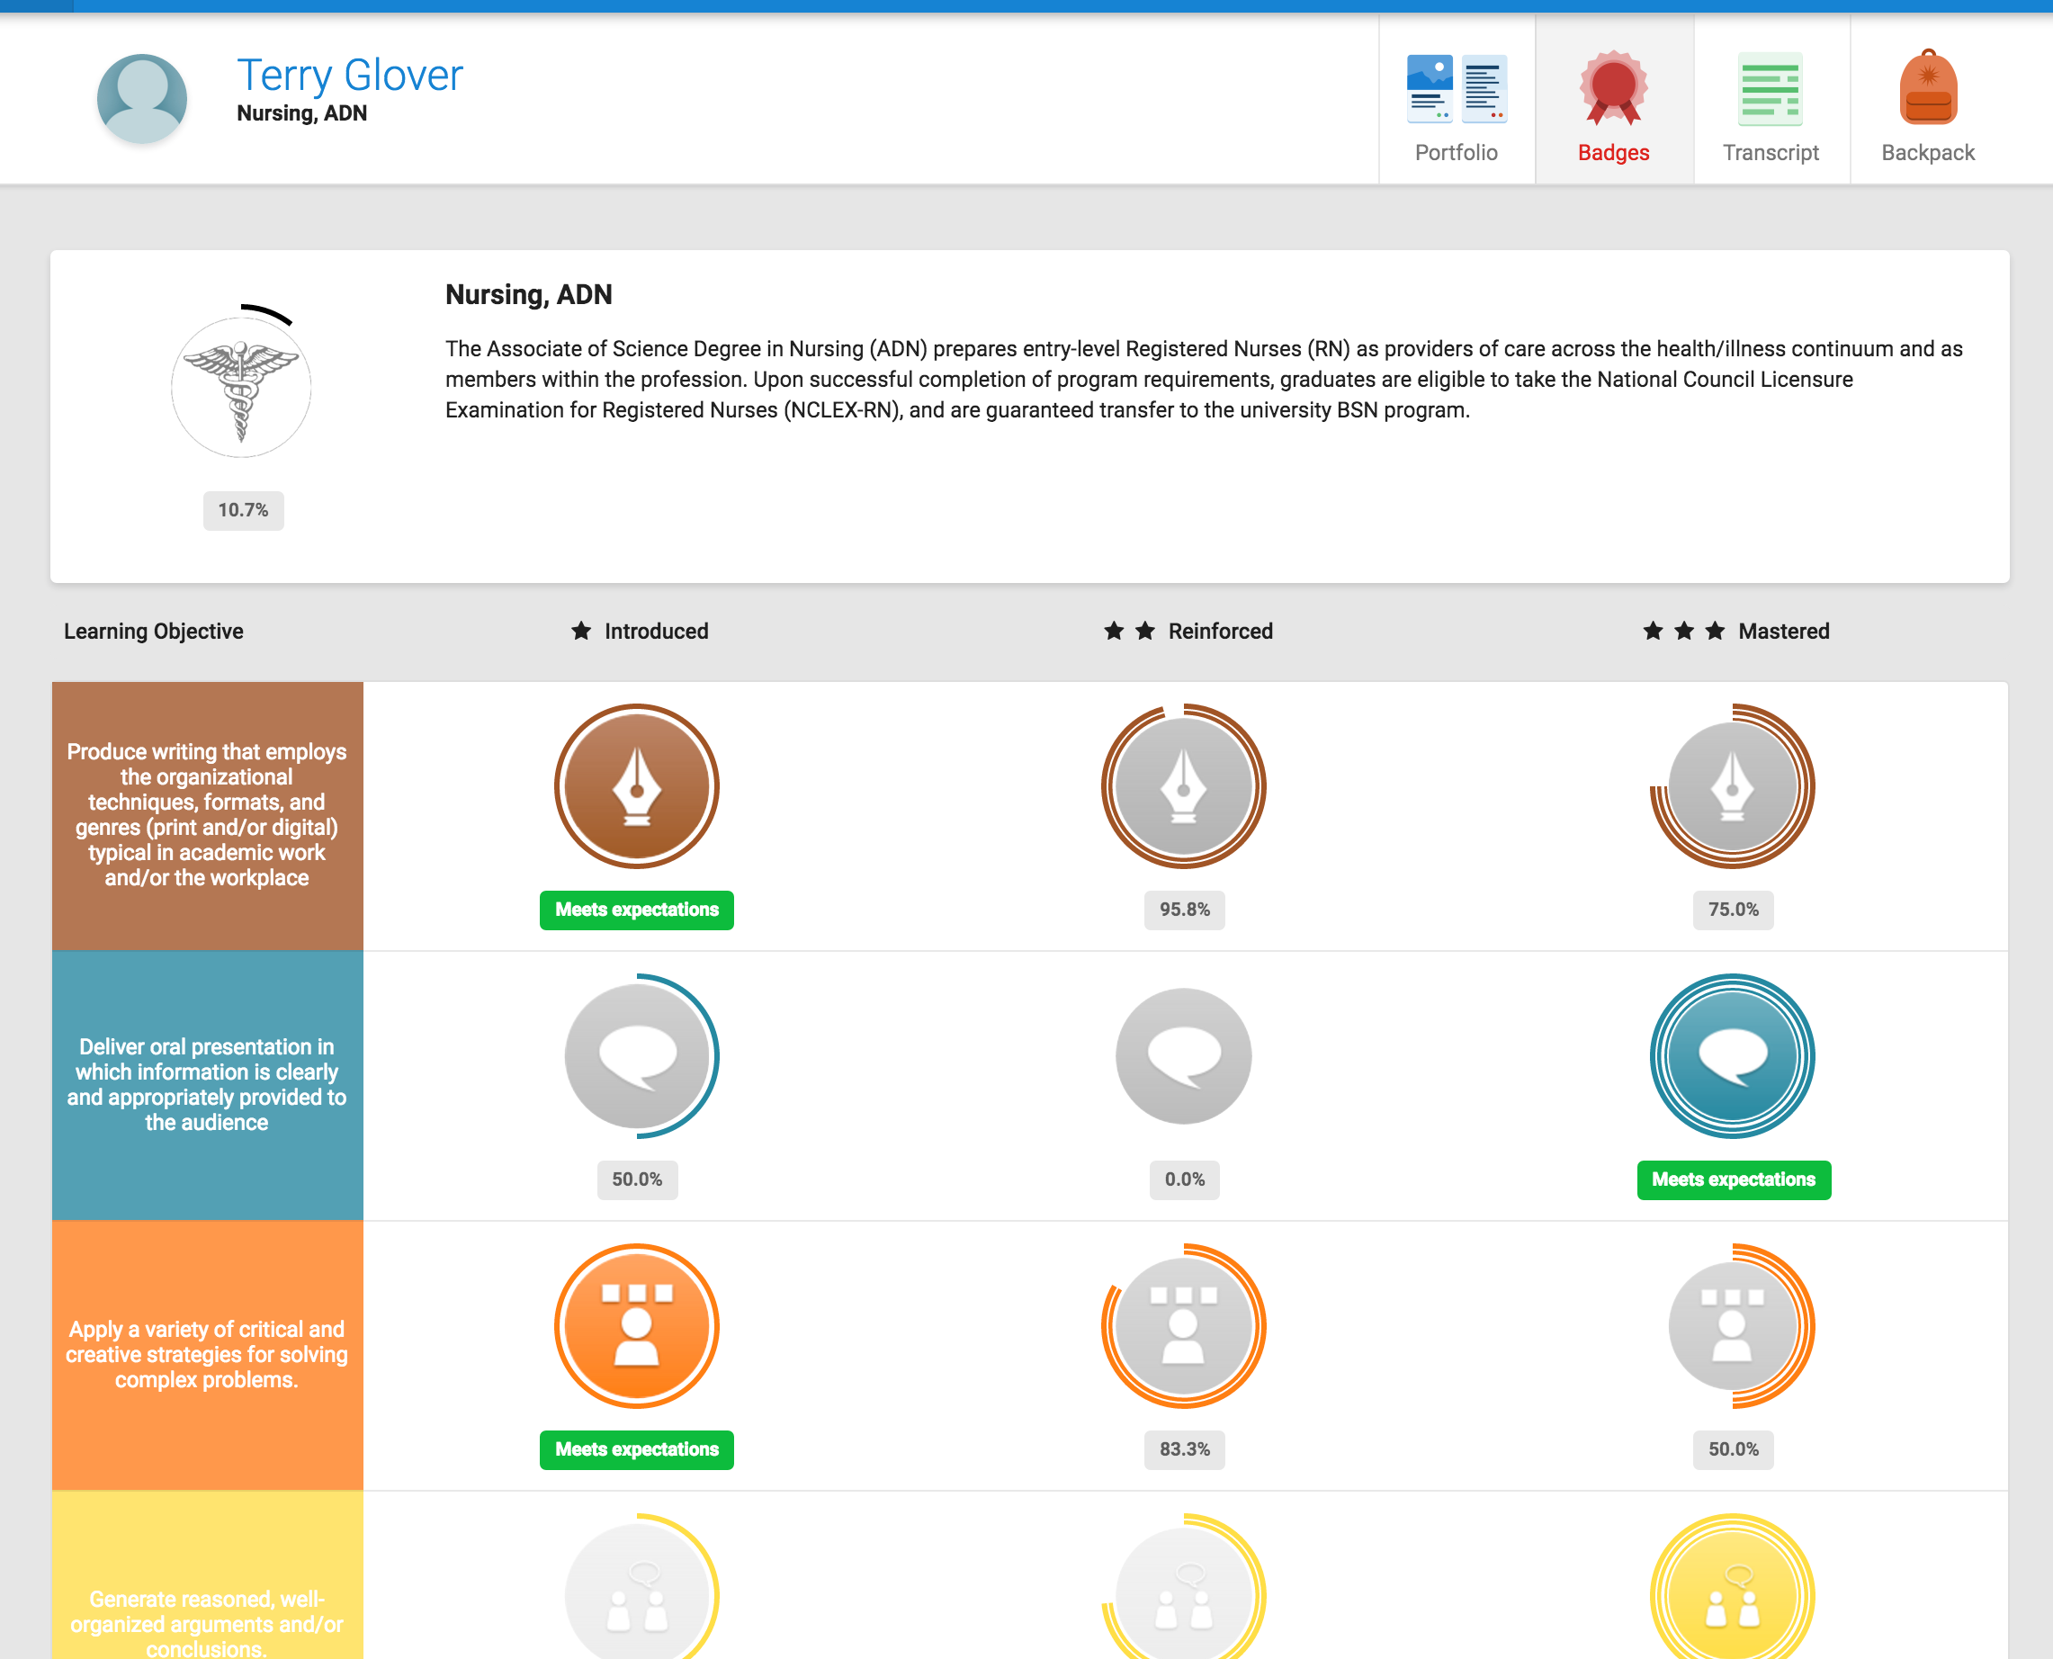
Badge Scorecard
<subheading>

Slide 32
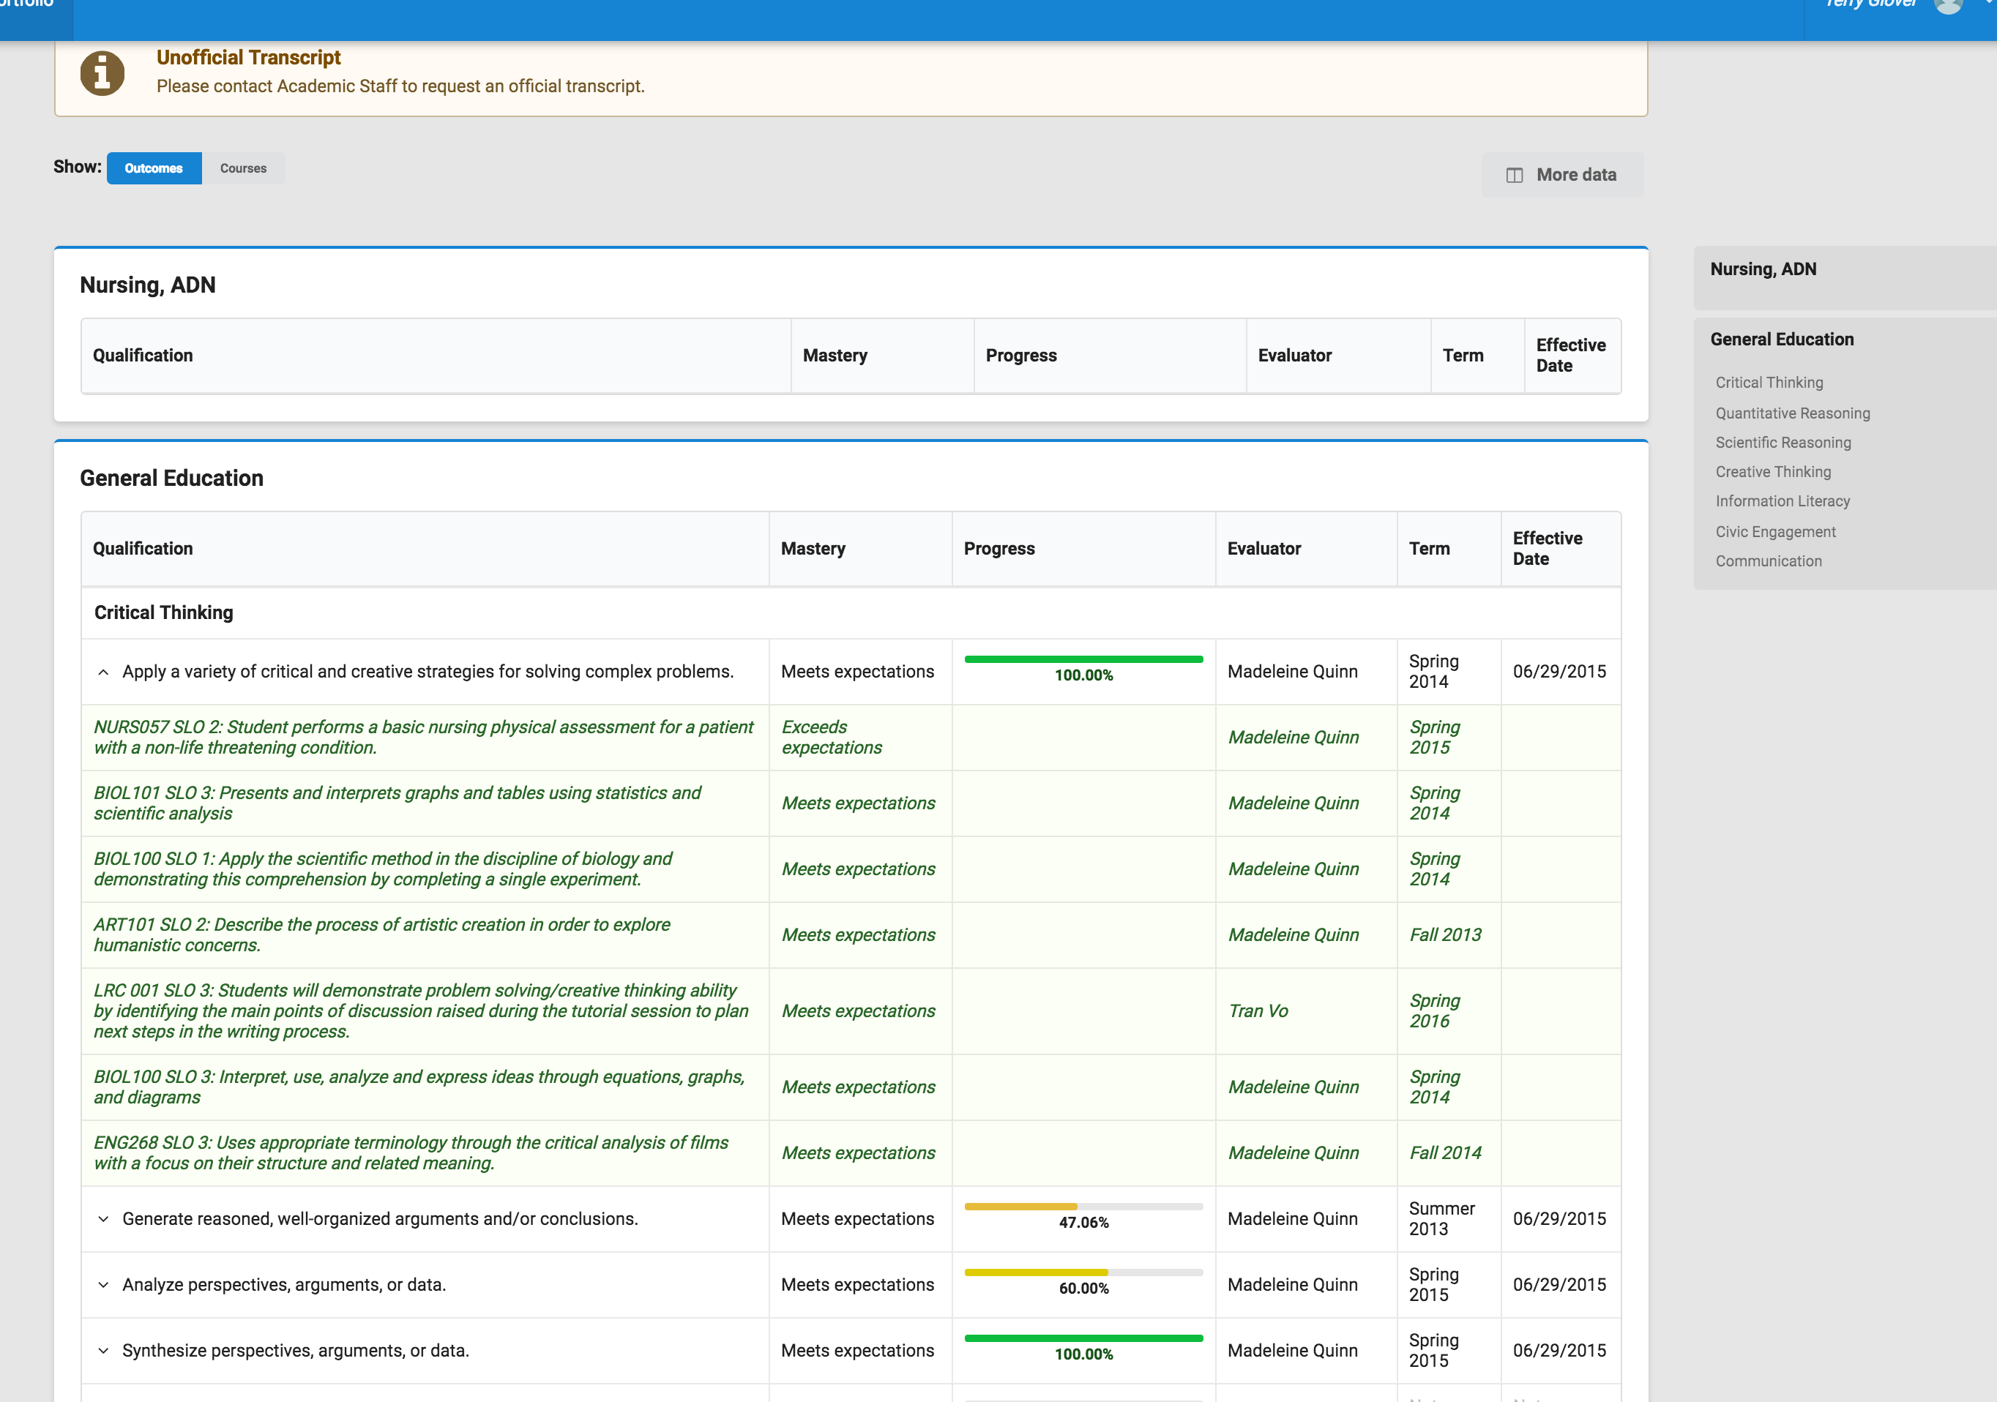
Extended Transcript
<subheading>

Slide 33
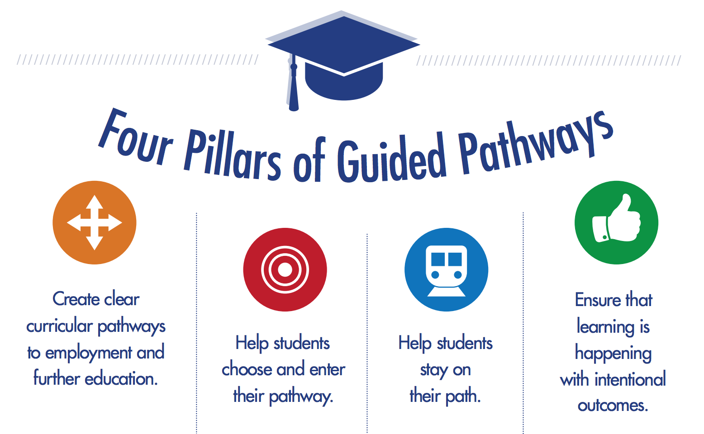
Guided Pathways

Slide 34
Winter is Coming

Slide 35
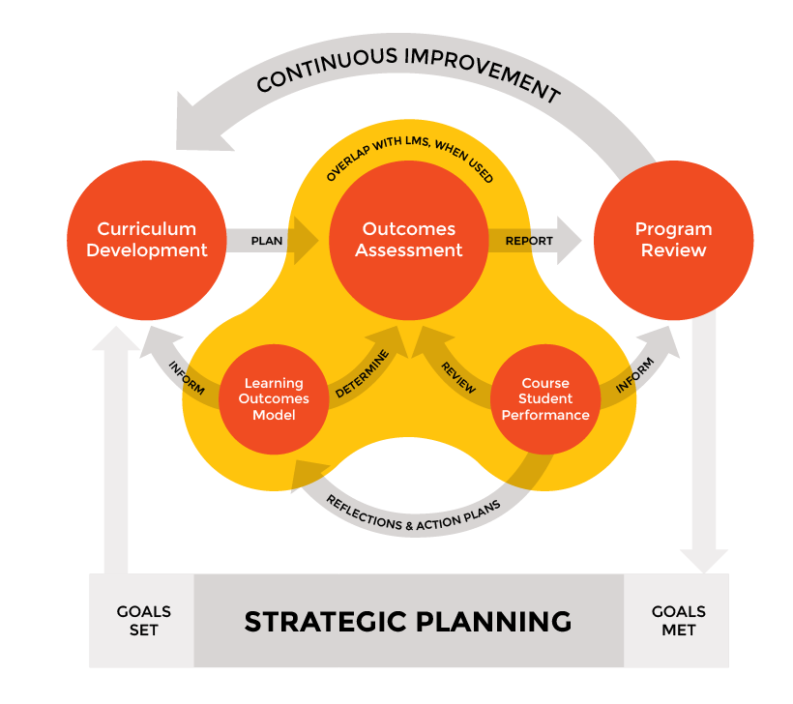
A Clear Picture is Emerging
Curriculum
Course and Program Developed around Competencies/Outcomes.
Assessment
Accreditation, yes: but also badging, workforce, early alert—we need to know how students, not just courses, are doing.
Program Planning & Review
Continuous Improvement needs to become truly continuous to succeed.

Slide 36
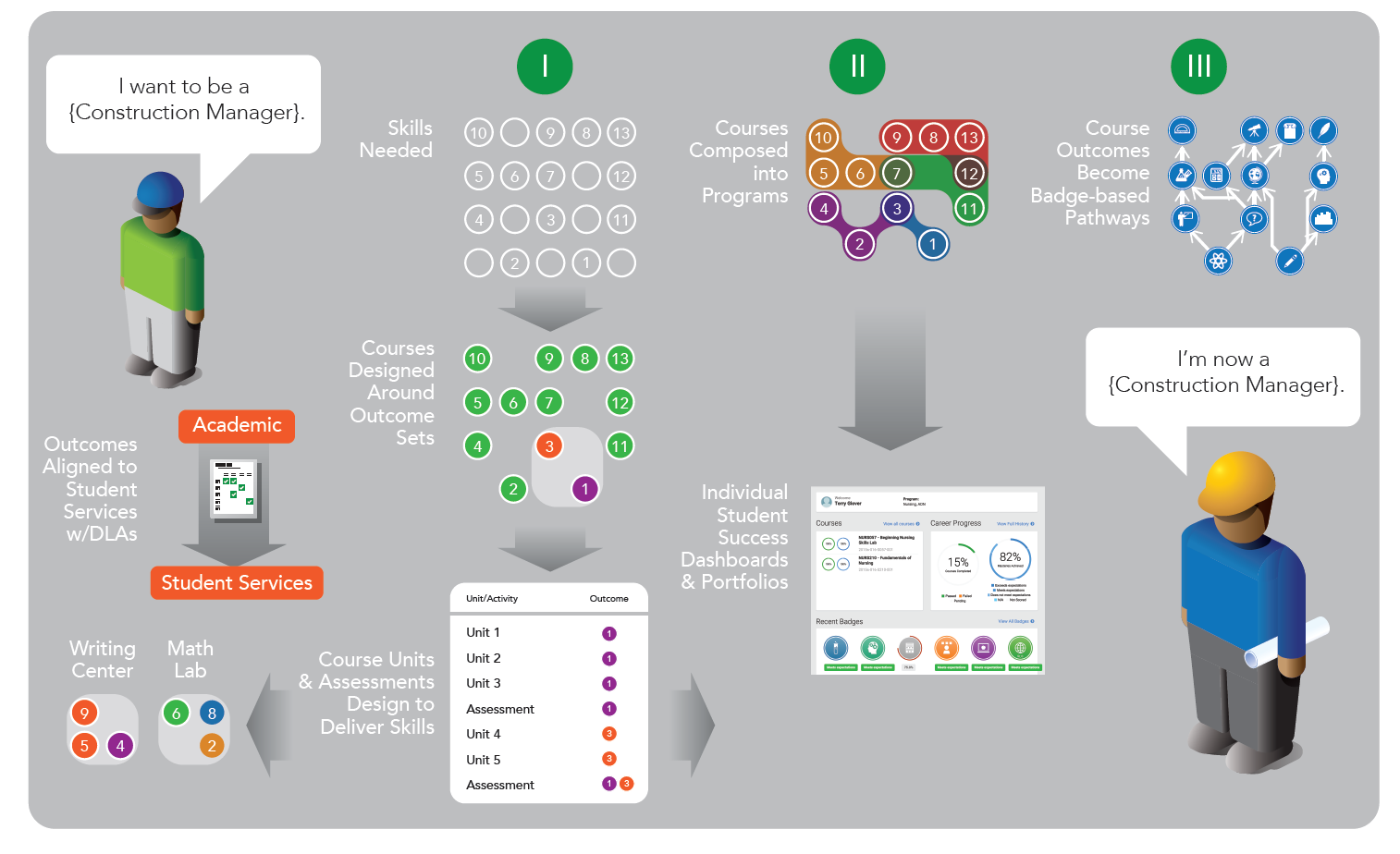
Student Success Becomes Intentional:

Slide 37
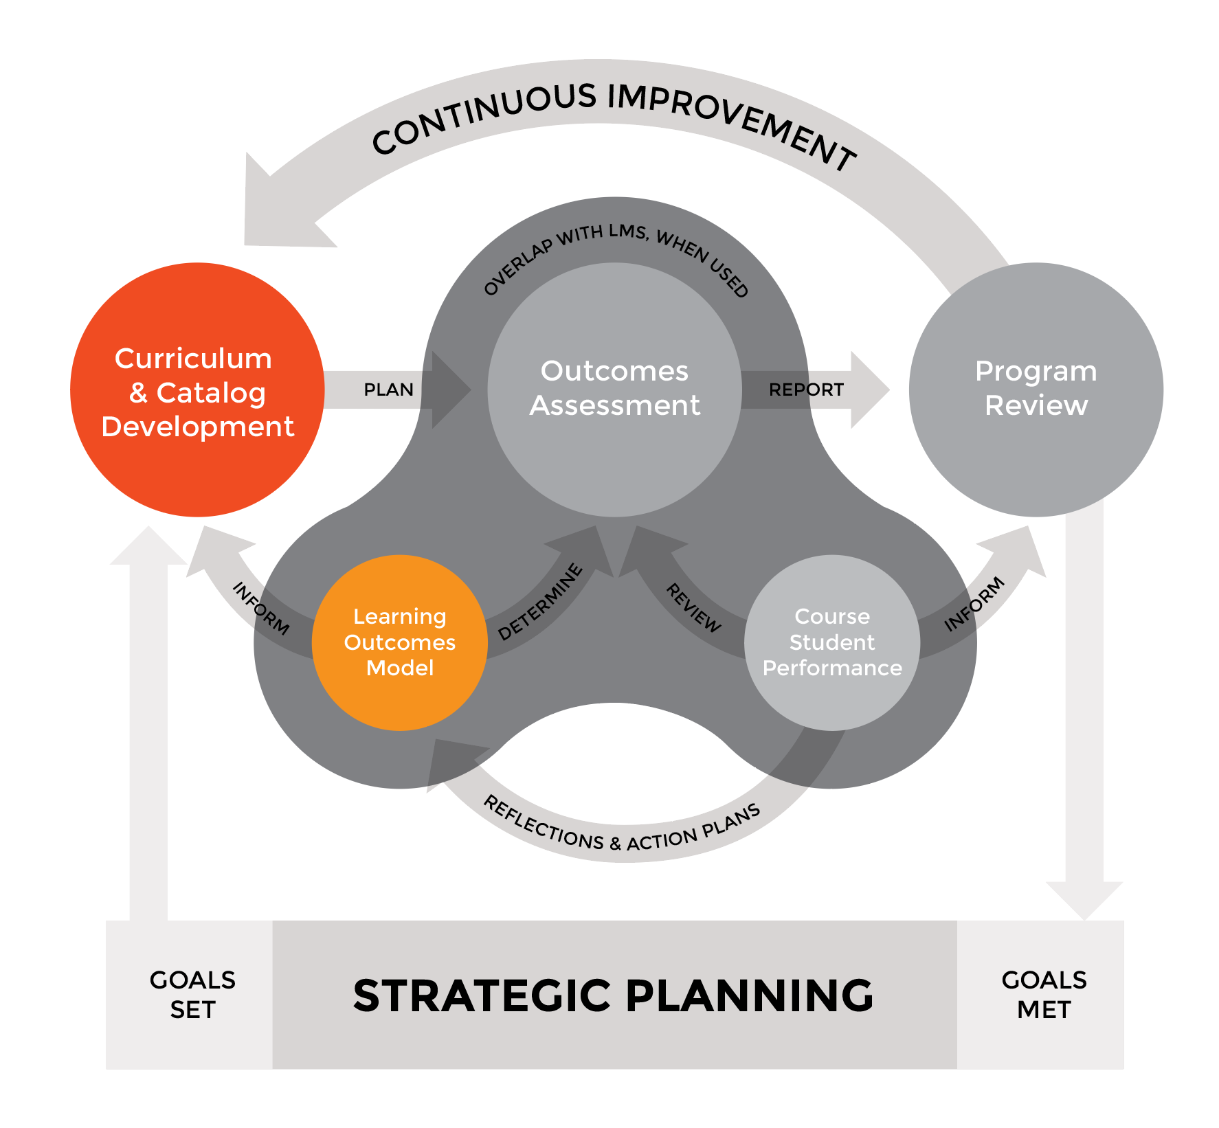



Curriculum is Disconnected
Curriculum & Catalog Vendors
Traditional curriculum and catalog solutions have evolved to have some learning outcomes development tools, but none support the development of multi-dimensional outcomes/competency models eLumen does.
More importantly, the are not able to integrate key course/learning outcome data with Assessment Management Systems or Learning Management Systems.
Notes:
We should be able to make all of this work together.
Instructure and eLumen are both committed to supporting next-generation interoperability standards being developed by IMS Global (as well as emerging CCCCIO standards like COCI 2.0).
We think that these standards will let schools adopt a range of improved curriculum and assessment models, ranging from just plain better continuous improvement to CBE implementations.

Slide 38
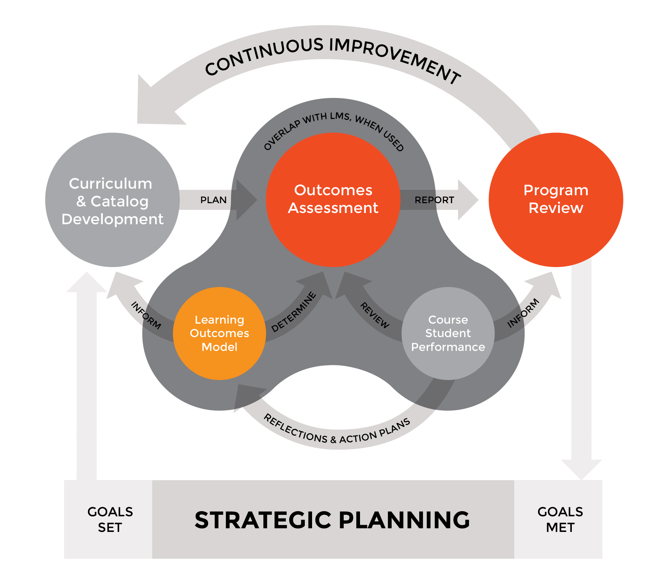




… and Assessment is Too Static
Assessment & Planning Vendors
Traditional assessment and planning vendors do not support (or support well) multi-dimensional learning outcomes/competency models and have weak LMS integration. More importantly, they don’t support things like APIs and versioning to ingest from Curriculum Systems, which are the system of record.
As a result, doing course-embedded assessment is very labor intensive and program review does not have a direct connection to course and program evolution.
Notes:
We should be able to make all of this work together.
Instructure and eLumen are both committed to supporting next-generation interoperability standards being developed by IMS Global (as well as emerging CCCCIO standards like COCI 2.0).
We think that these standards will let schools adopt a range of improved curriculum and assessment models, ranging from just plain better continuous improvement to CBE implementations.

Slide 39
This Serves Students AND Institutions
Ed Plan/Audit
Zero-Configuration Ed Plan & Audit with our Curriculum. Pathways become smarter & competency-aware with our Assessment.
Portfolio
Signature assessments can be embedded in pathways with portfolios; then portfolios used to get jobs.
Badging & Transcript
We enhance what becomes possible in representing achievement; in engaging in course/skills/badges over life of student success.

Slide 40
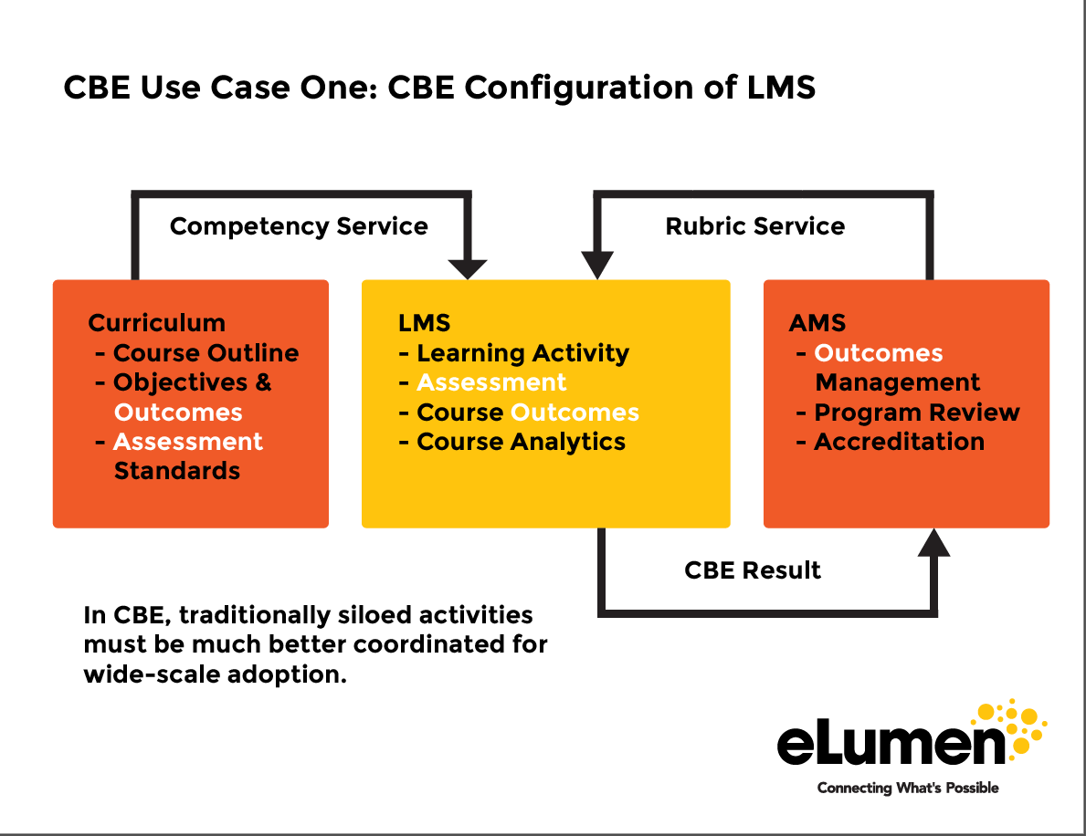
We Enhance & Extend the LMS
+

Slide 41
Students will Succeed on Purpose
Co-Remediation
Smart Pathways
Work Ready

Slide 42
Our Partner Ecosystem is Strong
LMS all Partners Today
Analytics (2017-18)
  Tableau
  Burning Glass/EMSI
Consortia
eLumen Sponsor Lumina/C-BEN CBE Initiatives
Higher Ed Technical Architects for IMS Global CASE Standard
AACC/League of Innovation Primary Sponsor
Infrastructure
Ellucian
Oracle/Peoplesoft
Unicon
CCCTC/Glue

Slide 43
Let’s See How This Works.

