Slide 1
SLO-Centric Instruction
There’s Nothing Average About
Lisa Marchand
Cosumnes River College
Professor of English as a Second Language
Paul Burwick
Shasta College
Educational Support Technician

Slide 2
What do these terms mean?
Course Objectives
Student Learning Outcomes
Exit Skills
Learning Targets
Assessment
Quiz
Exam
Grade

Slide 3
Title V division 6 section 55023
“The course provides for measurement of student performance in terms of the stated course objectives.”

Slide 4
“…culminates in a formal, permanently recorded grade based upon… ability to demonstrate…proficiency…by means of…skills demonstrations by students.”

Slide 5
“[Course] grades …shall be averaged on the basis of the point equivalencies to determine a student's grade point average using only the following evaluative symbols…”

Slide 6
Title V talks about averaging course grades as a standard for maintaining records of student GPA --

Slide 7
Title V talks about awarding course grades based on demonstrated proficiency.

Slide 8
I mean…you’ll give me something to do for extra credit, so I can still get an A, right?
Why do we even have to read this when you talk about different stuff in class?
…another student who didn’t read the syllabus…
When are you going to tell us what we have to know from the book?
So…if I mess up on the midterm, can I still get an A in the class?

Slide 9
Common Student Assumptions
Grades come from the teacher.
Good grades come from earning credit for doing assignments and taking tests.
Bad grades come from not getting a total or average score equal to a stated NUMBER.

Slide 10
WHY?

Slide 11
Traditional grading encourages students to focus on getting enough credit to earn “a good grade.”

Slide 12
Does this look familiar?
Methods of Instruction
In-class work will include lecture, discussion, small group and pair work, and individual reading (both silently and aloud). Homework will include reading the assigned novel, making vocabulary journal entries, and doing assigned exercises from the text.
Methods of Evaluation
Students will be given a grade based on assignments, quizzes, and two major exams.
Grading
Participation 3%
Vocabulary Journals 15%
Quizzes 30%
Assignments 10%
Midterm 15%
Final Exam 27%

Slide 13
Accounting Example:
GRADING POLICY
Your grades will be posted on the “Grades” page in Canvas on a regular basis. It is your responsibility to monitor your progress in the course. It is also your responsibility to drop the course if you decide you cannot complete it. If you do not drop the course, you will be awarded the grade you earned during the semester. Grades will be assigned based on points earned on assignments and assessments. A “C” grade (665 points or 70%) or better is required to pass this class.
Item Total Points % of Grade
Chapter Exams 500 53%
Comprehensive Final Exam 50 05%
Quizzes 150 16%
Homework Assignments 110 12%
LearnSmart Assignments 50 05%
Comprehensive Problems 90 09%
Total Possible Points 950 100%

Slide 14
SLOs
Notes:
Before I continue, it would probably be a good idea to address the SLOephant in the room…

Slide 15
SLO 1: APPLY ACCOUNTING CONCEPTS AND PRINCIPLES IN MAKING DECISIONS ABOUT BUSINESS OPERATIONS.
Interpret financial statements of corporate entities.
Use generally accepted accounting principles to develop and interpret financial information.
Explain the importance of operating, investing and financing activities reported in the Statement of Cash Flows.
Analyze and evaluate the use of accounting information for decision making by potential investors and creditors.
Analyze financial statements and financial condition using solvency and profitability analysis based on historical and current data.
SLO 2: APPLY THE CONCEPTS AND PRINCIPLES UNDERLYING ACCOUNTING PROCEDURES.
Explain the nature and purpose of generally accepted accounting principles (GAAP) and International Financial Reporting Principles (IFRS).
Interpret the assumptions, concepts, and principles underlying generally accepted financial accounting procedures.
Prepare financial statements following generally accepted accounting principles.
Analyze the effect of financial transactions on the accounting equation.
Apply generally accepted accounting principles in transactions related to cash and receivables, inventories, current liabilities and payroll, plant assets and intangible assets, stockholders' equity, and long-term liabilities.
SLO 3: ANALYZE, CLASSIFY, RECORD, AND INTERPRET FINANCIAL INFORMATION.
Analyze and record business transactions following generally accepted accounting principles.
Prepare end-of-period entries to adjust and close accounts following generally accepted accounting principles.
Use special journals and subsidiary ledgers to record entries.
Complete all phases of the accounting cycle from transaction analysis through financial statement preparation
SLO 4: IDENTIFY THE ETHICAL IMPLICATIONS INHERENT IN FINANCIAL ACCOUNTING AND REPORTING AND BE ABLE TO APPLY STRATEGIES FOR ADDRESSING THEM.

Slide 16
Math Example:
Student Learning Outcomes
Students will develop and advance their skills in each of the following:
Use mathematical operations (add/subtract/ multiply/divide) on real numbers (positive & negative integers, fractions, decimals, and square roots);
Apply rules for combining & simplifying algebraic expressions,
Solve single & multiple-step equations. Graphing solutions to linear equations.
Apply algebraic skills and critical thinking to solve problems.
Grading | Semester Grades
Exams 3 @ 20% | 60%
Online Quizzes and Homework | 8%
Pencil and Paper Assignments | 8%
Final Exam | 24%

Slide 17
With the ACCJC Accreditation Standards adopted in 2014…Expectations in the areas of student learning outcomes include the following:
• Student learning outcomes results are used by students as they progress through their programs of study and engage in other activities of the institution.
• The discussion of student learning is ongoing at both the institutional and programmatic levels, and is tied to data analysis, program review, planning, resource allocation and other institutional decision-making.
• Assessment of the students’ attainment of the learning outcomes happens continuously at the course level for adaptation and enhancement of instruction and instructional delivery.
• Information about student learning outcomes assessment results is available at the appropriate levels of granularity for use by programs and across programs, and by the institution as a whole, in analysis and evaluation, planning and decision-making, and for implementing change.

Slide 18
All Accredited Community Colleges must provide evidence →
evidence that the college conducts program review, collects and uses appropriate research and data on student achievement and progress through educational programs in analyzing its own effectiveness
evidence of how well the institution is achieving its mission by using data on student achievement and student learning
evidence that the institution has set future “stretch goals” or targets or benchmarks for student achievement and student learning, or otherwise assessed its own satisfaction with levels of achievement and learning
evidence the college uses data on student achievement and student learning to plan and implement improvements
evidence of the use of student achievement data in all program review reports
evidence the college has identified Student Learning Outcomes, designed appropriate assessments of learning, and uses the results of assessment for improving learning
evidence the institution uses results of learning assessments, and that those analyses factor into institutional priority setting and agendas for change

Slide 19
Current SLO Assessment Paradigm
Student Learning
Behaviors
&
Grading
SLO Assessment & Reporting

Slide 20
What we do for each course we teach:
Planning
Writing
Developing Materials
Lectures
Labs
Office Hours
Marking Homework
Testing
Grading
Meeting
Plus, plus, plus…
Planning
Writing
Developing Materials
Lectures
Labs
Office Hours
Marking Homework
Testing
Grading
Meeting
Plus, plus, plus…
Planning
Writing
Developing Materials
Lectures
Labs
Office Hours
Marking Homework
Testing
Grading
Meeting
Plus, plus, plus…
Meetings to discuss and interpret data
Plan changes
PROGRAM REVIEW
Assess SLO’s
Report Data
Assess SLO’s
Report Data
Assess SLO’s
Report Data
Planning
Writing
Developing Materials
Lectures
Labs
Office Hours
Marking Homework
Testing
Grading
Meeting
Plus, plus, plus…
Planning
Writing
Developing Materials
Lectures
Labs
Office Hours
Marking Homework
Testing
Grading
Meeting
Plus, plus, plus…
Assess SLO’s
Report Data
Assess SLO’s
Report Data

Slide 21
5 courses x 150 students = 3,000 papers
+ meetings & SLO Assessments
& Program Review
Ya gotta be frikin’ kiddin’ me!

Slide 22
“No hay mal
que por bien
no venga.”
(There is no bad from which good cannot come.)

Slide 23
In SLO-Centric Instruction,
Student Learning Outcomes are “unpacked” to determine
course content and lesson design
materials and methodology selection
channels for giving students feedback on their progress
grading schemes that align course grades to outcomes achievement
embedded outcomes assessment

Slide 24
The Teacher | The Classroom | The Student
From Course SLOs Develop Course Content Course Objectives Materials Methods | Learning Targets Activities Competency Feedback | Achieve Learning Targets Develop Exit Skills Demonstrate SLOs

Slide 25
Consider this schema…
COURSE CONTENT | LEARNING SOURCES | LEARNING PROCESS | LEARNING OUTCOMES | SUCCESS-DATA
Course Objectives Are derived from intended SLOs define course content. guide the teacher in selecting methods, materials, and activities to facilitate students’ acquisition of course content. Exit Skills Mental and actual tools successful students will be able to apply | Learning Targets The knowledge, skills and habits of mind students know they are trying to master Lessons Lecture Text Activities Homework Research Experimentation Practice Explicit metacognitive skills instruction | Students Know the learning targets Engage in lessons with attention to the learning targets Get feedback on progress through quizzes and tests Seek to improve Practice higher order skills such as analysis, integration, and evaluation Demonstrate ability to apply learning | Student Learning Outcomes Statements that describe what successful students can do at the end of the course. Several Objectives and their component learning targets are integrated to meet an outcome. Students’ products evidence acquisition of course content in measurable forms. | Assessment Evaluation of student success Interpreted to identify patterns of strengths and challenges in teaching and learning Applied to improve course, methods, materials, and/or learning activities Integrated with other course-level data to inform Program Review

Slide 26
Exit Skills
Learning Target
Learning Target
Learning Target
objective
Student Learning Outcome
COURSE CONTENT
Exit Skills
Learning Target
Learning Target
Learning Target
objective
Exit Skills
Learning Target
Learning Target
Learning Target
objective

Slide 27
Course Student Learning Outcomes
The descriptions of what students must show they can do by the end of this course

Slide 28
Course Objectives
Determine course content
Are addressed when we design or select the materials, activities and tasks that constitute opportunities for students to learn the course content.
For example:
Objective: Students will learn to write complex sentences.

Slide 29
Learning Targets
Discrete elements of knowledge, skills, and habits of mind that combine to enable one to demonstrate an outcome.
(students are often expected to have competence in certain learning targets BEFORE undertaking the course, but it is a good idea to identify the targets and identify which of them need more attention…not just review)

Slide 30
EXAMPLE
Objective: Students will learn to write complex sentences.
Learning Targets:
Know and use phrase and clause structures
Write a complete idea into one clause
Add information to sentence constituents
Use relative and reduced clauses to modify words and phrases in sentences
Understand and use logical connectors
Understand and use anaphora (pronouns)
Punctuation conventions for complex sentences

Slide 31
Student Learning Outcomes
What a student is able to do because s/he passed this course

Slide 32
Student Learning Outcome:
Write a 500-word academic essay that effectively develops a thesis, employs rhetorical forms appropriate to the writer’s purpose, and includes appropriately cited quotations.
Objectives:
The writing process
Rhetorical forms and paragraph structures
Logic and fallacies
Write simple, compound, and complex sentences
MLA citation
Paraphrasing
Sentence variety
LEARNING TARGETS
Know and use phrase and clause structures
Write a complete idea into one clause
Add information to sentence constituents
Use relative and reduced clauses to modify words and phrases in sentences
Understand and use logical connectors
Understand and use anaphora (pronouns)
Punctuation conventions for complex sentences

Slide 33
So … how is all this supposed to make SLO work more meaningful?

Slide 34
skills
objective X
knowledge
habits of mind
Successful Students can do this
skills
Objective
Y
knowledge
habits of mind
Student Learning Outcome
Course Objectives leading to a Student Learning Outcome
Learning Targets derived from course objectives

Slide 35
Student Learning
Behaviors,
Competency feedback,
&
SLO Assessment
Student Learning
Behaviors
&
Grading
SLO Assessment & Reporting

Slide 36
Student Learning Outcomes | Instructional Activities | Assessments | % of Final Grade
SLO #1: EMPLOY "TOP-DOWN" COMPREHENSION STRATEGIES use context clues and structural analysis as aids to understanding word meanings. infer meaning through application of previous knowledge. identify implied ideas in level appropriate texts. | Lecture Textbook assignments Extensive Reading Assignments | Quizzes | 25%
SLO #2: DEMONSTRATE EXPLICIT COMPREHENSION OF LEVEL-APPROPRIATE TEXTS recognize main ideas in intermediate level reading passages. locate topics and major supporting details of assigned readings. discuss and write responses to ideas from both fiction and non-fiction readings. answer literal comprehension and vocabulary-in-context questions after assigned readings. | Lecture Textbook assignments Reading: A Long Walk to Water | Quizzes Worksheets on A Long Walk to Water | 20%
SLO #3: DISTINGUISH THE MEANINGS CONVEYED BY FUNDAMENTAL ENGLISH GRAMMAR STRUCTURES recognize parts of speech from word forms and sentence structure. analyze sentences for their component parts and recognize the effect of word order on meaning. | Lecture In-class practice Textbook assignments Word Web Journal | Sentence Journal Quiz | 25%
SLO #4: DEMONSTRATE ABILITY TO READ LEVEL-APPROPRIATE TEXTS ALOUD use phonetic skills to attack and pronounce unfamiliar words. | Lecture In-class practice | Teacher Observation | 05%
SLO #5: DEMONSTRATE ABILITY TO READ AND UNDERSTAND EXTENDED WORKS OF LEVEL-APPROPRIATE FICTION increase vocabulary through reading. search for contextual clues to meaning. employ basic strategies to increase reading speed. employ rudimentary scanning techniques to locate specific textual information. | A Long Walk to Water “Reading Faster” exercises Textbook assignments | Quiz Journal Student records of Reading Speed and Comprehension | 15%
SLO #6: BE AN AUTONOMOUS LEARNER use an American English dictionary effectively in lieu of reliance on a translating dictionary | Lecture Textbook assignments | Quiz | 10%
SLO #7: DEMONSTRATE APPROPRIATE PARTICIPATION BEHAVIORS IN SMALL AND LARGE GROUP ACTIVITIES. | Classroom participation | Teacher Observation
SLO #8: EMPLOY TIME MANAGEMENT STRATEGIES TO COMPLETE OUT-OF-CLASS ASSIGNMENTS ACCORDING TO A GIVEN SCHEDULE | Scheduled due dates Unscheduled Progress Checks | Timeliness of Homework Completion

Slide 37
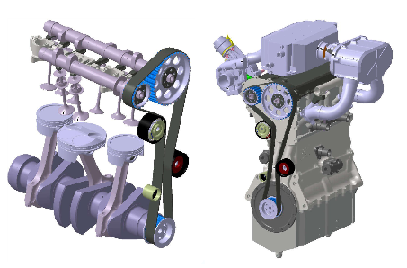
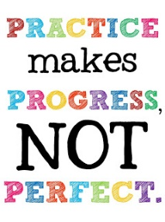
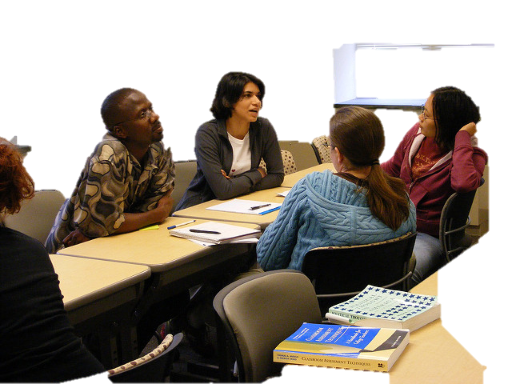
Students apply what they’ve learned to demonstrate a course SLO
Objective
A
Objective
B
Objective
C
LEARNING TARGETS
Understand:
Know:
Apply
Perform:
Solve:
Find:
Analyze:
Etc…
LEARNING TARGETS
Understand:
Know:
Apply
Perform:
Solve:
Find:
Analyze:
Etc…
LEARNING TARGETS
Understand:
Know:
Apply
Perform:
Solve:
Find:
Analyze:
Etc…
Learning Opportunities for Students
Course SLO’s Guide Content, Methods, and Materials

Slide 38
Course Learning Targets
To successfully pass this class, students must show that they can:
read English without translating
recognize parts of speech from word forms and sentence structure
recognize sentence parts and understand the effect of word order on meaning
search for and use contextual clues to understand written English
increase vocabulary through reading, not from assigned lists
use context and grammar clues to understand word meanings
recognize main ideas
infer meaning by combining information from reading with previous knowledge
identify implied ideas in readings from the text and the assigned novel
locate topics and major supporting details of assigned readings
discuss and write responses to readings
answer comprehension and vocabulary-in-context questions about readings
scan for and quickly locate specific information
use an American English dictionary
work collaboratively with students from other language backgrounds
attend class regularly and meet schedule deadlines

Slide 39
Learning opportunities explicitly linked to Learning Targets, Objectives, and SLOs
Rather than giving grades to assignments and tests, students receive feedback to help them monitor their progress toward meeting competency as they internalize and achieve Learning Targets and objectives required for each SLO.
Highest Competence
Developing Competence
Early Attempts

Slide 40
Individual assignments can be graded
using rubrics
in
Canvas.

Slide 41
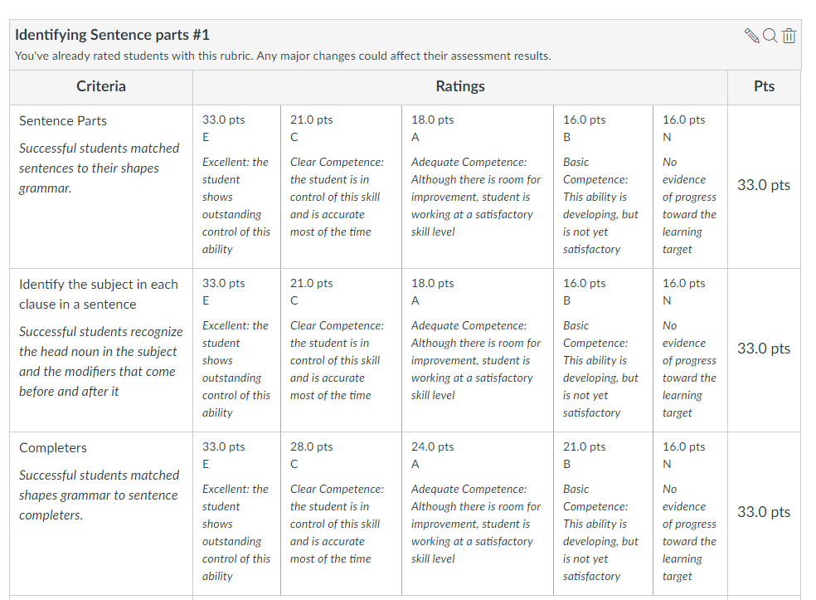

Slide 42
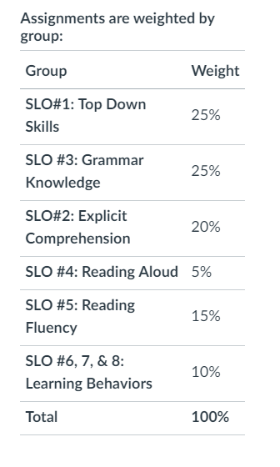
In Canvas, all assignments can be linked to one or more SLOs, and each SLO can be weighted according to the impact that achieving a particular SLO should have on a student’s final grade in the course

Slide 43
Use the Outcomes feature in Canvas to assess Student Learning
The Outcomes Feature in Canvas tracks student learning mastery in a course. As you create and use outcomes you can build rubrics, associate the rubrics to assignments and evaluate students’ mastery as you grade assignments…

Slide 44
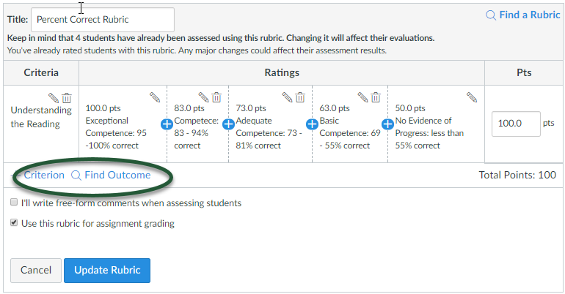
Add your outcomes to your rubrics to assess student mastery of a particular outcome

Slide 45
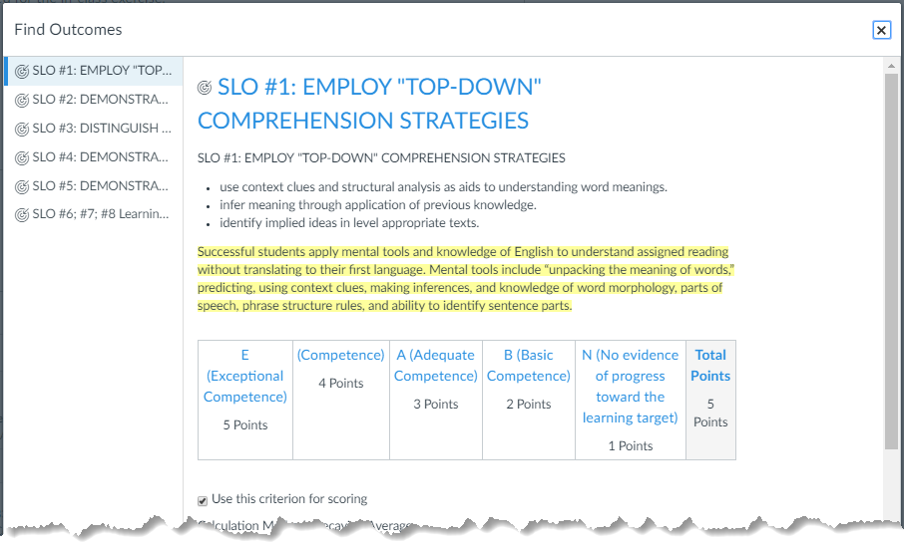
Click the Outcome link to get more information:
Aligned Items
Outcome Results by assignment

Slide 46
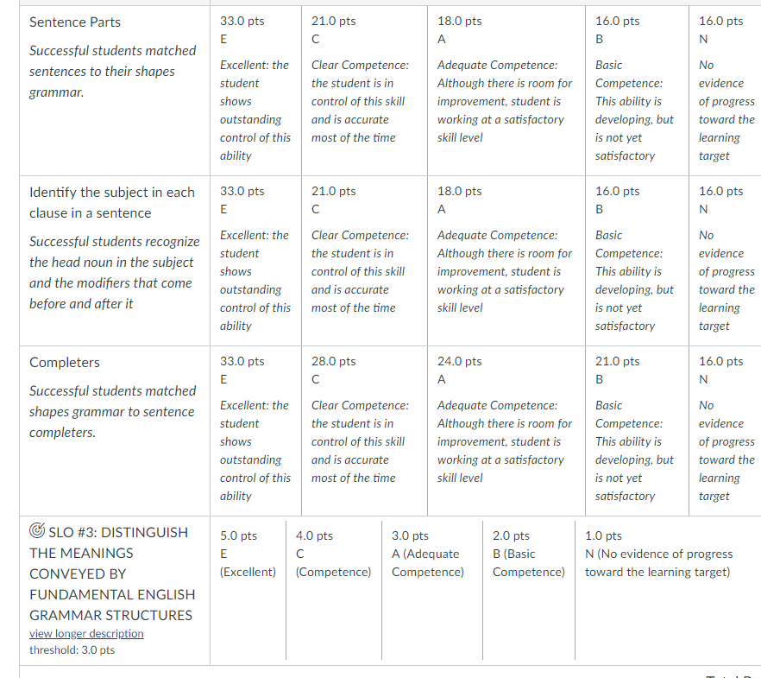

Slide 47
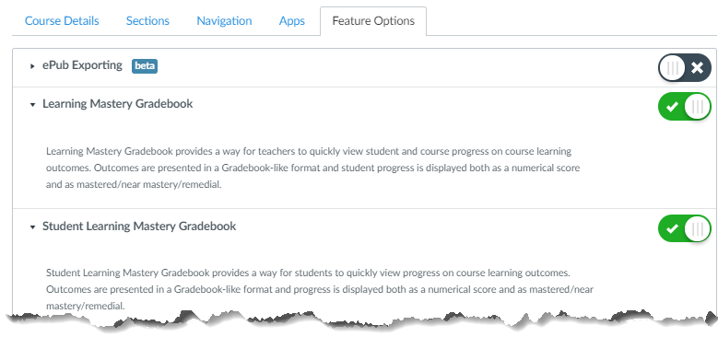
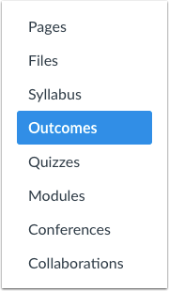
Activate Learning Mastery Gradebook and Student Learning Mastery Gradebook In Course Settings
Click the Outcomes link In Course Navigation.

Slide 48
View the progress of your students on each outcome

Slide 49
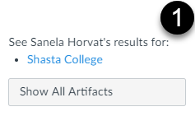
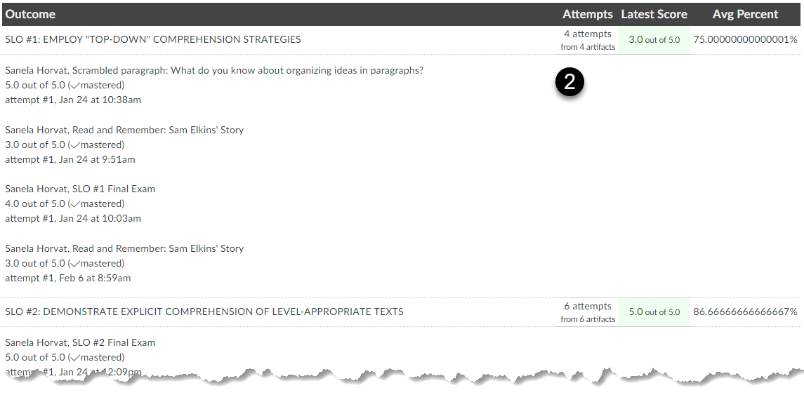
View details of each Outcome by assignment

Slide 50
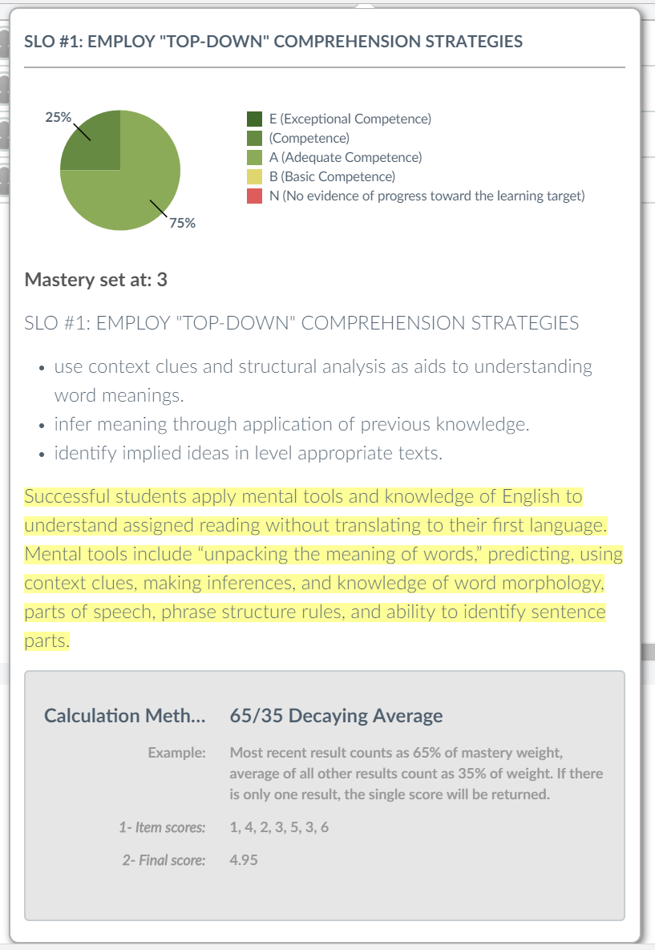
From the Learning Mastery Gradebook, hover over a learning outcome and the detail pops-out

Slide 51
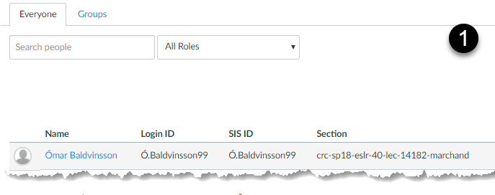
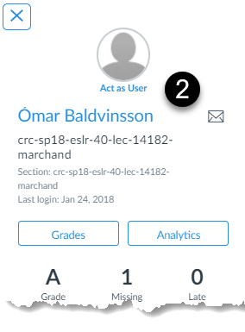
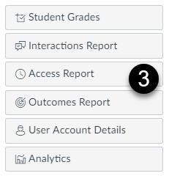
You can also view Outcome Reports from the User Details Page:
From the [1] Course Roster, click a student’s name;
then, click the [2] student’s name from the Context Card…
Click the [3] Outcomes Report

Slide 52
Using the Outcomes feature in Canvas to assess Student Learning…
…facilitates data-driven, informed decision making and makes end-of-term reporting much easier!

Slide 53
Use SLOs to guide course content and student learning
Develop grading strategies to simultaneously conduct comprehensive outcomes assessment without ‘workload creep’.
Manage assignments and grades in CANVAS to assess all course SLOs every semester

