Slide 1
SOC, CIP, TOP, SAM:
Re-imagining Curriculum in Three-letter Words
Daniel Keller, dean of curriculum and instructional SUPPORT services, laccd
Michelle Sampat, Associate dean of instruction, Mt. San Antonio College
Notes:
D

Slide 2
There’s a code for that!
Program
  What jobs are completers prepared to get?
  What subject does the program fall under?
Course
  What subject does the course fall under?
  Is it a CTE course?
  Where in the program sequence does it fall?
Who are the best people to answer these questions?
Notes:
D

Slide 3
Accurate coding benefits students
Perkins, Strong Workforce
Federal financial aid, veterans benefits
Salary Surfer, Here to Career, Career Coach
Data Mart, Scorecard, CTE Outcomes Survey, LaunchBoard
Notes:
D

Slide 4
Do you speak code?
SOC: Standard Occupational Classification codes
CIP: Classification of Instructional Programs
TOP: Taxonomy of Programs
SAM: Standard Accountability Model
How do you wield these three-letter acronyms to better serve your students?
Notes:
D

Slide 5
Start at the end
What is the primary goal of your program?
  To prepare students for transfer
  To prepare students for work
  To prepare students for a transfer or CTE program
  Other
Notes:
M

Slide 6
What jobs are completers prepared to get…
(Assuming no prior or additional coursework, training, or experience?)
Are there more than one?
How many is too many?
  Breadth vs. depth
  Transfer patterns
  CTE advisory committee recommendations
Ultimately, the discipline experts know best.
Notes:
M

Slide 7
Standard
Occupational
Classification
US Bureau of Labor Statistics occupational categories
Typical entry-level education required for employment
Projected job openings (LMI: Labor Market Information)
https://www.bls.gov/soc/
Example:
15-0000 Computer and Mathematical Occupations
15-1100 Computer Occupations
15-1120 Computer and Information Analysts
15-1121 Computer Systems Analysts
Notes:
M

Slide 8
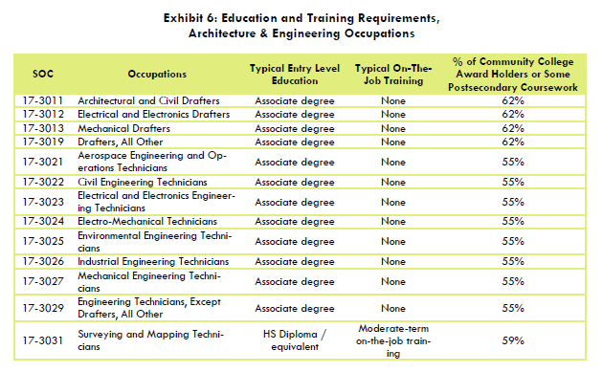
Typical entry-level education required
Example: SOC codes 17-3000 (Source: Centers of Excellence)
Notes:
M

Slide 9
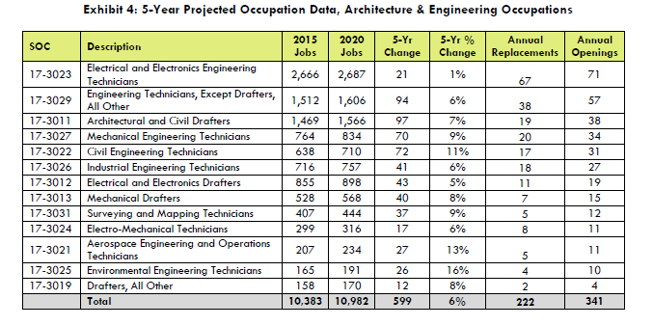
Projected job openings
Example: SOC codes 17-3000 (Source: Centers of Excellence)
Notes:
M

Slide 10
Who can help find these statistics?
COE: Centers of Excellence (http://www.coeccc.net/)
DWM: Doing What Matters (http://doingwhatmatters.cccco.edu/)
EDD: California Employment Development Dept (https://www.edd.ca.gov/)
MIS: Management Information Systems DataMart (https://datamart.cccco.edu/datamart.aspx)
BLS: US Bureau of Labor Statistics (https://www.bls.gov/)
Your college researcher
Notes:
M

Slide 11
What subject does the program fall under?
Many options
  On the dart board: use a cross-walk*
  Hit the bull’s-eye: ask a discipline expert
Only the discipline experts know which is best.
  *More on this later
Notes:
D

Slide 12
Classicification of
Iinstructional
Programs
US Department of Education postsecondary instruction programs
Eligibility for financial aid, veterans benefits
Gainful employment and accreditation reporting
Like California’s “TOP” code,* but more specific and more frequently updated
https://nces.ed.gov/ipeds/cipcode/Default.aspx?y=55
*More later
Example:
50.0000 Visual and Performing Arts
50.0400 Design and Applied Arts
50.0402 Commercial and Advertising Art
Notes:
D

Slide 13
Example: the “ECAR”
Eligibility and Certification Approval Report
(Sorry, that’s a four-letter acronym.)
US Department of Education (DOE)
  Eligibility for financial aid
  SULA: Subsidized Usage Limit Applies
  (Another four-letter acronym!)
    150% limit on financial aid
    Based on program length (in weeks)
    https://ifap.ed.gov/150PercentDirectSubsidizedLoanLimitInfo/FAQ.html
Notes:
D

Slide 14
GE (no, not that GE)
Gainful employment report (usually on the college website)
  Cost of program
  Financial aid and other benefits available
  Length of program
  Prospective jobs available at the end
  Job placement rates
  Etc.
Who can help with ECAR and GE: ask your Financial Aid Officer
Notes:
D

Slide 15
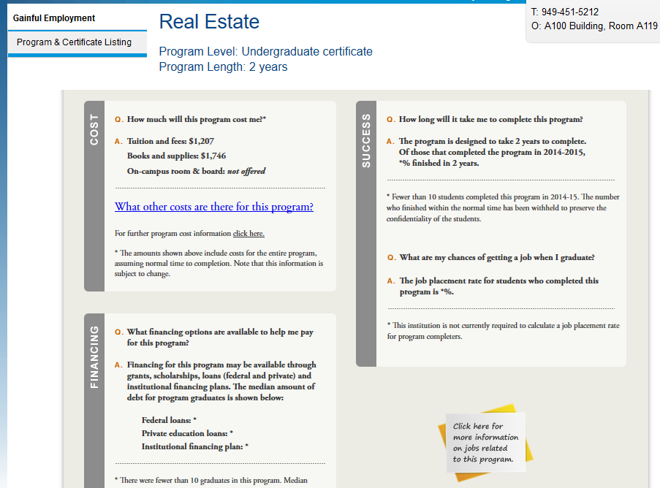
Gainful employment sample: (Source: a college GE website)
Notes:
D

Slide 16
Taxonomy of
Programs
State of California (only)
Identifies the primary subject (of both programs and courses)
Student Success Scorecard, Data Mart, Salary Surfer, LaunchBoard, etc.
http://extranet.cccco.edu/Portals/1/AA/Credit/2013Files/TOPmanual6_2009_09corrected_12.5.13.pdf
Example:
1200.00 Health
1230.00 Nursing
1230.30 Certified Nursing Assistant
Notes:
M

Slide 17
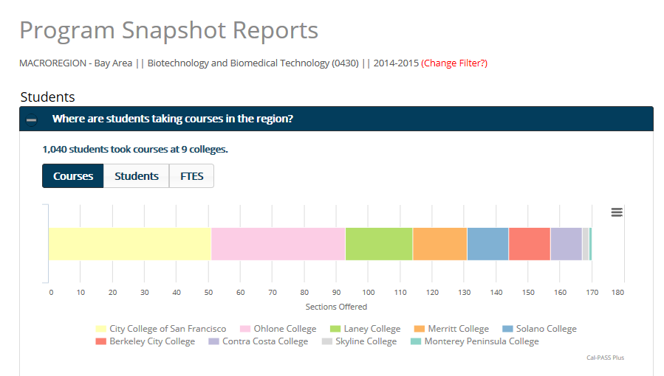
TOP data example: (Source: Launchboard)
Notes:
M

Slide 18
Exercise: Is the following program coded well?
Exploring Business
Career Certificate (9 units)
  BUS 100 Intro to Business (3)
  BUS 101 Intro to Management (3)
  BUS 102 Intro to Sales (3)
Current coding (using the TOP-CIP-SOC cross-walk*)
  TOP: 0501.00 Business and Commerce
  CIP: 52.0101 Business/Commerce, General
  SOC: 11-1011 Chief Executives
  *More on this in the next slide
Notes:
D

Slide 19
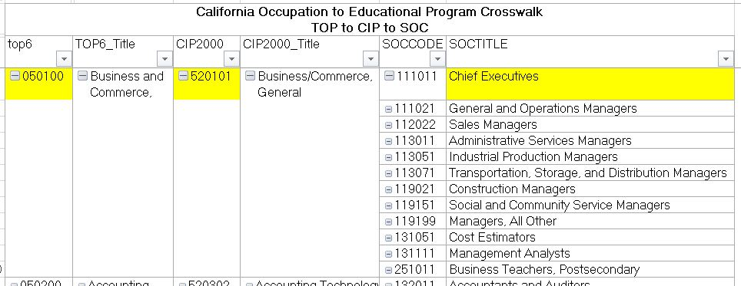
TOP-CIP-SOC crosswalk
(Source: Centers of Excellence)
Notes:
D

Slide 20
Would this be more accurate?
Exploring Business
Career Certificate (9 units)
  BUS 100 Intro to Business (3)
  BUS 101 Intro to Management (3)
  BUS 102 Intro to Sales (3)
Re-coding
  Sales and Related Workers (SOC 41-9099)
  Retail Sales (SOC 41-2031)
  And there are probably several more options
Notes:
D

Slide 21
Dart-board analogy (again)
To hit the dart board use a cross-walk
To hit the bull’s-eye ask a discipline expert
Notes:
D

Slide 22
Courses
What subject does the program fall under?
  TOP
Where in the program sequence does it fall?
  SAM
Notes:
M

Slide 23
Standard
Accountability
Model
Identifies CTE vs. non-CTE, and CTE course sequencing
Used to determine Perkins and Strong Workforce Program funding eligibility
  (Only SAM A, B, and C count)
Used in calculations for the Student Success Scorecard, CTE Outcomes Survey, and LaunchBoard
A: Apprenticeship*
B: Advanced Occupational
C: Clearly Occupational
D: Possibly Occupational
E: Not Occupational
*Only courses approved by the Division of Apprenticeship Standards (DAS) may be coded A.
Notes:
M

Slide 24
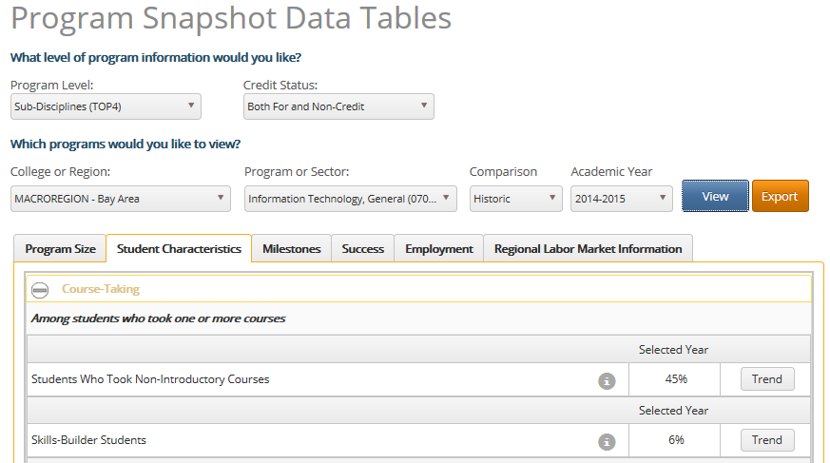
Statistical snapshot: (Source: Launchboard)
Notes:
M

Slide 25
SAM codes, prerequisites, and pathways
How do you decide which courses are clearly occupational vs. advanced occupation?
How might SAM codes and prerequisite sequences help define program maps (pathways) and educational plans?
Notes:
M

Slide 26
Where do I find my codes?
TOP and SAM
  COR: Course Outline of Record
  COCI: Chancellor’s Officer Curriculum Inventory
SOC
  SIS: Student Information System
  Launchboard
CIP
  ECAR (Eligibility Certification and Approval Report)
  SIS
Elsewhere: ask your researcher and financial aid officer
Notes:
D

Slide 27
How do I change them?
SAM and TOP
  Curriculum Committee/Senate
  Curriculum management system, SIS
  COCI (currently a “substantial change”)
CIP
  Curriculum Committee/Senate
  Curriculum management system, SIS?
  Coordinate with your financial aid officer and researcher
SOC
  Curriculum Committee/Senate
  Curriculum management system, SIS?
  Coordinate with your researcher and CTE Dean
Notes:
D

Slide 28
Other places to update them
Launchboard
IPEDS: Integrated Postsecondary Education Data System
  US Dept. of Ed. surveys on institutions receiving federal financial aid conducted by the National Center for Education Statistics (NCES)
Where else?
Notes:
D

Slide 29
One more link
Code Alignment Project (no, not that CAP)
  Information on codes and where they come from
  Recommended code alignment process
  What to know before changing a code
  http://doingwhatmatters.cccco.edu/LaunchBoard/CodeAlignment.aspx

