Slide 1
Scaling Up: campus strategies to maximize OER adoption
Heather Dodge, Berkeley City College
hdodge@peralta.edu
February 10, 2018

Slide 2
Discussion:
-How do you make the case for OER on your campus?
-What existing groups, committees, departments, etc. are stakeholders in OER?
-Who are your “sticky wickets”? Do they matter in the grand scheme of OER?

Slide 3
I can’t promise you...
Image from Katie Taylor, Flickr

Slide 4
Building a movement....
Get Educated… -conferences -webinars -websites -self-paced learning | Find Allies… -faculty -senate -committees -student groups -administration -bookstore | Create a structure… -website -professional development -tools for searching -compensation -tracking data | Go for low-hanging fruit… -new faculty -high-impact courses -multiple-section courses -adopters in the same departments

Slide 5
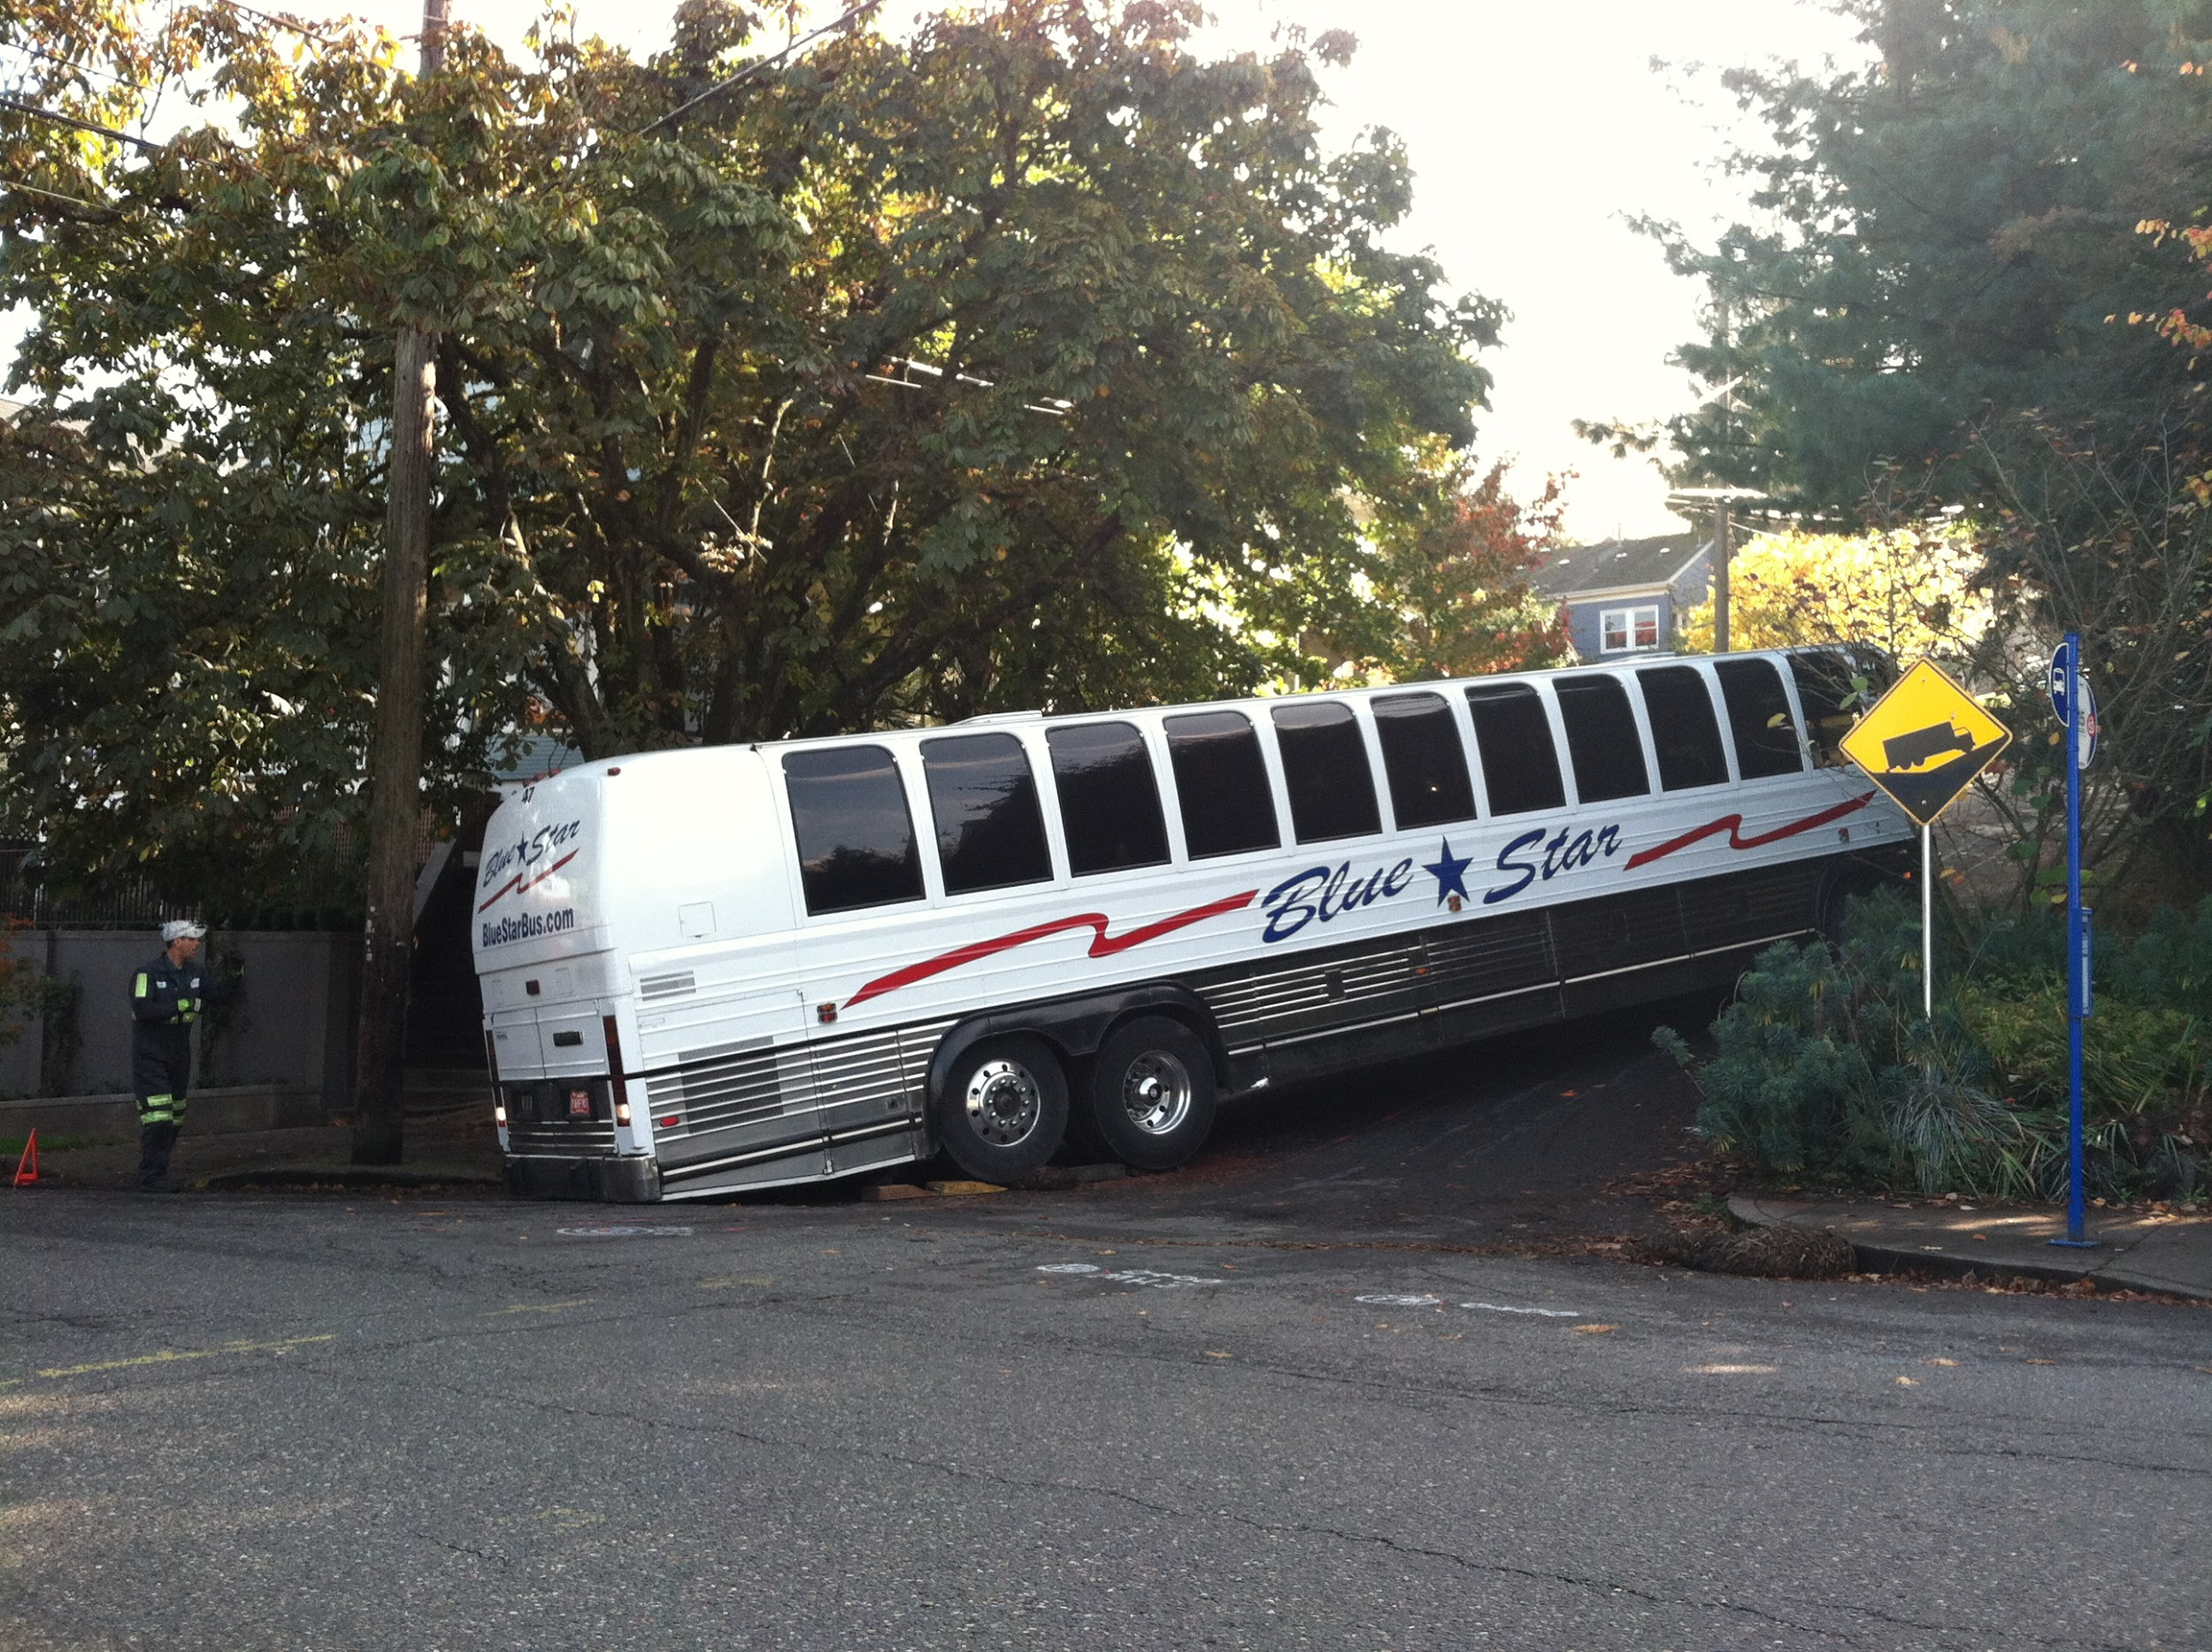
It might look like failure...
Image from Sam Beebee CC BY

Slide 6
Resources
-My Favorite sites for finding OER:
OER Metafinder, Open Textbook Library, OER Commons
-Sample Agenda and Contract for the BCC/COA OER Institute
-Link to BCC’s OER LibGuide
-Link to CCCOER Website (great list-serv, webinars, etc.)
-RFP for 2018 AB 798 grant

