Slide 1
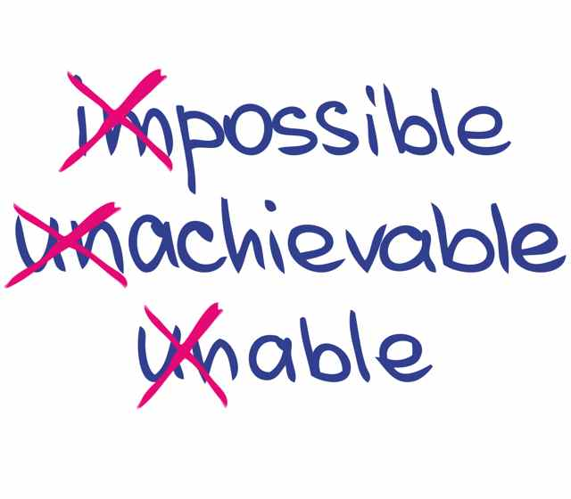
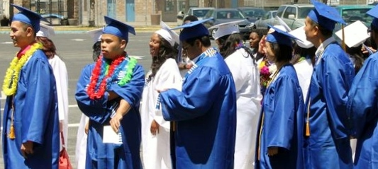
SCALING UP STUDENT SUCCESS PROGRAMS IN COMMUNITY COLLEGES: FROM “ISLANDS OF INNOVATION” TO INSTITUTIONALIZED PRACTICES
By Dr. Diana Bajrami
2016 Academic Academy

Slide 2
IMAGINE
IMAGINE a society that spends more money on keeping its prison system alive rather than educating their citizens.
IMAGINE a society where you soon might have more youth spending time behind bars than behind the desk.

Slide 3
Preface
…instead of plugging all our money into jails and prisons, we should be prioritizing education.
(Dr. Frank, over two decades of leadership experience in community colleges)
http://sundial.csun.edu/2012/09/california-budgets-1-billion-more-to-prisons-than-higher-education-and-leaves-students-hanging/

Slide 4
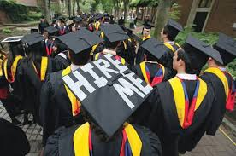
The Vicious Cycle of Low Success Rates in Community Colleges
Low Success
Rate
Lower Educational Attainment
Lower Human Capital
Slow Economic Growth
Increasing Inequality Diminishing Democracy

Slide 5
Research Questions
What are some of the major barriers faced by educational leaders in community colleges while attempting to scale up student success programs and initiatives aimed at improving the success rate for students from underserved communities in higher education (USCHE)?
What institutional or societal changes, according to community college educational leaders, need to take place for student success initiatives to be institutionalized on a larger scale?

Slide 6
Community Colleges as a Solution to Increasing
Educational Attainment in the United States
Community colleges are seen as the formidable solution to increasing educational attainment in the United States given that 45% of all undergraduate students in the United States attend community colleges and 59%, 56%, and 48% of all Native American, Latino, and African American undergraduate students, respectively, select community colleges as their first choice for pursuing a higher education (AACC, 2014).

Slide 7
The 20th century has been recognized as the “Human Capital Century” (cite)
The growing importance of knowledge in the production process, popularized as the “knowledge economy,” emphasizes the role of higher education as an engine for economic growth (Douglass, 2007, p. 17).
The argument that higher education provides benefits to societies, not only to individuals, transformed education from a personal to a public good.

Slide 8
Practitioners’ Voices and Feedback Essential to an
Informed Scaling Up Framework for Community Colleges
Drawing from the experiences of innovators to design an effective scale up model and utilizing interviews and case studies is a methodology used effectively by Sutton and Rao as they discussed in their book Scaling Up Excellence: Getting to More Without Settling for Less (2014).
The book is a product of seven years of scaling up literature research, interviews, and case studies with people who have been successful at scaling up best practices.

Slide 9
Data Collection & Analysis
Figure 8. A visual representation of data collection and analysis.

Slide 10
Table 2: Profile of Research Participants
Fictitious Names | Participants Position | Race/ Ethnicity | Gender | Years | Interview Time (mins)
Mrs. Hello Kitty | Classified Professional | Filipina | Woman | 12 | 35
Prof. Tony | English Faculty | African American | Man | 18 | 25
Dr. Frank | Faculty / Counselor | Polish American | Man | 24 | 57
President Romero | President | Latino | Man | 29 | 27
Dr. Kennedy | President | White | Woman | 14 | 31
Chancellor Ellis | Chancellor | African American | Woman | 30 | 42
Dr. Torres | Chancellor | Latino | Man | 41 | 34
Dr. Van | President | African American | Man | 31 | 43
Dr. Moffatt | Faculty | African American | Woman | 34 | 39
Dr. Anderson | Faculty | White | Woman | 15 | 56
Dr. Vargas | Director | Latino | Man | 8 | 44
Dr. Acampo | Vice President | Filipino | Man | 14 | 56
Dr. Finley | Faculty Leader | Mixed/Black | Woman | 15 | 45
VC Padilla | Vice Chancellor | Latina | Woman | 25 | 31

Slide 11
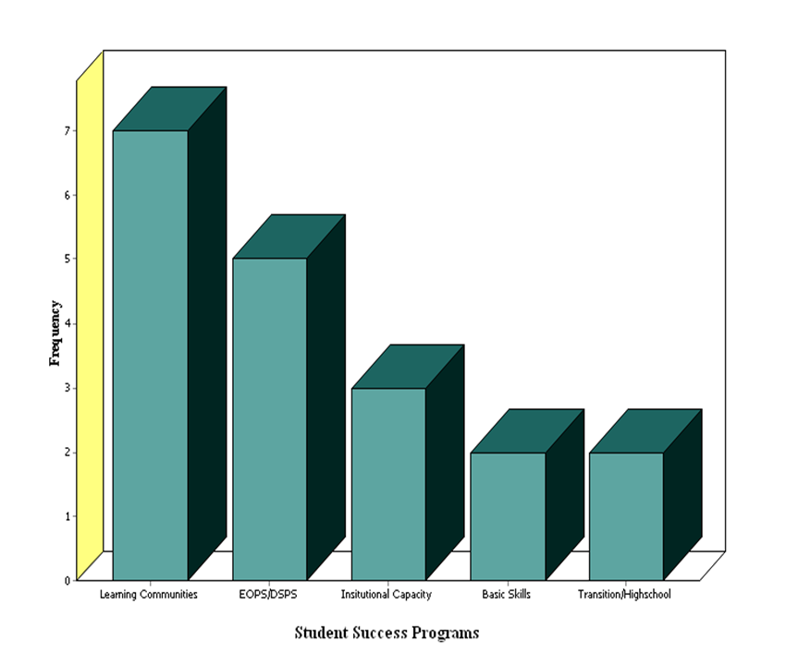
Shared Examples of Student Success Programs
Figure 9. Examples of student success programs shared by participants.

Slide 12
Barriers to Scaling Up Success
Figure 10. List of all codes within the axial category coded as barrier

Slide 13
Quotes Reflecting Barriers to Scaling Up Success
Funding
Definitely support. We are severely understaffed; this is one of the things that I have noticed. We are severely understaffed. In order to scale up any program you need to have the structure and the support behind that. (Vice Chancellor Padilla)
But, if I have to look at resources, I am looking at that. First you need staffing, you need counselors; this college has not had a career office in years. (Dr. Moffatt)
Professional Development
We have excellent instructors; however, many of whom are not prepared to deal with the student of today, and we need more training, more teacher training in creating more student focused classrooms, and different strategies to reach our different student population, our diverse student population, strategies what will that take into factor race/ethnicity, gender and income. (Professor T.)

Slide 14
Quotes Reflecting Barriers to Scaling Up Success Continued
Infrastructure
Community colleges are not agile enough with the curriculum to support businesses and industry, so while business and industry is willing and able to support community colleges, it takes us too long to adjust to their needs, and frustrates them and they pull off or pull away. (Chancellor Torres)

Slide 15
The First Element of Scaling Up Student Success Framework Identify the Main Pillars of Student Success
If that vision is not there, you can’t scale anything, because you might support the rhetoric, but you won’t support the program itself... (Dr. Acampo)
I think you cannot talk about equity and achievement and student success in community colleges if you cannot talk about the race. (President Romero)
Figure 11. The first element of the wheel of scaling up student success and its sub elements.

Slide 16
The Second Element of Scaling Up Student Success Framework Focus on People that Make Scaling Up Possible
You can have all the data …But, if you have not created the desire…People are not either going to fund it or they are not going to feel it. So, in addition to gathering the data is important to gather what I call the soft data, people, those who are going to be your champions…(President Van)
“There is much more success in the sense of community and people coming together as community,” Dr. Frank.
Every classified member at a counter or in the lab, every faculty member in the classroom, every manager making a decision, supporting a program has got to be thinking about how does it impact students and how does it create a more equitable environment. (President Romero)
Figure 12. Focus on people that make scaling up possible element of student success and its sub elements.

Slide 17
The Third Element of Scaling Up Student Success Framework Increase Agility, Decrease Bureaucracy & Increase Accountability
A lot of the times someone brings in an idea and it has to go through this committee, and this committee and this committee, and it takes three or four years, and by that time the whole idea has gone down because the money is not there anymore, and neither is the need. It should be a faster pace of introducing new ideas. (Mrs. Hello Kitty)
I will start with the state level. If we look at the California State Ed Code, [it] is very thick and California State in terms of community colleges, in my opinion, is overly regulated and sometimes it can hinder instructors’ efforts. (Professor T)
As Pedro Noguera says, “You cannot catch up by going slow.” Really ensuring that we have some accelerated programs, so that they can do some foundational and pre transfer course, so that they can do it in compressed time that they can immediately can get to the college level and fun classes because if you make them repeat things that they were not successful [at] in high school they are going to lose interest and not complete. (President Miller)
Figure 13. Increase agility by decreasing bureaucracy and increasing accountability element and its sub elements.

Slide 18
The Fourth Element of Scaling Up Student Success Framework Create a Culture of Equitable Success
I feel that …is the reason why education worked for me, [is] because I went to Catholic school, and there is an organizational culture…[that says] “You are going to come here, you are going to school, and you are going to do the homework. Your parents are coming for... And on down the line and it never changed from year to year, and “everybody in this room will succeed, we are not going to deal with people who think “I cannot do it.” “Ehe, no.” And “we do not have dropouts here.” (Dr. Frank)
Figure 14. Create a culture of equitable success element of the scaling up success wheel and its sub elements.

Slide 19
The Fourth Element of Scaling Up Student Success Framework Accelerate Scaling Up by Institutionalizing Equitable Student Success
So you have to start to learn what are the main documents within the organization the bylaws of the College Council, Senate Bylaws, is it Board Policy, and is it Program review forms? We codify in the culture what we think are really important concepts and language, and we have to either redefine that language and talk about how these concepts of equity, student achievement, institutional preference for those who are struggling are consistent with our language or we have to bring in new language and work it through the processes and get it established in our mission statement, in our program reviews. (President Romero)
Figure 15. Accelerate scaling up by institutionalizing equitable student success element and its sub elements.

Slide 20
The Six Element of Scaling Up Student Success Framework Advocate for Making Education a Community, State, and National Priority
I can stand outside and chant and say how long it is, but unless you get into the arena and become part of the “team” you cannot affect a permanent change because the policy and the law will always trump any initiatives, grassroots efforts that you build, if it does not follow through. (Chancellor Ellis)
I just do not know if politics is the way to run education, and I do not know what it takes to get political leaders to really listen to people with good experience and good ideas and to say: “Okay, I do not know anything about that because it is not me, but I am going to trust your skill, I am going to trust the data that you are showing me, and I am going to trust that enough to assist you in having the kind of funding it takes to provide these services.” (Dr. Frank)
Figure 16. Advocate for making education a community, state and national priority element and its sub elements.

Slide 21
The Wheel of Student Success

Slide 22
Elements and Sub-elements of the Wheel of Scaling Up Student Success

Slide 23
Scaling Up Student Success Elements | Strategies for Success
Identify Main Pillars of Student Success: Implement Best Informed Practices, Document and Disseminate their Impact | Identify and measure inequitable student success Discuss inequitable outcomes in the open Confront assumptions and practices that hinder student success Engage students in the design and implementation of scaling up efforts Document outcomes and spotlight the success
Focus on the People Who Make Scaling Up Possible | Identify student success champions Make everyone a member of the student success team Hire people who will propel equitable success
Increase Agility by Decreasing Bureaucracy and Increasing Accountability | Create infrastructure and pathways that support student success Increase accountability by simplifying structures Bridge the disconnected islands of academic and student services
Create a Culture of Equitable Success | Invest in training and retaining leaders Invest in meaningful and mindful professional development Instill new language and rituals Diversify community colleges so they resemble their communities
Accelerate Scaling Up by Institutionalizing Equitable Student Success | Tie student success to the mission, vision, and every planning document Reward success by integrating student success with resource allocation processes Make equitable student success part of every job description
Advocate for Making Education a Community, State, and National Priority | Advocate for equitable funding for community colleges Unite efforts with CSUs and UCs to create the united front of higher education Partner with K-12 to create pathways to student success Partner with communities, businesses, and industry Be a member of the policymaking team

Slide 24
Sometimes the issue of scalability in my mind is almost the wrong problem to solve initially because our problem is that the row numbers are so low that a cohort of 30 students becoming successful is a huge impact in the organization, and having that impact multiple years, or multiple semesters, creates…the numbers are dismal oftentimes. (President Romero)
The scaling up framework that resulted from this research indicates the importance of working together toward student success, since this task is a “Herculean task” as President Padilla stated, and it needs integrative and collaborative interventions. This integrative and collaborative work expands beyond community colleges because, as Anyon (2005) articulated, “individual and neighborhood poverty builds walls around schools and classrooms that education policy does not penetrate or scale” (p. 70). The current policies on education do not recognize the impact of “these walls” on educational outcomes.

Slide 25
Chapter 5: Personal Reflections and Recommendations
Support the creation of an educational insurance fund would operate just like the current Unemployment Compensation fund, as a federal and state partnership, but be administered by the states. It will also be funded totally by federal and state taxes paid by employers.
Just as unemployment insurance serves as a much-needed automatic stabilizer to any economic downturn, the educational insurance fund would be used by every American who would pursue education to improve his/her human capital and stay abreast of new technology and the demands of the 21st century.

Slide 26
New Educational Paradigm Reclaiming the Global Leadership Role in Educational Attainment
CA (US)
is capable of, resourceful enough to, and responsive to achieving educational excellence for all its members
Every person has access to equal and high quality education
Every student achieves the needed writing, critical thinking, and analytical skills needed for the 21st century
Every student achieves the needed writing, critical thinking, and analytical skills needed for the 21st century
Every member has the skills and ability to contribute to the American society and to the global world
Education is a civic and moral obligation for the state of California and the American Society

Slide 27
SCALING UP STUDENT SUCCESS PROGRAMS IN COMMUNITY COLLEGES: FROM “ISLANDS OF INNOVATION” TO INSTITUTIONALIZED PRACTICES

