Slide 1
Moving Past the Fear of Filming
Tracy Schaelen
Southwestern College

Slide 2
You can do this!

Slide 3
How to Move from Fear to Fun
1
simple strategies to try

Slide 4
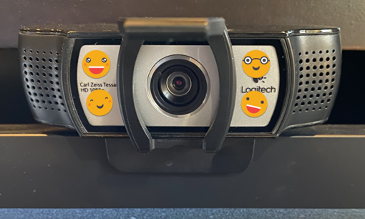
Speak to your Students
. . .and smile!

Slide 5
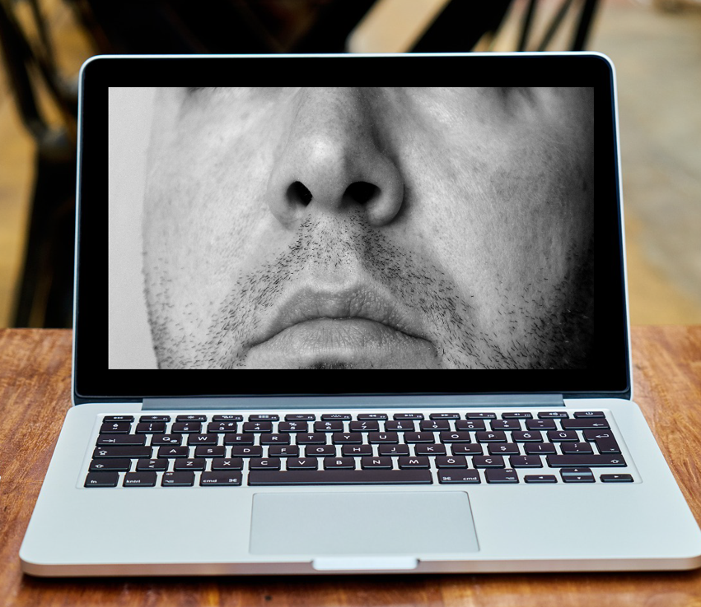
Nosecam Nightmares?
Sit at camera level so people aren’t looking up your nose.

Slide 6
Make Seeing & Hearing You Easy
Lighting
Light source should be behind your device, NOT behind you.
Aim for even light on both sides of your face.
Microphone
Consider a USB mic or earbuds

Slide 7
Find a Sidekick
Share the spotlight by including your parrot, your pup, or a favorite prop.
Prof. Michaela Vargas, English

Slide 8
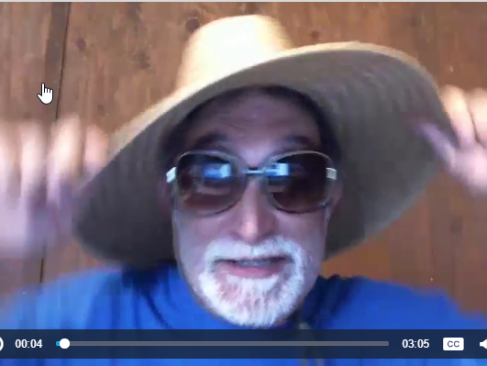
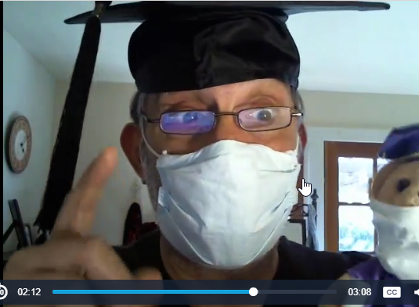
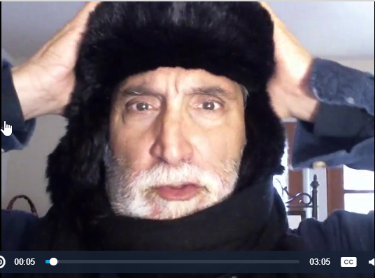
Prop Inspiration
How about hats?
Prof. Frank Paiano, Business

Slide 9
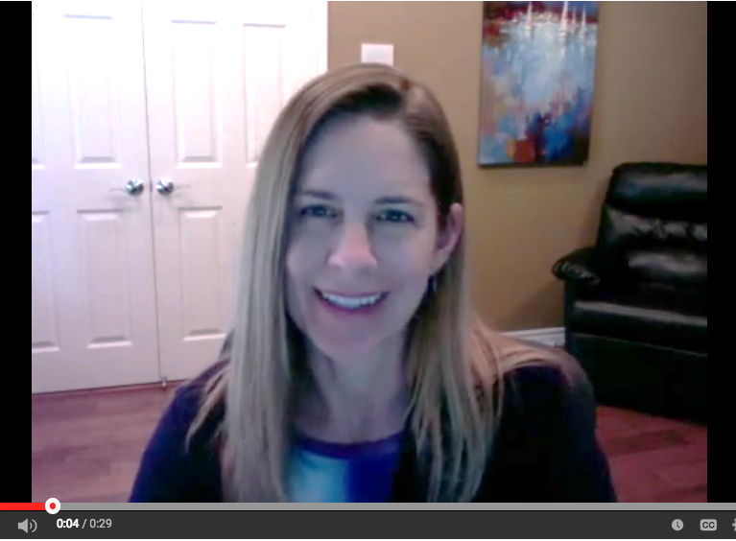
Give Youself a Break with Webcam Bookends
warm hello
warm goodbye
Visual content

Slide 10
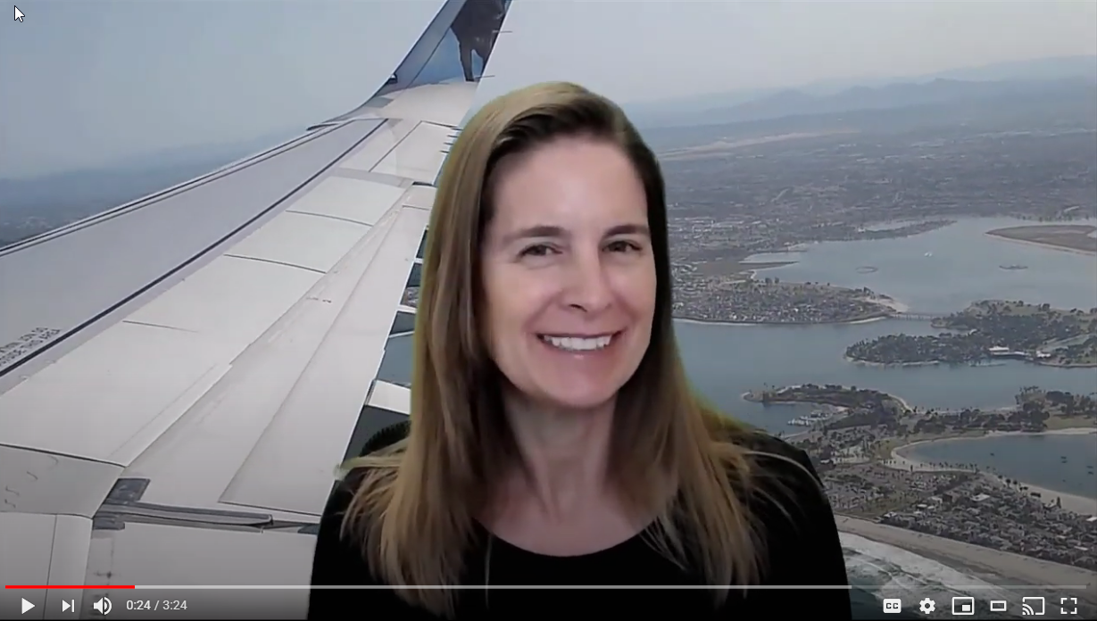
Webcam Bookend Example
Course Tour Video

Slide 11
Zoom Magic
2
simple strategies to try

Slide 12
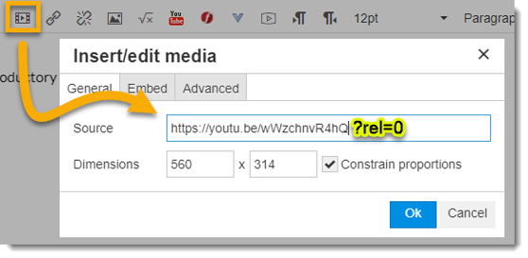
Record a Video in Zoom
1. Record
Use your empty Zoom room as a recording studio.
2. Download
Download cloud recording and edit if you wish.
3. Upload
Upload mp4 to YouTube, 3C Media, Canvas Studio, etc.
5. Embed
Place video into page.
4. Caption
Edit automatic captions or use captioning service.

Slide 13
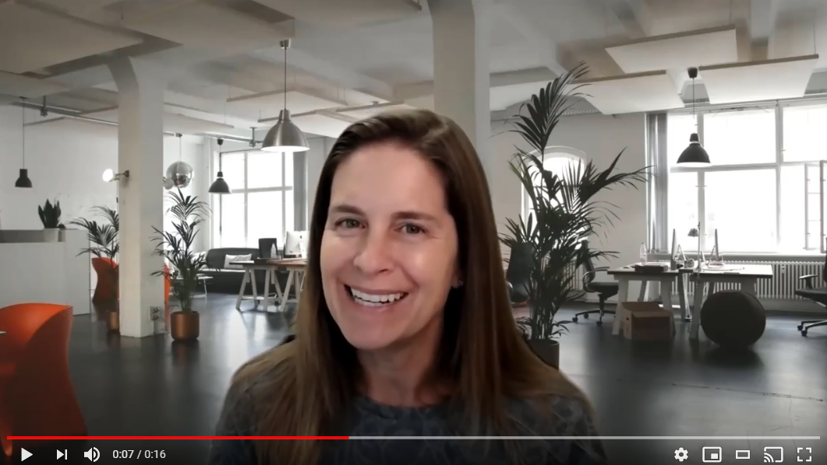
Zoom Recording Example

Slide 14
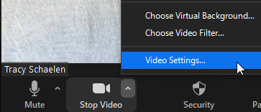
Fun Zoom Features using Desktop Client (downloaded Zoom app)
It all starts in Video Settings:

Slide 15
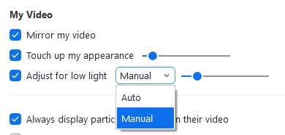
Video Options
Look well rested with “Touch up my appearance.”
Fix lighting problems with “Adjust for low light.”

Slide 16
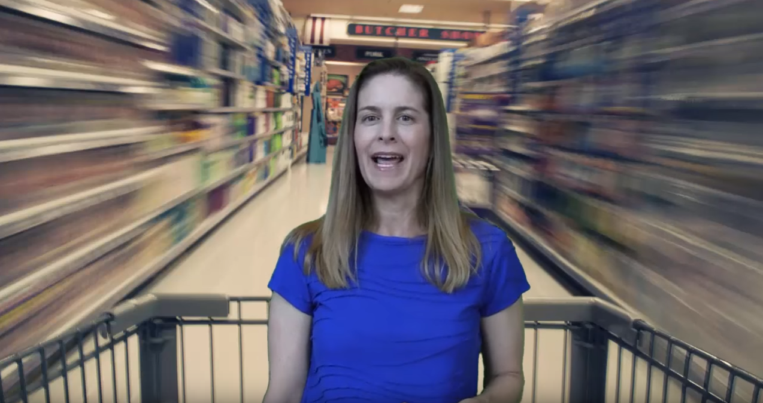
Backgrounds & Filters
Upload images and short videos to use as virtual backgrounds.
Free images: Pexels (videos too!) and Unsplash.

Slide 17
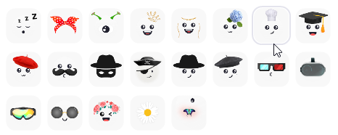
Backgrounds & Filters
Add humor with video filters.

Slide 18
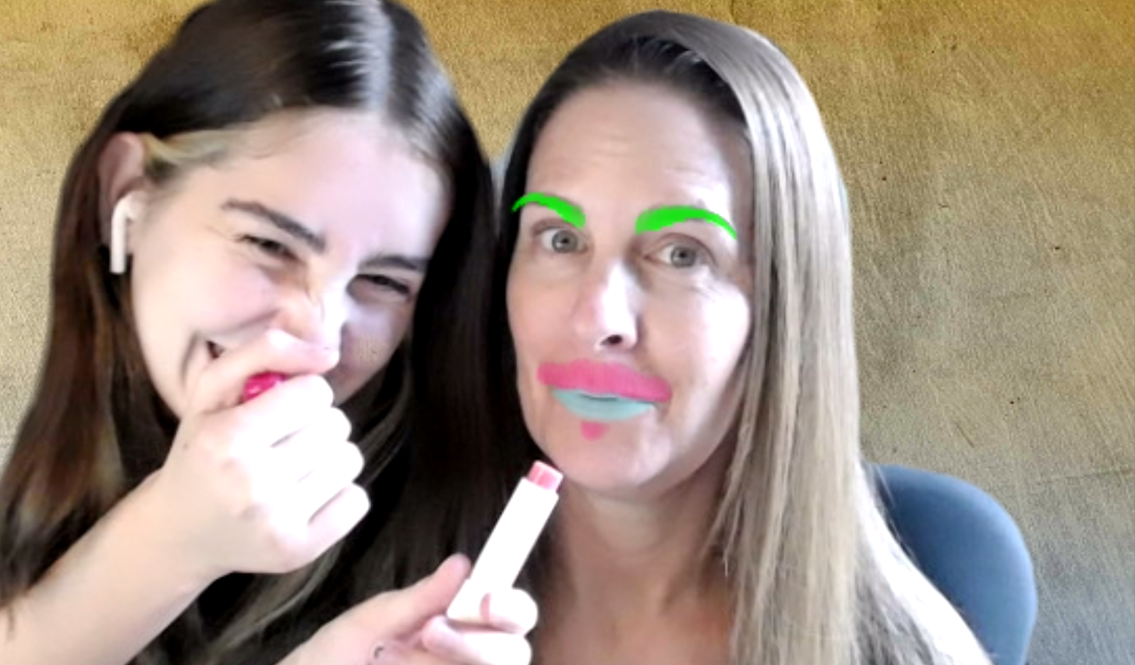
Backgrounds & Filters
Try Studio Effects for a no-commitment makeover.

Slide 19
Newest Zoom Background: Your Slides!

Slide 20
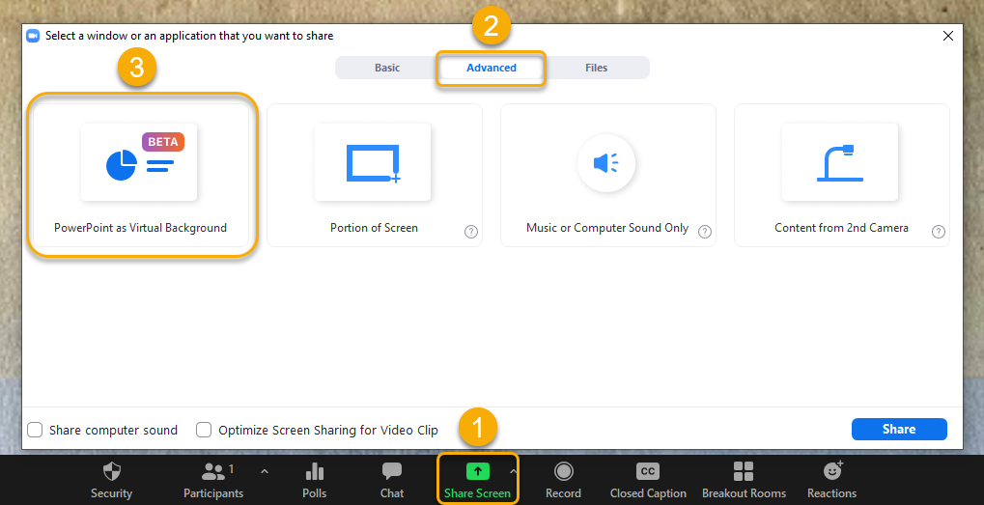
How?
Select Share Screen
Select Advanced tab
Select PowerPoint as Virtual Background, then Share

Slide 21
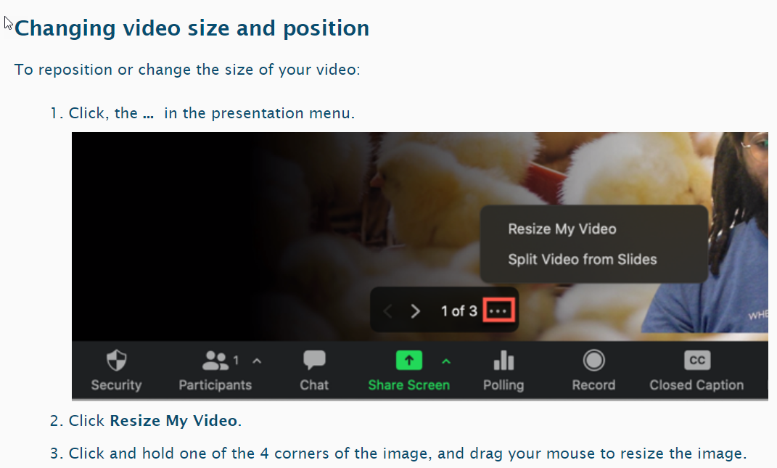
Guide
Check out the Zoom guide: Sharing Slides as a Virtual Background.

Slide 22
Breakouts: Try a Trick!
Virtual background
Video filters
Studio effects
Sidekick
Prop
Touch up
Low light
Slides as background

Slide 23
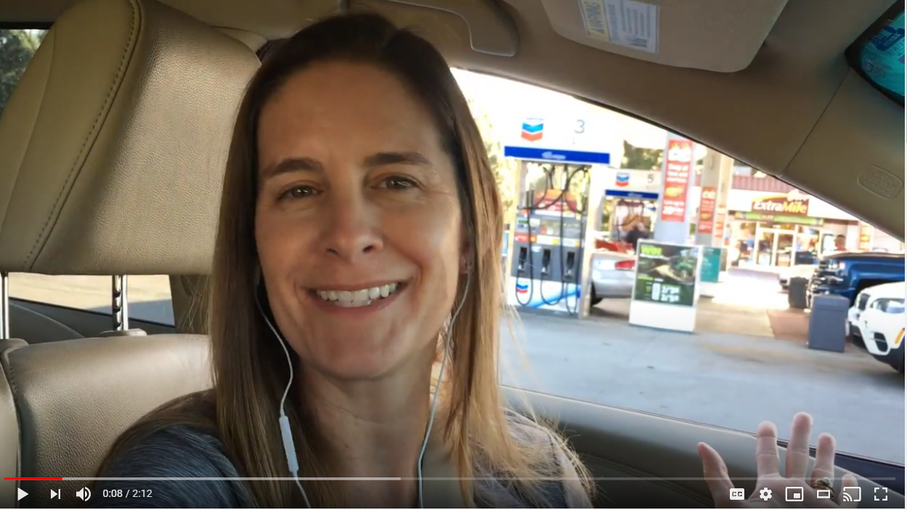
Phone Fun
Record on the go for video announcements, virtual fieldtrips, video postcards, and more.

Slide 24
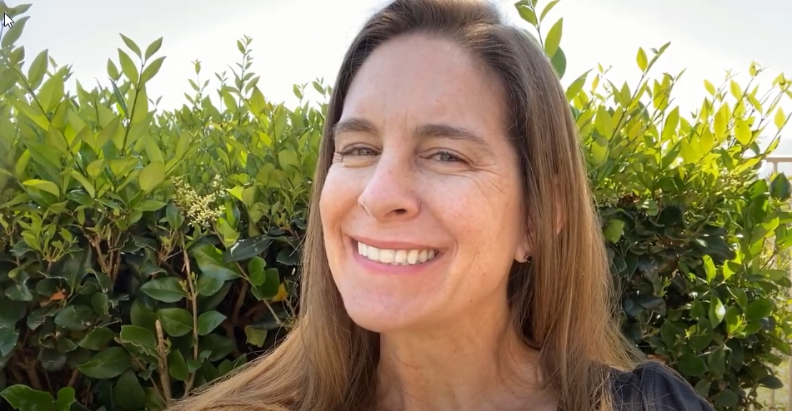
Mobile Recording Tips
Find camera and look there, not at screen
Record in landscape mode
Plug in a microphone for better audio
Trim start and end after recording

Slide 25
Resources
@ONE Pocket PD Guide: Humanizing Online Teaching & Learning
@ONE Pocket PD Guide: Microlectures
Zoom Guide: Video Enhancements
Zoom Guide: Sharing Slides as a Virtual Background
Zoom Guide: Cloud Recording

Slide 26
Questions?

Slide 27
Credits
Presentation template by SlidesCarnival
Images from Pexels

