Slide 1
President’s Address: An Academic Senate Update
2015 ASCCC Curriculum Institute
David Morse, ASCCC President

Slide 2
Budget News
A strong budget for the CCC System
$185 million in additional Prop 98 dollars
$100 million to increase orientation, counseling, etc.
$85 million to address gaps in access and success
$62.3 million for FT faculty hiring
Still no dedicated professional development funding

Slide 3
Transfer: ADTs and Other Paths
Associate Degrees for Transfer
As of June 24, 1,816 degrees approved and active
34 TMCs now available
Five year review process began this year
As of July 1, all new ADT submissions must have approved status for all courses for which C-ID is listed
Model Curricula: Engineering, Nursing, Information Tech
HBCU Transfer Guarantee Announced in March
UC developing major prep pathways

Slide 4
C-ID Branching Out
New Grant and Fiscal Agent: Mt. San Antonio College
Descriptors and model curricula in development for more CTE disciplines
Descriptors being developed for highest levels of basic skills
Possible use of C-ID for veterans’ credit (AB 2462 Block 2012)

Slide 5
The Community College Baccalaureate Degree Pilot
15 pilot colleges have been chosen
ASCCC has formed a task force that is working with the pilot colleges to address various issues that fall under Academic Senate purview:
Upper division definition
Upper division general education
Minimum qualifications
Necessary Support Services

Slide 6
Task Force on Workforce, Job Creation, and a Strong Economy
Extension of 2011 Student Success TF
Focus on topics such as the following:
job creation
alignment of K through higher education career pathways
responsiveness to industry
collaborative use of resources
Panel Discussion Tomorrow
Draft Recommendations available at http://doingwhatmatters.cccco.edu/StrongWorkforce/DraftReport.asp
Notes:
S

Slide 7
Statewide Initiatives
Often being referred to as “technology initiatives,” though they are about more than technology
Online Education
New CMS available for free to colleges for four years
Common Assessment
Educational Planning

Slide 8
Noncredit/Adult Ed
AB 86—regional consortia working around the state in 72 regions corresponding to CCC districts
Purpose is to provide all adults with access to “elementary and secondary basic skills, including classes required for a high school diploma or high school equivalency certificate,” along with short term CTE training, apprenticeship training, classes and courses in citizenship and ESL for immigrants, and instruction for adults with disabilities
Legislature unhappy with progress
Recent reports may give the majority of funding to K-12, but actual result still unclear

Slide 9
Noncredit/Adult Ed
Approved budget will bring CDCP noncredit funding to the credit level in 2015-2016
What are the curricular implications of this change, especially for basic skills instruction?
We were expected to have the courses in place by this fall. Most have not done so.

Slide 10
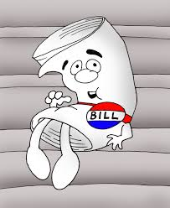
Legislation
AB 288 (Holden): Dual enrollment
ASCCC Support
AB 770 (Irwin): Basic Skills Innovation
ASCCC Support if amended
AB 798 (Bonilla): Open Educational Resources
ASCCC Support
SB 42 (Liu): Commission on Higher Education Performance and Accountability
ASCCC Oppose—joint letter with FACC
All ASCCC letters and legislative updates available at http://asccc.org/legislative-updates

Slide 11
Institutional Effectiveness Partnership Initiative
Chancellor’s Office Division of Institutional Effectiveness
Focus on technical assistance to colleges in need regarding accreditation status, fiscal stability, student performance and outcomes, and legal compliance
Partner district—College of the Canyons
Strong ASCCC Representation

Slide 12
Professional Development
Professional Development
General stress on Professional Development Statewide
A focus of Workforce Task Force, Board of Governors
Professional Development College
An ongoing training program over the course of a year rather than a one-time event.
First module, Faculty Leadership, in its second year
Plan to expand into other modules this year
Still advocating for better funding for professional development

Slide 13
ASCCC Update: Strategic Plan
Assert the faculty voice and leadership in local, state, and national policy conversations.
Engage and empower diverse groups of faculty at all levels of state and local leadership.
Lead faculty professional development for the California Community College System.
Enhance engagement, communication, and partnerships with local senates and system partners, and other constituent groups.
Secure resources to sustain and support the mission and the work of the ASCCC.

Slide 14
ASCCC Update: Changes to the Executive Committee
Area A Representative James Todd is now Interim VP of Student Services James Todd.
Michelle Grimes-Hillman will be Dean of Academic Services at Long Beach City College.
Elections will be held to fill the vacancy at the Fall Plenary Session.
Possible interim appointments under consideration.

Slide 15
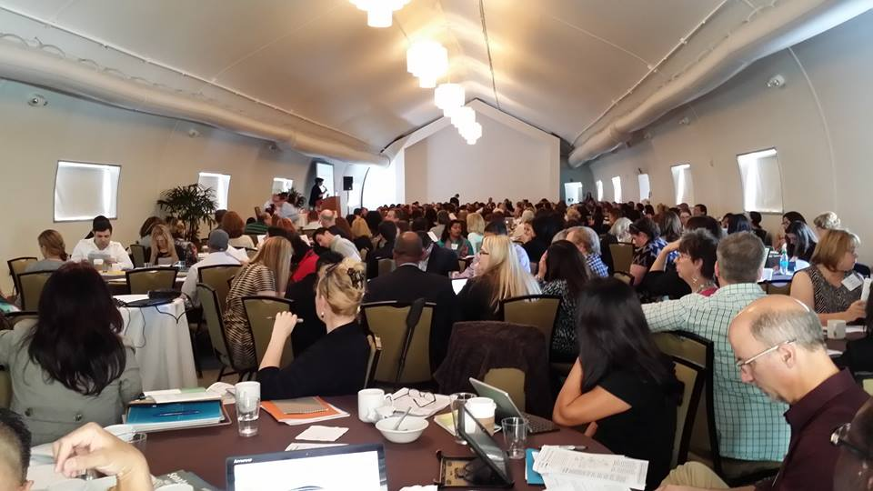
ASCCC Update: 2015-16 Events
Fall Plenary Session: November 5-7, Irvine
Instructional Design and Innovation Institute: January 21-23
Academic Academy (Equity and Diversity): March 11-12
Curriculum Institute: July 7-9

Slide 16
Executive Committee Meetings Coming to You
August 21-22: Los Angeles (Los Angeles City College)
September 11-12: Sacramento (Sacramento City College)
October 2-3: Oceanside/San Diego (MiraCosta CC)
November 4: Irvine (one day, no college; plenary session)
Spring meeting locations will include Cerritos, College of Alameda, and Mt. San Antonio College

Slide 17
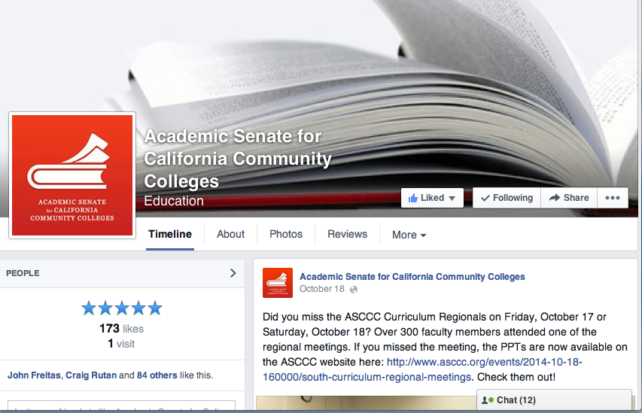
THE ASCCC Facebook Page

Slide 18
We Need Your Help
Get involved---volunteer to serve
We always need volunteers for committees, task forces, etc.
As local leaders, make sure your local faculty is informed about statewide issues so that you can provide us with feedback

Slide 19
Enjoy the Curriculum Institute
Ask us about our breakouts
Support the Foundation--buy a t-shirt
Executive Committee members are here to hear from you
Learn a lot and have fun

