Slide 1
Senate Leadership 101 Amber Gillis, South Representative Robert L. Stewart Jr., Area C Representative

Slide 2
Event Mask Guidelines
The Westin Long Beach continues to follow all city and state guidelines regarding safety and mask requirements. At this time, the hotel is enforcing the mask mandate, and all guests and employees are required to wear a mask when in public spaces throughout the hotel (except when actively eating or drinking in the hotel restaurant or event space). There are signs posted throughout the property to remind people of the mask requirement and masks are available at the Westin Long Beach front counter or the ASCCC Registration Desk.

Slide 3
Presentation Description
Now, more than ever, college faculty look to their local academic senates for answers about state mandates, legislation, COVID-19-related concerns, curriculum, DEI initiatives, accreditation, and much, much more. As a senate leader, navigating these waters successfully can be an arduous task. In this session, you will learn about the basics of academic senate leadership and ASCCC resources available to local academic senates. The session will conclude with a brief question and answer for new senators.

Slide 4
Getting to Know You
What’s your senate role on your campus?
Are you your college’s delegate? Yes, No
What area are you from? A, B, C, D
What biggest challenge are you currently facing on your campus?

Slide 5
Roles and Responsibilities: Statues
Protect and honor the participation of faculty in institutional decision making regarding academic and professional matters as defined by Title 5 Regulations – the 10+1
Identify and address statutory and regulatory issues in Education Code, and Title 5 Regulations as they relate to academic and professional matters and organize a faculty response in a collegial and timely manner
Observe the letter and spirit of all applicable laws, especially the Open Meetings Acts
Ensure the effective participation of faculty in the joint development of institutional policy, e.g., minimum qualifications and equivalencies, faculty hiring procedures, tenure review, faculty service areas, and faculty evaluation procedures.

Slide 6
Roles and Responsibilities: Statues
Adhere to the specific institutional responsibilities outlined in local constitution and by-laws.
Implement college and district governance policies, ensuring the effective participation of other governance groups and the primacy of faculty on academic and professional matters.
As required by Title 5, after consultation with the chief executive officer or designee, appoint faculty representatives to college and district-wide committees.

Slide 7
Roles and Responsibilities: Faculty Advocate
Official spokesperson and advocate for the faculty in academic and professional matters.
Work to resolve academic and professional concerns of individual faculty members.
In matters not involving academic and professional issues, refer faculty to appropriate processes.
Provide initiative in identifying and pursuing important institutional issues.
Meet regularly with the superintendent/president, vice-presidents and others as needed.
Advocate for appropriate faculty professional development funding.
Archive the senate’s historical records.
Sign certain institutional documents and reports sent to relevant authorities.

Slide 8
Roles and Responsibilities: Relationships with Administration and Board of Trustees
Attend and participate in meetings of the Governing Board (board) or college administration.
New faculty and trustees should receive orientation on board, faculty, and administrative responsibilities.
Faculty, administration, and board members must have opportunities to interact, both formally and informally.
The various college constituencies should have an opportunity to provide reasonable input into major college decisions.
Mutual respect and trust should exist among all parties, even when they seriously disagree.
For all parties, support successful compromise as the highest end and be willing to negotiate differences.
Colleges and districts should establish generally accepted and codified rules for settling disagreements among constituencies.

Slide 9
Roles and Responsibilities: Relationships with Administration and Board of Trustees
Attend other functions of the board, such as retreats and study-sessions, if possible.
Communicate recommendations of senate positions relating to academic and professional matters to the Board.
Serve as the primary source of recommendations to the board on academic and professional matters.
Participate in the review and creation of board policies and regulations which impact academic and professional matters.

Slide 10
Roles and Responsibilities: State Level
Attend fall and spring pre-plenary Area Meetings
Attend and participate in the fall and spring Academic Senate Plenary Sessions
Attend ASCCC Institutes
Remain vigilant about legislation affecting the California community colleges

Slide 11
Effective Leadership
Succession planning – develop upcoming leaders
Listen
Speak up, but not over
Acknowledge the good work of others
Encourage others
Create opportunities for a diverse collective of voices

Slide 12
Effective Leadership Reflection
Think of an effective leader who has connected with you…
What about that person stood out?
Now, reflect on the elements of your own effective leadership (yes, you have them!)
Name one element that you think helps you to be most effective?
Are you able to hold on to the element in all situations?
Name one element that you think you could develop to improve your leadership effectiveness?
What is your leadership philosophy? Is it time to create one?

Slide 13
ASCCC Mission
The Academic Senate for California Community Colleges (ASCCC):
Fosters the effective participation by community college faculty in all statewide and local academic and professional matters;
Develops, promotes, and acts upon policies responding to statewide concerns;
Serves as the official voice of the faculty of California Community Colleges in academic and professional matters.
The ASCCC strengthens and supports the local senates of all California community colleges.
Notes:
We’re here to support you. Resources on a later slide.

Slide 14
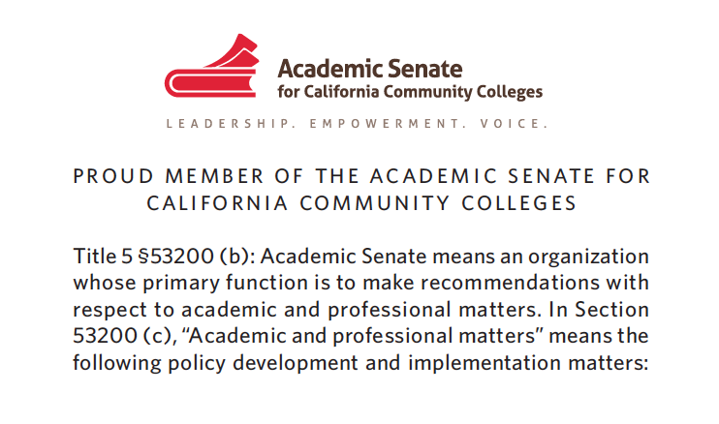
10+1 and New Member Card
https://asccc.org/10_1

Slide 15
Notes:
ASCCC Website

Slide 16
Local Senates Handbook
https://asccc.org/sites/default/files/ASCCC_Local-Senates-Handbook_2020_Apub.pdf

Slide 17
Connect to the ASCCC
ASCCC: Subscribe to Newsletter: https://asccc.org/signup-newsletters
ASCCC Request for Services: https://asccc.org/contact/request-services
ASCCC Resolutions: https://asccc.org/resources/resolutions
ASCCC Legislative Positions: https://asccc.org/legislative-positions
ASCCC Application for Service: https://asccc.org/content/new-faculty-application-statewide-service

Slide 18
Resolutions Information
Resolutions Handbook:
https://www.asccc.org/sites/default/files/ResolutionHandbookFinalFA17_1.pdf
Resolutions Operational Committee Webpage:
https://www.asccc.org/directory/resolutions-operational-committee
Search and Review Resolutions Here

Slide 19
Helpful Papers and Publications
https://asccc.org/publications/academic-senate-papers
Recent examples:
Equivalence to the Minimum Qualifications
Effective and Equitable Transfer Practices in the California Community Colleges
Optimizing Student Success- An Academic Senate White Paper
Anti-Racism Education in the California Community Colleges
Protecting the Future of Academic Freedom During a Time of Significant Change

Slide 20
Local Senate Visits
As part of its commitment to supporting local senates, the Academic Senate for California Community Colleges provides the opportunity for local senates to have visits from members of the Executive Committee and the Relations with Local Senates Committee. The purpose of such a visit is for the committee member to serve as a liaison between the Senate and your local senate. Our role is to listen to your discussions, share Senate resources to support you, and to gather questions and concerns to forward to the Academic Senate President for consideration and response. The visit can be with the local senate president, the local executive committee, the entire senate: whatever you would like. We are here to serve you!
Request a visit here
There is no cost for local Senate Visits. These are different from the formal Collegiality in Action visits done in collaboration with the CCLC (there is a fee for these visits).

Slide 21
Need ASCCC Help?
Need to ask a questions related to the 10+1? Submit it through info@asccc.org.
As soon as possible, but usually within a few days, you will receive a detailed response from an ASCCC Executive Member.

Slide 22
Additional Support Resources
Model Hiring Principles and Practices: https://ccconlineed.instructure.com/courses/5733
Professional Development College:
https://asccc-oeri.org/professional-development-college-pdc/
Guided Pathways: https://asccc.org/guided-pathways
ASCCC Open Educational Resources Initiative: https://asccc-oeri.org/
C-ID: https:c-id.net

Slide 23
External Support Resources
California Community Colleges Chancellor’s Office (CCCCO or CO):
http://www.cccco.edu
California Legislative Information: http://leginfo.legislature.ca.gov
Find your legislators: http://www.legislature.ca.gov/legislators_and_districts/legislators/your_legislator.html
Community College League of California (CCLC): https://www.ccleague.org
Accrediting Commission of Community and Junior Colleges (ACCJC): https://accjc.org

Slide 24
Questions?
Contact us: info@asccc.org

Slide 25
Thank you!
Have a great plenary session!

