Slide 1
Who’s job is it to unlock social mobility? -Working with academic, community, and workforce partners

Slide 2
Pathways To Career Success
https://vimeo.com/195228559
Intro from the CCC and Workforce system.

Slide 3
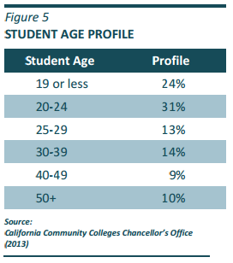
Student Success & Readiness
STRATEGIES
B1 Basic Skills as the Foundation for Student Success
B2 Assessment and Placement
B3 Articulation with K-12
B4 Intersegmental Transfer
B5 Teaching and Learning Effectiveness
B6 Degrees and Certificates
B7 Innovative Practices in Workforce Education
B8 Provide Students with Increased Direction and Expectations
Meeting Personal Educational Objectives is the key
Notes:
The Student Success Act Speaks Through the CCC System Strategic Plan (Updated 2013). It was determined that our system would definitively take steps to overcome the challenges plaguing our colleges by focusing on these strategies. Look familiar, we can probably place an acronym next to each of these system strategies (BSILC, CAI, AB288, C-ID/CSU or IGETC Cert. of Achievement, etc.)

Slide 4
Notes:
LW

Slide 5
Career Stratagem: Calling All Pathway Guides
Notes:
So we’re calling all pathway guides…because we need what I’m calling a career stratagem! We’ve been losing to many battles on a term to term basis. We need increased understanding of who our regional partners are and multiple perspectives of how we might outwit the enemies that are plaguing our students.

Slide 6
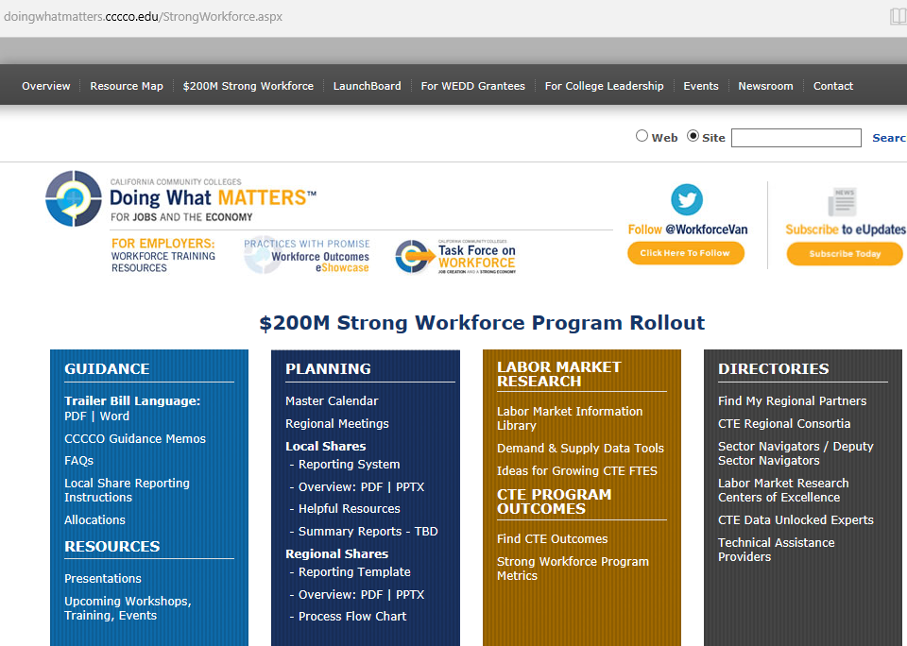
Notes:
The Strong Workforce Program is designed to be a collection of tools that prescribe an informed decision maker construct for overcoming local and regional barriers. However, it is by no means the central character in this story. We’ll get there in a second.

Slide 7
Strong Workforce Taskforce Recommendations
Student Success
Workforce Data & Outcomes
Curriculum
Career Pathways
CTE Faculty
Regional Coordination
Funding

Slide 8
Use of $200M Strong Workforce Program
More and Better…
Increase quantity of CTE
Improve quality of CTE
Courses, programs, pathways, credentials (licensure), certificates, degrees
Requirement: labor market demand!
Notes:
For you CTE folks in the audience, does it strike you as odd that the requirement for accessing these funds are programs and strategies that consider labor market demand. Of course not, this is how you have always validated your courses and programs. But I’d like to take you back about 7 years ago to highlight an interesting dynamic.

Slide 9
Convergence Precepts
Student Success Task Force Recommendations
4.1 Highest priority for course offerings shall be given to credit and noncredit courses that advance students’ academic progress in the areas of basic skills, ESL, CTE, degree and certificate attainment, and transfer, in the context of labor market and economic development needs of the community.
3.4 Community colleges will require students to begin addressing basic skills needs in their first year and will provide resources and options for them to attain the competencies needed to succeed in college-level work as part of their education plan.
1. Organizing Principle
2. College and Career Readiness Approach
*Emphasis added by L. Wiggins in 4.1 and 3.4
1
2
Notes:
(LW)1. “in the context of labor market and economic development needs of the community. 2. College and Career Readiness Approach is Skill Attainment through a framework of competency or credential acquisition.

Slide 10
Student Success Act of 2012
Gov. Jerry Brown signed into law the Student Success Act of 2012, the legislative cornerstone of a California Community Colleges reform initiative aimed at improving educational outcomes for students and better preparing the workforce needed for California’s changing economy.
Goal: Help more California community college students reach their goal of earning a degree, certificate, career advancement or transferring to a four-year institution.
Notes:
(LP)The Seymour-Campbell Student Success Act of 2012 grew out of the Student Success Task Force Recommendations (REFORM INITIATIVE).

Slide 11
Transfer Reality
From the 2016 State of the System Report, p. 13
Notes:
(LP/LW)In 2014-15 we transferred 102,987 students to UC, CSU, ISP, and OOS. Yet, we have over 2.3 million in our system….IN THE CONTEXT OF LABOR MARKET AND ECONOMIC DEVELOPMENT NEEDS OF OUR COMMUNITIES!

Slide 12
Strong Workforce Taskforce Recommendations
1a. Provide resources for student support and career center services to raise the awareness of career planning and provide information to high school, adult education and community college students on labor market demand and earnings potential.
1b. Develop and implement common, effective career and educational planning tool for high school, adult education and community college counselors to provide detailed and comprehensive information, resources, and support on career awareness, preparation, and exploration; CTE pathway and education planning; workplace-readiness skills; work-based learning opportunities; and local and regional employer needs and job requirements.
Notes:
(LP)So the first SWP Recommendation sought to address Student Success for CTE learners. Specifically, “Broaden and enhance career exploration and planning, work-based learning opportunities, and other supports for students.”

Slide 13
Strong Workforce Taskforce Recommendations
1d. Collaborate with workforce boards to enhance capacity to provide career counseling, job placement, and supportive services.
1e. Enhance capacity of counselors to provide CTE-related program counseling through professional development and the sharing of best practices such as designating counselors as CTE specific or designating liaisons to CTE programs.
Notes:
(LP)

Slide 14
Counselor Capacity Building Events
Regional Doing What Matters for Student Success and/or Pathways to Paychecks Counselor Conferences
Counselor Professional Development Resources
Lunch and Learn Webinars on Key Strong Workforce Topics
Calendar of Regional Events (Continually Updated)
Institutional Effectiveness Partnership Initiative sponsored (Seven PD trainings focused on system-wide EPI initiatives to be offered in Macro Regions)
Critical Conversations: Partnerships that Unlock Social Mobility (17 statewide conversations to align & increase understanding;
Notes:
LP

Slide 15
Pathways To Career Success
https://vimeo.com/199061142
Stories of Workforce and CCC students transitioning
Notes:
(LaTanya) To develop a bit more of an in-depth perspective of how students are benefitting from the workforce system and the community college, take a look at this video.

Slide 16
Answer at least three of the following questions:
To me, success means
In my education and work, I am driven by
I face or have faced barriers or challenges like
One experience or person that changed my path
A question I wish an expert would help me with is
Notes:
LaTanya, if you’re interested I’d like for you to lead an icebreaker with the audience. These questions/statements are part of an online mural project that builds on the stories of community college students. We can have each table turn to a colleague and answer three of these questions with someone else.

Slide 17
Plan Alignment and Integration
Workforce Regional/Local Plans
Working regionally with economic development and education, regional business engagement and sector partnerships, regional workforce policies
Strong Workforce Regional/Local Plans
Priority and emergent sectors, how do we move students through career pathways, job placement/internships/industry engagement be coordinated, how can industry inform and co-invest
ABEG Block Grant plans
Basic Skills, Citizenship and Workforce Prep, Apprenticeship, Short-term Career Tech Ed, Programs for Adults with Disabilities; career pathways to work or for-credit programs
Content provided by California Workforce Association
Notes:
LW

Slide 18
Re-inventing the AJCC System
Connecting Centers to Strategic Directions
Moving towards an "integrated model"
Utilizing technology
Continuous Improvement – AJCC Certification
MOU – Cost Sharing
Notes:
(LW)The CCC does not have job placement at the core of its mission. However, its vital that we identify how to execute this service systemically, as we face competition from all fronts with their own version of training options. How do we use the AJCC’s for the benefit of our shared outcomes and metrics?

Slide 19
CCC Educational Goal Options
1. Prepare for a new career (Skill Attainment)
2. Advance in current job/career (Skill Attainment)
3. Discover/develop career interests (Core Task)
4. Obtain two-year vocational degree without transfer ** (Skill Attainment and Core Task)
5. Obtain non-vocational degree without transfer ** (Skill Attainment & Core Task) 6. Obtain a vocational certificate without transfer **Major __________ (Skill Attainment & Core Task)
Notes:
(LP)

Slide 20
CCC Educational Goal Options (Cont.)
8. Obtain a Bachelor’s degree after Associate degree ** (Skill Attainment & Core Task) 9. Obtain a Bachelor’s degree without Associate degree ** (Skill Attainment & Core Task) 10. Maintain license * (Skill Attainment/Enhancement)
11. Improve basic skills (English, Reading, Math) (Skill Attainment & Core Task) 12. Complete credits for HS diploma or GED (Skill Attainment)
13. Personal Development * (Skill Attainment & Core Task)
14. Undecided on goal (Skill Attainment & Core Task)
Notes:
(LP)

Slide 21
CCC Educational Goal Options (Cont.)
15. To move from non-credit coursework to credit coursework (Skill Attainment, Core Task, Pathways) 16. 4-year college student taking courses to meet 4 year requirements*
*Educational Goals that do not require Matriculation: 10, 13, and 16 (Exception: All high school seniors should be required to matriculate.)
**Eligible Educational Goals for Financial Aid: 4, 5, 6, 8, 9 require you to complete Matriculation.
Notes:
(LW)

Slide 22
Students want to know
What are my career options?
What are the education paths to those careers?
What will I need to take?
How long will it take and how much will it cost?
How much financial aid can I get?
Will my credits transfer?
Community College Research Center
Notes:
(LP)

Slide 23
Convergence Precepts
Student Success Task Force Rec.
Our Primary Challenge is Prescription
*Emphasis added by L. Wiggins in 2.4 and 3.1
2.4 Require students whose diagnostic assessments show a lack of readiness for college to participate in a support resource, such as a student success course, learning community, or other sustained intervention, provided by the college for new students.
3.1 The Community Colleges will adopt system-wide enrollment priorities that: (1) reflect the core mission of transfer, career technical education and basic skills development; (2) encourage students to identify their educational objective and follow a prescribed path most likely to lead to success; (3) ensure access and the opportunity for success for new students; and (4) incentivize students to make progress toward their educational goal.
3A
3B
Notes:
(LW)3A. Most of the diagnostic assessments that potential students take prior to entry are seeking to identify English, math, and reading skill levels, but don’t typically address college success behaviors. Nor do they account for a students potential for employability, which business and industry is clamoring after with the soft-skills conversation.
3B. Our fundamental challenge is that we are asking adolescents to engage in a process that requires them to ‘model being mature adults’
***Therefore, our system is providing tools and community colleges must select the most appropriate strategies to help learners engage in decision-making that will help them achieve their life and educational goals.

Slide 24
Seeking To Maintain Successes
Challenges Within the CCC System
1
2
Inconsistencies between HS & college curriculum
3
Unaware of educational objectives upon applying
High English and math remediation levels
4
Counselor ratios of 800:1 & more than 1800:1
Notes:
LW

Slide 25
Intrusive Advising To Build Tomorrow’s Workforce
To help learners deal with the following questions:
Who am I? (character/ethical decisions)
What opportunities exceed my skills?
What am I going to do about it?
Develop a plan of attack
Heighten your level of core task competence
In the community college, student services seeks to positively affect student development through the student success and support program
Notes:
LP

Slide 26
Career Pathways Is A Relational System
Data Informed Decisions
Experiential Learning
K-12/Adult Ed to Career
Stackable Credentials
Industry Engagement
Labor Market Information
Work Based Learning
Alignment
Student Success + Completion
Project Based Learning
Notes:
(LW) Four key components of Career Pathway
Data gathered within each component
Valuable data from the connection or overlap between the elements
K-12 to Career Structured Programs of Study Leading to Industry Recognized Credentials and Gainful Employment
Experiential Learning through Contextualized Teaching and Learning (CTL) and Work Based Learning Experience (WBL)
Industry and Public Engagement through Advisory Committees, Credentialing and Partnerships
Data Informed Decisions through real time student success, labor market, program performance and cost information

Slide 27
Learning from the Past
Not just learn, build
Navigating the Present
Website, catalog
Who’s in the STEAM pathway?
Who’s in the ECE/Child Development pathway?
Who’s in the CTE Teacher path?
Envisioning Tomorrow
Visible, clear, and connected
What is the destination?
Notes:
LW

Slide 28
Pillar 1: Clarifying the Path
The 4 Pillars
Clarify paths to student end goals
Help students choose and enter a pathway
Help students stay on path
Ensure that students are learning

Slide 29
Strong Workforce
Begin your career search with the end in mind
What’s the job or career area?
What’s the projected salary?
http://livingwage.mit.edu/
How long will it take me to get there?
-What training, credentials, and jobs I attempt along the way?
Notes:
LW

Slide 30
Strong Workforce
Produce highly-skilled and knowledgeable workforce
Through data informed regional coordination
Increase the quantity and ensure workers are qualified
Assist business and industry with preparing workers with hard and soft skills
Meet local workforce demand
Notes:
LW/LP

Slide 31
Notes:
LW

Slide 32
Pillar 2: Help Students Choose and Enter a Pathway
The 4 Pillars
Clarify paths to student end goals
Help students choose and enter a pathway
Help students stay on path
Ensure that students are learning
Notes:
LP

Slide 33
Strong Workforce
Broaden & Enhance Career Exploration
Early on-boarding to a career
Curricular Alignment / Dual Enrollment
Business and Industry offer consultation on skills/training needed for careers
Notes:
LP

Slide 34
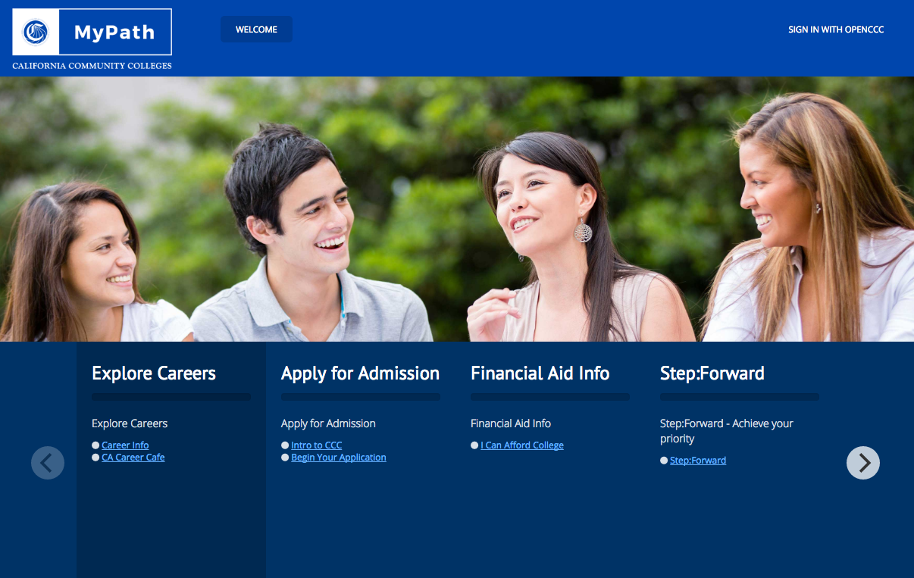
www.cccmypath.org
Notes:
LW

Slide 35
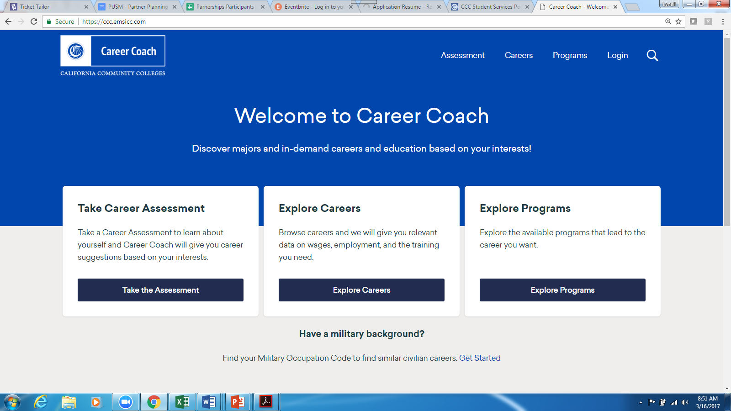
https://ccc.emsicc.com
Notes:
LW

Slide 36
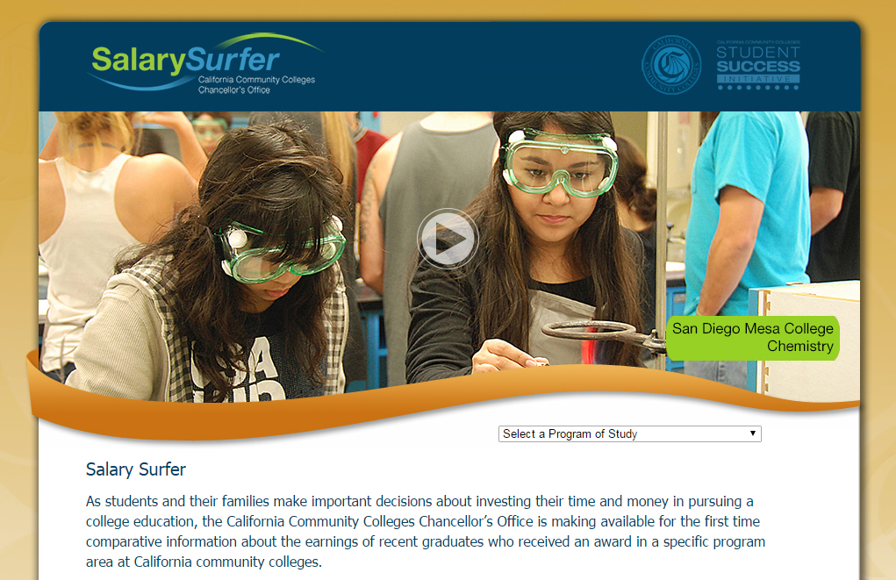
Notes:
LW

Slide 37
Here to Career Mobile App
Developed to help students make informed education and career decisions that lead to greater economic opportunities and professional success
Provides students, counselors, and parents information about community colleges and high-demand career opportunities
W.K. Kellogg Foundation funded the development of the app and an outreach pilot in the Inland Empire region
Notes:
- Powered by regional Salary Surfer data
- The goal of the app, funded with a $375,00 grant by the W.K. Kellogg Foundation, is to provide low-income Latino families, specifically in the Inland Empire, with access to information about California Community College education opportunities and awareness of careers that can increase earning potential and provide improved economic prosperity for the entire family.

Slide 38
Pillar 3: Keeping Students on the Path
The 4 Pillars
Clarify paths to student end goals
Help students choose and enter a pathway
Help students stay on path
Ensure that students are learning

Slide 39
Pillar 3: Keeping Students on the Path
By Counseling and Program Planning with the End in Mind
Identify the skills, abilities, knowledge needed for career success
Backwards map from the students career interest area to build motivation and strengthen connections to educational objective
Help students select courses that secure career pathway credentials, licensure, and third-party certifications
Encourage the development of 21st century employability skills that can be practiced in live work based learning scenarios

Slide 40
www.newworldofwork.org
Notes:
LW

Slide 41
Strong Workforce
Encourage the Development of Employability Skills In and Out of the Classroom
On-going Employment
Work Based Learning
Apprenticeship
Internships
Contextualize learning
Develop applied English and math courses that meet both CTE and Associate degree requirements
Embed career related content into GE courses
Notes:
LW

Slide 42
Pillar 4: Ensuring That Students Are Learning
The 4 Pillars
Clarify paths to student end goals
Help students choose and enter a pathway
Help students stay on path
Ensuring that students are learning
Notes:
LW

Slide 43
How do we maximize impact?
SCOPE
MEASURABLE IMPACT
SCALE
Notes:
LW

Slide 44
Datascape - original
Career Pathway Datascape | Student | Instruction | Support Services | Institution
K-12 to Career Structured Programs of Study | Multiple Entrance + Exit Points Stackable Credentials Competency Based Education / Credit for Prior Learning | Project Based Learning Integrated Academics Contextualized Skills Learning Outcomes | Pre-Assessment Just in Time Remediation Directed Learning Activities Tutoring Career Navigation | Dual Enrollment Professional Development Regional Collaboration Educational Master Plan
Experiential Learning | Work Experience Education Project Based Learning Soft Skills Training | Credit bearing Internships Interdisciplinary Programs | Internship Program Coordination Workforce Events Coordination | Curriculum and Instruction Approval
Industry + Public Engagement | Career Onboarding Networking Mentorships | Industry Approved Programs Industry Credentialing Industry Advisories | Industry Certifications Professional Externships Small Business Development | Labor Market Information Sector Navigators
Data Informed Decisions | Student Career Plan Financial Aid Status Career Readiness | Success, Retention, Persistence, Completion Learning Assessment Program Review | Student Completion Slot costs Employment Income | Enrollment Management Resource Allocation Long Term Planning
Developed by Pasadena City College EWD - Career Pathway Datascape
Notes:
LW

