Slide 1
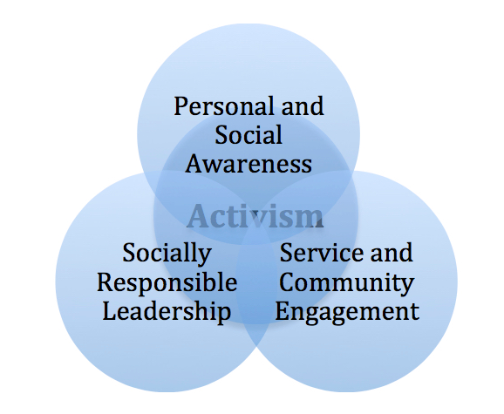

Slide 2
Students lack of trust in large social institutions, declining interest in politics, and decreasing civic skills. But they have a sense of justice. So…
“ Education has more value in addition to training students for a profession. A student should leave the university with the understanding that they can use the knowledge and skills of their degree for a career and for the public good. Those things are not mutually exclusive.” - Michael Willard, Office of Service Learning, CSLA
“Education finally isn’t about doing homework -- it’s about actively desiring to use your personal knowledge to accomplish something in the world,” Richard Brodhead, President Duke University

Slide 3
Prepping for
Civic Engagement
Create spaces of dialogue for students to explore their individual identities and the impact of power and privilege in relation to service and social justice.
Develop mutual, beneficial partnerships that will enhance commitment to service and enrich the communities that (fill in your campus) supports.
Provide opportunities for students to develop as socially responsible leaders and expand their worldview.

Slide 4
Institution vs Intrinsic
Institution | Intrinsic
Service Learning | Knowledge Discernment
Event Planning/Participation | Experiential Value
Project Based Learning | Purpose in Information
Action Research | Students as Practitioners

Slide 5
Information Literacy
Information literacy is the set of integrated abilities encompassing:
the reflective discovery of information,
the understanding of how information is produced and valued,
the use of information in creating new knowledge

Slide 6
Information Literacy Framework
The Framework opens the way for librarians, faculty, and other institutional partners to redesign instruction sessions, assignments, courses, and even curricula; to connect information literacy with student success initiatives;
to collaborate on pedagogical research and involve students themselves in that research; and
to create wider conversations about student learning, the scholarship of teaching and learning, and the assessment of learning on local campuses and beyond.

