Slide 1
Spring 2022 Curriculum Regionals

Slide 2
Todays Agenda
I. Welcome, Introductions and Greetings
II. Chancellor's Office Update with Dr. Aisha Lowe
III. Updates
a. Ethnic Studies
b. AB 1111 and 928
IV. Legislation Related to Curriculum
V. Curriculum Institute Planning
BREAK
VI. AB 705
a. AB 705 Implementation
b. Intermediate Algebra and Articulation
VII. DEIA in Curriculum
a. Cross Listing
b. Culturally Responsive Curriculum and the COR
c. IDEA Curriculum Tool Preview
Yes it is a full agenda!

Slide 3
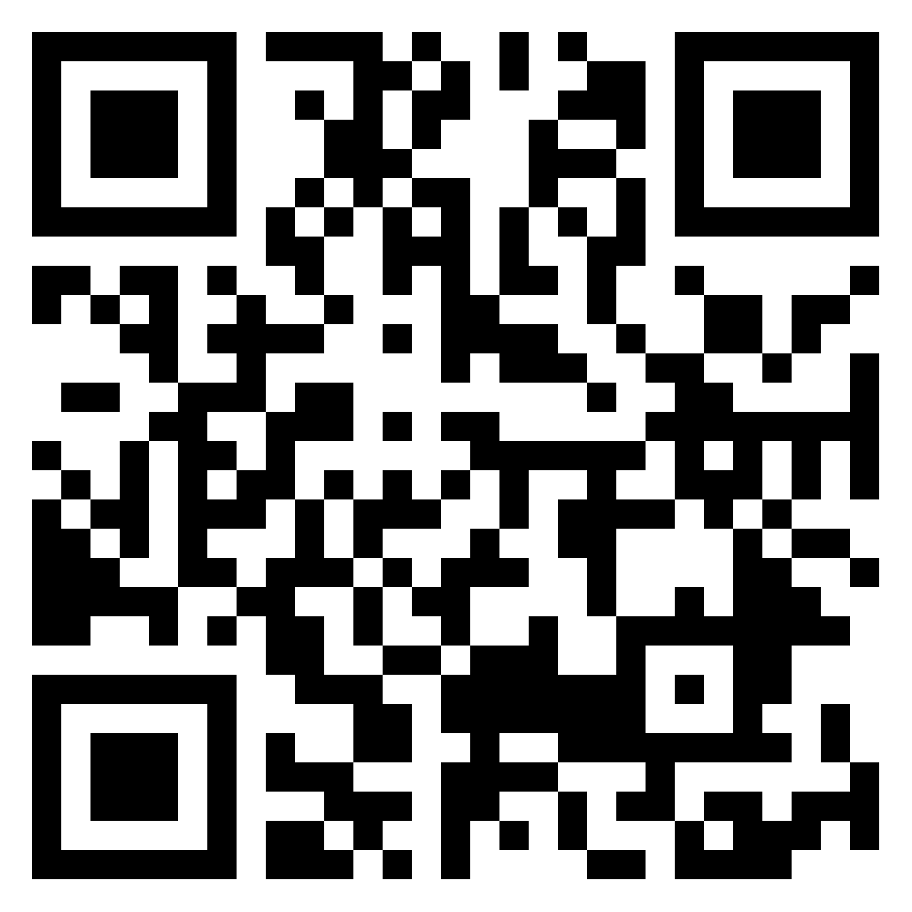
Sign In Links (Name, College, Role)
MONDAY 2/28
https://padlet.com/stephaniecurry/x8is8x9m73vajbyn
WEDNESDAY 3/2
https://padlet.com/stephaniecurry/mdbwroh22r4m5636

Slide 4
Chancellor's Office Update

Slide 5
5C Updates–Potential Title 5 Changes
Drafts in progress:
Work Experience
Allow for non-credit work experience
Associate Degree (55060-55064)
Changes to wording on competencies to align with AB 705
Reorganizes sections to separate regs for designing degrees and awarding degrees
Standards and Criteria for Courses (55002)
Add inclusiveness/diversity/equity/antiracism (IDEA) as a standard for course approval
Require IDEA to be integrated into existing areas of COR, locally determined

Slide 6
Ethnic Studies Update
Ethnic Studies Task Force met in November and February. First step will be recommendation on implementation date. Expected to be around Summer/Fall 2024
Delegates are set to vote Spring Plenary (April 2022) on 2 new Minimum Qualifications
1) Native American Studies
2) Asian American Studies
New Qualifications mirror those for African American Studies and Chicano/Latino Studies
UC proposed Area 7- Going through internal processes

Slide 7
Ethnic Studies TMC DRAFTS
DRAFT TMC’s for
Ethnic Studies
Ethnic Studies: African American Studies
Ethnic Studies: American Indian Studies
Ethnic Studies: Asian American Studies
Ethnic Studies: Chicana and Chicano Studies
The FDRG is currently reviewing feedback from the field for all proposed Ethnic Studies TMCs. Be on the lookout for future announcements through the ASCCC listservs.

Slide 8
ICAS/General Education and AB 928
ICAS Special Committee on AB 928
Faculty–3 from each system; chair is ICAS chair
Students–1 from each system
Administration–advisors from each system
Charge to make consensus-based recommendation to ICAS for potential singular general education pathway
Special committee to complete work on or before May 6, 2022
Each system will vet through own process before May 2023

Slide 9
AB 1111
SOVA is working on landscape analysis for AB 1111.
Chancellor's office is contracting with UC Berkeley to use AI technology to look at curriculum alignment and patterns of articulation

Slide 10
Upcoming Legislation Related to Curriculum
AB 1187- Community College Tutoring and Apportionment
AB 1505- Community College FON-Recalibration.
AB 1705- AB 705 2.0 –More on future slides
SR 45- Resolution on Academic Freedom
For more information on Legislation related to CCC’s
Read the Leg Reports in Monthly Exec Agendas
Faculty Association of California Community Colleges (FACCC) website

Slide 11
Curriculum Institute 2022
WHEN: July 6-9, 2022
WHERE: RIVERSIDE, CA and Potentially Hybrid Options
HIGHLIGHTS
6 General Sessions
4 Pre-Session Trainings for Curriculum Chairs, Specialists, Administrators and Articulation Officers
60 Breakouts
We need your help to plan for potential Hybrid Options. Logistically there is no way to make all 10 breakouts available virtually.

Slide 12
Curriculum Institute Planning Poll
Are you planning to attend the Curriculum Institute July 6-9, 2022 (Riverside, CA)
In-Person
Online
Not Attending
If you were attending online would you prefer
A curated streamlined collection of breakouts (up to 4 breakouts)
Access to recordings of breakouts but not live and without interaction (more breakouts but not live and time delayed)
If we are only able to offer a curated/streamlined collection of breakouts for online attendees what topics are “must see”? https://padlet.com/stephaniecurry/95cjxlrmq2emqqsv

Slide 13
Break Time
10 Minutes

Slide 14
AB 705

Slide 15
705 Implementation
Reports Due in March 2022- Make sure your Senates and/or curriculum committees have been part of the process.
How can we be innovative to support students
Locally aligning with Adult Education Opportunities
Pipeline for students
Impact of AB 705
Data Collection of students in pipeline.
Noncredit opportunities
Bring in your DSPS experts to locally discuss 705 implementation and impact on students. What intervention strategies can there be to support students.
What are you doing that is innovative?

Slide 16
AB 1705
The bill would require that high school transcript data be used as the primary means for determining placement in transfer-level English and transfer-level mathematics courses and would limit the use of multiple measures by colleges in the placement and enrollment of students so they do not restrict a student’s ability to demonstrate preparedness for transfer-level coursework if a single measure would satisfy the requirement.
The bill would require that a community college district or community college not recommend or require students to enroll in pretransfer level English or mathematics coursework, except under specified circumstances.
This bill would require a community college district or community college, by July 1, 2023, to place and enroll all new and continuing United States high school graduate students and those who have completed a GED into transfer-level English and mathematics, with specified exceptions for mathematics placement.
The bill would prohibit a community college district or community college from using specified factors as justification for placing a student in a pretransfer level course.
The bill would require the Chancellor’s Office of the California Community Colleges to create a Transfer Level Gateway Completion Dashboard by July 2023.

Slide 17
Intermediate Algebra
Enrollment, Placement, and Listing Courses
Concerns over courses for Intermediate Algebra
AB705 governs placement, AB1805 advising
Chancellor’s Office memo and proposed AB1705 shift focus from placement to enrollment
Colleges will need to show enrollment in courses prior to transfer leads to success in transfer-level, except in limited circumstances
Do we still keep courses if they are not being offered?
What are possible impacts to articulation?
Local interdepartmental discussions about changes/deletions of courses that might be prerequisites in other departments

Slide 18
Pre-Reqs and Co-Reqs and Articulation
Example language from LACCD
Math 125, the equivalent or higher; or by meeting CA Title 5 CCR 55063 math competency requirement of intermediate algebra, per LACCD e-reg 79; or by placing into any college level math course.

Slide 19
Proposed Resolution for Spring 2022
Co-Reqs and Pre-Reqs of Intermediate Algebra and Articulation and C-ID alignment
Whereas, AB 705 was passed in 2017 and discouraged the placement of students into college level intermediate algebra and encouraged the placing students directly into transfer level math based on multiple measures data;
Whereas, With the implementation of AB 705, the scheduling of college level math courses courses, such as intermediate algebra, has significantly reduced over the past three years, some schools completely eliminating offerings and a 2022 required plan from the California Community College Chancellor's Office asks colleges to justify, with data, the scheduling of below transfer math courses;
Whereas, California State University and University of California articulation requirements require a prerequisite or corequisite of intermediate algebra skills for the transfer of courses such as biology; and
Whereas, C-ID also recommends prerequisites of intermediate algebra skills for course alignment;
Resolved, that the Academic Senate for California Community Colleges work with the California Community College Chancellor's Office and the Academic Senates of the California State University and University of California to provide guidance for the articulation of courses that require requisites below transfer level math.

Slide 20
Cross Listing

Slide 21
Cross Listing Definition
Cross-listing or cross-referencing courses is the practice of assigning an identical COR to two or more subject area codes (e.g., SOC 10 and PSYCH 10).
This practice is distinct from the articulation practice of equivalency (different CORs that meet the same requirement) and
Where colleges have a process for discipline assignment in the COR, this is also distinct from cross-listing.
When a course is cross-listed, the COR for each course should be identical, with the exception of the subject code. This includes discipline assignment and all course content.

Slide 22
Cross Listing Guidance
Rostrum article forthcoming - discusses definition of cross listing, implications for teaching disciplines (including ethnic studies), local considerations for use of cross listing
Forthcoming resolution from curriculum committee requesting for guidance from CCCCO on appropriate use of cross listing

Slide 23
Impact of Cross Listing and Ethnic Studies
From California Community College FAQs on CSU GE Breadth Policy (01/21/2021) :
“Is cross listing of Area F Ethnic Studies courses with non-Ethnic Studies courses allowed?
Yes. If a course is approved via traditional curricular processes for cross-listing (meaning both departments agree to this cross-listing) and the course meets the core competencies and is approved by the campus GE committee for Area F, then the course meets the requirements. For example, if a course on the “History of African Americans in the United States” is cross-listed with a course with an African American Studies prefix and a History prefix, and is approved for Area F, students would receive credit for meeting Area F no matter which section of the course they took.”
While this guidance allows for cross-listing, it should not happen without participation of impacted faculty in all disciplines.
Any pre-existing course that will be newly cross-listed with Ethnic Studies should be able to be taught by either the original discipline or Ethnic Studies faculty.

Slide 24
Culturally Responsive Curriculum

Slide 25
Culturally Responsive Curriculum and The COR
Consider making it standard practice for the curriculum committee to ask faculty if and how their department has discussed infusing DEI principles into their courses and programs when they come before the committee to modify or add courses and programs. It doesn’t have to be tied to a specific requirement, but it opens the door to a conversation with the presenting faculty informed by all of the perspectives committee members bring. It can then be made certain that the COR captures the elements from that conversation such as projects, assignments, readings, group work, instructional methods, content, objectives, etc …

Slide 26
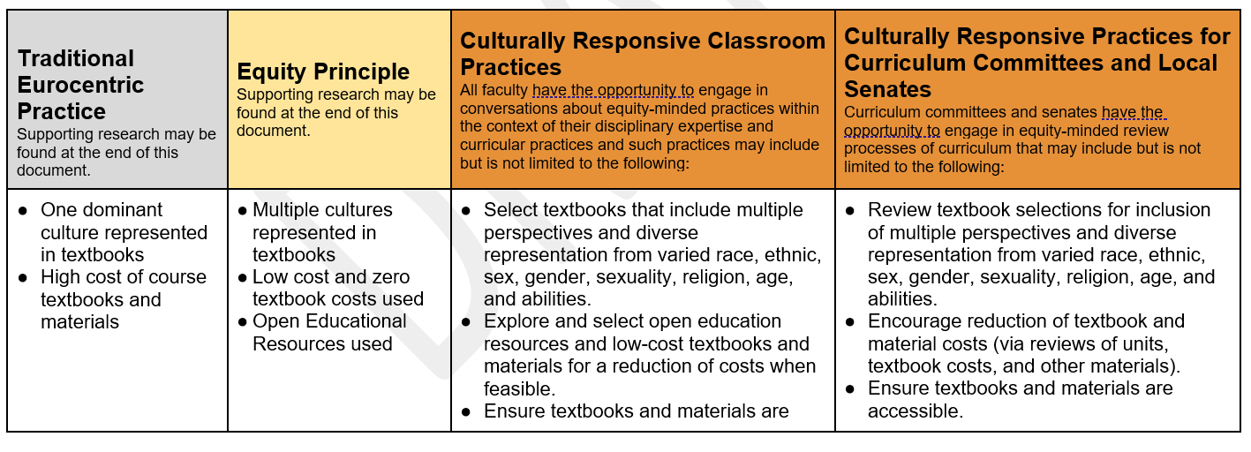
Culturally Responsive Curriculum Tool
The California Community College Curriculum Committee (5C) in 2020 created a set of recommended priorities that focuses on championing equity-minded curriculum and practices for credit and noncredit instruction.
5c Principles
Priority 1: Champion curricular diversity of representation and culturally relevant and responsive content with an anti-racism focus and in support of our disproportionately impacted students
Priority 2: Recommend policy changes and additions that remove systemic barriers to student success and equity
Priority 3: Provide guidance and support for instructional continuity and system resiliency
The DEI (diversity, equity, and inclusion) in Curriculum workgroup created a chart with promising practices for both discipline/teaching faculty and for curriculum committees and local academic senates to begin conversations on how to redesign practices from working within a traditional Eurocentric model to working within an equity-minded framework.

Slide 27
ASCCC Curriculum Committee
Stephanie Curry, ASCCC Area A Representative (Chair)
Michelle Bean, ASCCC Treasurer (2nd)
Adrienne Brown, Los Angeles Harbor
Sarah Harris, College of the Sequoias
Nili Kirschner, Woodland College
Jeff Waller, Grossmont College
Henry Young, Victor Valley College
Michelle Grimes-Hillman, VPI Orange Coast College

Slide 28
ADDITIONAL QUESTIONS?

Slide 29
THANK YOU!
Contact the ASCCC with questions at info@asccc.org

