Slide 1
Stack’em High Stackable Certificates
Brandi Asmus, Woodland Community College
Dianna Chiabotti, Napa Valley College
Conan McKay, ASCCC Area B Representative

Slide 2
The Rules….
Title 5, §55070 Credit Certificates
18 units or more, CO approval (**16) | Transcripted
12-17 units, may be submitted to CO (**8) | Transcripted
12-17 units established locally | Not transcripted
<12 units established locally | Not transcripted
Notes:
Background information on “allowable certificates” of 1. Achievement (Credit).
Note – noncredit certificates are cert of competency and cert of completion.

Slide 3
The Rules….
Title 5, §55070 Credit Certificates
If CO approved, called
Certificate of Achievement
18 units or more, CO approval (**16) | Transcripted
12-17 units, may be submitted to CO (**8) | Transcripted
12-17 units established locally | Not transcripted
<12 units established locally | Not transcripted
CANNOT be called: Certificate of Achievement, Competency, or Completion
Notes:
Background information on “allowable certificates” of 1. Achievement (Credit).
Note – noncredit certificates are cert of competency and cert of completion.

Slide 4
Background
54% of all jobs in the U.S. require more than a high-school diploma, but LESS THAN a bachelor’s degree.
*Only 45% of working-age population (2012, National Skills Coalition)
Bachelor’s degree holders will continue to need short-term training as technology evolves
Earnings – 27% of individuals with post-secondary licenses or certificates EARN MORE than the average bachelor’s degree recipient. (Pathways to Prosperity: Meeting the challenge of preparing Young Americans for the 21st Century)

Slide 5
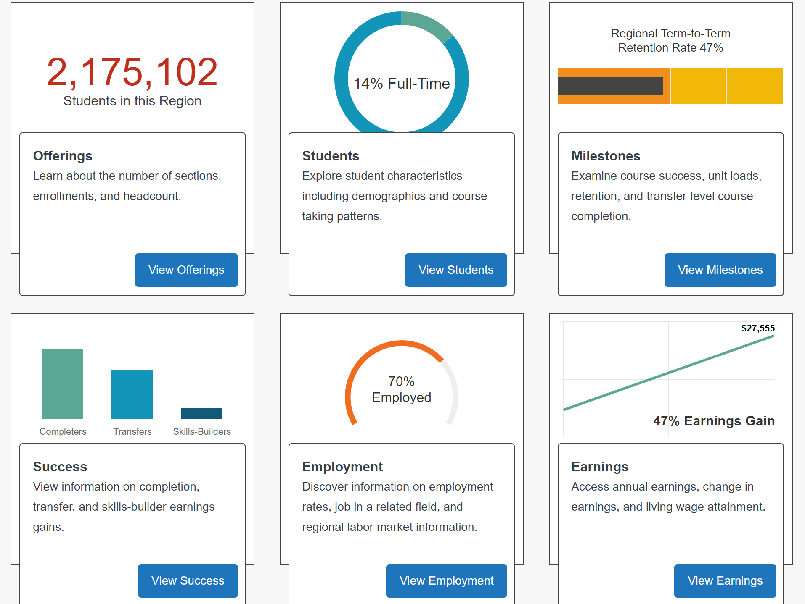
Data: Launchboard & CTE Outcomes Survey
Completers
Transfers
Skills-Builders
https://www.calpassplus.org/LaunchBoard/Home.aspx
Notes:
Launchboard 2015-2016 statewide data – Community College Pipeline
Successes – completers across programs
Employment – percentage based on success (Cert, Associate, Skills-builders)

Slide 7
So, Why Stack?

Slide 8
Stackable Certificates
Can be one or more courses (local vs. transcripted)
Align curriculum to workforce needs
Provide Employability Skills
Align with external certifications and/or licensure

Slide 9
Stackable Certificates
Design is INTENTIONAL
Gaps in current curriculum (program review)
Gaps in data (CTE Outcome Survey, Launchboard, Scorecard)
Employer need (lack of low to mid-entry talent)
Industry change

Slide 10
Where to Start?
Instructional Faculty
Advisory Committee
Industry / Employers
DSN, SN
Other?

Slide 11
Where to Start? Q & A
Occupation-specific labor pool needs
Gaps in technical and employability skills
Current industry challenges and operational obstacles
Projected changes to the industry that will impact curriculum
Partnership opportunities, including work-based learning experiences
Industry certifications most valued in and/or required of job applicants

Slide 12
Think -- Building Blocks
Occupation
(Specific to job)
Occupation
(Specific to job)
Occupation
(Specific to job)
Occupation
(Specific to job)
INDUSTRY RELATED
(apply to a particular industry pathway)
INDUSTRY RELATED
(apply to a particular industry pathway)
Foundational Skills
(may apply to many careers; skills can apply to work and/or future schooling)

Slide 13
. . . with Specialty Blocks
specialization
specialization
specialization
specialization
specialization
specialization
Occupation
(Specific to job)
Occupation
(Specific to job)
specialization
Occupation
(Specific to job)
Occupation
(Specific to job)
INDUSTRY RELATED
(apply to a particular industry pathway)
INDUSTRY RELATED
(apply to a particular industry pathway)
Foundational Skills
(may apply to many careers; skills can apply to work and/or future schooling)

Slide 14
. . . With Work Force / Industry
S
S
S
S
S
S
Occ.
Occ.
Occ.
Occ.
S
INDUSTRY RELATED
INDUSTRY RELATED
Foundational Skills

Slide 15
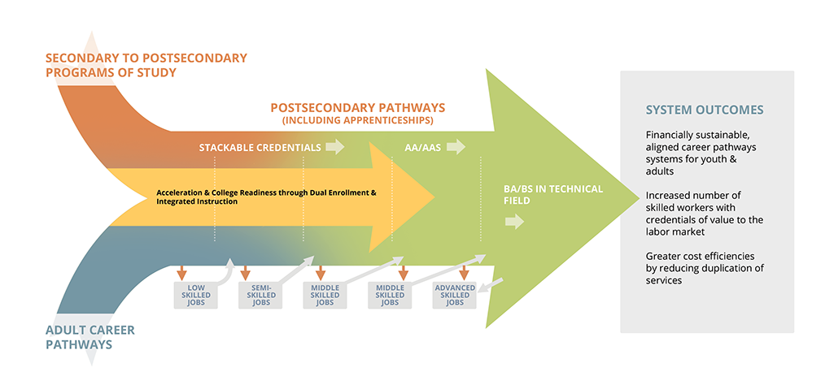
And transfer options…..

Slide 16
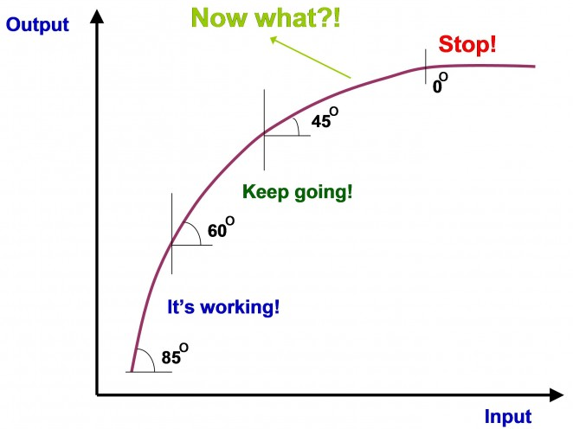
How high???

Slide 17
Examples
Health – LA Mission College
Horticulture – Statewide (Mapping Upward)
Manufacturing Technology – Harper College

Slide 18
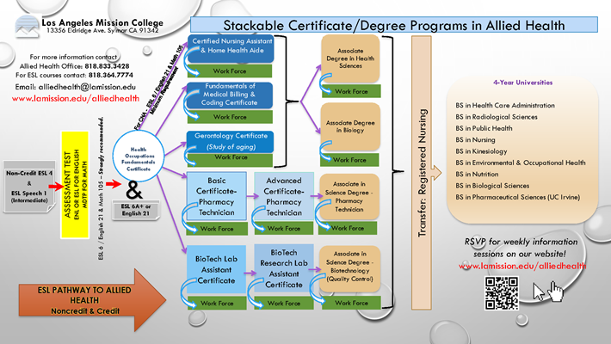
LA Mission College - Health

Slide 19
Horticulture

Slide 20
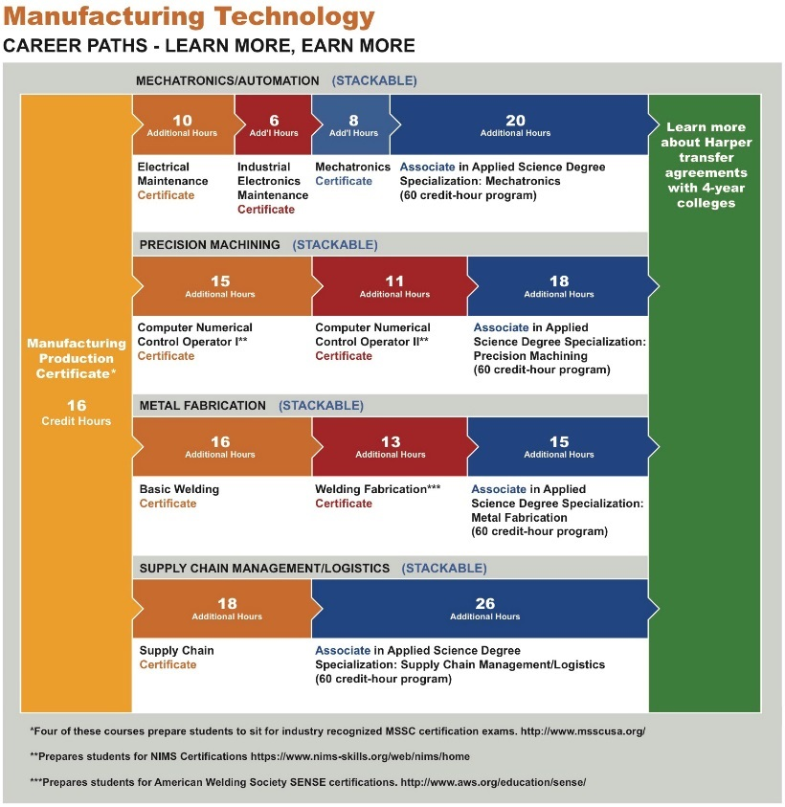
Harper College

Slide 21
Other Considerations…..
Scheduling courses to accommodate working students
Offering courses online
Awarding credit for prior learning
Making college affordable
Assisting students with individualized pathways
Evaluate every year!

Slide 22
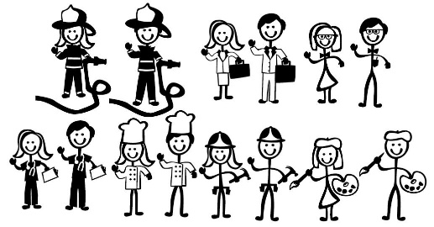
Stackable Certificates . . .
Prepare students for
Can increase
Reflected in

Slide 23
“Sequence of credentials that can be accumulated over time to build up an individuals’ qualifications and help them move along a career path or up a career ladder to different higher-paying jobs” U.S. Department of Labor

Slide 24
Questions
Brandi Asmus, Woodland Community College
basmus@yccd.edu
Dianna Chiabotti, Napa Valley College
dchiabotti@napavalley.edu
Conan McKay, ASCCC Area B Representative
cmckay@mendocino.edu

Slide 25
References
Center for Occupational Research and Development, for CCC-CTE Stackable Certificates Initiative; US Department of Education
Stackable Credentials Toolkit (April 2018)
Community College Research Center, Columbia University.
Stackable Credentials, Awards for the Future (May 2017)

