Slide 1
Stackable Certificates
Dianna Chiabotti, TAP Curriculum & WFTF
Toni Parsons, San Diego Mesa College

Slide 2
T5 §55070 Credit Certificates
18 units or more, CO approval | Transcripted
12-17 units, may be submitted to CO | Transcripted
12-17 units established locally | Not transcripted
<12 units established locally | Not transcripted
Notes:
Such a certificate may be given any name or designation deemed appropriate by the district governing board, except that such a certificate may not be referred to as a certificate of achievement, a certificate of completion, or a certificate of competency, unless approved by the Chancellor pursuant to subdivision (c). Such a certificate may not be listed on a student's transcript, unless approved by the Chancellor pursuant to subdivision (c).
FYI – certificates of competency and completion are used in non credit

Slide 3
27 percent of people with post-secondary licenses or certificates—credentials short of an associate’s degree— earn more than the average bachelor’s degree recipient.
Pathways to Prosperity: Meeting the challenge of preparing Young Americans for the 21st century

Slide 4
. . . find that long- term certificates in about half of CTE fields, and short-term certificates in more than half of CTE fields, produce positive returns that frequently are the equal of, if not greater than, returns to associate degrees in the same fields.
The Labor Market Return in Earnings to Community College Credits and Credentials in California

Slide 5
. . .though enrolling in a random mix of community college courses is unlikely to result in earnings gains, a strategic selection of courses in CTE subfields appears to be a potentially rational means of advancing one’s earning potential.
The Labor Market Return in Earnings to Community College Credits and Credentials in California

Slide 6
Skills Builders
What / Who ??

Slide 7
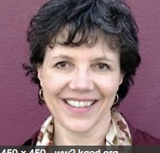
CTE Outcomes Survey
Info. on employment outcomes for CTE students
Methodology developed by the RP Group, the BACCC, and statewide practitioners
Results used in Launchboard and by DWM
Housed at Santa Rosa JC
Lead – KC Greaney, Director, Office of Institutional Research

Slide 8
Some results . . .
55.5%
39.1%
32.7%
28.3%
15.5%
3.3%
Certificates

Slide 9
Outcomes looked at
Skills Builders

Slide 10
Georgetown University Center on Education and the Workforce
"The work on skills builders … is forcing a pause and reset in how we think about college dropouts by revealing that many students have figured out how to effectively engage the postsecondary system at low cost with high returns."
Notes:
https://www.insidehighered.com/news/2016/03/04/california-community-colleges-find-new-way-measure-success-noncompleters

Slide 11
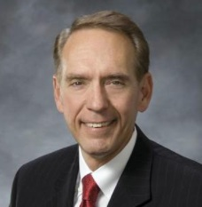
And according to
Skills builders have a median wage gain of 14% or $4,300/year
Skill builder metric added to Scorecard
“. . . critical to include nontraditional measures of success for students who are building better lives for themselves and their families”

Slide 12
New Reality for CTE and EWD
Georgetown University’s Center on Education and the Workforce:
Certificates accounted for 22 percent of post secondary awards in 2010, up from 8% in 1980
Certificates are now the second most common post secondary award, ahead of associate’s degrees and master’s degrees
54% of these certificates are short term (1 year or less)
Kathy Booth, West Ed Spring 2014 presentation

Slide 13
Some Clarifications About. .
Skills Builders

Slide 14
So what are Stackables?

Slide 15
Stackable . . .
Can be one or more courses
Align curriculum to workforce needs
Provide employability skills
Align with external certifications and/or licensure

Slide 16
Stackable . . .
I n t e n t i o n a l
Adjective: Done on purpose; deliberate

Slide 17
What certificates make sense?

Slide 18
What certificates make sense?
Stacked based on skill
Aligned to industry needs
Aligned with licensure or state exams
Others??

Slide 19
Should they all be transcripted?

Slide 20
Which ones should be counted?

Slide 21
Where to

Slide 22
Start with. . .
Department faculty
Advisory committees
Industry

Slide 23
First, determine the following
What are the entry level skills needed?
What class or classes contains those skills?
What’s the next level in that industry?
What class or classes contains those skills?
Is there a next level?
What class or classes contains those skills?

Slide 24
Then overlay…
External licensure in the industry?
What groups of classes contains those skills?
What groups of the previous considerations contain those skills

Slide 25
Think -- Building Blocks
Occupation
(Specific to job)
Occupation
(Specific to job)
Occupation
(Specific to job)
Occupation
(Specific to job)
INDUSTRY RELATED
(apply to a particular industry pathway)
INDUSTRY RELATED
(apply to a particular industry pathway)
Foundational Skills
(may apply to many careers; skills can apply to work and/or future schooling)

Slide 26
. . . with Specialty Blocks
specialization
specialization
specialization
specialization
specialization
specialization
Occupation
(Specific to job)
Occupation
(Specific to job)
specialization
Occupation
(Specific to job)
Occupation
(Specific to job)
INDUSTRY RELATED
(apply to a particular industry pathway)
INDUSTRY RELATED
(apply to a particular industry pathway)
Foundational Skills
(may apply to many careers; skills can apply to work and/or future schooling)

Slide 27
. . . With Work Force / Industry
S
S
S
S
S
S
Occ.
Occ.
Occ.
Occ.
S
INDUSTRY RELATED
INDUSTRY RELATED
Foundational Skills

Slide 28
. . . With Work Force / Industry
S
S
S
S
S
S
Occ.
Occ.
Occ.
Occ.
S
INDUSTRY RELATED
INDUSTRY RELATED
Foundational Skills

Slide 29
Examples

Slide 30
LATTC
A.S. - Renewable Energy Technician w/emphasis in Solar PV Installation and Maintenance
Advanced Technical requirements
ECONMT 110
REF A/C 100
CODE REQ OPTION: ECONMT 171 or
PLUMBNG 28
GE Requirements (18 units)
Solar PV installation & Maintenance Technician Certificate (26-28 units)
CRPNTRY 148
CHOOSE ONE OF 7 CLASSES
Core Solar PV Technical courses
Energy Systems Tech. Fundamentals Cert.
16-18 units)
CRPNTRY 111A
CRPNTRY 111B
ECONMT 105
ECONMT 205
ECONMT 100
BLDGCTO 010
ECONMT 115
ECONMT 116
ECONMT129
Applied Math req.*
Notes:
Applied math can me met with ECONMT 119, ECONMT 173, OR MATH 115

Slide 31
LATTC
A.S. - Renewable Energy Technician
Advanced Technical requirements
GE Requirements
(18 units)
Solar Thermal Installation & Maintenance Technician Certificate
Solar PV installation & Maintenance Technician Certificate (26-28 units)
Solar Thermal Fundamentals Cert.(14 units)
Energy Systems Tech. Fundamentals Cert.
(16-18 units)
Core Solar PV Technical courses
CRPNTRY 111A
CRPNTRY
111B
REF A/C 105
REF A/C 110
REF A/C 165
courses
courses
Notes:
Applied math can me met with ECONMT 119, ECONMT 173, OR MATH 115

Slide 32
Map Program and Skills
CDE -Permit Matric
Program Director
BA+
CFS Program Certificates
Must transfer to 4 year
Assistant Teacher
Site Supervisor AA+
Master Teacher
24 units + GE + Specialization
Associate Teacher 12 units
Teacher 24 units + GE
Assistant Teacher
6 units
Associate Teacher
AS –T ECE
AS CFS
Specialization certificates
Associate Teacher with Administration
Allowed to be left alone with children, if enrolled
Positions
Program supervisor qualified in a CDE subsidized center, multi sites
Director qualified in a CDE subsidized center
Teacher qualified in a CDE subsidized center
In a regular licensed center, director qualified
In a regular licensed center, Teacher qualified academically

Slide 33
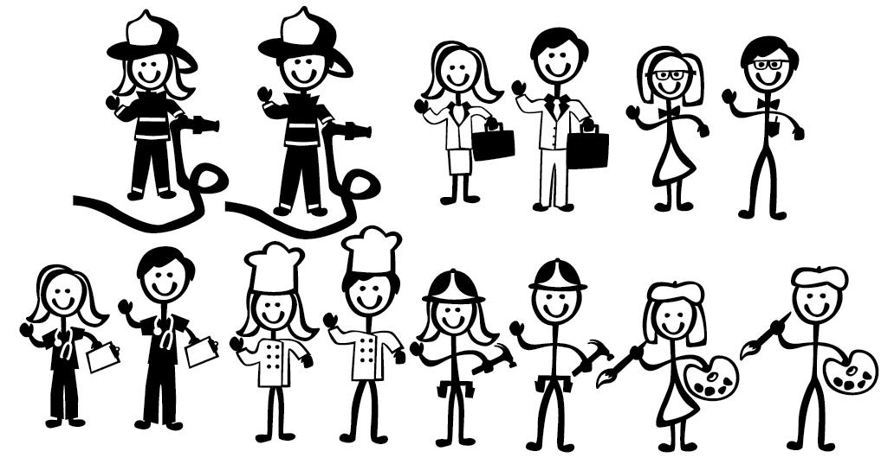
Stackable Certificates . . .
Prepare students for
Can increase
Reflected in

Slide 34
QUESTIONS

Slide 35
THANKS!

