Slide 1
Welcome Dolores Davison, ASCCC President

Slide 2
Land Acknowledgement Adoption of the Procedures by Ginni May, ASCCC Vice President

Slide 3
Land Acknowledgement
We begin today by acknowledging that we are holding our gathering on the land of the Tongva (Gabrieleno) and Chumash Nations who have lived and continue to live here. We recognize the Tongva (Gabrieleno) and Chumash Nations and their spiritual connection to the ocean and the land as the first stewards and the traditional caretakers of this area we now call Burbank. As we begin, we thank them for their strength, perseverance and resistance. We also wish to acknowledge the other Indigenous Peoples who now call Burbank their home, for their shared struggle to maintain their cultures, languages, worldview and identities in our diverse City.

Slide 4
Adoption of Procedures
It is time to adopt the procedures for the Spring Plenary Session 2022 on the Resolutions page of the Spring Plenary Session 2022 Conference website.
Is there a motion to approve?
Is there a second to the motion?
Please use the Poll feature to vote, if you are attending virtually, otherwise indicate your approval by saying, “aye”.

Slide 5
Foundation for Academic Senate for California Community Colleges: Report Spring 2022

Slide 6
Our Foundation Mission
The mission of the Academic Senate Foundation for California Community Colleges is to enhance the excellence of the California community colleges by sustained support for professional development of our diverse faculty in the furtherance of effective teaching and learning practices.

Slide 7
ASCCC Foundation Directors
Stephanie Curry (President)
Manuel Velez (Treasurer)
Michelle Bean (Secretary)
Karen Chow
Krystinne Mica
Van Rider

Slide 8
Your donations make a difference
Plenary Scholarships
4 in-person for Fall and Spring (include registration/hotel and some food)
10 online scholarships (4 guaranteed for part time faculty)
A2MEND Conference Scholarships
5 registrations
1 registration to the Women’s Conference
Board of Directors meeting, we voted to support providing a $3000 sponsorship to the upcoming SSCCC's General Assembly

Slide 9
INNOVATION SCHOLARSHIPS
Innovation Scholarships provide faculty with funding to attend ASCCC events as well as external events and conferences to expand their understanding of best practices and apply them to their local college and share those results with the field at large.

Slide 10
Amazon Smile
Smile Donations have already contributed almost $ 700 to the Foundation
Faculty can support fellow faculty by donating to the ASCCC Foundation.
1) Selecting the ASCCC Foundation through Amazon Smile
2) Using the amazon smile website when you purchase items.

Slide 11
Partnership with FACCC
FACCC is dedicated to representing your interests in state and federal government. Its professional staff and volunteer leaders testify at hearings, meet with legislators, and organize policy forums to promote the message of community college faculty.
Sign up as a member of FACCC and note that you are doing it through the ASCCC and FACCC will make a donation to the ASCCC Foundation
Sign up here https://faccc.memberclicks.net/index.php?option=com_mcform&view=ngforms&id=2053231#/

Slide 12
Spring Area Competition

Slide 13
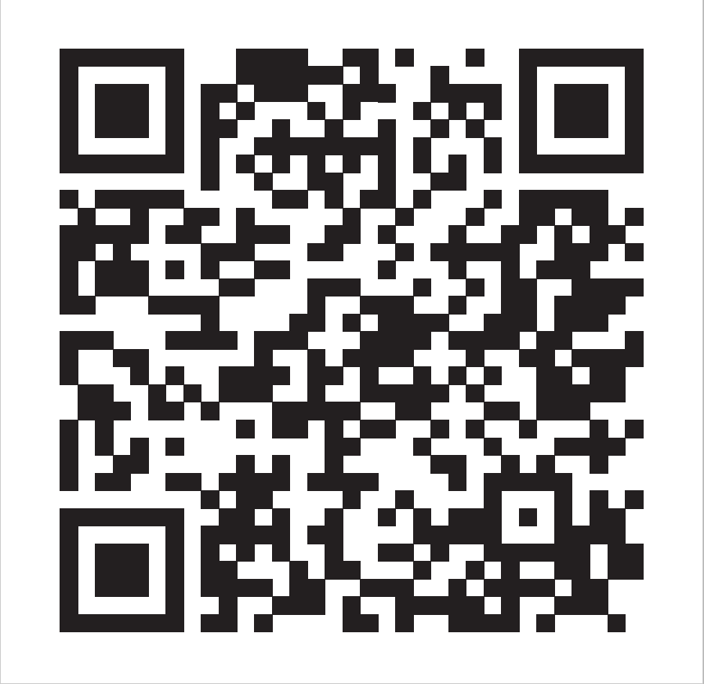
Area Competition
Starts Thursday April 6 at 8:00am and ends Saturday April 9th at 10:00am
Only donations through the Area Pages will count for your area
Online and in person tallies will be available so you can keep track of the donations.
Area A Representative: Stephanie Curry
Area B Representative: Karen Chow
Area C Representative: Robert L. Stewart Jr.
Area D Representative: La Tonya Parker

Slide 14
How you can give
Online through the Area Competition Links
https://asfccc.com/2022-spring-area-competition/
Use the QR Codes on the Tables or here.
Pathable Foundation Link
Stop by the table at Plenary and bring your checkbook
(sorry no cash accepted)
Any donation amount is welcome!
You don’t need to attend plenary to donate.
Top 25 donor will be eligible for the prize drawing on Saturday

Slide 15
GOAL= $6,000 in three days!

Slide 16
Prizes
To Area Winners
EPIC Bragging Rights
a snack party during their area meeting at the 2022 Faculty Leadership Institute, and of course
Individual Prizes (Top 25 Donors Entered)
Free registration to 2022 Faculty Leadership Institute (1 Drawing)
Free registration to 2022 Curriculum Institute (1 Drawing)
Two Nights Hotel stay for the 2022 Curriculum Institute in Riverside, CA (1 Drawing)
Free registration to 2022 Fall Plenary Session (1 Drawing)
Two Nights Hotel stay for the 2022 Fall Plenary Session in Sacramento, CA (1 Drawing

Slide 17
Who will win this coveted trophy?

Slide 19
Approval of the Minutes from Fall 2021 Plenary
The minutes can be found on the Plenary homepage under “Resources”.
Delegates will be asked to use Poll Everywhere to approve the minutes from the Fall 2021 Plenary Session.

Slide 20
ASCCC Statement of Activities (Treasurer’s Report)
Please find the ASCCC Statement of Activities on the Plenary page under “Resources”. No action is required by the body on this item – it is informational only.

Slide 21
The State of the Senate – Spring 2022 Dolores Davison, ASCCC President

Slide 22
Welcome to Our Many Friends and Partners
THANK YOU!!

Slide 23
So This Year Has Been Something…
As a reminder, all of these things have happened since our Executive Committee Orientation in June 2021
Derek Chauvin was sentenced to prison for the murder of George Floyd
Rudy Giuliani law license suspended
Summer Olympics in Toyko
Dixie Fire
Andrew Cuomo resigned
Bipartisan Infrastructure Bill is passed
Hurricane Ida hits the east coast
Recall election of Governor Newsom is held
SpaceX launches first all civilian aircraft
Britney Spears conservator (her father) is formally suspended

Slide 24
Actually….
All of those things happened between 25 June and 30 September.
So, if your brain feels full and you’re exhausted – you have every right to be!!
Remember – you can’t pour from a glass that’s empty; self care is crucial for all of us.

Slide 25
What Has the ASCCC Been Doing Since the Last Plenary Session in the Fall?
Nothing. Eating bonbons and relaxing on the Arno. Oh, wait… not quite.

Slide 26
Areas of Emphasis for 2021-22
Culturally Responsive Curriculum, Student Services, and Student Supports
Continued work around Ethnic Studies graduation requirement, including new disciplines
ASCCC OERI Work
Title 5 changes around EW grades and P/NP
Rising Scholars Program
Equity Driven Systems
Changes to EEO Title 5 language
New Hiring Practices Manual – Spring 2022
Transfer
Work continues on implementation of AB 928 and AB 1111 (both Berman, 2021)

Slide 27
Legislation
AB 1187(tutoring) and 1705 (changes to AB 705) (Irwin, 2022)
AB 1505 (Rodriquez, 2022) – rebenching the FON
AB 1746 (Medina, 2022) -- CalGrant reform
AB 1984 (Fong, 2022) – Ethnic Studies
AB 2624 (Kalra, 2022) – course materials
SB 1141 (Limon, 2022) – support for nonresident tuition to change from three years of attendance to two years
SR 45 (Min, 2022) – Academic Freedom

Slide 28
Adoption of IDEAA
At its March meeting, the ASCCC Executive Committee officially adopted the acronym ”IDEAA” to describe and inform its work around:
Inclusion
Diversity
Equity
Anti-Racism
Accessibility

Slide 29
Webinars, Institutes, Local Senate Visits, and Collegiality in Action
Webinars on CTE, Academic Freedom, Legislation, Legislative Advocacy with FACCC
Part Time Institute
Accreditation Institute in partnership with ACCJC
Area Meetings
More than 40 local visits and Collegiality in Action visits this year
Still to come:
Faculty Leadership Institute
Curriculum Institute
More webinars/local senate visits/CIA visits

Slide 30
Continued Collaboration and Partnerships
RP Group – Keynote at Conference Next Week
CCCCIO Board – CIO Conference Next Week
ICAS – Transfer/Legislation/Intersegmental Issues
CCLC – Collegiality in Action Visits/Legislative Conference
FACCC – Legislation/Advocacy/Webinars/Academic Freedom
CoFO – Legislation/Budget/Return to Campus
Student Senate – Campus Listening Tours/Student Grievance Policy/Presentation at GA Last Week/ Joint June Conference
Chancellor’s Office
5C/TTAC/DEETAC/EWPAC/Rising Scholars/Veterans Summit/EEODAC/Title 5 Revisions

Slide 31
Our Amazing ASCCC Staff

Slide 32
The 2021-22 ASCCC Executive Committee

Slide 33
A Moment of Silence

Slide 34
Thank You and Welcome to Plenary!

