Slide 1
State of the Senate John Stanskas, ASCCC President

Slide 2
Updates
Professional Development
Advocacy and Leadership
4 Areas of work with the Chancellor’s Office
Upcoming Events
Governance

Slide 3
Professional Development and Technical Assistance
Between November 2 and April 3
11 Regional Meetings with 515 attendees
(Faculty Diversification, Curriculum, Coding)
24 Webinars with 1118 attendees
(Guided Pathways and OERI)
23 Technical Assistance Visits
SLO Symposium 157 attendees
Part-Time Faculty Institute 189 attendees

Slide 4
Intersegmental Advocacy and Leadership UC Transfer Pathway Degree Pilot
Degree Components:
Major’s Preparation: Chemistry and Physics UCTP
General Education: 20 units specified
GPA: 3.5
Guaranteed admission to the UC System

Slide 5
Legislative Advocacy and Leadership Funding Formula
Three areas of immediate concern:
Level the point system for associate degree awards
Award colleges only once per year per student for the highest award achieved
Keep the performance metric portion set at 10%
Notes:
Behavior really needs to be student centered, not dollar chasing

Slide 6
Legislative Advocacy
Pathways to CC Faculty Program
Accessibility Concerns and ADA compliance
Full Time Faculty and Faculty Diversification
Notes:
Behavior really needs to be student centered, not dollar chasing

Slide 7
Legislative Advocacy
AB1427 (Carillo) Minimum Standards for FT Noncredit Instruction
SB462 (Stern) Forestland Restoration Workforce Program
AB1727 (Weber) Noncredit CDCP eligible for census enrollment
Notes:
Behavior really needs to be student centered, not dollar chasing

Slide 8
Advocacy for Faculty Voice Fully Online College District
Appointed a group of five faculty to serve as the faculty voice for the new district
Actively engage Board of Trustees meetings
Notes:
We have attended the BoT meeting and are participating in the hiring committee for the CEO

Slide 9
Leadership – Data and Recoding
Impacts funding formula and local goal setting
Requested the Chancellor’s Office authorize a subcommittee or task force of 5C to address MIS infrastructure revisions

Slide 10
Four Areas: Strong Workforce Recommendations
CTE Minimum Qualification
Equivalency Toolkit Regional Meetings
Professional Development for faculty regarding
The role of deans, CIOs, department faculty, HR and the senate
Equivalency to the Associates Degree
Faculty Internship Programs
Toolkit Feedback Requested!
https://asccc.org/directory/standards-and-practices-committee

Slide 11
Four Areas: Strong Workforce Recommendations
Equivalency Toolkit Regional Meetings
April 29 Los Rios District
May 2 LA Trade Tech
May 3 Reedley
May 8 Moorpark

Slide 12
Four Areas: Strong Workforce Recommendations
Credit for Prior Learning
Military Credit
Broader Concepts
Title 5 Regulations
Pilot Program with the Foundation, CO and ASCCC in select disciplines

Slide 13
Four Areas: AB705 Implementation
AB705 – Reformation of assessment for placement
Title 5 Regulations approved through regular process and the BoG accepted them as written for Math and English
Work continues on ESL
Re-coding of CB21 and other MIS data elements
Regional meetings
Evaluation of this models success through out the 2019-20 academic year

Slide 14
Four Areas: Faculty Diversification
Longstanding priority for ASCCC
Messaging to stakeholders
ASCCC and CO leading the BoG Taskforce on Diversity
Evaluation of our internal procedures
Focus on the second minimum qualification

Slide 15
Four Areas: Guided Pathways
ASCCC Efforts
Webpage / Canvass
Guided Pathways Liaisons
Resource Team visits
Resources
Onboarding Processes for Students
Next Year
Professional Development
Program Review
Onboarding Processes
Notes:
These endeavors all align with our new strategic plan that you adopted in the spring.

Slide 16
The Current Focus of the System
Transfer Directed Students
AB705
Guided Pathways
Funding Formula
But our role is bigger than that
We advocate for all our students

Slide 17
Upcoming Events
Faculty Leadership Institute, June 13-15, Sacramento
Curriculum Institute, July 10-13, Burlingame
Academic Academy: The Student Experience, Sept. 13-14, Southern California

Slide 18
Governance – System Perspective
Resolution FA18 07.03 Response
Significant efforts to improve collegiality and ensure faculty voice and primacy
Challenges remain and are being addressed
https://asccc.org/sites/default/files/3.18.19%20Improving%20Participatory%20Governance%20with%20the%20Chancellor%20of%20the%20California%20Community%20Colleges_3.pdf

Slide 19
Governance – Local Advice
Evaluate and Update Local Governance Structure – Technical Assistance is Available
Ensure collegial consultation and effective participation
Review and strengthen policies and processes
Work with Union leadership to unite faculty
Create partnerships with administration, classified staff, and students
Know your community and students
Build trust and goodwill
Create space for difficult conversations
Lead!

Slide 20
Remember
There is so much happening right now it cannot be the job of one senate president or even an executive team. Collective engagement by the entire institution must be the goal for a college to succeed.
Do not take all of this on by yourself
Delegate and let go of the outcome
Practice self-care
Remember to care for others

Slide 21
Questions?

Slide 22
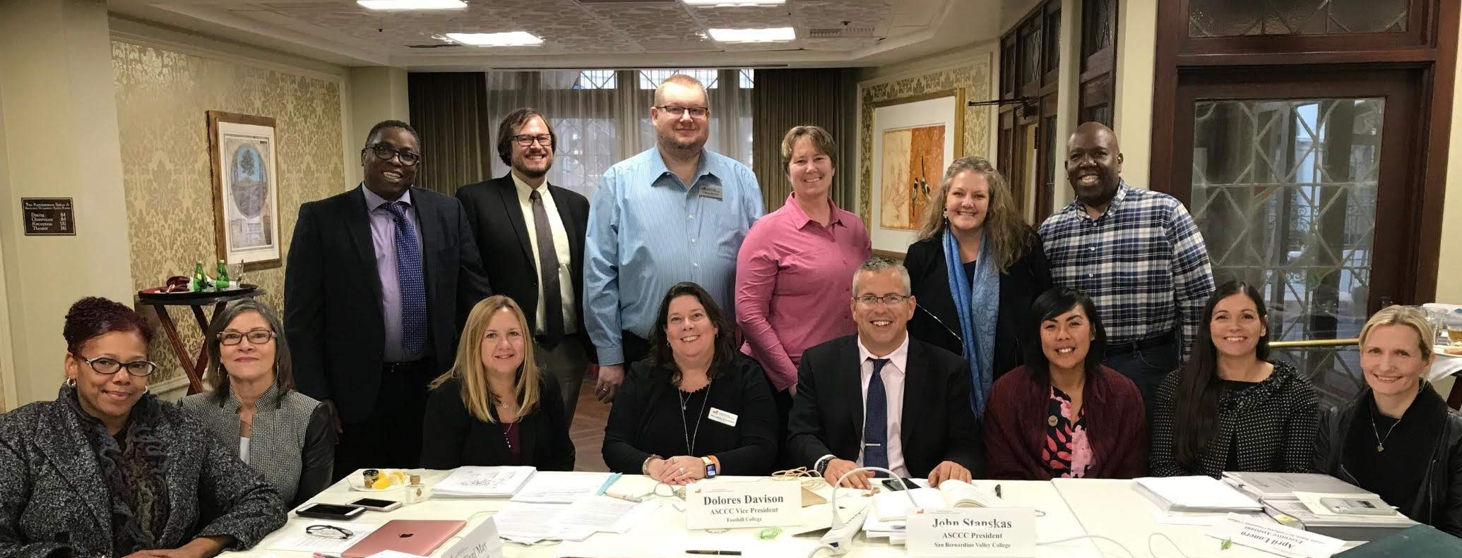
Thank You

