Slide 1
Statewide Awards: Recognizing the Excellence of our Colleagues
Julie Adams, ASCCC Executive Director
John Freitas, Los Angeles City College
2017 Spring Plenary Session, San Mateo

Slide 2
Overview
Why Faculty Recognition is Important?
What Awards does the ASCCC sponsor?
What is the process?
Notes:
Who is in the room?
How many new Senate Presidents?
How many of you have a cohesive and united faculty to lead?

Slide 3
Pillars of Professional Development
Part of being a leader is building a team – celebrating our own!
Recognizing what we do well is an important part of motivating all faculty
What are examples of celebrating accomplishments at your college?
Notes:
One of the top five HR issues is low morale – employees feel undervalued, unappreciated, and unrecognized for their contributions. This is one way to address that!

Slide 4
Notes:
Call for Nominations goes to the Senate Presidents Listserv and on our website.

Slide 5
Exemplary Program Award
Recognizes outstanding community college programs
BOG Award with theme set by the ASCCC Executive Committee
Call for nominations in October
Deadline is November
Program – could also be teams of people
Honored at the January BOG meeting
Notes:
established in 1991, recognizes outstanding community college programs. Annual Theme. Two college programs receive $4,000 and up to four colleges receive an honorable mention. plaque. Nomination in October.

Slide 6
Exemplary Program Award Criteria
Indicators of Overall Success
Evidence of Need and Innovation
Demonstrated Collaboration
Evidence of Alignment with College Mission
Suggestions for Replication at other CCCs
Notes:
This is a Board of Governors award sponsored by the Foundation for California Community Colleges

Slide 7
Your Turn!
What should next year’s theme for the
Exemplary Program Award?

Slide 10
Hayward Award
Honors full-time and part-time faculty for excellence in education
BOG Award in honor of former CCC Chancellor Gerald C. Hayward
Call for nominations in November
Deadline is December
Recipients are honored at the March BOG meeting
Changes implemented for 2017:
Statewide, no longer Area-based
Senates may now nominate two faculty, provided one is part-time
Changes address the intent of resolution 13.01 S16
Notes:
$1250 4 faculty members faculty who have a track record of excellence both in teaching and in professional activities and have demonstrated commitment to their students, profession, and college. Nomination Call November. Resolution 13.01 S16 called for expanding awards so both full and part-time faculty could be honored in each Area annually.

Slide 11
Hayward Award Criteria
Committed to serving diverse populations
Committed to the principles of the CCC mission
Participation in professional development/student activities
Committed to education
Represent the profession beyond the local institution
Notes:
This is a Board of Governors award sponsored by the Foundation for California Community Colleges. Nominations go out in November.

Slide 12
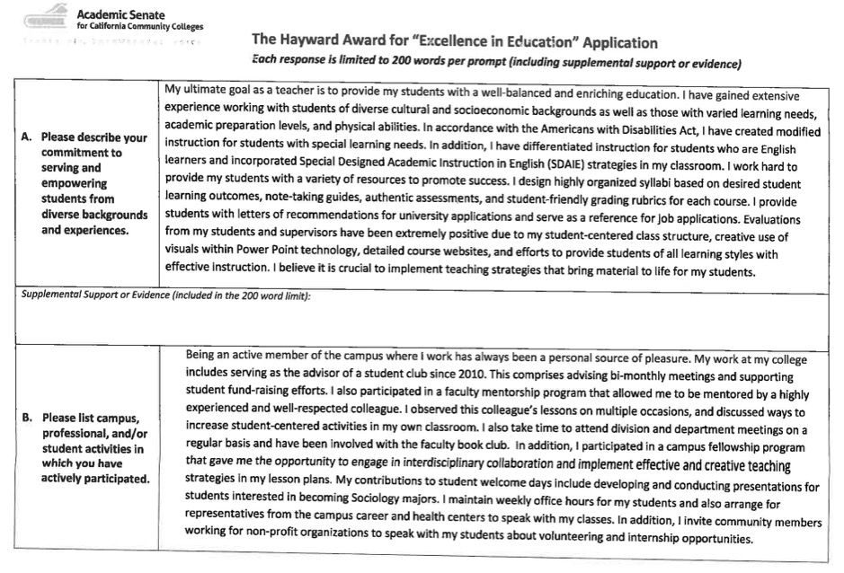

Slide 13
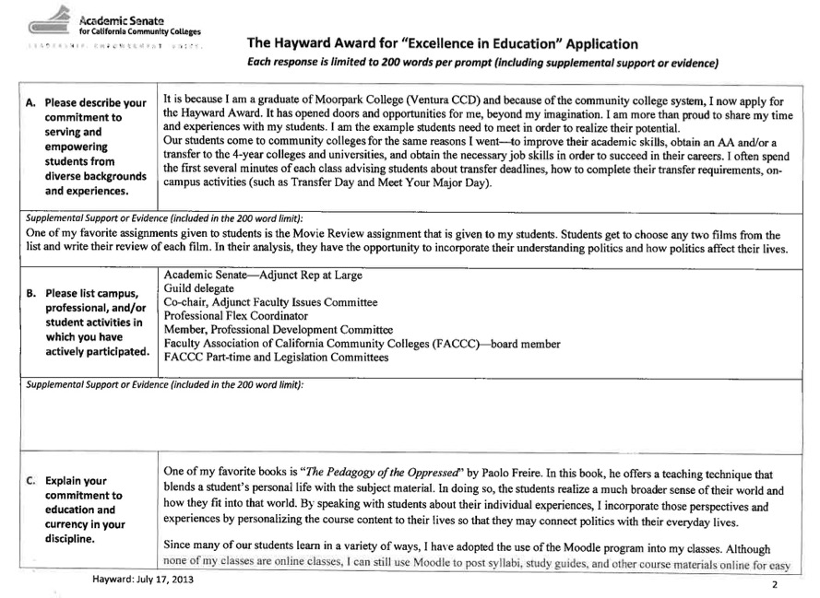

Slide 14
Stanback-Stroud Diversity Award
Honors faculty who are exceptional in advancing intercultural harmony, equity, and campus diversity
Named for former ASCCC President Regina Stanback-Stroud
Call for nominations is December
Deadline is February
Honored at the ASCCC Spring Plenary Session
Notes:
Senate President Regina Stanback-Stroud, honors faculty who have made special contributions addressing issues involving diversity. One person $5,000 and a plaque. call for nominations December This is a Senate award, is sponsored by the Foundation for California Community Colleges

Slide 15
Stanback-Stroud Diversity Award Criteria
Creating an inclusive and supportive campus climate; implementing effective teaching and learning strategies or establishing or expanding an effective learning environment; and facilitating student access, retention and success; fostering student engagement in campus life. (Resolution 3.03 S98)
Direct and demonstrated evidence (observable and/or measurable) of the nominee’s work is required

Slide 16
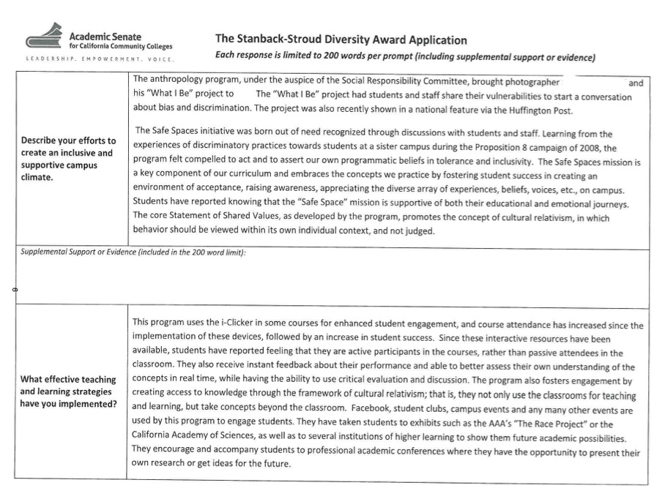

Slide 18
Your Turn!
What local effective practices do you have for recognizing faculty?
What improvements could be made to the ASCCC process that would help you nominate faculty for statewide recognition?
Notes:
Think of the faculty on your campus. Can you think of one that may be worthy of each of these awards.
Tell us about them?
Let’s start writing a nomination…

Slide 19
For more information…
Go to asccc.org
Find the Tab that says “AWARDS” (asccc.org/awards)

Slide 20
Questions?
Julie Adams – julie@asccc.org
John Freitas – freitaje@lacitycollege.edu
Stacey Searl-Chapin – schapin@msjc.edu
Thank you!

