Slide 1
We want YOU! Consider Statewide Service
Krystinne Mica, ASCCC Chief Operating Officer
Fall Plenary 2018
Irvine, CA

Slide 2
Why Get Involved?
Representation!
Provide your expertise on a variety of different committees
Serve alongside your colleagues
Engage in rich discussion on issues affecting the higher education landscape in California

Slide 3
A Bit of Background
The Board of Governor’s Procedures and Standing Orders, section 332, explicitly recognizes the role of the Academic Senate as the official voice of faculty in academic and professional matters and directs the community college system to rely upon the ASCCC for appointments of all faculty to statewide committees and groups.

Slide 4
Service at the State-Level
Each year the Academic Senate appoints faculty members to the statewide Standing Committees, Chancellor's Office advisory committees, and task forces.
Currently, there are 15 standing committees of the Academic Senate, 3 task forces, 2 operational committees, and 1 ad hoc committee
There are almost 50 Chancellor’s Office Committees active this year!

Slide 5
Senate Committee Appointment Process
The Academic Senate continuously collects Application for Statewide Service Forms at ASCCC events such as plenary session and institutes.
ASCCC Standing committee chairs review the list of interested faculty and select members based on criteria. The committee chair may also search the Senate directory or solicit the local senate presidents for additional nominations.
Criteria for selection include:
Diversity (i.e., regional, discipline, ethnicity, skill sets)
Previous senate assignments
Location
Committee chairs will contact selected faculty to confirm willingness to serve. Faculty members will be notified in mid-August of appointment.

Slide 6
Ad Hoc, Special Task Forces, and Advisory Groups
The Senate Office reviews the list of faculty interested in serving on Senate committees for faculty that have the expertise needed on the task force or advisory committee.
If no faculty on the list have the skills or expertise needed for the task force or advisory committee, the Senate Office contacts local senates for nominations.
Names of potential appointees are given to the President for approval. Once the President has selected potential appointees, the Senate Office contacts the local senate president to confirm the nominee’s appointment.
Notes:
The Academic Senate strengthens and supports the local senates of all California community colleges.

Slide 7
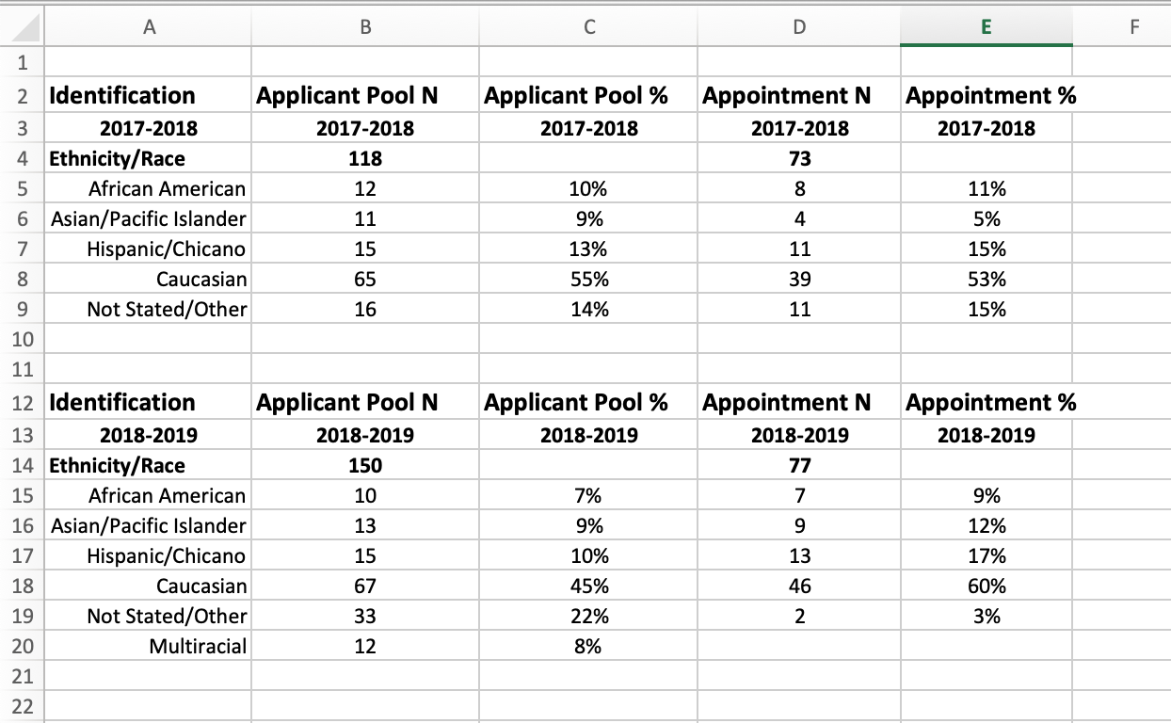
Application to Serve – Applicant Pool Demographics
Notes:
Take a few minutes to review the web site. Past resolutions, past papers, Rostrum Articles, links to Title 5, Curriculum, SLO’s, future events, Disciplines List and Minimum Qualifications, request site visit, other???

Slide 8
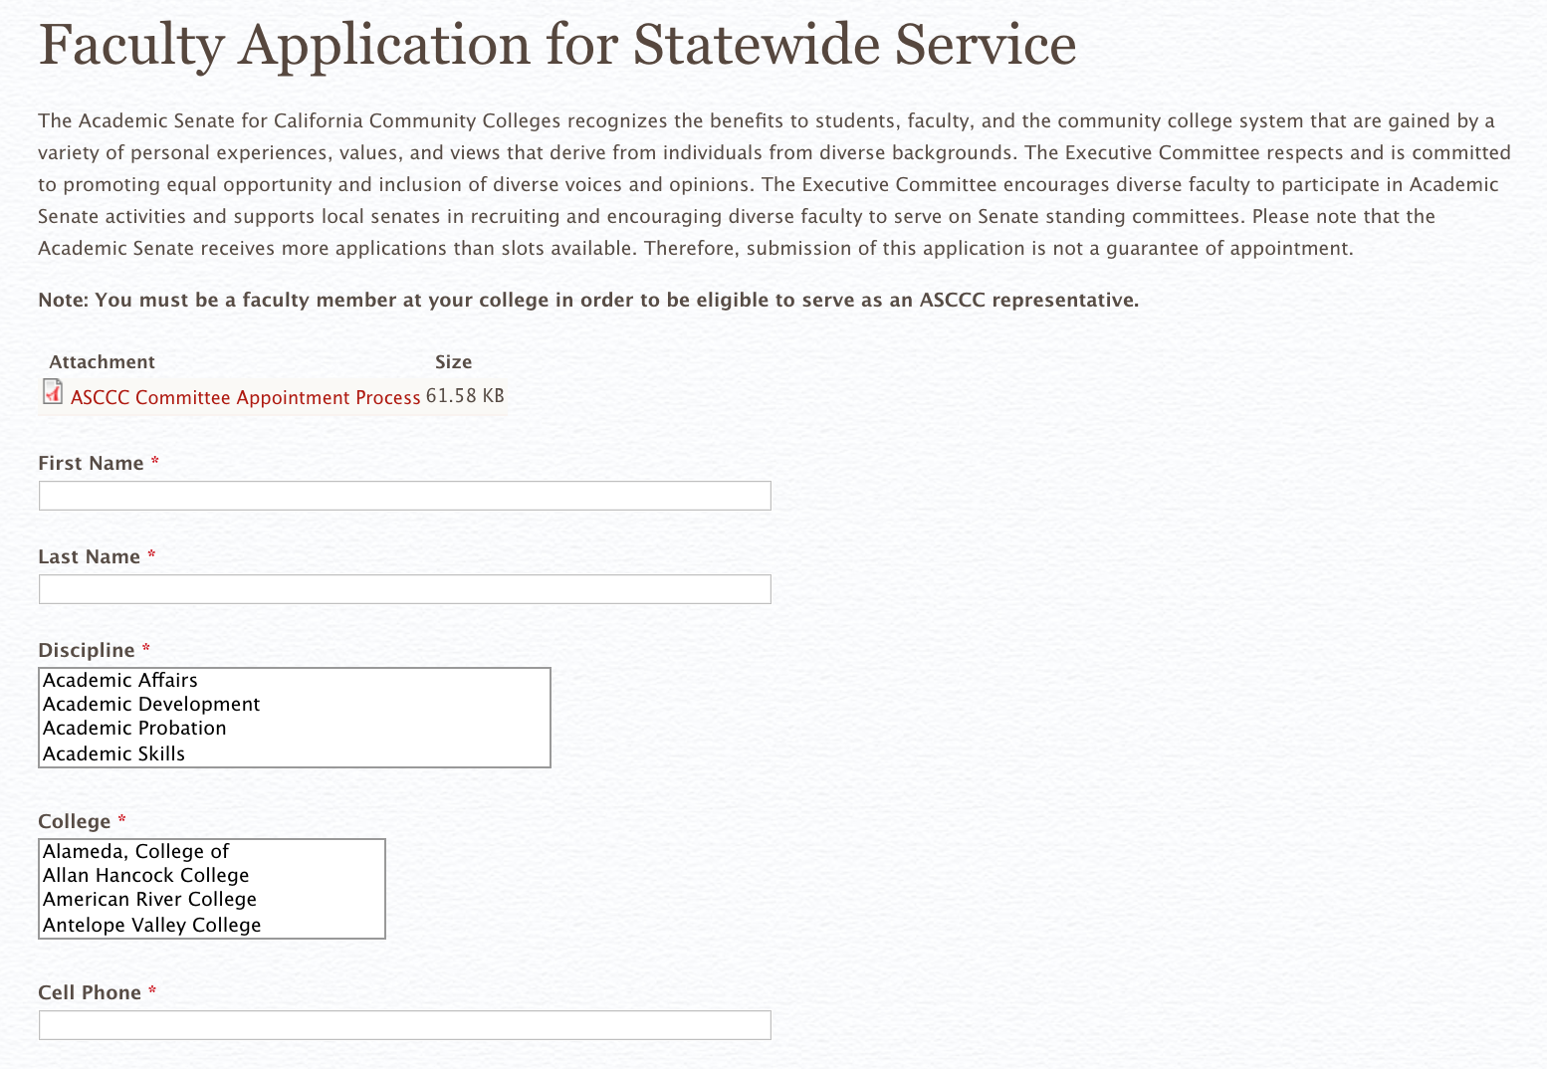
So how do I sign up?! https://asccc.org/content/faculty-application-statewide-service
Notes:
Slides 6-10 are regarding new delegates. John S. need to let us know if these need any changes, since this is his 20-30 minute section of the breakout.

Slide 9
Questions?
THANK YOU!
Contact Information
Krystinne Mica: krystinne@asccc.org

