Slide 1
Statewide Service and the Senate President's Approval
Anna Bruzzese, ASCCC South Representative
Sam Foster, ASCCC South Representative
LaTonya Parker, ASCCC Area D Representative
Notes:
ALL

Slide 2
We want you...to be of service to the Academic Senate for California Community Colleges! And we have 10+1 reasons…
Faculty voice is crucial to ensuring that our students’ needs are served effectively. The ASCCC strives to ensure that diverse faculty perspectives are represented on the state level. This requires active participation of faculty volunteers on various statewide committees, task forces, and the Executive Committee. If you are interested in becoming more involved in this important work, join us for this interactive session where we will discuss different committees, the appointment process, as well as time commitments and responsibilities. In addition, we will talk about the role of the Senate President in approving faculty for statewide service.

Slide 3
A Bit of Background
The Board of Governor’s Procedures and Standing Orders, section 332, explicitly recognizes the role of the Academic Senate as the official voice of faculty in academic and professional matters and directs the community college system to rely upon the ASCCC for appointments of all faculty to statewide committees and groups.

Slide 4
Service at the State-Level
Each year the Academic Senate appoints faculty members to the statewide Standing Committees, Chancellor's Office advisory committees, and task forces.
Currently, there are 15 standing committees of the Academic Senate, 3 task forces, 2 operational committees, and 1 ad hoc committee
There are almost 50 Chancellor’s Office Committees active this year!
https://www.asccc.org/communities/committees

Slide 5
#1
REASON: Mission of ASCCC
The Academic Senate for California Community Colleges fosters the effective participation by community college faculty in all statewide and local academic and professional matters; develops, promotes, and acts upon policies responding to statewide concerns; and serves as the official voice of the faculty of California Community Colleges in academic and professional matters.
The Academic Senate strengthens and supports the local senates of all California community colleges.
REALITY: Direction and purpose in a continuously ongoing process to achieve goals and outcomes
Faculty voice
10+1 academic and professional matters
Leadership, Empowerment, Voice
Notes:
KRYSTINNE

Slide 6
#2
REASON: Strategic Plan
Assert the faculty voice and leadership in local, state, and national policy conversations
Engage and empower diverse groups of faculty at all levels of state and local leadership
Lead faculty professional development for the California Community College System
Enhance engagement, communication, and partnerships with local senates and system partners, and other constituent groups
Secure resources to sustain and support the mission and the work of the ASCCC.
REALITY: ASCCC’s 6 focus/priority areas for 2019-2020:
Faculty Diversification, Guided Pathways, Governance Processes and the Faculty Role, Coordination of Career Technical Education and Online Education, Transfer, Legislative Action
ASCCC Strategic Plan
Notes:
CARRIE

Slide 7
#3
REASON: Equity is ESSENTIAL!
ASCCC representatives and faculty commitment to equity and diversity
REALITY: Must advance in reflecting and supporting the students we serve, with an equity lens
Notes:
MAYRA

Slide 8
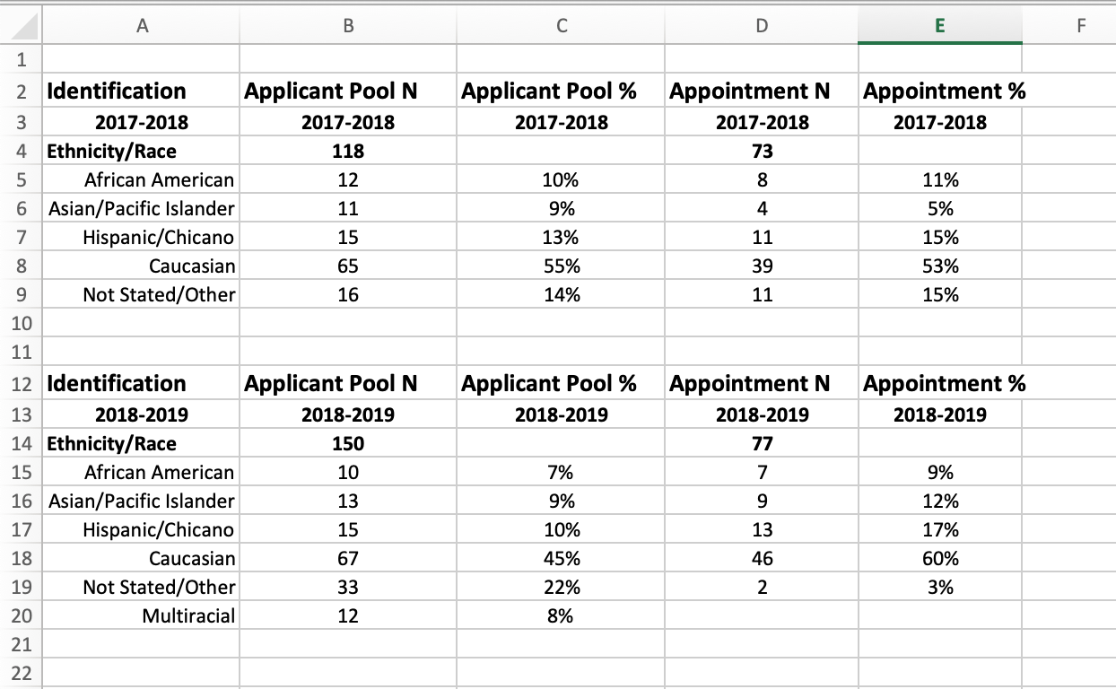
Application to Serve – Applicant Pool Demographics
Notes:
Take a few minutes to review the web site. Past resolutions, past papers, Rostrum Articles, links to Title 5, Curriculum, SLO’s, future events, Disciplines List and Minimum Qualifications, request site visit, other???

Slide 9
#4
REASON: Opportunity awaits!
ASCCC has robust opportunities, what are you waiting for?
REALITY: Only so many… or up to you!
Join/start an ASCCC Caucus
Apply for ASCCC Statewide Service
Elections for ASCCC Executive Committee
Notes:
SILVESTER

Slide 10
#5
REASON: Expertise and/or learning opportunities welcomed!
Committees
Taskforces
Rostrums
Other?
REALITY: Expertise or learn
Expectations of commitment!
Notes:
DAN

Slide 11
#6
REASON: Takes so many people to do so many things!
REALITY: Time… is of the essence
Commitment requires work/life balance, self care, and professional flexibility which supports effective leadership.
Notes:
MAYRA

Slide 12
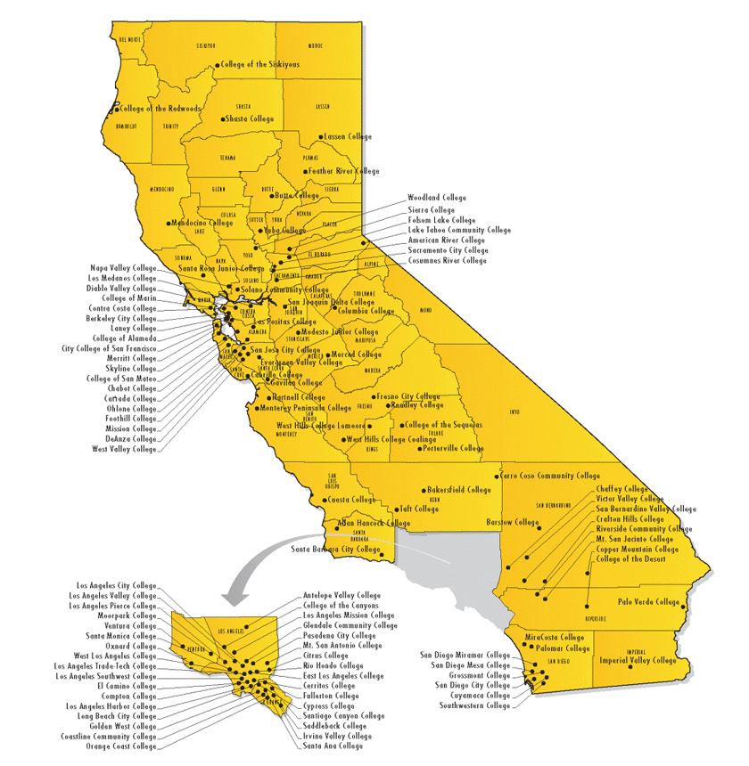
#7
REASON: Support faculty and serve students system wide
That’s YOU…
REALITY: 62,000 faculty and 2.4 million students
Represent faculty, not college, individual programs/ departments/ courses
Advisory role
Think like a student!
Notes:
CARRIE

Slide 13
#8
REASON: Dynamic, but critical roles/responsibilities
REALITY:
Governance skills/ knowledge
Skills in collegiality
Professional management/ planning
High level of higher educational knowledge acumen
Local Senates Handbook
Notes:
KRYSTINNE

Slide 14
#9
REASON: Responsibility…
What does it mean to YOU?
What does it mean to your college?
What does it mean to your colleagues?
What does it mean to your students?
REALITY: Honor!
Leadership Style
Relational Flexibility
Notes:
SILVESTER

Slide 15
#10
REASON: Go for it OR let the body decide…
REALITY: PROCESS, but WE WANT YOU!
Appointments
Elections
Notes:
DAN

Slide 16
+1!
REASON: YOU!
REALITY: Lots of Q…&…A
Notes:
ALL

Slide 17
Senate Committee Appointment Process
The Academic Senate continuously collects Application for Statewide Service Forms at ASCCC events such as plenary session and institutes.
ASCCC Standing committee chairs review the list of interested faculty and select members based on criteria. The committee chair may also search the Senate directory or solicit the local senate presidents for additional nominations.
Criteria for selection include:
Diversity (i.e., regional, discipline, ethnicity, skill sets)
Previous senate assignments
Location
Committee chairs will contact selected faculty to confirm willingness to serve. Faculty members will be notified in mid-August of appointment.

Slide 18
Ad Hoc, Special Task Forces, and Advisory Groups
The Senate Office reviews the list of faculty interested in serving on Senate committees for faculty that have the expertise needed on the task force or advisory committee.
If no faculty on the list have the skills or expertise needed for the task force or advisory committee, the Senate Office contacts local senates for nominations.
Names of potential appointees are given to the President for approval. Once the President has selected potential appointees, the Senate Office contacts the local senate president to confirm the nominee’s appointment.
Notes:
The Academic Senate strengthens and supports the local senates of all California community colleges.

Slide 19
Senate President’s Approval
When ASCCC requests your approval of a faculty member for the statewide service…
Support participation of faculty members from your college
ASCCC needs and wants diverse voices at the table
Be fair and neutral, do not use this process as an opportunity for payback
Be honest and transparent

Slide 20
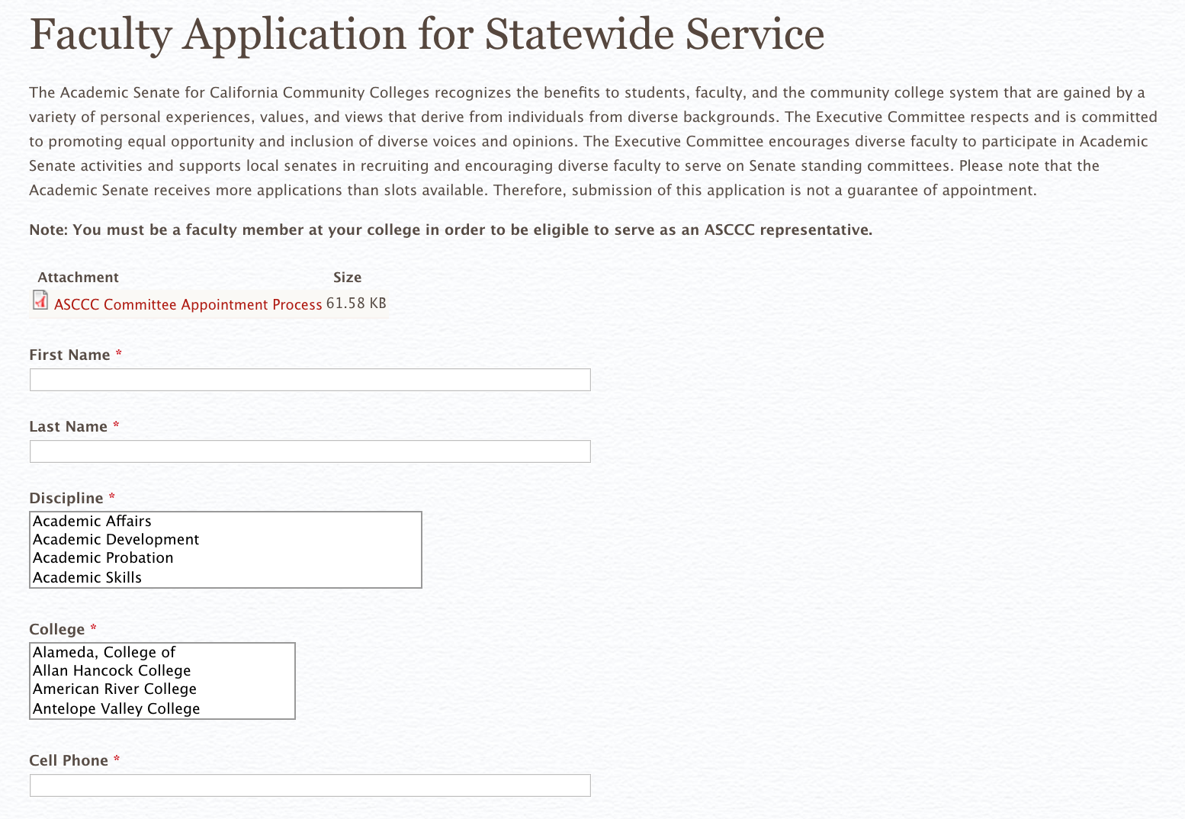
So how do I sign up?! https://asccc.org/content/faculty-application-statewide-service
Notes:
Slides 6-10 are regarding new delegates. John S. need to let us know if these need any changes, since this is his 20-30 minute section of the breakout.

Slide 21
Questions & Comments?
Anna Bruzzese
bruzzeaa@piercecollege.edu
Sam Foster sfoster@fullcoll.edu
LaTonya Parker latonya.parker@mvc.edu

