Slide 1
2018 Strong Workforce Stars

Slide 2
2018 Strong Workforce Stars Recognizing Excellence in Student Outcomes
The Strong Workforce Stars program celebrates career education programs that are moving the needle on factors that enhance social mobility for students who earn a certificate or degree.
Notes:
Background
The Strong Workforce Stars program celebrates career education programs that are moving the needle on factors that enhance social mobility, by recognizing programs whose students achieve at least one of the following measures:
An increase in earnings by 50% or more, based on a match to the state wage file, for students who earned a certificate or degree and were last enrolled in 2015-16
Attainment of the regional living wage by 70% or more students, based on a match to the state wage file, for those who earned a certificate or degree and were last enrolled in 2015-16
90% or more students are employed in a job similar to their field of study, according to the CTE Outcomes Survey, for those who earned a certificate or degree and were last enrolled in 2014-15

Slide 3
2018 Strong Workforce Stars Recognizing Excellence in Student Outcomes
Students improved earnings by 50% or more
Notes:
Background
The Strong Workforce Stars program celebrates career education programs that are moving the needle on factors that enhance social mobility, by recognizing programs whose students achieve at least one of the following measures:
An increase in earnings by 50% or more, based on a match to the state wage file, for students who earned a certificate or degree and were last enrolled in 2015-16
Attainment of the regional living wage by 70% or more students, based on a match to the state wage file, for those who earned a certificate or degree and were last enrolled in 2015-16
90% or more students are employed in a job similar to their field of study, according to the CTE Outcomes Survey, for those who earned a certificate or degree and were last enrolled in 2014-15

Slide 4
2018 Strong Workforce Stars Recognizing Excellence in Student Outcomes
90% or more of students were employed in a job similar to field of study
Notes:
Background
The Strong Workforce Stars program celebrates career education programs that are moving the needle on factors that enhance social mobility, by recognizing programs whose students achieve at least one of the following measures:
An increase in earnings by 50% or more, based on a match to the state wage file, for students who earned a certificate or degree and were last enrolled in 2015-16
Attainment of the regional living wage by 70% or more students, based on a match to the state wage file, for those who earned a certificate or degree and were last enrolled in 2015-16
90% or more students are employed in a job similar to their field of study, according to the CTE Outcomes Survey, for those who earned a certificate or degree and were last enrolled in 2014-15

Slide 5
2018 Strong Workforce Stars Recognizing Excellence in Student Outcomes
70% or more of students attained the regional living wage
Notes:
Background
The Strong Workforce Stars program celebrates career education programs that are moving the needle on factors that enhance social mobility, by recognizing programs whose students achieve at least one of the following measures:
An increase in earnings by 50% or more, based on a match to the state wage file, for students who earned a certificate or degree and were last enrolled in 2015-16
Attainment of the regional living wage by 70% or more students, based on a match to the state wage file, for those who earned a certificate or degree and were last enrolled in 2015-16
90% or more students are employed in a job similar to their field of study, according to the CTE Outcomes Survey, for those who earned a certificate or degree and were last enrolled in 2014-15

Slide 6
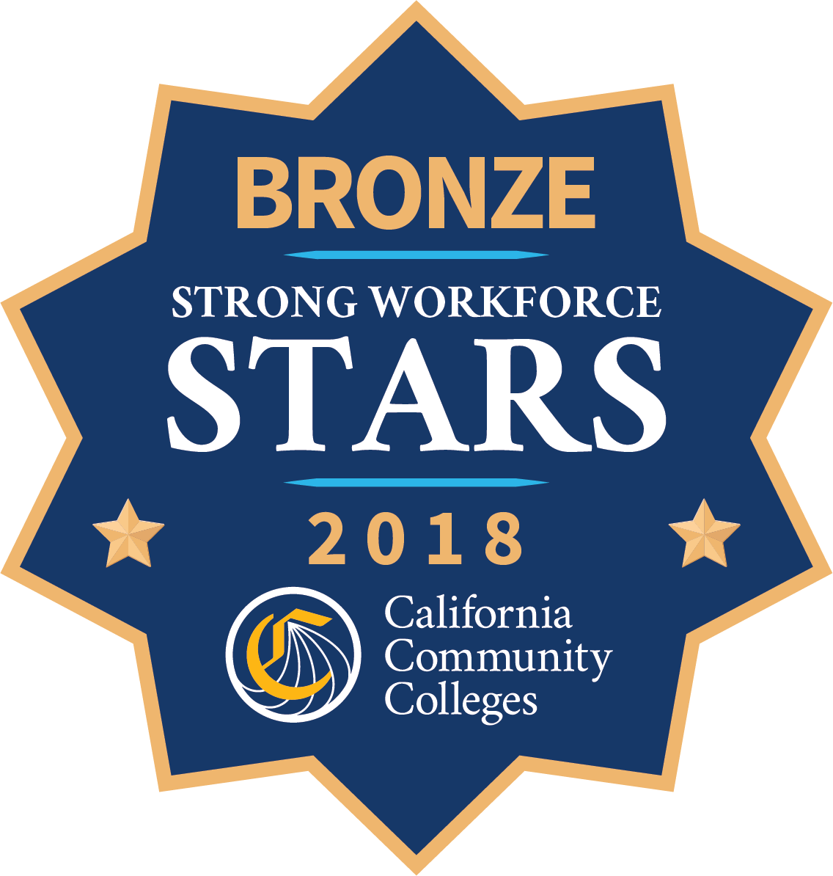
Three categories correspond to number of thresholds achieved
Gold: 114 programs
Silver: 296 programs
Bronze: 977 programs
Total: 1,387 programs
Notes:
Programs fall into three categories:
Gold—attained all three thresholds
Silver—attained two of three thresholds
Bronze—attained one of three thresholds
In total, we have 114 Gold Star programs, 296 Silver Star programs, and 977 Bronze Star programs
For a total of 1,387 recognized programs across the California Community College system

Slide 7
Regional Summaries
Notes:
Regional Totals for All Stars

Slide 8
Regional Summaries

Slide 9
2018 Strong Workforce Stars Common Characteristics
Analysis of the Gold Star programs reveals six common program characteristics:
Industry driven
Career directed
Faculty led
Student centered
Data informed
Intersegmentally engaged
Notes:
We had researchers interview all of the Gold Star programs to identify reasons why they perform so well. Then we conducted an analysis of the Gold Star programs to identify common characteristics.
Most of the Gold Star programs were in healthcare, construction and public services programs. Often these programs are jointly designed with area employers. Several are apprenticeship programs, thus guaranteeing employment, union-negotiated wages, on-the-job training, and co-design and delivery of coursework. Finally, several accounting programs received Gold Star recognition.
Analysis of the Gold Star programs reveals six common program characteristics:
Industry driven: sector partners play a vital role in shaping and delivering their programming, and programs align both content and instruction with external standards to ensure students were fully prepared for the requirements of their future workplace
Career directed: make direct connections between program participation and related career opportunities and integrate real-world experiences, such as hands-on simulations, project-based learning, field experiences, internships, and clinical placements
Faculty led: faculty work in the industry while teaching, stay connected through sector-based associations, and/or participate in professional networks
Student centered: respond to the priorities, experiences, and needs of the students by integrating academic support and focused educational advising; and (in some cases) include students in program design and decision-making
Data informed: continuously use data and evidence to direct the development and delivery of their offerings, often by soliciting information from current and former students and employers
Intersegmentally engaged: recognize the value of intersegmental partnerships for placing students on a path to employment success by building strong relationships with both high schools and four-year institutions

Slide 10
2018 Strong Workforce Stars Publicity
www.dwmshowcase.com
Notes:
Beginning in early June, the Chancellor’s Office spearheaded a publicity push for the Stars, including:
A Strong Workforce Stars page on the DWM Showcase website. It includes a list of all the recognized programs.
Users can search for Stars programs by college, region, industry sector, type of criteria, and type of star
You can also read a brief write-ups of each of the Gold Star programs
The website includes additional background information on the Strong Workforce Stars initiative as well as a write up of the common characteristics of Gold Star programs
Strong Workforce Stars Programs will be flagged as recognized in the Here to Career (an app that helps CCC students make informed education and career decisions)
Media kits were provided to all the recognized colleges so that they could conduct their own publicity campaigns locally

Slide 11
Browse the eShowcase Success Stories - search for strategies and practices that advance student success and workforce outcomes:
Industry Engagement
Data-Backed Decision Making
Contextualized Content
Student Engagement and Career Awareness
Regional Collaboration
Notes:
These are a list of the Gold Star programs from the San Diego-Imperial region.
Joining us here today are some representatives from Strong these programs. Please give them a hand for all the good work that they do.

Slide 12
Future of the Strong Workforce Stars

Slide 13
Q u e s t i o n s
and thank you

