Slide 1
Student Equity and Achievement Metrics and Student Equity Plans
Silvester Henderson, ASCCC At Large Senate Representative
Alyssa Nguyen, Director of Research & Evaluation,
the RP Group
,
ASCCC Spring Plenary -2019
Westin San Francisco Airport
1 Old Bayshore Highway Millbrae, Ca 94030
April 11-13, 2019

Slide 2
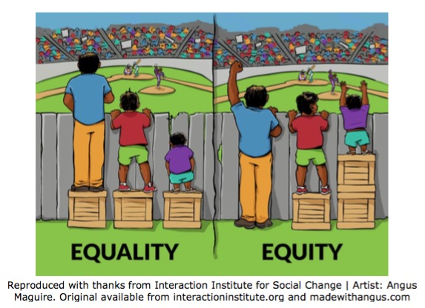
AB 705 - the Student Equity Plan
Title 5 (§51026 and §54220)
Requires college districts to produce a student equity plan. Vision for Success
With adoption of the Vision for Success, the Student Equity and Achievement (SEA) Program was created to replace the Basic Skills Report, the Student Success and Support Program report, and the Equity report. Components of the Student Equity and Achievement Plan can be grouped into four broad categories: (1) research, (2) goals, (3) implementation, and (4) evaluation.

Slide 3
AB 705: Summary, Intent, Opportunity
Bill Summary
AB 705 helps more students succeed in completing a degree, certificate or transfer by ensuring that they have access to college-level courses when they first enter a community college. In order to maximize the likelihood that students will complete college-level coursework in English and math within a one-year timeframe (a key indicator of student success),
AB 705:
1. requires colleges to use high school transcript data, and it sets a standard for how community colleges use high school transcript data, in the placement of students into Math and English courses. 2. allows more students to enroll directly into college-level courses in which they can be successful.
AB 705 leaves room for colleges to exercise local control over placement in response to research with their own student body. AB 705 does not dictate specific placement rules or criteria, rather sets standards that colleges must use in their local decision-making. These standards are designed to ensure that placement decisions maximize a student's likelihood of completing math and English milestones. The Opportunity
With an expected workforce skills gap of 2.4 million, California can’t afford to lose any more capable students at our community colleges, a critical entry point to higher education in the state. AB 705 helps ensure that poor placement policies do not determine a student's destiny, making capable students less likely to reach their college dreams. In doing so, California will help reduce persistent achievement gaps by race/ethnicity, reduce a student’s time-to-degree, and increase successful student outcomes.
https://collegecampaign.org/wp-content/uploads/2016/06/AB-705-Fact-Sheet.pdf
Notes:
Mallory - Remove background logos

Slide 4
A Brief History of AB 705’s Origins and Development
STEPS started with 14 colleges
Multiple Measures Assessment Project (MMAP) – started in 2014-15 with the 14 STEPS colleges
Common Assessment Initiative (CAI) and Multiple Measures Work Group formed
MMAP decision rules guidance released – over 90 colleges eventually join pilot
AB 705 passed (October, 2017)
AB 705 Implementation Committee formed and an ESL subcommittee formed
Selection bias question: Are students with a certain GPA who were placed into a course representative of all students with that GPA, including those not so placed?
RP Group adjusted predicted pass rates for the AB 705 Implementation Committee
RP Group recommendations incorporated into CCCCO guidance memos on English and math
AB 705 Implementation Committee and ESL subcommittees continue to meet to provide additional guidance
Notes:
Mallory - Remove background logos

Slide 5
MMAP Recommendations
English & Math Transfer-Level Placement
Transfer Level Course | Recommended for Placement
English | HS GPA ≥ 2.6
Statistics Passed Algebra I (or better) | HS GPA ≥ 3.0 or HS GPA ≥ 2.3 & Pre-Calculus C (or better)
Pre-calculus Passed Algebra II (or better) | HS GPA ≥ 3.4 or HS GPA ≥ 2.6 & enrolled in Calculus
bit.ly/RulesMMAP
Notes:
Mallory
These are no longer MMAP rules, strictly speaking. The high school GPA in question is either cumualative 11th grade GPA or 12th grade cumulative GPA (unweighted)

Slide 6
Results from Early Adopters of AB 705
Notes:
Mallory - Remove background logos

Slide 7
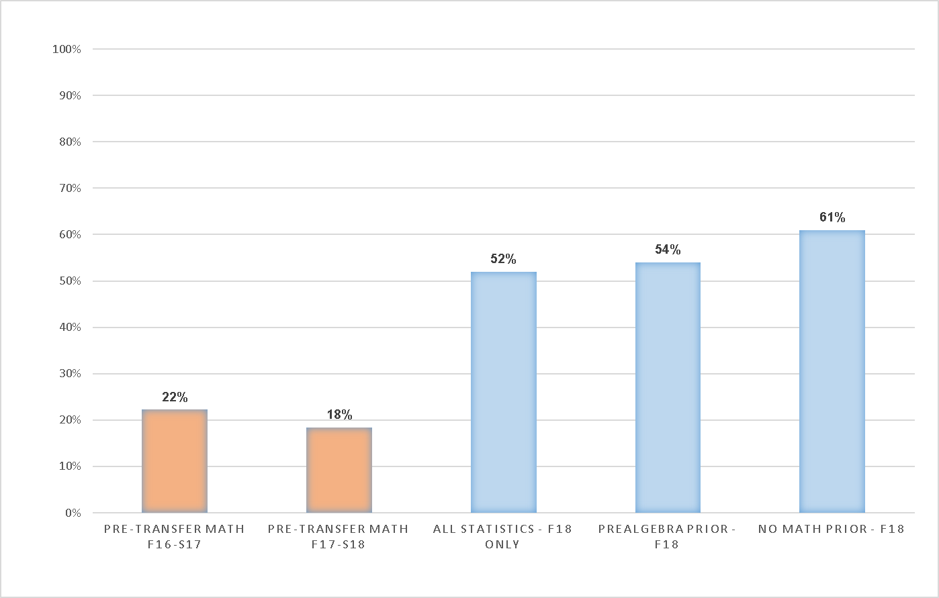
Throughput Rates – Statistics
Pretransfer math includes 3 levels below transfer tracked for three terms, fall 2016 to spring 2017. Fall 2018 statistics became open enrollment with no coreq, represents one-term success rates.

Slide 8
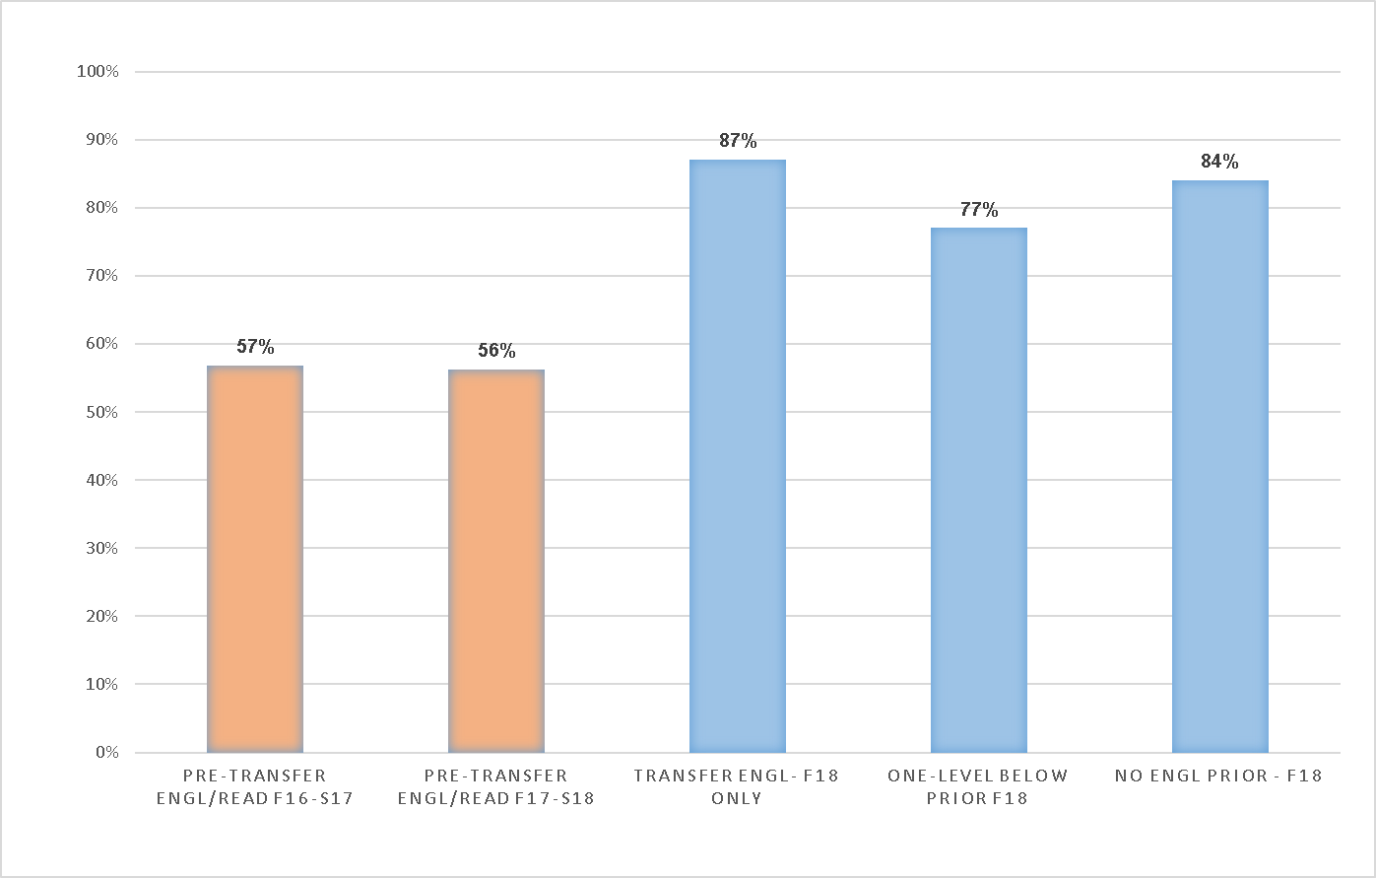
Throughput Rates – English and Reading
Pretransfer English and Reading includes 2 levels below transfer for each course tracked for three terms, fall 2016 to spring 2017. Fall 2018 reading was integrated into English and open to > 2.6 HSGPA with no coreq, represents one term success rate.

Slide 9
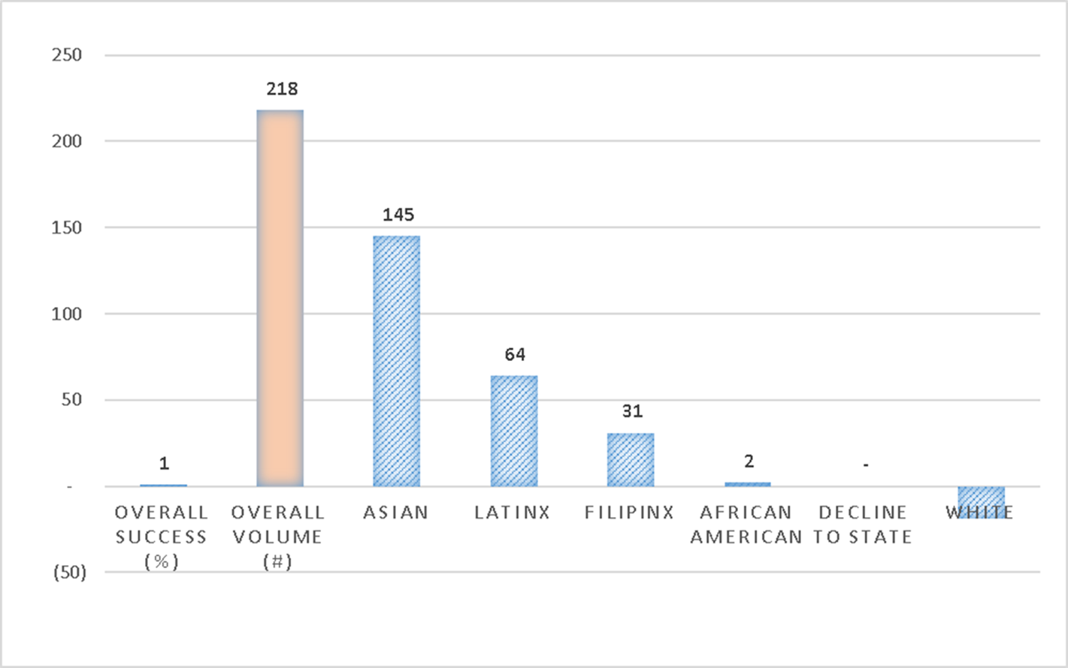
ENGL1A Success Rate and Volume of Successful Completions Fall 2017 vs. Fall 2018
The overall success rate increased by 1% and total successful completions increased by 218 total students.
< 2.6 HSGPA eligible in fall 2018.

Slide 10
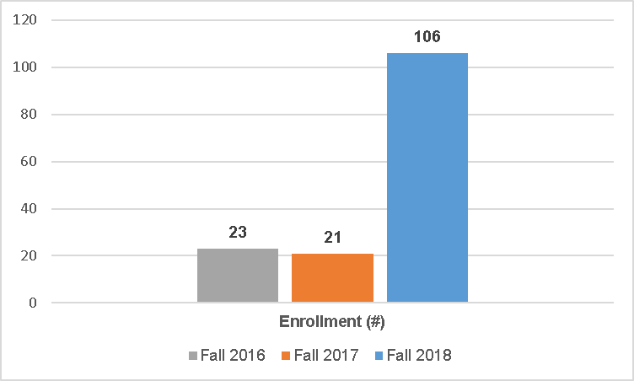
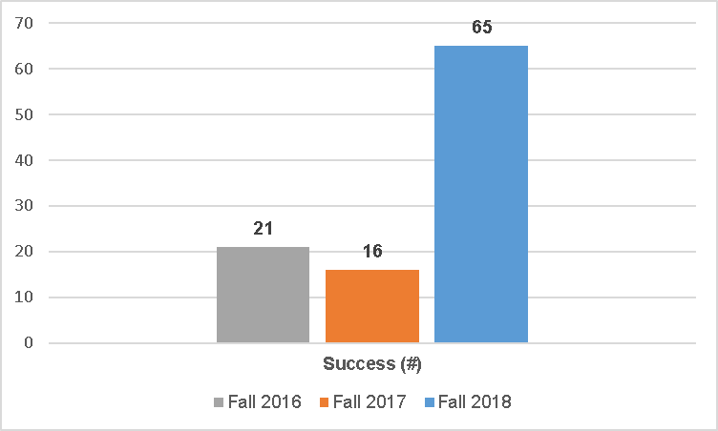
College of the Redwoods Contemporary Math Enrollment and Success
Liberal Arts Math open to all students in fall 2018 with no corequisite. Overall success rates between fall 2017 and fall 2018 decreased 15% but overall completions increased by 49 students.

Slide 11
Upcoming Events:
NAVIGATING AND NETWORKING THROUGH AB 705 IMPLEMENTATION: WE’RE ALL IN THIS TOGETHER
The MMAP Research Team in collaboration with the Chancellor’s Office for California Community Colleges, The RP Group, and Educational Results Partnership would like to invite up to 8 members from your AB 705 implementation team to join us for a half-day of discussion, learning and networking regarding the various ways colleges are implementing AB 705 requirements. The event will bring together colleges within your region at this in-person convening to share their experiences, challenges and opportunities. A CCCCO representative, as well as members of the MMAP Team will be available to address questions. Lunch will be provided.
APRIL 12 | DE ANZA COLLEGE
10 a.m. - 3 p.m.
APRIL 19 | IRVINE VALLEY COLLEGE
10 a.m. - 3 p.m.
APRIL 26 | SIERRA COLLEGE
10 a.m.- 3 p.m.
MAY 3 | SAN DIEGO MESA COLLEGE
9 a.m.- 2 p.m.
RSVP: https://bit.ly/2T7ZXGO
Notes:
Mallory/Terrence
The Multiple Measures Assessment Project (MMAP) created models (decision trees) for mathematics and English placement.
Models built using high school performance data, including HS GPA, HS course grades, and HS courses taken.
RP Group researchers identified students that were highly likely to succeed (70%+ likelihood), thereby reducing the “underplacement” that had been observed when test scores primarily drove student placement.
Colleges that implemented MMAP placement rules saw an increase in the number of students being placed into transfer level courses.
Most colleges maintained or increased their success rates.

Slide 12
Questions & Comments?
Please feel free to contact each of us for more information:
Silvester Henderson, ASCCC At-Large Representative – shenderson@losmedanos.edu
Alyssa Nguyen,Director of Research & Evaluation,
the RP Group – anguyen@rpgroup.org

