Slide 1
Student Learning Outcomes, Assessment, and the Curricular Process
Ginni May, ASCCC North Representative, Sacramento City College
Michael Wyly, Solano Community College
ASCCC Curriculum Institute
July 8-11, 2015
Anaheim, CA
Notes:
Ginni and Michael

Slide 2
Overview
We will consider the following questions:
What is SLO Assessment?
How do we use our assessments to inform our curriculum?
When does assessment data meaningfully reveal needs to make curricular modifications--whether it be about prerequisites, course design or even program design?
How does your college use SLO assessment, and what processes make for effective practices in SLO and curricular improvement?
Notes:
Michael

Slide 3
What is SLO Assessment?
Evaluating the learning and mastering of core ideas in the curriculum…
Notes:
Ginni

Slide 4
How do we use our assessments to inform our curriculum?
First of all…
Assessment of student learning is integral to what we do.
ACCJC requirement: II.A.3. The institution identifies and regularly assesses learning outcomes for courses, programs, certificates and degrees using established institutional procedures. The institution has officially approved and current course outlines that include student learning outcomes. In every class section students receive a course syllabus that includes learning outcomes from the institution’s officially approved course outline.
Notes:
Ginni

Slide 5
How do we use our assessments to inform our curriculum?
Some models…
Sacramento City College:
Department SLO Assessment Multi-year Plan – 6 year cycle to align with Program Review
Course SLO Assessment reporting – annually to align with Unit Plan cycle
Annual Reporting Form for each course includes: SLOs, Assessment methods, Summary of assessment results, Plans for follow-up changes
Program SLOs, General Education SLOs, and Institutional SLOs are assessed through a course-embedded approach
Notes:
Ginni

Slide 6
How do we use our assessments to inform our curriculum?
Some models…
Solano Community College:
Individual course SLO assessment per departmental multi-year plans as part of Program Review cycle, including how SLO assessments support Program Learning Outcomes (PLOs)
SLO Assessment reporting: 1. until F 2014, an aggressive cycle wherein all courses were individually assessed in a given academic year; 2. beginning with AY2014-15, course SLO assessments reporting annually per five-year cycle to inform regular PLO assessment as well as updates to departmental EMPs
SCC SLO Assessment Form includes for each SLO: Success Criteria; Results; Planned Action (which may inform course specific changes or suggest macro-changes such as at the program level)
The English Department is currently piloting an approach for embedding College equity goals into our assessment process: departmental equity goals; SLO assessments; analyses of assessment results as they relate to department-specific equity/success data
Program Level Outcomes assessments are informed by course-level SLO assessments. Institutional Level Outcomes (ILOs) and GE Learning Outcomes (GELOs) are currently being revised at SCC with the aim of developing clearer and more sustainable methods of assessment through a course embedded process. This is a work in progress.
Notes:
Michael

Slide 7
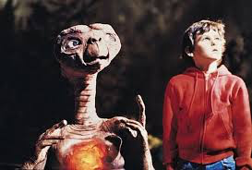
How do we use our assessments to inform our curriculum?
Some models…
Your colleges:
Notes:
Michael – take volunteers to describe their assessment processes

Slide 8
How do we use our assessments to inform our curriculum?
Examples…
Add more course time to a specific topic
Implement a prerequisite
Change course sequencing
Others?
Notes:
Small group discussion and report out for this slide and the next two

Slide 9
How does your college use SLO assessment, and what processes make for effective practices in SLO and curricular improvement?
Notes:
Small group discussion and then report out…

Slide 10
When does assessment data meaningfully reveal needs to make curricular modifications whether these changes be to prerequisites, course design? What if the need for a prerequisite creates worries for enrollment? What if the assessment data calls for real programmatic change? Discontinuance?
Notes:
Small group discussion and report out…

Slide 11
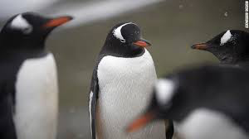
Discussion
Notes:
Ginni and Michael

Slide 12
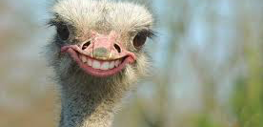
Thank you!

Slide 13
References
ACCJC http://www.accjc.org

