Slide 1
Student Services and Care in a Pandemic Friday, February 19 12:30--1:30 p.m.

Slide 2
Session Description
As educators and researchers know, students do better and are more likely to complete their education goals if they feel connected to their campus. In these unprecedented times when our students are disproportionately impacted by Covid 19, how do we provide much needed student services in the virtual realm? This session will focus on practical steps and strategies we can take as educators and student service professionals to provide much needed services and care online.

Slide 3
Land Acknowledgement
We acknowledge the land that American River College occupies today as the traditional home of the Nisenan, Maidu, and Miwok tribal nations. These sovereign people have been the caretakers of this land since time immemorial. Despite centuries of genocide and occupation the Nisenan, Maidu, and Miwok continue as vibrant and resilient tribes and bands, both Federally recognized and unrecognized. We take this opportunity to acknowledge the generations that have gone before as well as the present-day Nisenan, Maidu, and Miwok
https://native-land.ca/
Source: https://arc.losrios.edu/student-resources/native-american-resource-center

Slide 4
Introductions
Dr. Emilie Mitchell
ASCCC Part-time Committee
American River College
Psychology Professor
Faculty Coordinator for ARC Pride Center
Lead Planner on CCC LGBTQ+ Summit
Martin Gomez, MA
ASCCC Transfer, Articulation, Student Services Committee
American River College
EOP&S/CARE/NextUp Faculty Coordinator

Slide 5
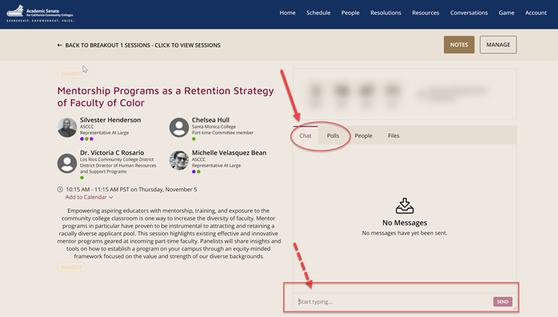
Questions
Use the Pathable platform CHAT box

Slide 6
What We Hope You Get Out of This Presentation:
Understand the important difference between empathy and sympathy.
Understand how Covid 19 is affecting our most marginalized students
Acknowledge the unique challenges in providing student services in the virtual realm
Develop strategies for how to connect with students virtually
Notes:
Emilie

Slide 7
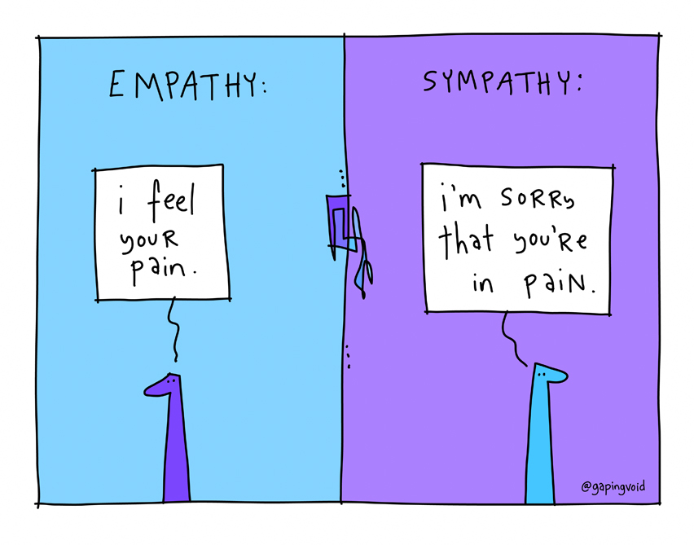
Empathy Versus Sympathy
Empathy is defined as the feeling that arises when you perceive another’s suffering and feel motivated to relieve that suffering.
Source: https://ggie.berkeley.edu/student-well-being/kindness-and-compassion-for-students/.
Sympathy is feelings of pity and sorrow for someone else's misfortune.
Source: https://www.google.com/search?client=firefox-b-1-d&q=sympathy
Notes:
Martin

Slide 8
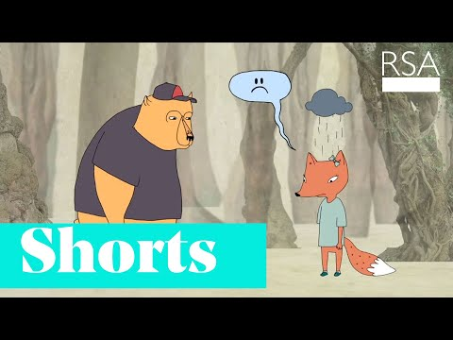

Slide 9
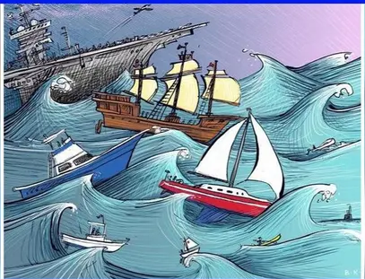
We are NOT all in the same boat
We are all in the same storm but were are not all in the same boat - exact authorship unknown
Notes:
Martin

Slide 10
The Pandemic Is Not Affecting Everyone Equally
BIPOC communities have higher cases, hospitalizations and death rates than white americans.
Source: https://www.cdc.gov/coronavirus/2019-ncov/covid-data/investigations-discovery/hospitalization-death-by-race-ethnicity.html
Notes:
Emilie

Slide 11
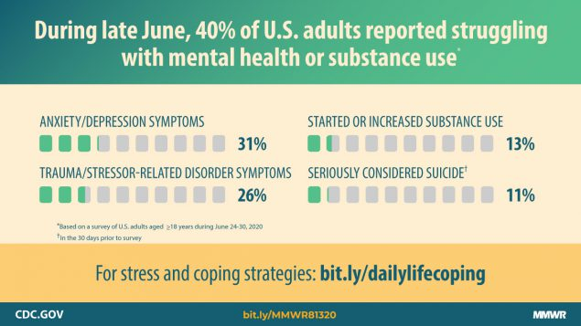
The Psychological Toll
Younger adults, racial/ethnic minorities, essential workers, and unpaid adult caregivers reported having experienced disproportionately worse mental health outcomes, increased substance use, and elevated suicidal ideation
Source: Czeisler MÉ , Lane RI, Petrosky E, et al. Mental Health, Substance Use, and Suicidal Ideation During the COVID-19 Pandemic — United States, June 24–30, 2020. MMWR Morb Mortal Wkly Rep 2020;69:1049–1057. DOI: http://dx.doi.org/10.15585/mmwr.mm6932a1 external icon
.
Notes:
For example, almost 75% of those 18-24 reported at least one adverse mental or behavioral health symptom and 66% of those with less than a high school diploma also reported at least one behavioral/ mental health symptom. This is in comparison to about 10% of individuals in 2019.
Emilie

Slide 12
Student Narratives
I was dropped from an engwr 300 class for not joining a Facebook group by a stated time. when I asked if I could make a Facebook to join the group I was told no because it was pass a Friday evening deadline. I was dropped from a speech 301 class because when I signed on to the zoom meeting I was in the car and that was a problem for the professor. I think the professors shouldn't been a little more understanding seeing how many students such as myself didn't fully understand this remote learning
It was hard for me to take online classes and hard to focus in these online environment. I prefer on campus classes.
Right now I financially responsible for my household and I am working full time and some side jobs so I could catch with home renting, bills and all other expenses.
Notes:
Martin

Slide 13
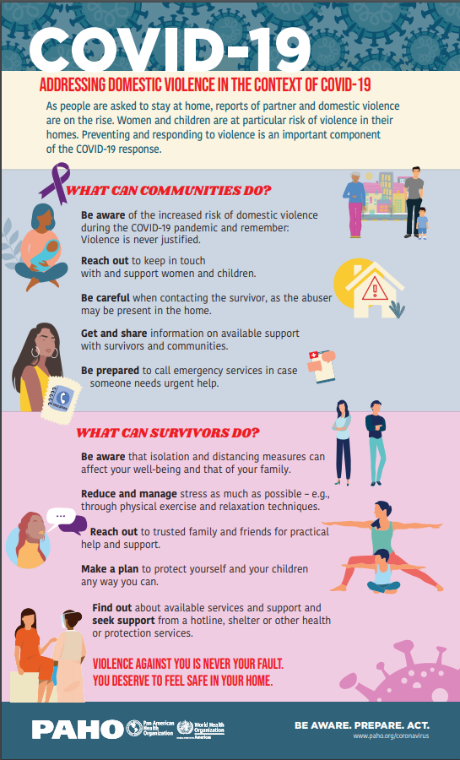
Family Violence
The Lockdown associated with keeping folks safe in the time of Covid also increases family violence with few options for victims
Less likely to come to the attention of those who could intervene (doctors, educators, and other service providers.
Notes:
Factors Increasing Family Violence
Stress/ Financial Insecurity
Constant Contact
Increased calls to hotlines

Slide 14
Student Narratives
Half way through the semester I was doing great in all my classes and had As and Bs in my classes until I was infected with COVID-19 and had to go through so much pain, not only physical but mental too, and hard time that made it difficult for me to stay on track with my classes and after getting back to health and also mentally getting better I tried to catch up with missing assignment then another big event happened in my life and that was losing my closest friend to death. He was shot with one other guy I knew while grocery shopping and that incident was to much pain for my heart and brain to handle. I was going through depression. I contacted with my professors and let them knew that I need break and thanks to them they all accepted it with some conditions that I have to finish all the assignments when I get back.

Slide 15
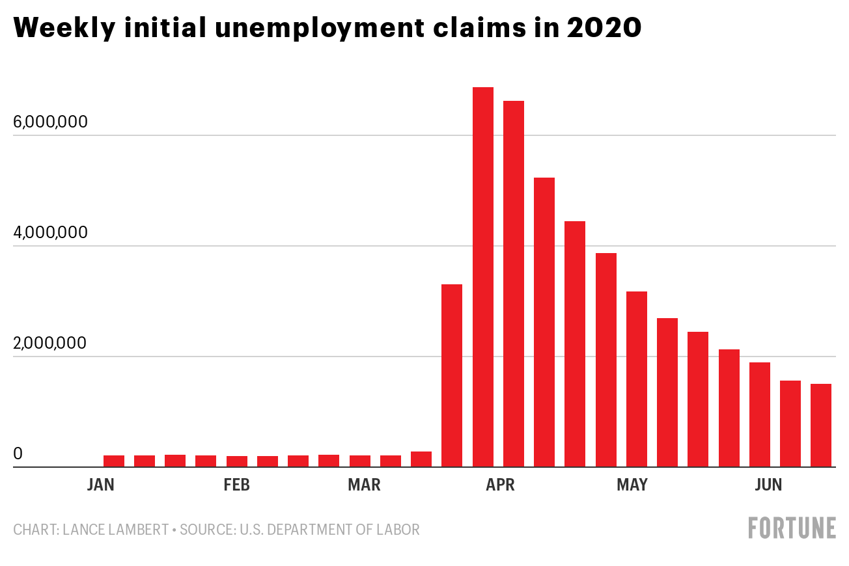
Unemployment
Extraordinarily high rates
Higher than during the Great Recession
Not equal across all groups
Source: https://fas.org/sgp/crs/misc/R46554.pdf
Notes:
Emilie
The unemployment rate peaked at an unprecedented level, not seen since data collection started in 1948, in April 2020 (14.7%) before declining to a still-elevated level in November(6.7%)
In April, every state and the District of Columbia reached unemployment rates greater than their highest unemployment rates during the Great Recession
Young workers, women, workers with low educational attainment, part-time workers, and racial and ethnic minorities had relatively high unemployment rates

Slide 16
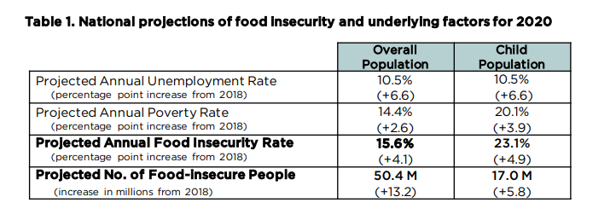
Housing and Food Insecurity
Housing
In September, 8.5% of renters, or 2.82 million households, missed, delayed, or made reduced payments while 7.1%, or 3.37 million homeowners, missed their mortgage payments. (https://www.usatoday.com/story/money/2020/10/17/covid-19-stimulus-6-million-miss-rent-mortgage-payments-september/3694327001/)
Food insecurity
Notes:
Emilie

Slide 17
Student Narratives
When it was the time period to sign up for classes, my family was moving because covid stalled my families income and we no longer could afford the place we were staying previously. My family moved out to Fairfield which is nearly a 50 minute drive to American River college. After we moved, the California fires caused my family to evacuate so we had to pack up and go back to Sacramento and stay at a friends house for a little while until we were cleared to move back.
Notes:
Martin

Slide 18
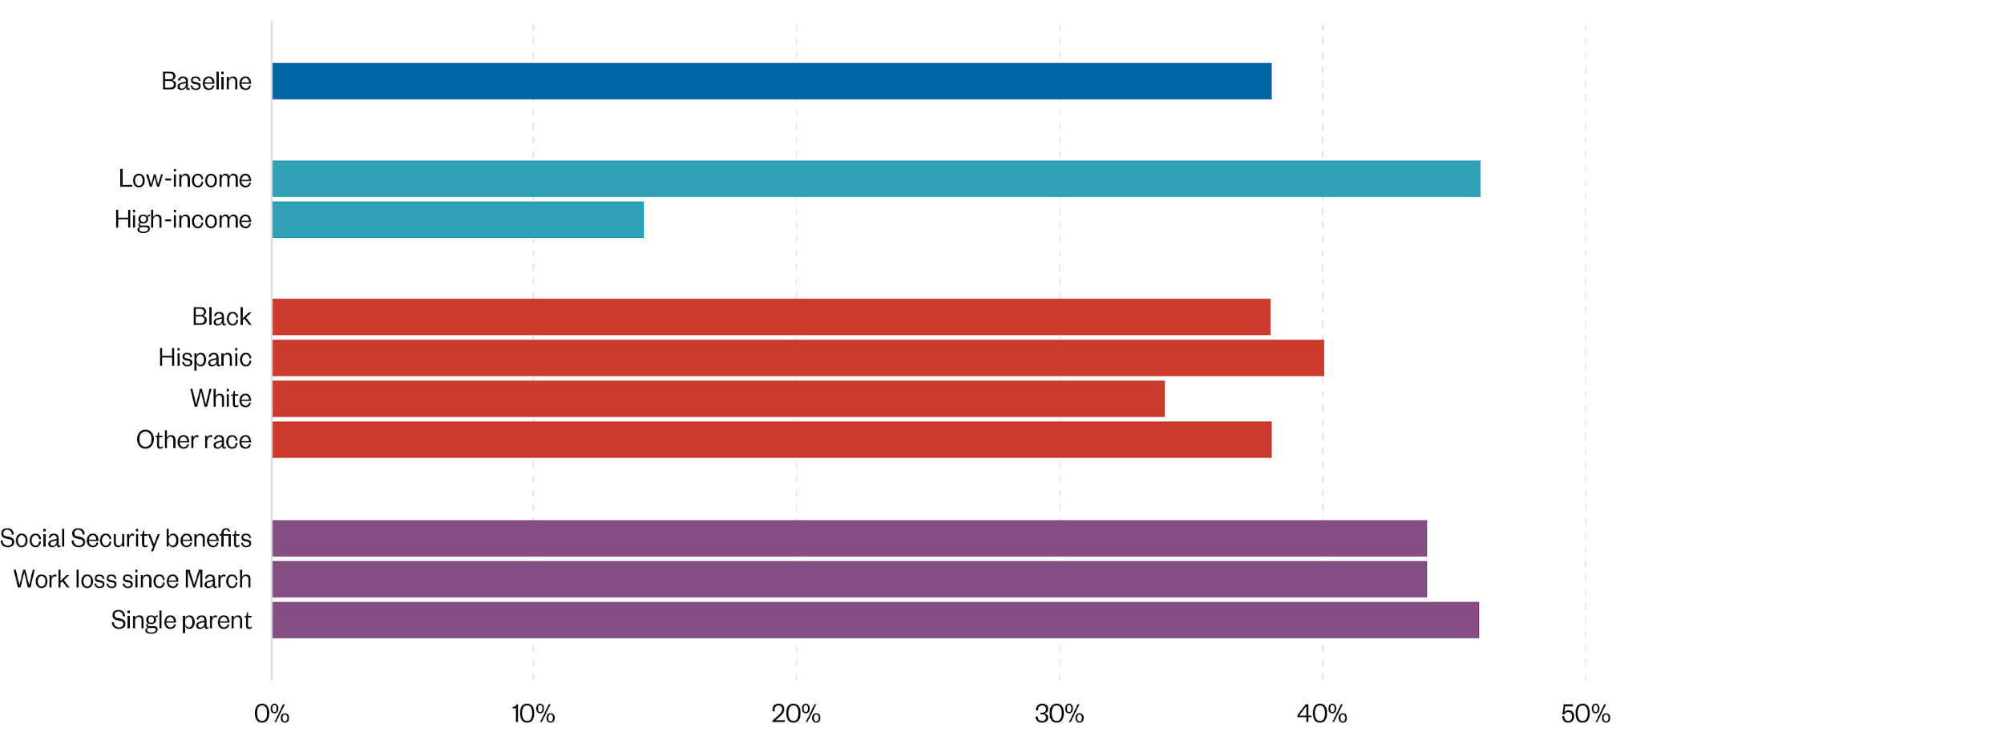
Less Students Are Enrolling
We have seen across CA a drop of 5-7% in enrollment (Fall - 2019;
https://edsource.org/2020/fewer-students-attending-california-community-colleges-early-fall-numbers-show/640373)
Notes:
Martin

Slide 19
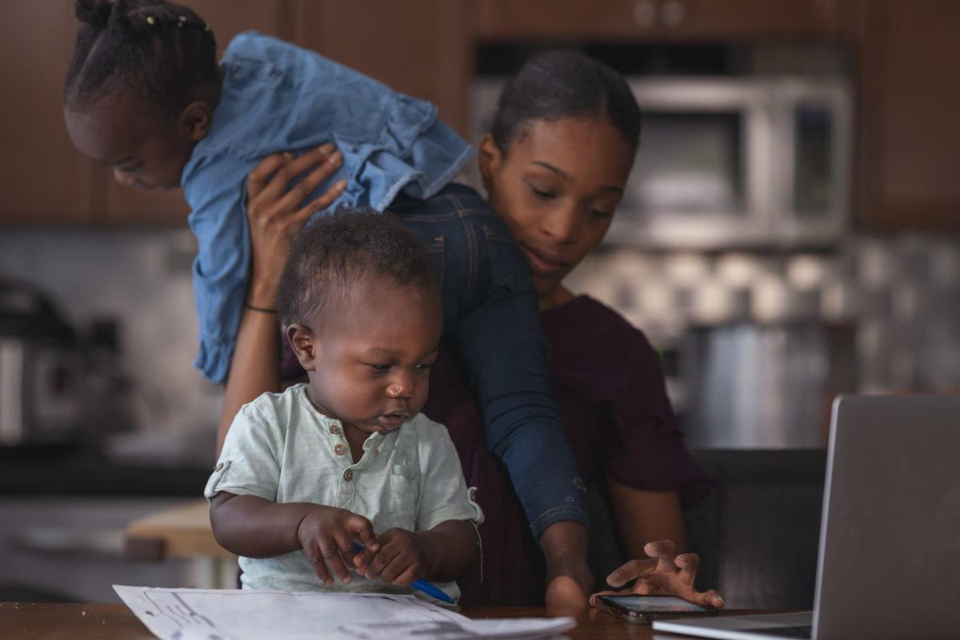
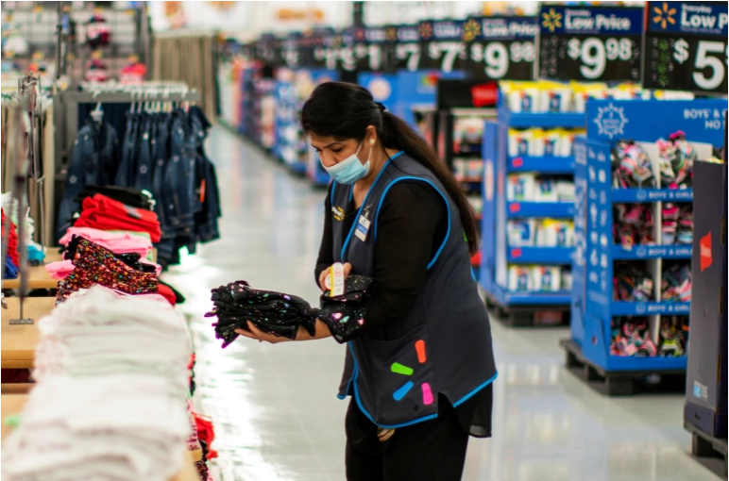
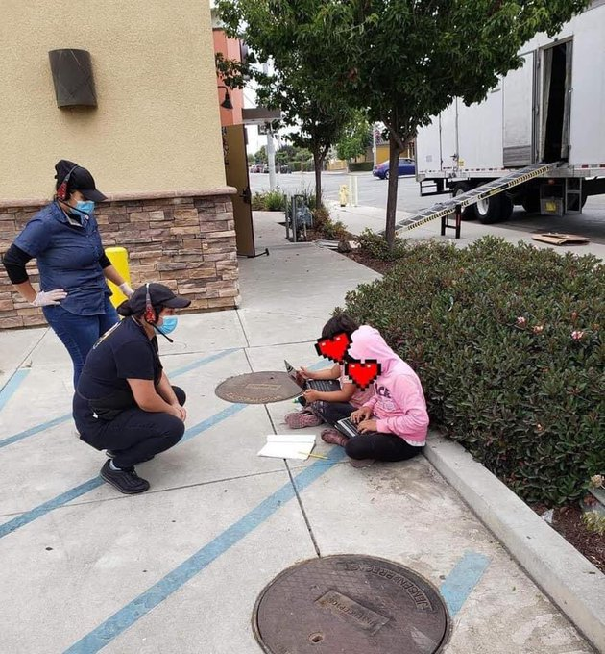
Additional Environmental Stressors
Technology isn’t free
Availability of resources (laptops, hot spots)
Children at home
Essential workers
Notes:
Emilie

Slide 20
Part -Time Colleagues
Part-time faculty make up almost seventy percent of the California Community College system educators
Part -time classified professionals
More likely to serve our most marginalized students
Lack tenure and job security/lower pay/ lack of health insurance
Notes:
Emilie

Slide 21
Strategies for Serving Our Students (3 Cs)
Create community when you can
Connect virtually
Convey important information
Notes:
Martin

Slide 22
For Further Information and Support
Email info@asccc.org
Contact Info:
Martin Gomez gomezm@arc.losrios.edu
Dr. Emilie Mitchell mitchee@arc.losrios.edu
https://cccqsummit.blogspot.com/

