Slide 1
Leveraging Data for Student Support: Tools for Student Services Professionals and Students
Bryan Miller, Foundation for Community Colleges
Omid Pourzanjani, Golden West College
Lynell Wiggins, Pasadena College
Kathy Booth, WestEd

Slide 2
Objectives
Frame the question of how data on jobs and salaries relate to advising and educational planning
Introduce you to Here to Career, a mobile career exploration app that can help with educational planning
Show how the LaunchBoard Program Snapshot can support advising

Slide 3
Jobs of the Future
Extent of training
Transfer curriculum
Much more theoretical
Extended soft skills training through semester-long General Education courses.
Extended Math and English skills through college-level courses.
Time for extended “SSSP” onboarding
Engagement through Student Clubs

Slide 4
Jobs of today
Job-specific orientation
Faster training
Industry-aligned, ever changing training
Hands-on education
Contextualized basic skills
Integrated soft-skills training
Internships and/or Service Learning
Job readiness, interviewing skills, resume writing...
Pathways for transfer and/or skill-building
Industry Associations and Certifications

Slide 5
Advising Expertise
What are the fastest growing jobs - NOW?
What occupation types have the strongest need for employees?
What skills are needed?
How much do they pay?
Who else is offering training programs for these jobs?
Regional view of stackable certificates and job opportunities based on levels of training.

Slide 6
A Counselor’s Perspective
The Utility of Historical Knowledge and SSP as Catalyst
The Proper Ingredients
Career Decisions are like making chocolate chip cookies
Being an informed decision maker is more art than logic; heart, than mind
As Student Services Professionals we must help students cultivate career based engagements
To achieve success, you must know the correct “elements” to add
Begin with the end in mind – a satisfying occupation offering a living wage
Change your campus culture by adopting the Girl Scout mentality
Notes:
Career Decisions are like making chocolate chip cookies
Many can not identify the correct elements to include!
Being an informed decision-maker is more art than logic; heart, than mind (it takes practice)
But using labor market information is intensely rational & reason based
We must begin with the end in mind by helping students understand the value of acquiring a satisfying occupation with a living wage
Passion is initiated once the learner gains a more realistic perspective of the work environment and opportunities within the field
As Student Services Professionals we must help students cultivate career based engagements
Change your campus culture by adopting the Girl Scout mentality
Since our students are our most successful program marketers, we designed a continuum based experience that relied on labor market data and “significant reactions” within a construct of multiple contacts.

Slide 7
PCC Uses the LaunchBoard Program Snapshot Tab for Workforce Experience Education On-Boarding
Career readiness is the attainment and demonstration of requisite competencies that broadly prepare college graduates for a successful transition into the workplace.
Critical Thinking/Problem Solving
Oral/Written Communications
Teamwork/Collaboration
Information Technology Application
Leadership
Professionalism/Work Ethic
Career Management
WEE Onboarding
Career Onboarding
Major Onboarding
Professional Onboarding
Workforce Onboarding
Application
Intake form
Orientation
Industry
Labor Market
Salaries
Program of Study
Learning Outcomes
Employer Feedback
Occupational Selection
Employment Preparation
Career Ready
High school/First Year
First Year/Change of Major
End of Program of Study/Internship
Employment/Returning Student/Displaced Worker

Slide 8
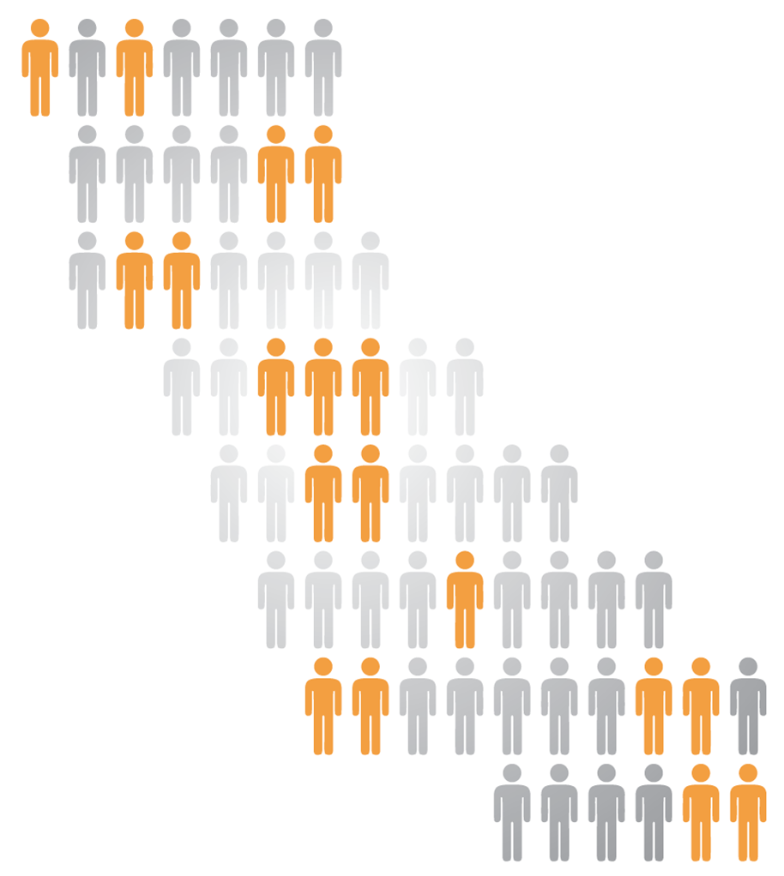
Task Force Roll Out
14 Regional College & Faculty Conversations
Over 700 attendees, including 40% faculty
6 Strong Workforce Town Hall Meetings
Over 500 participants in regions across the state
6 expert background papers on common themes
Workforce Data & Outcomes
Curriculum Development & Instructors
Structured Pathways and Student Support (2 parts)
Regional Coordination
Funding
5 meetings of the 26-member Task Force
221 website & 10 letters during public comment period

Slide 9
Recommendations: Advising and Ed Planning
Broaden and enhance career exploration and planning, work-based learning opportunities and other supports for students
Improve the quality, accessibility, and utility of student outcome and labor market data to support students, educators, colleges, regions, employers, local workforce investment boards, and the state in CTE program development and improvement efforts.
Create a sustained, public outreach campaign to industry, high school students, counselors, parents, faculty, staff, and the community at large to promote career development and attainment and the value of career technical education.

Slide 10
Here to Career powered by salary surfer
Tools You Can Use:

Slide 11
HERE TO CAREER powered by salary surfer
Here to Career
Objectives
Develop an app to help students make informed education and career decisions that lead to greater economic opportunities and professional success
Provide students, counselors, and parents information about community colleges and high-demand career opportunities in the Inland Empire region.

Slide 12
HERE TO CAREER powered by salary surfer
Here to Career
Background
Initiated by a two year investment from The W.K. Kellogg Foundation

Slide 13
HERE TO CAREER powered by salary surfer
Here to Career
Project Team
Chancellor’s Office:
Workforce, Technology/Research, and Communications Divisions
Foundation for California Community Colleges
The Young Invincibles - the nation's largest youth advocate organization

Slide 14
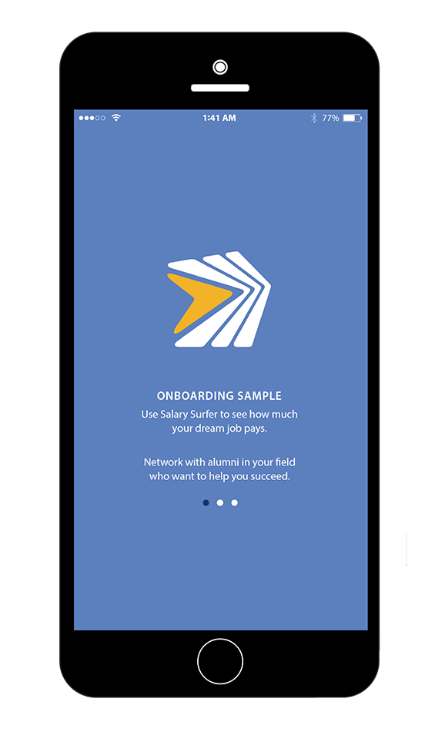
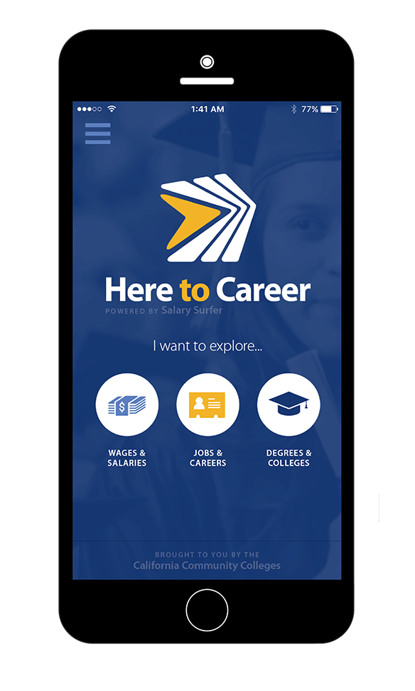
HERE TO CAREER powered by salary surfer
Here to Career
Development
Data Sources: Salary Surfer, Doing What Matters, O*NET, CCC Alumni
Focus Groups: Middle school, high school, and community college students in the Inland Empire area

Slide 15
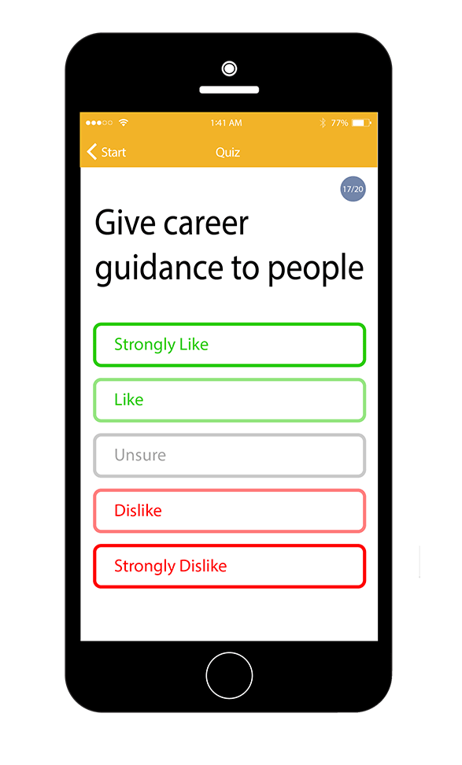
HERE TO CAREER powered by salary surfer
Here to Career – Key Features
Interest Explorer
The 60 question quiz based on the O*NET Interest Profiler
The O*NET Interest Profiler was developed by the U.S. Department of Labor through an extensive research and testing process

Slide 16
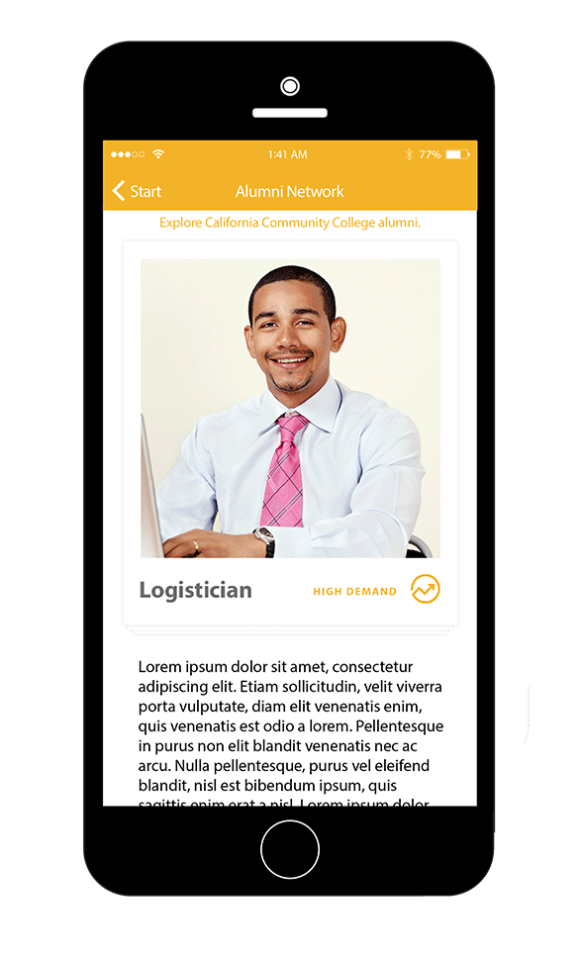
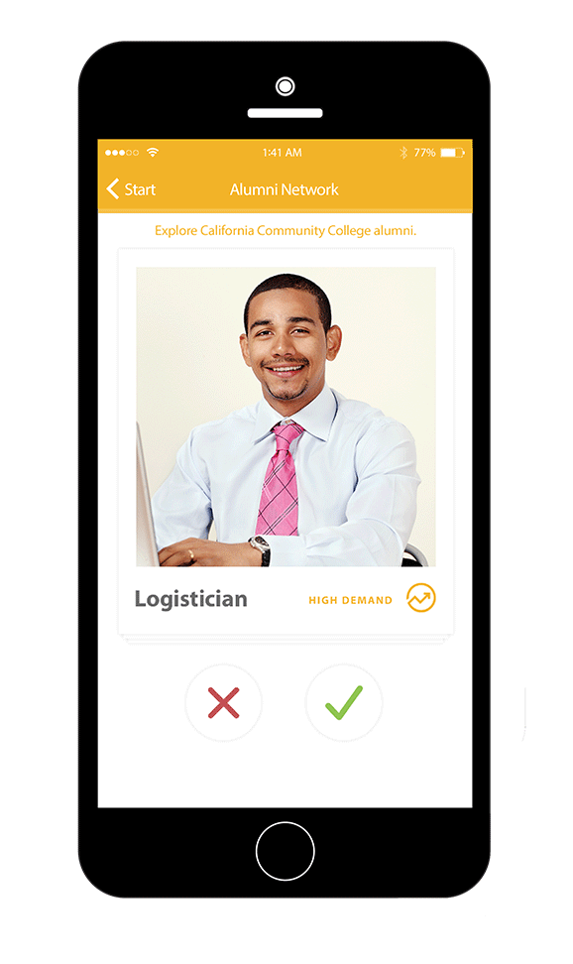
HERE TO CAREER powered by salary surfer
Here to Career – Key Features
Career Profiles
Spotlights regionally in demand careers and salary ranges to help students make informed decisions
Students select profiles of interest, influencing their customized recommendations
Short video vignettes provide engaging insight into careers of interest (currently under development)

Slide 17
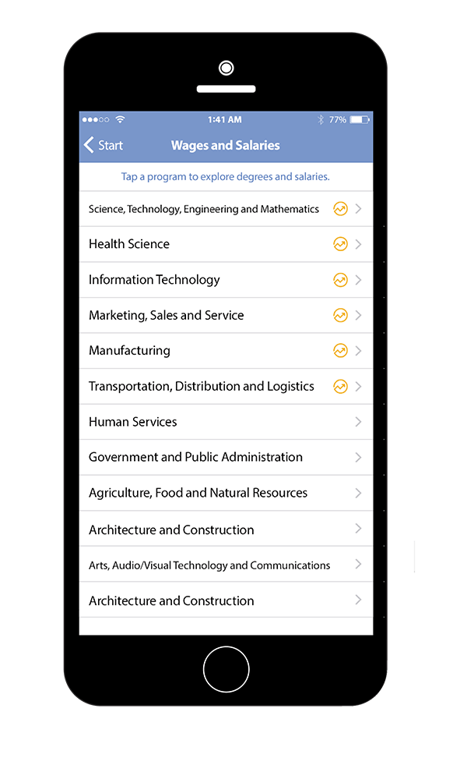
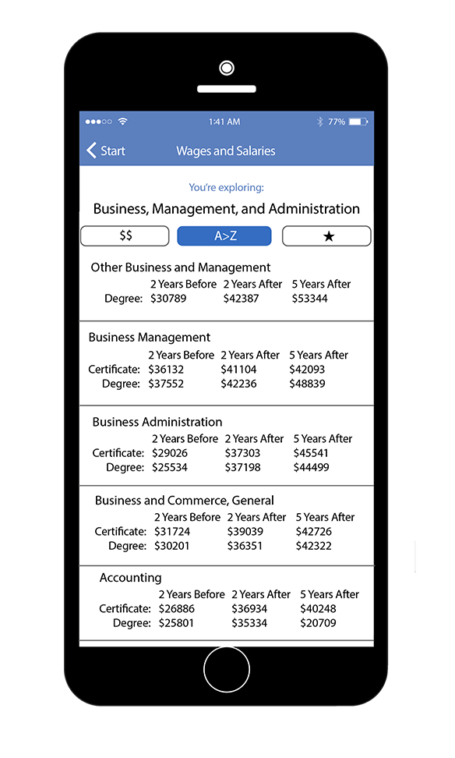
HERE TO CAREER powered by salary surfer
Here to Career – Key Features
Salary Information
View change in salaries for occupations before and after a student earns a related degree or certificate
Regional occupational information from Doing What Matters helps direct students toward in demand jobs.

Slide 18
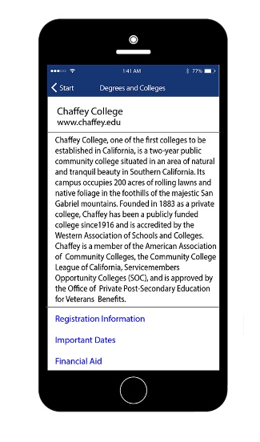
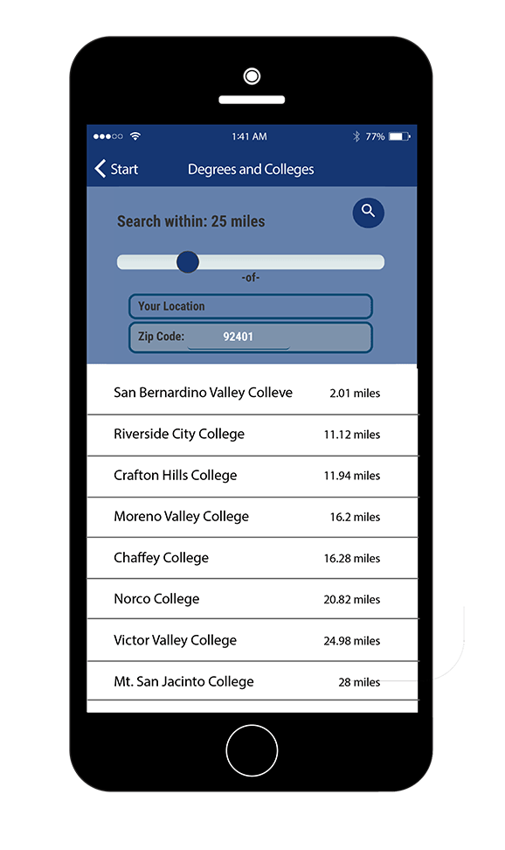
HERE TO CAREER powered by salary surfer
Here to Career – Key Features
Geo Location
Geo location information helps students identify nearby community colleges and explore degree programs offered in the area aligned with their interests

Slide 19
HERE TO CAREER powered by salary surfer
Here to Career
Project Timeline
Previous Phases
Research and Focus Groups: July — December 2014
Initial Development: January — December 2015
Outreach and Further Development: July — December 2015
Current Phase
Final Development and Release: January — March 2016
Outreach and Analytics: February — June 2016

Slide 20
Feedback
How does this tool relate to key concerns for CIOs?
How does this tool relate to key concerns for counselors?
How does this tool relate to your key concerns?

Slide 21
LaunchBoard Program Snapshot
Tools You Can Use:

Slide 22
The LaunchBoard Program Snapshot Tab
Access student outcomes, employment and earnings data, and labor market information by program, sector, college, and region
View visual reports that answer questions like "are the right number of people being trained for available jobs" and "how much money are students making“
Drill down into detailed data tables on student characteristics, milestones, and success

Slide 23
www.calpassplus.org/Launchboard/Home.aspx

Slide 24
Determine what you want to see

Slide 25
In the Reports, find answers to your questions

Slide 26
Get a deeper level of information

Slide 27
Compare figures with other colleges

Slide 28
Common Questions: Labor Market Data
What kinds of jobs are available?
See which jobs have projected openings in the region and the number of people currently employed
What are those jobs like?
View information on starting and median wages

Slide 29
Related Jobs: Nursing
Notes:
San Diego Imperial Environmental Technology

Slide 30
Labor Market Information: Nursing
Notes:
San Diego Imperial Environmental Technology

Slide 31
Regional Salaries: Nursing
Notes:
San Diego Imperial Environmental Technology

Slide 32
Common Questions: Labor Market Data
How do former students do?
See whether students got jobs and how much money they earned
Will students who succeed in this program earn a living wage?
View information on how former students’ earnings compare to regional living wages

Slide 33
Employment Trends: Licensed Vocational Nurse
Notes:
LA County LVN

Slide 34
Employment Trends: Certified Nursing Assistant
Notes:
LA County CNA

Slide 35
Earnings: Licensed Vocational Nurse
Notes:
LA County LVN

Slide 36
Earnings: Certified Nursing Assistant
Notes:
LA County CNA

Slide 37
Earnings: Licensed Vocational Nurse
Notes:
LA County LVN

Slide 38
Earnings: Certified Nursing Assistant
Notes:
LA County CNA

Slide 39
Find Out More
Various two-minute videos describing how to use the LaunchBoard for specific tasks like starting a new program, program review, equity planning, and accessing employment and earnings data
Four-minute video on why we need to count skills-builders in CTE success measures
Eight minute video on earnings outcomes for various CTE pathways
Two guides on understanding and using labor market information
http://doingwhatmatters.cccco.edu/LaunchBoard.aspx

Slide 40
Feedback
How does this tool relate to key concerns for CIOs?
How does this tool relate to key concerns for counselors?
How does this tool relate to your key concerns?

Slide 41
CTE Data unlocked
Getting Support:

Slide 42
CTE Data Unlocked
Provides tools, training, technical assistance, and funding to support better use of CTE outcomes data and labor market information
Strengthens ongoing capacity for CTE data usage in program review, accreditation, integrated planning, and regional and sector-based program design
Supports the development of regional workforce plans and prepares for $200 million in new CTE funding that will be available in 2017

Slide 43
Building Awareness (Spring 2016)
Provide an overview on CTE data at regional trainings:
learn about the expanded CTE metrics on the Student Success Scorecard
get hands-on experience using statewide tools like the LaunchBoard to answer common questions
send a team including a senior administrator (CEO, CIO, or CSSO), plus one or more CTE deans, faculty, and institutional researchers

Slide 44
Deepening Expertise (Summer 2016)
Resources on how to use data tools in various usage cases such as program review, accreditation, and planning, offered in various formats including:
Two minute videos
Seven page guides
Detailed how-to guides
Animated PowerPoints
Short documents on how to analyze and work with metrics such as employment and earnings data and labor market information

Slide 45
Expanding Regional Data Use (Fall 2016)
Support the development of regional workforce plans:
release regional reports that integrate labor market information and student outcomes data from Data Mart, the LaunchBoard, the CTE Employment Outcomes Survey, and other sources
host meetings with colleges, employers, and other educational partners to create regional workforce plans

Slide 46
Supporting College Data Usage (2016-2017)
Support colleges in integrating regional plans and CTE data into core activities:
offer $50,000 in funding and 10 hours of technical assistance to support CTE data usage (for colleges that attended spring training)
host in-depth “super-user” trainings to help practitioners develop a deeper understanding of CTE data tools and labor market information.
provide one free year of participation in the CTE Outcomes Survey (tracks employment and other post-college outcomes)
roll out three years of participation in the CATEMA system (tracks participation in articulated courses and eligibility for credit)

Slide 47
Technical Assistance Examples
Onsite training with student services professionals, faculty, and deans on using employment data for educational planning and to strengthen support services
Hands-on support to pull and format data from statewide data tools to support local and regional processes like program review, accreditation, and planning

Slide 48
Funding Examples
Hire a communications consultant to develop outreach and educational planning materials based on data found in the LaunchBoard, Salary Surfer, and other tools
Hire a consultant or pay faculty release time to gather stories on skills-builder students and analyze skills-builder pathways, to provide a deeper understanding of these students, course clusters, and outcomes

Slide 49
Find Out More
• training content, locations, and dates
• requirements to receive funding and technical assistance
• full details on CTE Data Unlocked
http://doingwhatmatters.cccco.edu/LaunchBoard/CTEDataUnlocked.aspx

