Slide 1
Student Data: Greater Success with Higher Placement, Shorter Remedial Sequences, and Student Development Support
Craig Rutan, ASCCC Facilitator; Janet Fulks, Bakersfield College; Eileen Pierce, Bakersfield College
Bakersfield College has redesigned and restructured basic skills placement and coursework, creating a shorter and more successful pathway for students that is combined with wrap-around support services. College research revealed a “whittling syndrome” with the remedial sequences, a syndrome that not only affected unsuccessful students but also successful students. To address these issues, Bakersfield College implemented multiple measures based upon the Common Assessment Multiple Measures work-group suggestions and the ASCCC 2014 paper Multiple Measures in Assessment: The Requirements and Challenges of Multiple Measures in the California Community Colleges recommendations. Combining higher placement with compressed and accelerated coursework has shortened the path to gateway math and English classes, and as a result Bakersfield has seen increased success and closing of achievement gaps in gateway courses.

Slide 2
Student Data: Greater Success with Higher Placement, Shorter Remedial Sequence's, and Student Development Support
ASCCC Instructional Design Institute 2016

Slide 3
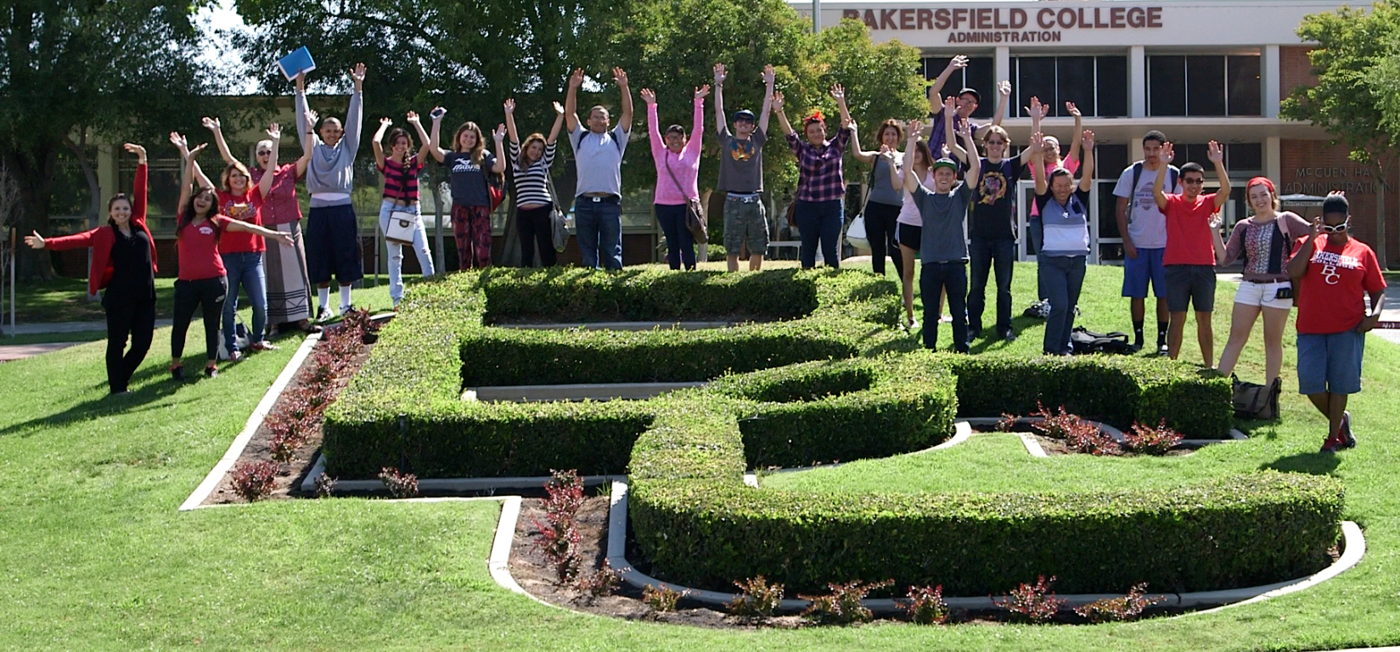
Goals
Improve access
Increase student engagement
Improve student progression
Decrease student time to completion
Notes:
Janet

Slide 4
Student Success at BC

Slide 5
BSI new proposal
The Community College Basic Skills Student Outcomes and Transformation Program
More, faster, better
Redesign – Curriculum Career Pathways – Assessment and Placement procedures
Include minimum of 2 evidence based practices
(Placement practices, placement to gateway courses, align remedial content with voc ed, contextualize remedial instruction, proactive student services, 2-3 course sequences to college level English or Math, other)
Bonus points for collaboration with K-12 and articulation

Slide 6
Connection with High Schools
1. Assessment Testing at High schools (increased placement 9% in math and 3% in English college level)
2. Matriculation and Registration at high schools (42)
3. Retrieval of transcripts
4. Discussion of ERWC, AP and IB courses and placement
5. Development of better HS curriculum and college alignment

Slide 7
BC Philosophy behind MMs and Assessment
Tests aren’t always the best measures
Tests alone are TERRIBLE measures
The goal is to predict success
More information provides better placement
We need to simplify the algorithm – junior year grades
Not perfect, iterative – don’t wait
Thousands of reasons to START NOW

Slide 8
Match scores with variables
23%
28%
32%
43%
49%
55%
65%
70%
75%
Students Results | 30 Compass Score Very Low | 60 Compass Score | 90 Compass Score Very high
2.0 HS GPA
3.0 HS GPA
4.0 HS GPA

Slide 9
Multiple Measures: Why We Do It
 | Compass Score (30 extremely low to 90 extremely high)
High School GPA | 30 | 60 | 90
2.00 | 23% | 28% | 32%
3.00 | 43% | 49% | 55%
4.00 | 65% | 70% | 75%
Westrick & Allen, 2014: Conditional Success Rates (Table 6) http://bit.ly/ACTandGPA

Slide 10
Westrick & Allen, 2014: ACT COMPASS Validation Median Logistic R (Table 4) http://bit.ly/ACTandGPA
Multiple Measures: Improved Accuracy
Course | Compass Test | Compass | HSGPA | HSGPA + Compass
English 1 | Writing Skills | .31 | .57 | .62
Arithmetic | Pre-Algebra | .57 | .34 | .66
Algebra | Pre-Algebra | .36 | .65 | .80
Intermediate Algebra | Algebra | .47 | .66 | .84
College Algebra | Algebra | .41 | .76 | .88
College Algebra | College Algebra | .51 | .76 | .94
Notes:
HSGPA also more accurate at placing students and identifying students most in need of intervention (bottom 10% of distribution).
HSGPA better predictor of first year GPA, degree completion or transfer
Radunzel & Noble, 2012: http://www.act.org/research/researchers/reports/pdf/ACT_RR2012-5.pdf
ACCUPLACER scores did not add to the predictive power of the English models, though they did improve some math models, particularly sub-models predicting success in Pre-calculus and Calculus I at the community college.
Overall Predictive Strength, Median Logistic R
Course type Compass test
Predictor set
Compass HSGPA
Compass &
HSGPA
English Composition 1 Writing Skills 0.31 0.57 0.62
Speech/ Rhetoric Writing Skills 0.36 0.69 0.75
American History Reading 0.40 0.69 0.80
Other History Reading 0.47 0.67 0.81
Psychology Reading 0.47 0.63 0.77
Sociology Reading 0.54 0.60 0.77
Biology Reading 0.57 0.79 0.92
Arithmetic Skills Pre-Algebra 0.57 0.34 0.66
Elementary Algebra Pre-Algebra 0.36 0.65 0.80
Intermediate Algebra Algebra 0.47 0.66 0.84
College Algebra Algebra 0.41 0.76 0.88
College Algebra College Algebra 0.51 0.76 0.94

Slide 11
Multiple Measures Success: English
Notes:
SDCCD F2015 Pilot (N = ~1000)

Slide 12
Multiple Measures Success: Math
Notes:
SDCCD F2015 Pilot (N = ~1000)

Slide 13
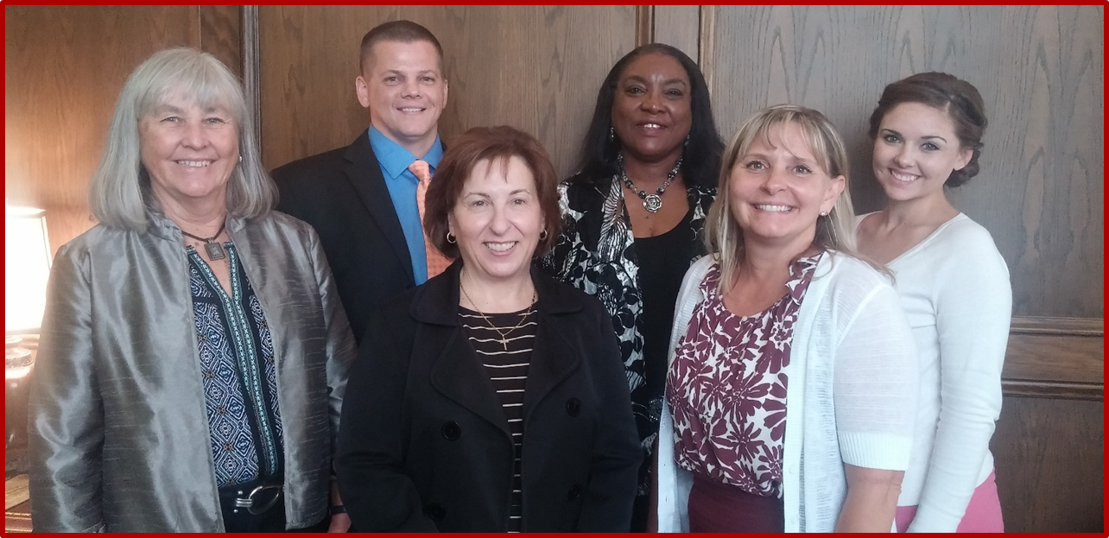
Lessons learned from High School partners and Multiple Measures
1. Good communication with High Schools – find a champion
2. Listen
3. Be honest but acknowledge your own data
4. Focus on the students – like us they have other targets required
5. High Schools want their students and community to be educated

Slide 14
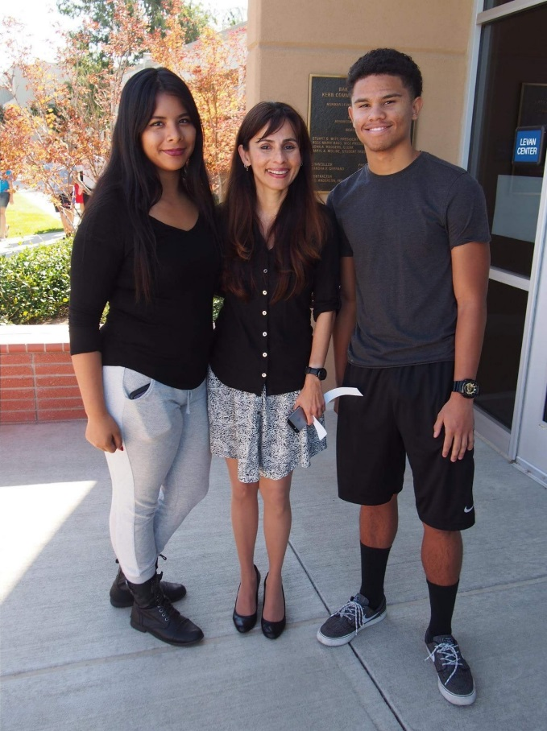
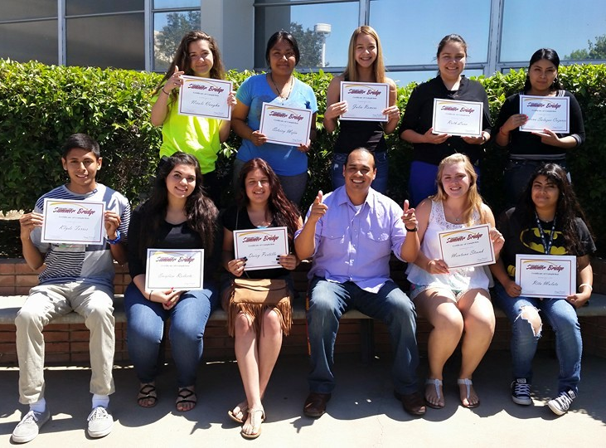
MIH Mentors
50 Mentors
5-10 Students/each
Faculty, Staff, and Administrators
Required Training: 20 Hours
Issues with communication
Issues with follow-thru
Moving to Peer Mentors
Moving to Pathways
Notes:
Kim, Carol, and Gloria Time here.

Slide 15
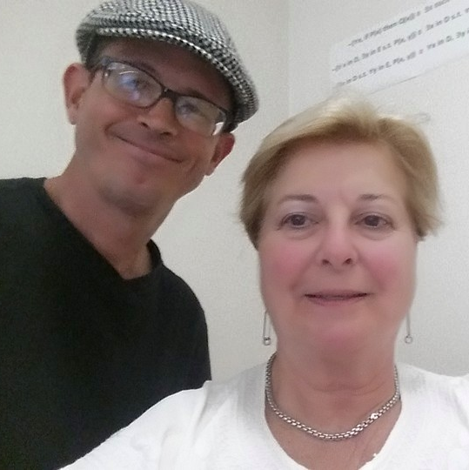
MIH Mentoring: Successes
Greater connection with students
Awareness of programs & activities (SI, tutoring Financial Aid)
Sense of BC Community
Reassurance (Being on the right track; Questions are addressed)
Insight to students’ “college knowledge”
Professional Development & fundamentals for Mentors
Recognition of SEP & other “college essentials”

Slide 17
Student Success at BC

Slide 18
Progression and Completion
1. Late Adopters - Accelerated and compressed curriculum in English, Math and Reading
2. Early Adopters - Multiple Measures (Developed using CAI MM workgroup suggestions, STEPs (LBCC), ASCCC Multiple Measures paper). These have morphed every year …..
3. Coordinated - Used the transcript review to place students into accelerated after bumping up
4. Early adopters - Pathways

Slide 20
Course Acceleration & Compression Scaling up at BC

Slide 21
Success rates
Term | Overall (pct.) | Compressed Courses (pct.) | Accelerated Courses (pct.)
Fall 2011 | 65.5 | 60.1
Fall 2012 | 67.1 | 64.0
Fall 2013 | 67.0 | 65.5 | 54.8
Fall 2014 | 66.5 | 66.4 | 59.2
Spring 2012 | 64.7 | 60.2
Spring 2013 | 66.8 | 61.6
Spring 2014 | 68.2 | 65.5 | 60.0
Spring 2015 | 68.3 | 64.8 | 57.8

Slide 22
Course Acceleration & Compression
Notes:
CAP: Completion of transfer-level math for traditional and accelerated pathways by ethnicity

Slide 23
Saving Students Money and Time
In 2015, BC saved students
2111 semesters
through multiple measures and improved testing

Slide 24
Student Success at BC

Slide 25
Supplemental Instruction (SI) The Essential Elements
Targets Specific Courses, Not Students
Offers Peer-Facilitated Study Sessions
Combines Content & Study Skills
Peer Leader Attends Every Class
Peer Leader Receives Ongoing Training

Slide 26
Role of the SI Leader (Peer Leader)
Attends students’ class every lecture/lab meeting
participates in class & identifies student needs
acts as a model student
Facilitates voluntary study sessions for students outside of class time 2-3 hours/week
on a regular schedule
Promotes upcoming study sessions in class at start of each lecture
Establishes rapport and builds relationships with students
Shows students how to learn course content
Meets with instructor weekly (30 min.) to discuss how study sessions are progressing and exchange ideas on ways to assist students

Slide 27
The Power of the SI Group to Promote Learning
*Study SI Data alone for 5 minutes—take notes or employ whatever strategy you would normally use to understand and retain the info. Then, write down 3 observations you made based on your study of the data.
*Now get in groups of 3 and discuss these questions regarding the same set of data:
1. What trends or patterns do you see in the data?
2. Are there any aspects of it that surprise you? Explain.
3. What overall story is the data telling regarding the effectiveness of SI?
Which method of study was most effective in engaging you in your analysis of the information?

Slide 28
Supplemental Instruction
Term | SI Leaders | Sections
Spring 2014 | 12 | 20
Summer 2014 | 5 | 9
Fall 2014 | 17 | 29
Spring 2015 | 26 | 43
Summer 2015 | 9 | 15
Fall 2015 | 60 | 102
Spring 2016 | 115 | 154
Fall 2015 SI Attendance | A | B | C | D | F | Total # Students | Avg GPA
0 | 22% | 25% | 25% | 11% | 16% | 847 | 2.28
1-2 times | 18 | 34 | 24 | 9 | 14 | 179 | 2.33
3-5 times | 24 | 35 | 24 | 9 | 8 | 101 | 2.55
6+ times | 35 | 29 | 26 | 7 | 2 | 215 | 2.87
SI Success Fall 2015 | Attendance: 0 | Attendance: 1-2 Times |  | Attendance: 3-5 times |  | Attendance: 6+
Successful | 72% | 77 |  | 83 |  | 91
Unsuccessful | 28% | 23 |  | 17 |  | 9

Slide 29
Parting Thought on SI
What would it take to implement an SI Program at your school?

Slide 30
Goal 2: Improve Student Progression

Slide 32
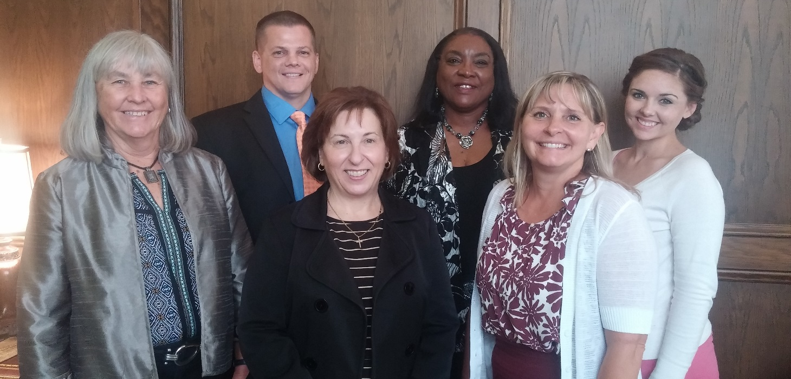
Moving Forward: Partnerships
Dr. Janet Fulks, BC Dean of Student Success & Pre-collegiate Studies, Dr. Ben Sherley KHSD Director of Ed Services, Vickie Spanos, KHSD Director of Instruction, Dr. Jacqueline Mimms, CSUB AVP of Enrollment Management, Kristy Fraley, KHSD Resource Counselor, Lesley Bonds, BC MIH Program Manager
Notes:
Photo of collaborative work group meeting for College Futures project; photo includes BC, KHSD and CSUB

