Slide 1
Students in Statistics Pathways California Acceleration Project
Hal Huntsman, CCSF Math Professor

Slide 2
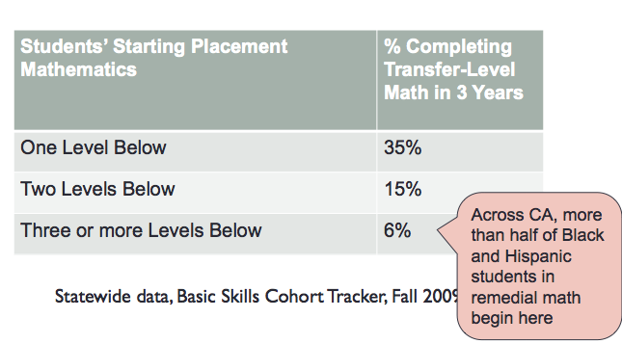

Slide 3
What these students have in common
•These students are from colleges that have implemented accelerated Statistics pathways with the support of CAP. They took a pre-statistics course followed by a traditional Statistics course (e.g. content of C-ID Math 110) taught mainly in the math department.
•These students have majors that are in the Humanities and Social Sciences. Statistics meets their GE transfer requirement and their major does not require additional math or quantitative reasoning courses.

Slide 4
RP Group’s study of 16 CAP colleges. Used statistical methods to control for pre-existing differences between students (653 students in pre-statistics)
In math, students’ odds of completing a transfer-level math course were 4.5 times greater than students in traditional remediation

Slide 5
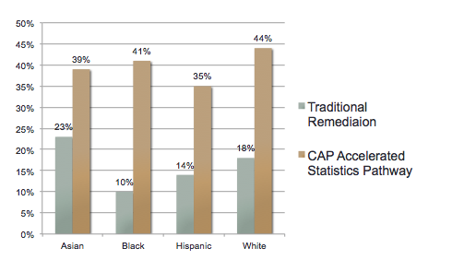
Completion of Transfer-Level Math (within 1.5-2 years)
The first 8 colleges piloting accelerated statistics pathways in CAP
(Descriptive data, no statistical controls)

Slide 6
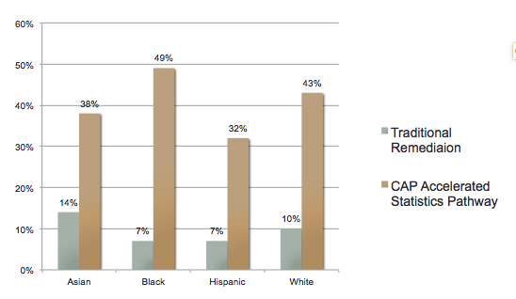
Completion of Transfer-Level Math (within 1.5-2 years)
Students at 3-4 Levels Below Transfer in Math
(Descriptive data, no statistical controls)

Slide 7
Thank you!
Hal Huntsman: shuntsma@ccsf.edu More information at: http://accelerationproject.org/

