Slide 1
Support Gender, Ethnicity and Racial Diversity on your Campus
Silvester Henderson, At-Large Representative Mayra Cruz, At-Large Representative Nathaniel Donahue, Senate President Santa Monica College
,
[Date]

Slide 2
Presentation Highlights
What is the definition of Ethnicity?
Is the concept of defining “Racial Diversity” and individual person or a way of thinking?
How can faculty leaders strengthen and promote a culture of equitable practices on our campuses?
How can we encourage our students to honor their individual heritage, while expanding their minds to support global and equitable relationships and community practices?
Why is it important to define “Genders and Gender Equity” from the lens of current thoughts and practices?
How Can you Support LGBTQ+ Students on your campus?
Wisdom and Human Practices that will move your campus culture to an environment of “Inclusive Equity”
Questions and Comments?

Slide 3
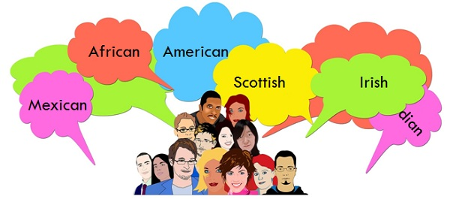
What is the definition of Ethnicity?
Ethnicity - “An ethnic group or an ethnicity, is a category of people who identify with each other based on similarities such as common ancestry, language, history, society, culture or nation. Ethnicity is usually an inherited status based on the society in which one lives. Wikipedia

Slide 4
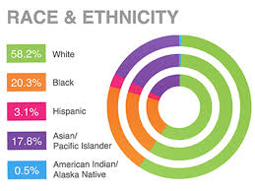
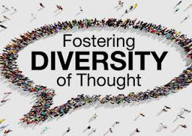
Is the concept of defining “Racial Diversity” and individual person or a way of thinking?
Various Ethnic Groups – Racial Identification
Diversity of thoughts?
Race & Ethnicity
Does racial identity matter at all?
Discussion?
Susan Wood (2008) “Diversity of thought—the idea of more-than-one-way— is key to understanding the potential of diversity and inclusion as an organizational resource”.
https://digitalcommons.ilr.cornell.edu/cgi/viewcontent.cgi?article=1573&context=articles

Slide 5
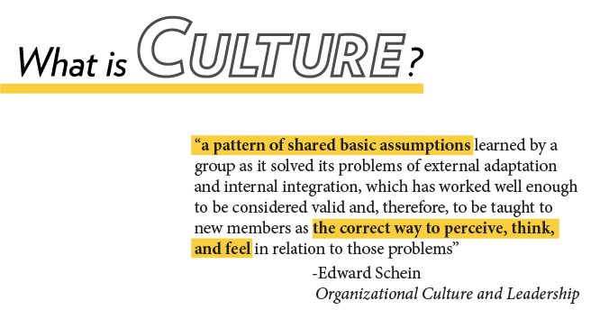
How can faculty leaders strengthen and promote a culture of equitable practices on our campuses?
Discuss student cultural views regarding your
discipline.
Define Cultural Relativism. (Pros. Vs Cons)
Practice “Equity” – Fair and Impartial (Non Judgmental)
Create group classroom activities that challenge global views and encourage open sharing.
Encourage your students to participate in campus cultural events that demonstrate a “Diversity of Social Practices”. This promote cultural and community respect and collaborations.
Practice what you “Preach”

Slide 6
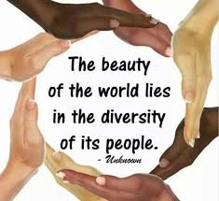
How can we encourage our students to honor their individual heritage, while expanding their minds to support global and equitable relationships and community practices?
“Steps Toward Promoting Equitable Practices” A: Know each students name or preferred name. Respect their “Decision”.
B: Celebrate your students micro and macro successes and challenges.
C: Openly acknowledging varying social inequities. D: View each student’s heritage as a benefit and resource.
E: Allow students to discuss their views and beliefs in regards to other cultures.
F: Encourage healthy “Debate”.

Slide 7
Why is it important to define “Genders and Gender Equity” from the lens of current thoughts and practices?
Assigned Sex: The sex one is assigned at birth based on anatomy
AFAB/AMAB: Assigned Female at Birth, Assigned Male at Birth
Assigned Sex does not always correspond with Gender.
Gender is where an individual identifies along a socially constructed continuum of “masculine” and “feminine”
Cisgender: A person is cisgendered when their assigned biological sex corresponds with their gender identity. Many gay,
Lesbian, and bisexual people are cisgendered.
Transgender: A person whose assigned sex does not correspond to their gender identity
Non-Binary Gender: A person who does not identify as male or female. Trans Non-Binary.
Queer: A person whose gender performance problematizes social notions of “maleness” and “femaleness”
A straight person can also be queer.
Ally: A person who supports equity for marginalized communities.
GENDER EQUITY: Providing the resources students need, specific to their gender, in order for them to achieve goals.

Slide 8
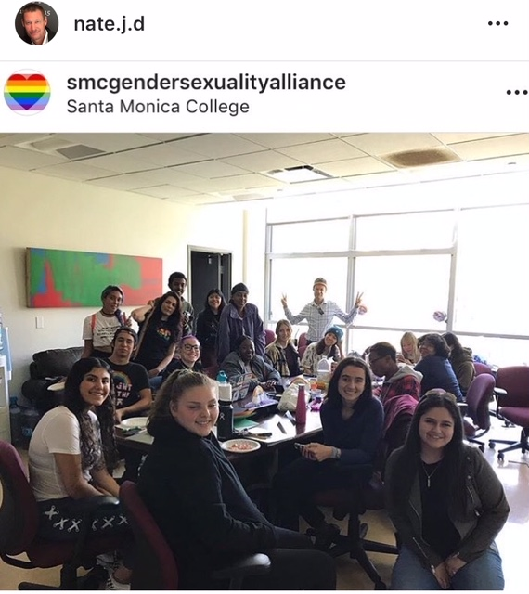
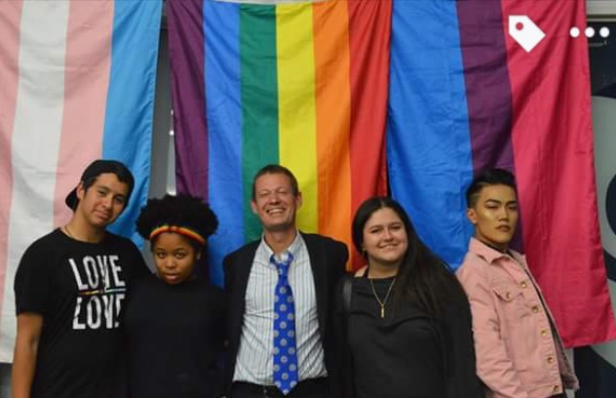
How Can you Support LGBTQ+ Students on your campus?
Hire LGBTQ+ faculty
Create All-Gender Restrooms for student use, preferably not converted single stall use
Restrooms, but actual all-gender restrooms
Establish a Social Justice Center to benefit all marginalized student Groups
Establish an Ally Training Program/Safe Zone Training
Create an option for a “preferred name” on your local CCC application.
Connect LGBTQ students with the point foundation Scholarship Program!
Establish a robust and active LGBTQ+ Student Club with strong
Social Media presence. Provide food every week, if you can.
Hold Events for Pride, National Coming Out Day,
TransRemberance Day, etc.

Slide 9
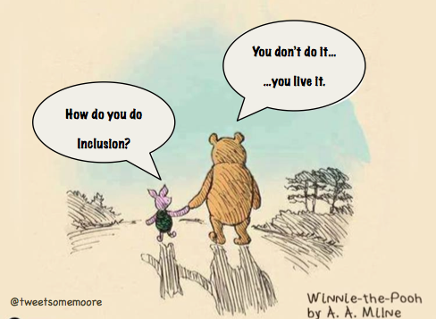
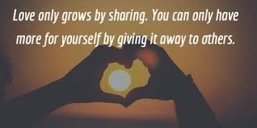
Wisdom and Human Practices that will move your campus culture to an environment of “Inclusive Equity”
Speak your words with care and keen sensitivity.
Demonstrate Love and deliver respect to all of your students!
Practice “Equity” when offering individual counsel to all of your students.
Practice Care & Respect. This classroom practice leads to a Campus Culture that promotes “Inclusion and Equity”!

Slide 10
Questions & Comments
Please feel free to contact each of us for more information.
Silvester Henderson Shenderson@losmedanos.edu
Mayra Cruz cruzmayra@fhda.edu
Nathaniel Donahue
donahue_nathaniel@smc.edu

