Slide 1
Reedley College Mentoring Programs
Dr. Darlene Murray
Nate Saari
Ruby Marin-Duran

Slide 2
Student Equity
Reedley’s Target Population
Hispanic/Latino
African American
Low-income
Male
Success Indicator
Degree and Certificate Completion
Activity: Student Mentor Programs

Slide 3
Benefits of Mentoring
Increases student engagement
Retention during the first year of college
Socialization to academic and professional roles
Students’ satisfaction with college
Supports student persistence- goal commitment

Slide 4
Benefits of Mentoring
Psychological & Emotional Support
Academic & Subject Knowledge Support
Degree & Career Support
Presence of a Role Model
Holistic Support System
(Crisp, 2010)

Slide 5
Latino Males in Community College
Ingram and Gonzalez-Matthews (2013)
Latino Male Experience
Lack of Campus Involvement
“The Streets is Watching”
Barriers to Participation
Need for Support and Social Services

Slide 6
African American Males in College
Murray (2013)
Factors that Support Resiliency
Caring Adult/Mentor
Opportunities for Participation
Freedom of Expression
Campus Life

Slide 7
Reedley College Mentoring Programs
Mentoring for Success
Education to Empowerment - E2E

Slide 8
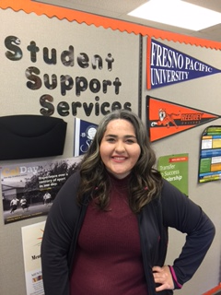
Reedley College Mentoring Programs
"The Mentoring for Success Program has shaped me into a more responsible student. I appreciate the opportunity to interact with College Faculty and Staff that want to help me succeed".
Yesica Ibarra-Campos, Mentoring for Success Student

Slide 9
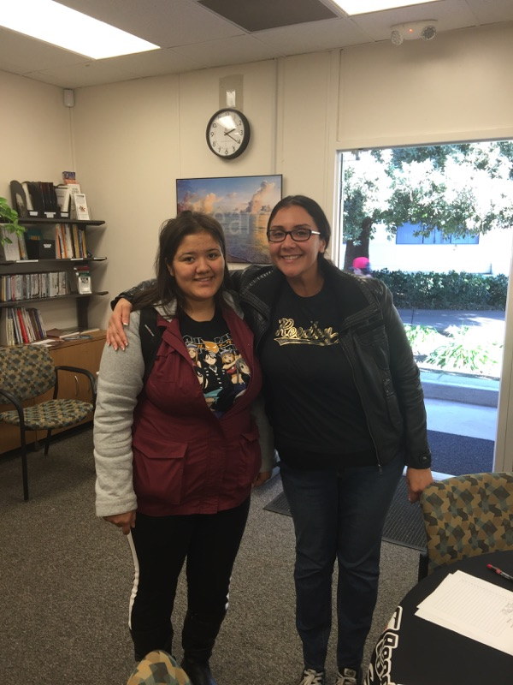
Mentoring for Success Program
Personal connection and student empowerment supports student success.
Guiding progress toward educational, professional and personal goal attainment.
Goals setting: include graduation from Reedley College, transferring to a university and gaining valuable career advantages.

Slide 10
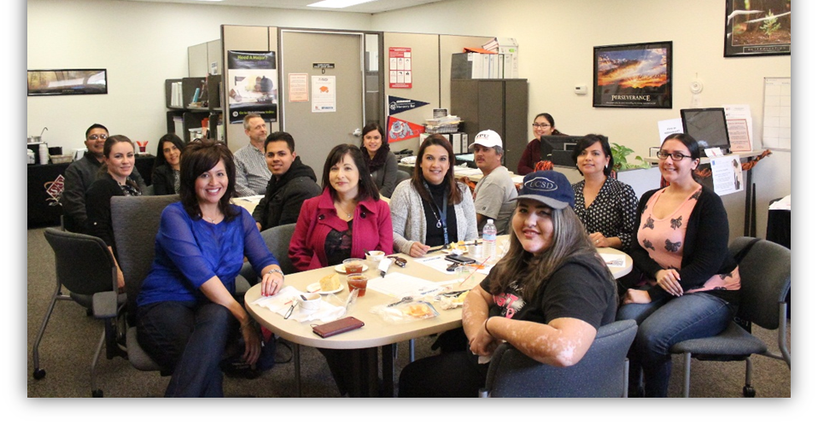
Program Mission
Students are selected and matched with Reedley College employees to develop a student-centered mentoring relationships focused on student success.

Slide 11
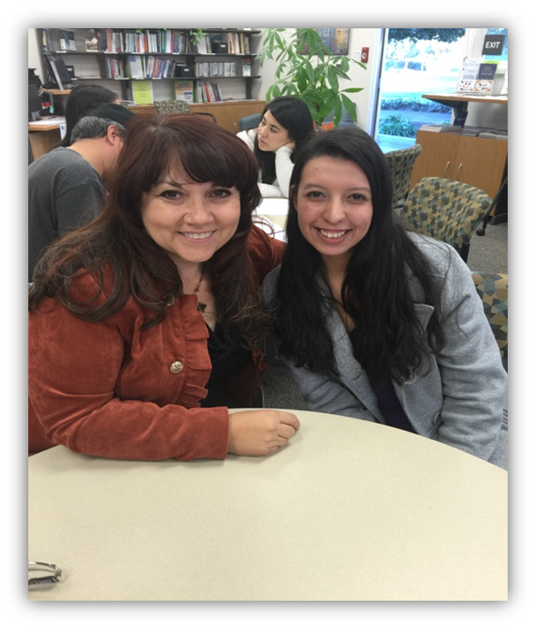
Program Goals
Establish a network of employee volunteers to support and guide students
Foster mentoring relationships that support students’ journey toward self-reliance, successful graduation, and transfer to a four-year institution or job placement.
Challenge students to work through personal and academic challenges, and build self-esteem and confidence through the pursuit of higher education.

Slide 12
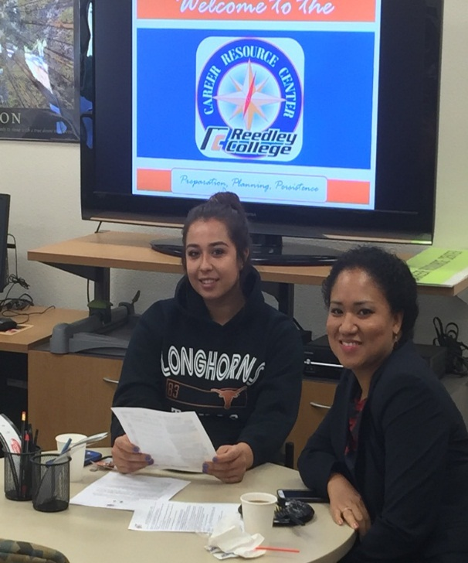
Expected Outcomes & Data
Development of student-centered mentoring relationships.
Foster the establishment of a comfortable, safe and welcoming learning environment.
Students will be challenged and rewarded by successfully navigating the college process.
Support the acquisition of knowledge and experiences on the journey to becoming life-long learners.

Slide 13
E2E Program Mission
Provide young men a place to empower their voice and develop the soft skills needed to support their educational goals.

Slide 14
E2E Program Goals
Goals | Strategic Plan Alignment | Desired Outcomes
Increase Student Engagement in Male Residence Hall Students. | 1.3 Increase students’ campus and community engagement in order to facilitate persistence and completion rates for all students (DO 1.5, 4.3 | Increase the male Residence Hall retention and academic involvement.
Assist young men in maneuvering through their educational experience while addressing their personal challenges. | 1.4 Develop strategies to address unique needs of students to aid their academic success (DO 1.1) | Increase the sense of belonging and development of the young men’s leadership tools.
Provide young men a place to empower their voice and promote institutional buy in with face to face interaction on a continuous basis. | 2.4 Maintain a safe environment conducive to learning while providing services and activities that maximize the opportunity for educational and personal growth | Create a place of trust to build genuine relationships with male student population.

Slide 15
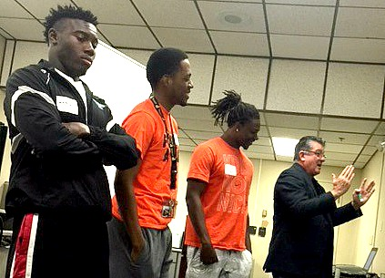
E2E Program Activities
Monthly Connections
Guest Speakers
Leadership, Self Empowerment Workshops
Attending the A2MEND Conference (African American Male Education Network & Development)

Slide 16
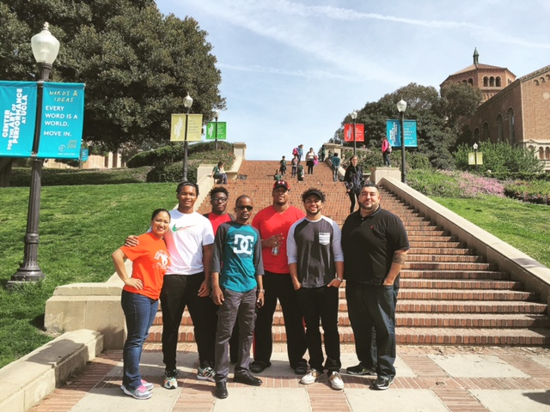
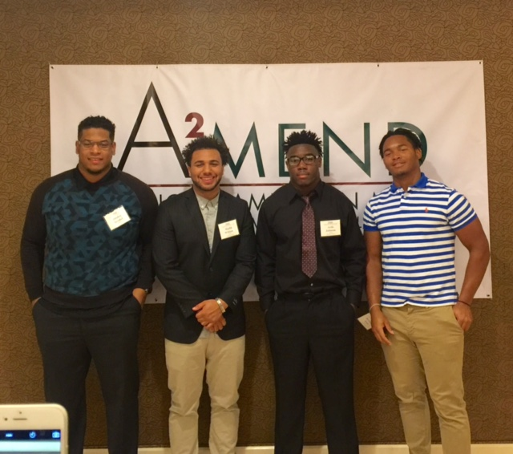
E2E Program Activities

Slide 17
Getting Started
SWOT Analysis (handout)
Best Practices
Institutional Buy-In
Support from College Administration
Know your Target Population

Slide 18
Getting Started: SWOT Analysis
Established employee organization (RC LFSA)
Support from the College President
Counselor direct access to students for program referrals
Lack of identified funding sources
Committee member availability to work on project
No official release time to develop project
Seek out funding sources
Potential to collaborate with college support pro-grams i.e. Career Center & TRiO SSS Program
Supports college Student Equity Plan.
Employee resistance
Student resistance
Lack of participation/attendance

Slide 19
Next Steps
Create a mentoring program for your institution

Slide 20
Questions & Discussion

Slide 21
Thank you for Attending!
Contact Information
Ruby Marin-Duran
ruby.duran@reedleycollege.edu
Nate Saari
nate.saari@reedleycollege.edu
Dr. Darlene McMurray
darlene.murray@reedleycollege.edu
All materials will be available via DropBox

