Slide 1
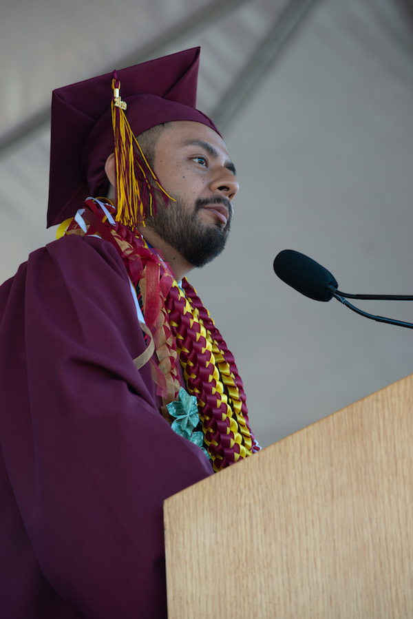
SUPPORTING UNDOCUMENTED STUDENTS
IRIS AGUILAR, SENIOR DIRECTOR EQUITY AND COMMUNITY IMPACT, FCCC
MAYRA CRUZ, ASCCC AREA B REPRESENTATIVE
IIYSHAA YOUNGBLOOD, SSCCC
Notes:
Add logos- ASCCC, Foundation, SSCCC
ADD LOGOS to this page- ASCCC, Foundation, SSCCC
Timeline:
August 26- Input content and Zoom meeting at 9:30am (tentative)
August 19- Draft of the session
Sept 3- Zoom meeting to finalize the session
Sept 3 (2)- Materials posted on the ASCCC website

Slide 2
SESSION OUTCOMES
Acknowledge the challenges and opportunities facing our undocumented community
Describe the current policies affecting our students
Identify strategies to support students and create institutional change
Notes:
1min Mayra

Slide 3
ACTIVITY ABOUT OUR KNOWLEDGE
Share a concept or word about what it is to be identified as an undocumented student.
OR
What does an undocumented student bring to the classroom or your institution?

Slide 4
Creating a common understanding
Notes:
Undocumented person
An undocumented person refers to a foreign-born individual that has entered the United States without inspection (and not subsequently obtained any right to remain) or stayed in the United States beyond the expiration date of a visa or other status.
Source: Immigrants Rising, https://immigrantsrising.org/resource/glossary-of-common-legal-terms/#undocumented

Slide 5
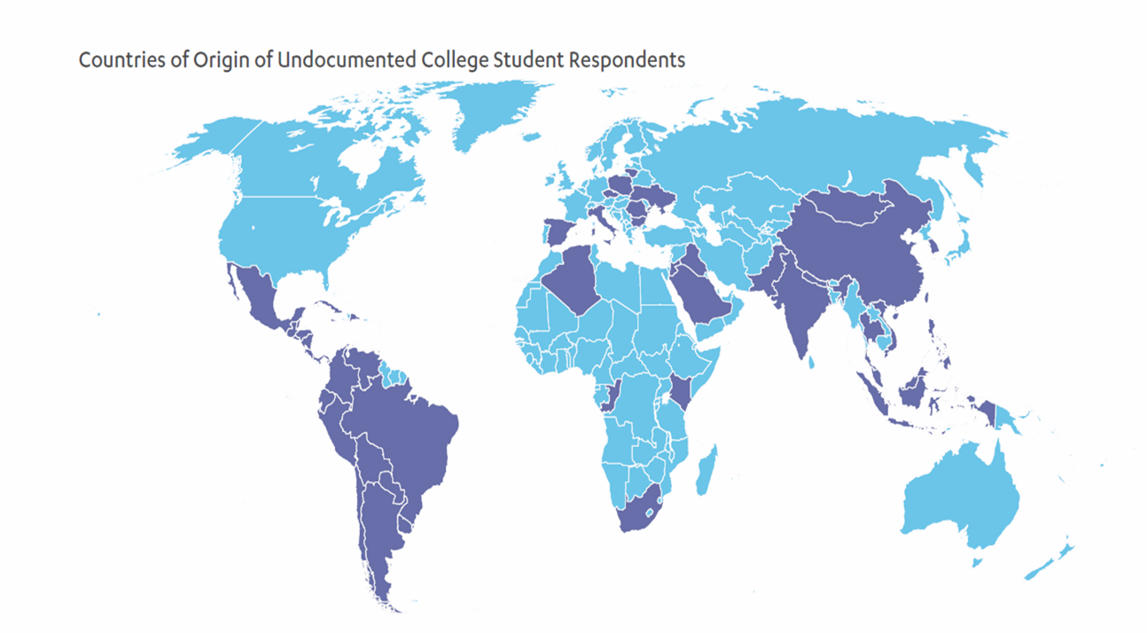
About 11 million undocumented
4.5M citizen children have at least one undocumented parent
1.3M undocumented Asian immigrants
400,000-600,000 undocumented immigrants of African, Afro Latino and West Indian descent
In the Shadow of the Ivory Tower, 2015, UCLA
Notes:
While the undocumented include people from across the world, the largest groups are from Mexico, the rest of Latin America and Asian. Among Asians, the largest groups are Chinese, Filipino, Indian, and Korean. One in 7 Koreans in the U.S. are estimated to be undocumented.
National breakdown of the undocumented children birth counties is 56% Mexican, 22% Latin America, 13% Asian, 6% Europe and Canada, 3% Africa and other regions of the world.
Talk about reasons why 60% from Mexico -- geography, economic conditions in Mexico

Slide 6
Common Challenges Undocumented Students Encounter
Living in Fear
Secrecy vs. Need for Support
Complex immigration and economic concerns
Lack a way to become legal residents/US citizens
Often work to pay for school and help their families
Many face legal constraints to work
Inability to receive federal financial aid
Lack of familiarity with financial aid process
Lack of sufficient institutional awareness/support
Predominantly first generation & low-income
Notes:
Living in Fear
•Immigrants face new challenges and trauma under Trump administration
•Increased deportations/ICE agents
•Muslim ban
•Threats against sanctuary cities
•DACA rescission
•Scapegoating in the media
•Students have reported increased discrimination as a result of the above (The Psychological Harm of Anti–Immigration Policies: webinar slides--start at 16)

Slide 7
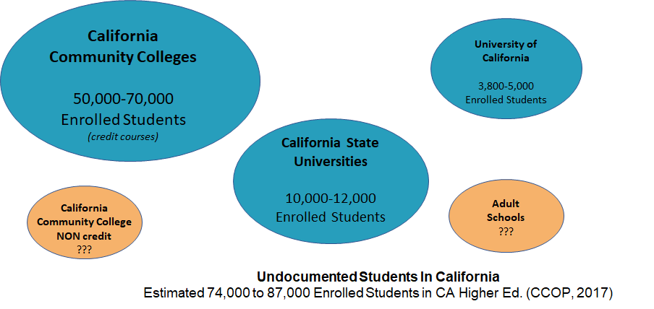

Slide 8
Dreamers Project Overview
CCCCO, FCCC, Immigrants Rising
Dreamers Advisory Group
Comprehensive Survey
Over 200 valid responses from 111 colleges
8 regional meetings
over 87 attendees from 50 colleges
Final report published in march
Art created by Favianna Rodriguez

Slide 9
Statewide Trends
Top Challenges:
Financial Support
Legal & Mental Health Services
Identifying Students/Outreach
Lack of Institutional Support
Limited Resources for non-AB 540/ non-DACA students
Need for cross-campus collaboration

Slide 10
Immigration Legal Services Funding for CCC
Assembly Bill (AB) 1809 appropriated $10 million for immigration legal services for persons on California community college campuses.
This one-time amount must be spent by June 2024.
Given that there are 115 community colleges in California, “host” colleges will be identified in each Guided Pathway region.

Slide 11
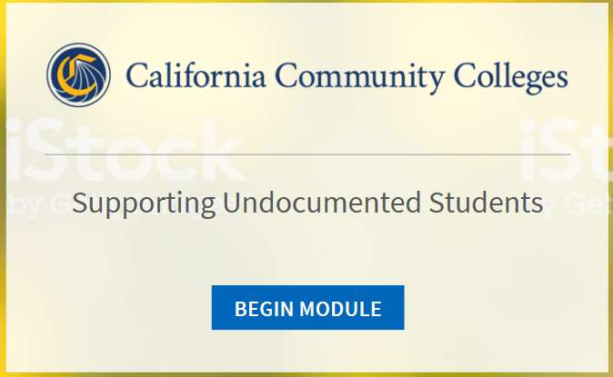
Training Module
The Vision Resource Center is a professional development tool
Chancellor’s Office secured funding
Training Module will provide baseline information
It will be available the third week in October

Slide 12
POLITICAL & LEGAL CONTEXT- TUITION & FINANCIAL AID
AB 540 (2001) | Allows non-resident students to pay in-state fees
AB 130 (2012) | Private scholarships can be administered by Public Institutions
AB 131 (2012) | State funded grants including CAL grants and institutional grants
CALIFORNIA DREAM ACT | Allows undocumented students to apply for state financial aid
Ed Code 76140 | Fee exemption to nonresidents who enroll for six or fewer units, demonstrate a financial need for the exemption
AB 595 (2019) | Authorizes a student enrolled in an apprenticeship program or an internship program, who does not have a social security number to use an individual tax identification number for purposes of any background check required by the class or program.
Notes:
AB540 (2019) Amended the CAL Grant B programs
AB 130/131 (2012)
CA Dream Act Administered by California Student Aid Commission (CSAC), the California Dream Act Application allows undocumented students to apply for state financial aid. It is unrelated to the federal Deferred Action for Childhood Arrivals (DACA) program.
Dream Act applications are available to students who were brought to the United States under the age of 16, without documentation and who have consistently attended school while meeting other in-state tuition and GPA requirements for state financial aid.
Education Code 76140 - Non resident tuition
All nonresidents who enroll for six or fewer units
Demonstrates a financial need for the exemption.
Any nonresident who is both a citizen and resident of a foreign country, if the nonresident has demonstrated a financial need for the exemption.
AB 595 (2019 Medina) Community Colleges: Apprenticeship Programs This bill would authorize a student enrolled in a community college class or classes pursuant to an apprenticeship training program or an internship training program, as defined, who does not have a social security number to use an individual tax identification number for purposes of any background check required by the class or program.

Slide 13
POLITICAL & LEGAL CONTEXT
AB 60 (2013) | Driver License
SB 1159 (2014) | Requires all 40 licensing boards under the California Department of Consumer Affairs to consider applicants regardless of immigration status
SB54 (2017) | Sanctuary policy- not allowing Immigration and Customs Enforcement (ICE) officers without warrant
New Public Charge Rule (2019) | The inadmissibility ground at issue says a person is inadmissible if they are likely to become a public charge.
Notes:
AB60 (2013)
Requires the department to issue an original driver license to an applicant who is unable to submit satisfactory proof of legal presence in the United States. Driver license applicants under AB 60 must meet all other qualifications for licensure and must provide satisfactory proof of identity and California residency.
SB 1159 (2014)
Allows individuals applicants for professional licenses to use an Individual Tax Identification Number (ITIN) in the process to seek licensure. For Example, Accountants, CPA, Counselor, Electrical, exterminator, Lawyer, Nurses tec.
SB54 (2017)
mandates that the Attorney General publish model policies “limiting assistance with immigration enforcement to the fullest extent possible consistent with federal and state law at public schools… and ensuring that they remain safe and accessible to all California residents, regardless of immigration status.”
Sanctuary Policy
Example: CCSF joins other colleges and universities around the country as a sanctuary campus, which include the following policies:
Not allowing Immigration and Customs Enforcement (ICE) officers onto campus without a warrant
The refusal of campus police to enforce immigration law
Not sharing student immigration status with ICE
Not gathering information on immigration or citizenship status
Providing tuition support, including in-state tuition rates at public universities to students with DACA status
Providing distance-learning options for departed students to complete their degrees
Providing confidential legal support to students with immigration law questions and issues.
New Public Charge (2019)
https://www.ilrc.org/public-charge
The new rule interprets a provision of the Immigration and Nationality Act (INA) pertaining to inadmissibility. The inadmissibility ground at issue says a person is inadmissible if they are likely to become a public charge. INA § 212(a)(4). This law only applies to individuals seeking admission into the United States or applying for adjustment of status. This provision of the law does not apply to all immigrants.
Public charge and this rule do not apply in the naturalization process, through which lawful permanent residents apply to become U.S. citizens.

Slide 14
SSCCC EFFORTS
Student Resolutions
SSCCC Caucuses- API Caucus, Black Caucus, and Latinx Caucus
Future possibilities for the SSCCC and Undocumented Student Support
The Student Senate for California Community Colleges works to promote and safeguard access for current and future students to California public higher education in accordance with the Master Plan for Higher Education through system participatory governance, legislative and policy advocacy, and regional support and development.

Slide 15
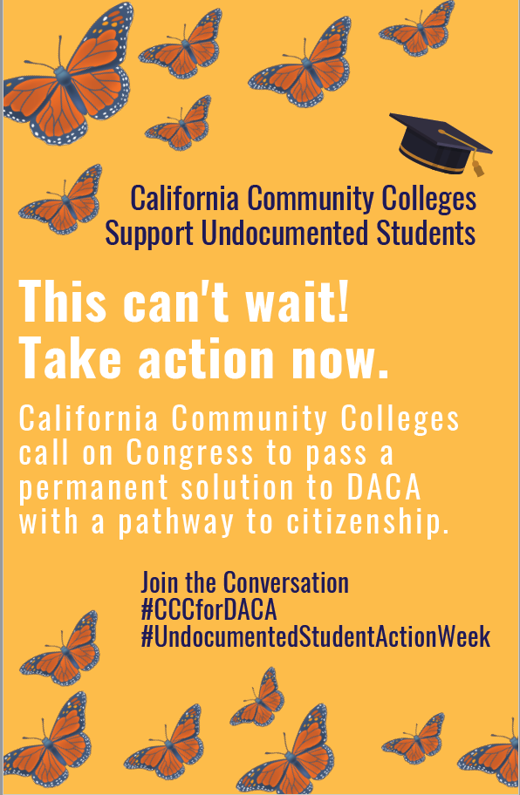
Undocumented Student Action Week
Chancellor’s Office designated third week in October
This year Action week is October 14-18
An array of suggested activities being provided to colleges

Slide 16
NEXT STEPS
for
YOU AND YOUR COLLEGE

Slide 17
BECOMING AN ALLY
How do I create a welcoming, inclusive and equitable environment?
How can I increase support for undocumented students in my office, program, and/or department?
How can I contribute to a conversation about increasing campus-wide capacity to support undocumented students?
How can I be an effective ally and advocate?
What commitment can I make today?

Slide 18
CHARACTERISTICS OF AN ALLY
Allies are knowledgeable, empathic, and willing professionals who:
Provide a safe, nondiscriminatory environment for undocumented students
Respond to incidences of discrimination and harassment
Understand, stay apprised of, and act upon policies that support students
Assist colleagues to understand the fears, needs, concerns of students
Support the academic, professional, personal and social growth of students

Slide 19
ACTION TO SUPPORT UNDOCUMENTED STUDENTS
Stay informed about changing laws and policies
Know campus resources
Communicate your support effectively to students
Make your support visible
Review policies in your work area
Undocumented Students Week of Action- October 14th-18th

Slide 20
SCENARIO AND DISCUSSION
After you read the scenario, discuss:
What would you say to this student?
What resources would you give to this student?
Who and/or where would you go to find additional information or support for this student?
What is a new word or concept learned today?
Notes:
Scenario: You observe that some of the undocumented students you know are visibly distraught, depressed, or absent after a recent legislative setback to a bill that would have given DACA recipients a path toward legalization. After asking them about it, some of them tell you that they feel like giving up on getting their degrees and exclaim, “It’s pointless!”
How could an ally respond to the students?
- Going to college gives you access to benefits (health, legal, etc.); your status may changes, you can’t predict future opportunities.

Slide 21
QUESTIONS/COMMENTS
THANK YOU!
For additional questions, contact:
Iris Aguilar, iaguilar@foundationccc.org
Mayra Cruz, cruzmayra@deanza.edu
Iiyshaa Youngblood,pastexec@studentsenateccc.org

Slide 22
RESOURCES
California Community Colleges Dreamers Project
https://foundationccc.org/What-We-Do/Equity/Dreamers-Project
Public Charge https://www.ilrc.org/public-charge
Introduction to Supporting Undocumented students at the CCC -Training Module (available this fall)

Slide 23
