Slide 1
Taking Action: Affirming Commitment to Culture, Lived Experiences, and Relationships in Learning Spaces
Wednesday, July 7, 2021 at 3:45 – 5:00 p.m.
Notes:
Michelle--3 min.

Slide 2
Land Acknowledgement
We begin today by acknowledging that we are holding our gathering on the land of the Nisenan Nations, the location of the ASCCC Office on One Capitol Mall, Sacramento, and the Tongva Nations, where I am currently located in what is now called La Mirada. We recognize the sovereign people who have lived and continue to live here. We recognize the Nisenan and Tongva Nations and their spiritual connection to the ocean and the land as the first stewards and the traditional caretakers of these areas.
As we begin, we thank them for their strength, perseverance, and resistance. We also wish to acknowledge the other Indigenous Peoples who now call these areas their home, for their shared struggle to maintain their cultures, languages, worldview, and identities in our diverse cities.
Notes:
We invite you to research your area by texting this number (907 312 5085) with your city and state to see the Indigneous tribes and information about land acknowledgment or find your area at https://native-land.ca.

Slide 3
Today’s Presenters
Michelle Velasquez Bean (she/her), ASCCC Treasurer
Karla Kirk (she/her), ASCCC North Representative
Don Miller (he/him/él), CCCCIO President, Rio Hondo College, Vice President of Academic Affairs
Alketa Wojcik (she/her), 5C, MiraCosta College, Vice President of Student Services

Slide 4
Session Description
Valuing our students’ excellence and understanding that our students learn and demonstrate their learning better in culturally sensitive learning environments is central to an institutional framework of inclusion, diversity, equity, and anti-racism necessary for closing the success and persistence gaps for disproportionately impacted student populations. In a culturally sensitive environment, students’ prior learning and authentic lived experiences are central to the design of instruction. How can faculty facilitate this when sometimes we struggle to find or develop strategies to create it? How are faculty at your college achieving this? Presenters will share models to promote diversity across the curriculum and ways to frame and inform culturally responsive practices in college learning spaces.

Slide 5
Today, we will . . .
Reflect on the history and architecture of American higher education
Discuss why DEI and antiracism is vital
Provide recommendations for designing learning spaces
List tools for agency and healing
Commit to take action together!
Notes:
2 min--Michelle

Slide 6
What’s your CULTURAL SUPERPOWER?
Use Padlet https://padlet.com/ProfessorBean/muf93qtuaugah55b
Click on link in CHAT
Click pink plus + in bottom right corner
Type your answer (optional title—your name)
Like other’s posts—use heart button
Notes:
3 min--Michelle
Mindfulness Activity
Let’s ground ourselves and anchor to the space: Deep breathe. Out—say Go SLOW!
Notice the space. Release the jaw. Deep breathe in. Out—say I’m SAFE.
Relax the shoulders. Deep breathe in. OUT—say ALL is WELL!
Today--this hour, as we delve into courageous conversations, remember to return to this moment--a safe space to engage.
GIVE YOURSELF PERMISSION today to be open and raw. It’s okay to be imperfect.

Slide 7
The History: Reflection
Who designed our education system?
Whom did it benefit? Whom does it harm?
What are you doing to work toward anti-racism?
Education is activist work!
Decide to enter this space.
–Dr. Regina Stanback Stroud
Notes:
3 minutes--Don
Let’s move into critical conversations from a place of love and empathy.
Ask yourself:
Who designed our American education system?
For whom is was it designed? Whom did it benefit?
If we acknowledge the architecture of education:
Structural racism
Need to acknowledge systems of oppression in our society (white supremacy and anti-blackness)
Who was left out?
Institutional racism
Need to interrogate our policies and practices including curriculum development and program review
Are we conditioned and socialized to see and celebrate one dominant lens or perspective?
Privilege--consider, do we
Weaponize our roles by holding onto status quo or do we celebrate diversity and holding each other accountable
Self-reflection and sitting with the discomfort is needed
Education is activist work.
Do you want to do this work?
Dr. Regina Stanback Stroud said in a webinar with Dr. Luke Wood and Dr. Frank Harris on anti-blackness: DECIDE TO ENTER THIS SPACE.

Slide 8
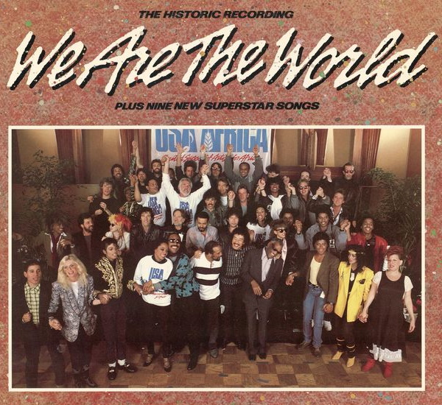
The History
2021: We are moving deeper.
Engaging in antiracism and new theories and practices
Questioning the cannon and the institution
Calling on everyone--staff, faculty, students, administrators, trustees--requires self-awareness and reflection
Being color brave--equity-mindedness requires investigating racialized patterns
1980s: We are the world.
Taught tolerance and colorblindness
Notes:
3 min--Don

Slide 9
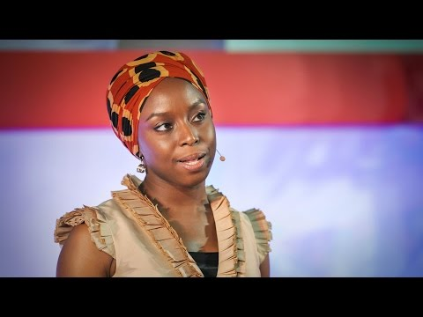
The WHY and the IMPACTS
Notes:
3 min—Don (PLAY until mark 2:58)
The danger of a single story.

Slide 10
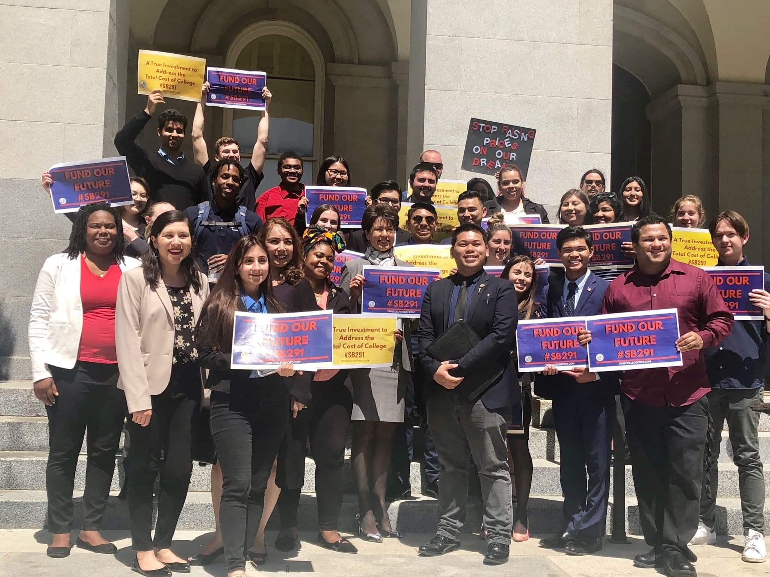
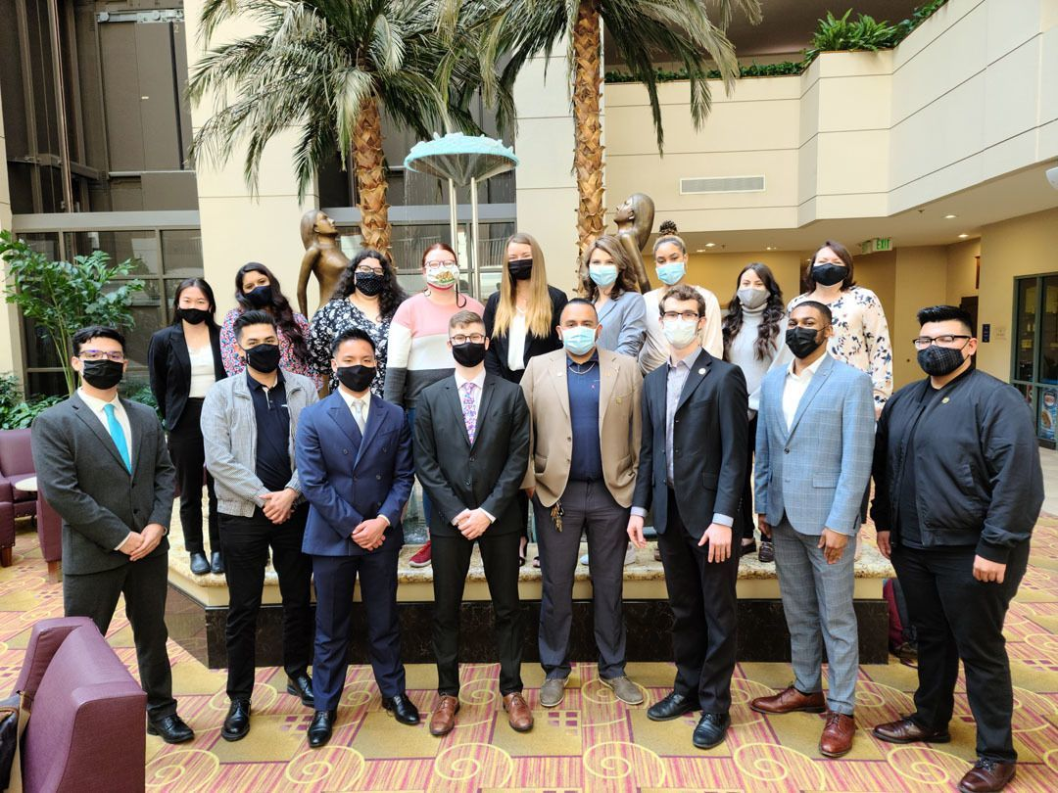
The WHY: Is the WHO!
Who are your students?
What’s your campus culture?
Who is in the community?
Anything about the students, without the students,
isn’t about the students.
–Stephen Kodour, SSCCC President 2020-2021
Notes:
3 min--Karla
Do not do culture for cultures sake!
Authentic lived experiences and identification of community diversity.
3 min--Alketa: Who are the students in your classes, in your community?
Poll: How many of you routinely pull your own classroom disaggregated data by: Race/ethnicity, gender identity, age, etc.
Poll: How many review Equity plan data or data around equity gaps and compare that to your student classroom data? How are the students who a disproportionately impacted reflected in your classroom? What does that data tell you?
Poll: How many look at retention and graduation data?
Poll: How many incorporate student feedback? Survey data? Focus group? How does student voice compare against the data? How much value do you lend to student voice… really?

Slide 11
How is this all connected?
Equity Minded
Multiculturalism
Social Justice
Culturally Responsive Teaching
Celebrating diversity
Exposing privileged with multiple perspectives
Using representative images and readings
Raising consciousness of everyday inequities
Creating an anti-racism lens
Disrupting systems, practices, patterns
Addressing curricular trauma
Focuses on a mindset shift—widening your aperture
Creating agency by celebrating and providing space for learning in a collective
Establishing a community focused on affective to build intellective
Notes:
3 minutes--Michelle
Ella Baker: The reduction of injustice is NOT freedom. Check off a DEI list for compliance is NOT enough.
Liberation: Requires humans to work with humans collectively to eliminate all manifestations of oppression (Love, et al., 2007)
Multicultural—diversity and inclusion: Centers on representation and exposure to diverse differences. Student of color need to see themselves represented.
Social justice—anti racism—being aware of the injustices socially, politically, economically, environmentally. Marginalized communities thrive in villages and familias! But have rarely been given that in the ed system.
Culturally responsive education—agency: Our students know a lot! Build on that! Allow them to teach you! Provides for the affective.
BUT requires wider aperture! Teacher needs to think of shifting your mindset toward flexibility for rigor with support—NOT technical fixes, not just a list of things to DO—rather a way to BE. It’s a mindset that informs our practice.
Center on collectivism and culturally responsive--builds community!
In communal cultures, connection is at the center of daily living and learning!
Not individualism and Eurocentricity--emphasizes individual achievement
Celebrate and allow for diverse lived experiences: Exposure is not experience!
Create space and time for building agency and acknowledges schemata and diverse backgrounds
Provide rigor that intentionally builds by scaffolding
Become a learning partner with students
Push back on the dominant culture and narratives that demonize people of color

Slide 12
Recommendations for Designing Learning Spaces

Slide 13
Align with College Mission, Vision, Goals, Values, and Priorities
Ask for a review and update of college mission, vision, and values (good for accreditation)
Update policies and procedures
Design department goals and priorities
Look at how it all aligns
Avoid duplicating efforts--instead focus on a few to measure and then scale up what works
Don’t forget to ask students if it works!
Notes:
3 min--Don and Karla
Alignment important (antiracism needs to be documented institutional) while also acknowledgement of academic freedom.

Slide 14
Design COLLECTIVE ENVIRONMENTS
Provide brave spaces—validate and just listen
Be authentic and build relationships
Affirm students’ identities and backgrounds
Build on schemata—what students bring to the classroom
Be flexible—give options for agency
Create collaborative learning opportunities
Notes:
3 min--Michelle
Brave Space: Avoid COMPARING your story to there's
Being authentic and relational—check-ins: learn names, interests, concerns, passions
Build trust by being vulnerable!
AFFIRM students: Avoid saying you get it!
Schemata: Build on their backgrounds and knowledge to get to synthesis.
Be FLEXIBLE: give options
Menus of assignments.
Provide multiple points of entry to assignments.
Collaborative Groupwork:
We talk to learn—pair shares and groups!
Train students how to learn in academic collaborations!
You should be working harder as the facilitator!
Check-in and all be accountable even YOU!
RESOURCES for the AFFECTIVE:
Student Experience Crosswalk: https://rpgroup.org/Portals/0/Documents/Projects/StudentSupportReDefined/Resources/SSRD_GP-Crosswalk-UPDATED-June2020.pdf?ver=2020-06-19-160250-210
10 Ways Tutors Can Support Students: https://rpgroup.org/Portals/0/Documents/Projects/StudentSupportReDefined/Resources/Tools_and_Guides/10-Ways-Tutors-Can-Support-Student-Success-May2020[47].pdf?ver=2020-05-14-115157-077
Success Factors to Ensure Student Learning—Student Support ReDefined: https://rpgroup.org/Portals/0/Documents/Projects/CCC_Guided_Pathways/UsingSSRDSuccessFactorsToEnsureLearning_June2020.pdf?ver=2020-06-04-095909-493

Slide 15
Design with RIGOR
High expectations with scaffolding and support
Evaluate your Course Outline of Record
Redesign your syllabus
Interrogate your policies and practices
Notes:
3 min--Michelle
High Expectations
SCAFFOLD w/support: Be a WARM DEMANDER (push students to take more academic risks and build self-efficacy and independence academically)
Avoid false hope—not all hope is helpful (superficial—not acknowledging inequities and barriers)
Feedback that is clear, specific, and USEABLE (timely with opportunity for growth)
Evaluate Course Outline of Record
Do not just cut and paste into your COR!
Use your academic freedom when designing curriculum:
methodologies (include authentic engagement)
textbook and material selections (representation and OER)
types of assignments (projects and menus)
types of assessments (formative vs. summative)
interrogate the need for excess units and pre-reqs that may create barriers
consider your outcomes and objectives--how do they support students?
Redesign your SYLLABUS
Introduce yourself—use affirmed name and pronouns; first person point of view!
Make it visually appealing
Use asset-minded language and care
List self-care and support services—maybe assign journaling or visiting the center/website
Interrogate your policies and practices
Look for racialized patterns
Level the playing field by providing care and support

Slide 16
Design with ACCOUNTABILITY
Take ownership and be a CO-LEARNER
Goals and outcomes
Intrusive practices
Formative assessments
Regular feedback and affirmations
End of semester surveys
Notes:
3 min--Michelle
Take ownership and be a CO-LEARNER with your students!
Goals and outcomes—do you state the course outcomes and goals? Plan backwards from them?
Be intrusive! (do guided practice—not just direct instruction)
Formative assessments! Regular and substantive feedback—have you communicated with students what they are doing well? (avoid microaggressions, racelighting, and attacking character) This is for understanding and connection.
Affirmations! Model positivity and self-talk.
End of semester surveys--do not be risk averse! CRT calls for us to examine, self-reflect, and take emotional risks to see our deeply held beliefs (the root of our bias and our triggers). It’s not just an equity lens--it’s more like an equity and antiracism APERTURE! Let more light in! Expand your thinking--be open.

Slide 17
Design PROFESSIONAL DEVELOPMENT that
Trains on antiracism, inclusivity, and intersectionality
Adopts culturally responsive curriculum and OER
Brings student voices to the curriculum table
Notes:
3 min--Don and Alketa
Don’t forget to compensate students!

Slide 18
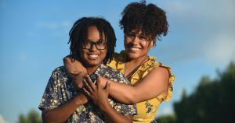
Tools, Agency, and Healing

Slide 19
Agency
Students—support their academic agency
Faculty—know your power and be powerless
Administrators and staff—support and bring empathy
Become a social justice campus
Educate yourself
Be an ally
Be a co-conspirator
Ask about DEI in every committee
Advocate and educate
Provide intentional professional development
Notes:
3 min--Alketa

Slide 20
Equity Programs: Learn and Collaborate
Co-curricular learning, dialogue, and advocacy skill building around social justice and equity topics
Coordination of history and heritage programming
Notes:
3 min--Alketa

Slide 21
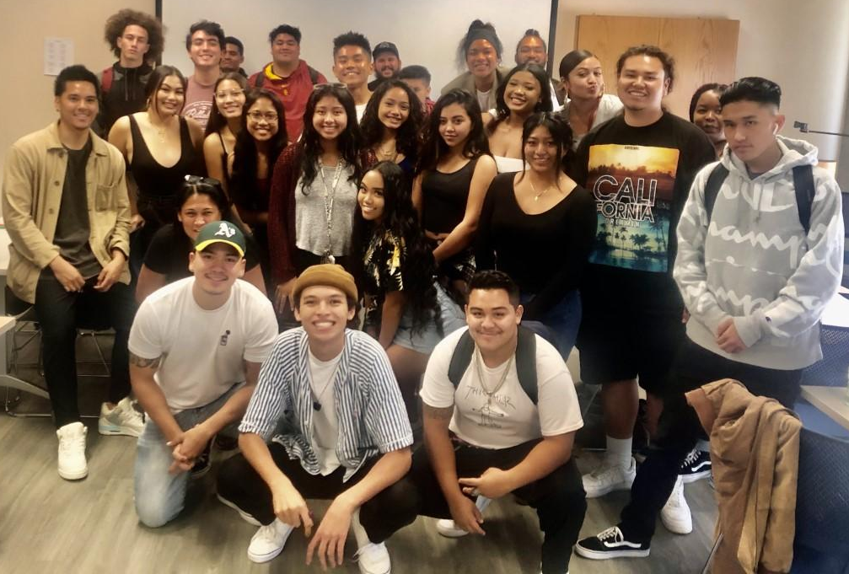
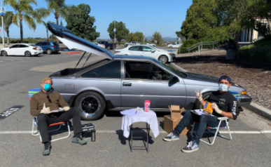
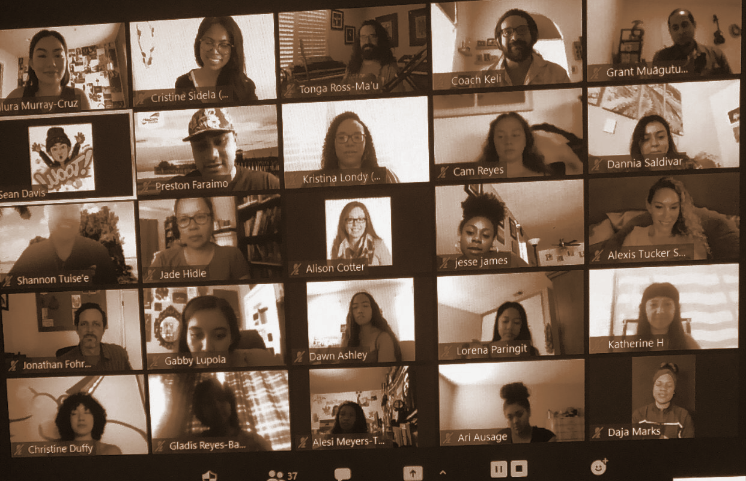
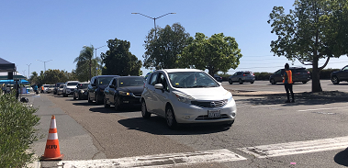
Tools and Strategies
CONNECT
CONNECT through regular virtual and physical spaces with students to bond as a community
LEARN
LEARN from student experiences and backgrounds
PARTNER
PARTNER to ensure students have access to basic needs support and resources
WELCOME
WELCOME students, family and loved ones with expressive spaces
Notes:
3 min--Alketa
Partnership: CARE Program, EOPS,

Slide 22
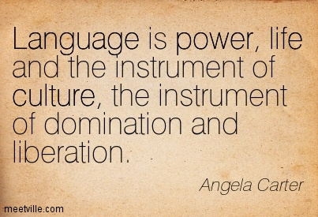
Review Artifacts and Documents
CORs
Syllabi
Is there asset-minded language used?
Are your policies trauma-informed?
Teaching and Learning
Did you build in continual check-ins?
Are you using formative, low-stakes assessments?
Is there balance between nurture and structure?
Notes:
Alketa (3 min--#1 COR and artifacts)
Artifacts traditionally are written documents. Culturally responsive teaching acknowledges oral traditions, story telling, poetry, and songs. So include those elements in your CORs (assignments, assessments, texts).
Michelle to share Canva syllabus link. (3 min--#2)
Deficit thinking defines students by their weaknesses instead of their strengths. It is important to acknowledge systemic racism and biases and not attack students’ character.
Karla (3 min--#3)
Our brains are wired to make connections--provide a space collaboration, relational environments, and collaboration, and then regular check for understanding and authentic engagement.
Alketa--Acknowledge the prevalence and impact of trauma, especially among marginalized students; Consider what happened to the student instead of what’s wrong with them; Ensure policies are clear and predictable; Empower students and give them control by providing choices; Balance between nurture and structure

Slide 23
Healing: Restorative Justice
There can be no healing without caring!
Mindset—awareness of students' lived experiences and acknowledgement that we must do better
Provide regular routines and flexibility with a space to practice
Go slow to go fast—develop the community, the village, the familia first
This is the foundation for rigor
Find your huddle and time to recharge yourself
History, despite its wrenching pain cannot be unlived, but if faced with courage need not be lived again.
―Maya Angelou
Notes:
3 min--Karla
MINDSET:
Listen with grace—honor students’ narratives
Recognize your power to resist and do better. For your students AND for yourself. (Luke Wood Frank Harris Care webinar w/CCCCO&CUE)
Collective uplift!

Slide 24
We are in this together!

Slide 25
What were your 2020 actions?
Some college action examples:
Equity keynotes
Antiracism liaison and DEI coordinator
Student panel or town halls
Resolutions
Data review
Professional development workshops and Canvas shells
Book clubs
Critical reflection
Curriculum audits and revisions
When I dare to be powerful—to use my strength in the service of my vision, it becomes less and less important whether I am afraid.
–Audre Lorde
Notes:
3 min--Karla
Give me a thumbs up if you want to support student success and anti racist practices.
Raise your hand if you want your students to fail.
At your Convocation, you asked students: HOW welcome did you feel when you came to campus?
Critical Reflection: Have you reflected and asked HOW they feel when walking into your classroom or Zoom room?
--Addressing equity from the PERSONAL to the INSTITUTIONAL = means addressing your own emotion and reflecting on your purpose and practices.

Slide 26
What ACTION will you take to create your PLAN?
How have you actualized and operationalized equity, anti-racism, culturally responsive teaching?
Use Padlet: https://padlet.com/ProfessorBean/l9o53ry8jno027mz
How will you take action this year?
Volunteer to share out: What will you do?
Notes:
3 min--Karla

Slide 27
Thank you! Any questions? info@asccc.org
“I’m not saying I’m going to change the world, but I guarantee that I will spark the brain that will change the world.”
–Tupac Shakur
Take the survey on Pathable home page!
Notes:
Wrap up and take any questions if time allows (Michelle--3 min)

Slide 28
Resources
Hammond, Zaretta. (2014). Culturally Responsive Teaching and the Brain: Promoting Authentic Engagement and Rigor Among Culturally and Linguistically Diverse Students. Thousand Oaks, CA: Corwin.
Kendi, Ibram X. (2019). How to be an Antiracist. New York: One World.
Love, Barbara, Dejong, Keri, and Hughbanks, Christopher (2007). Critical Liberation Theory. Social Justice Education. Amherst: University of Massachusetts.
Major, Amielle. (2020, May). How to Develop Culturally Responsive Teaching for Distance Learning. Mindshift. KQED. https://www.kqed.org/mindshift/55941/how-to-develop-culturally-responsive-teaching-for-distance-learning.
Sims, Jeremiah J., Taylor-Mendoza, Jennifer, Hotep, Lasana O., Wallace, Jeramy, Conaway, Tabitha. (2020). Minding the Obligation Gap in the Community College. New York: Peter Lang. http://www.mindingtheobligationgap.com/
Wood, Luke and Frank Harris, III. (2020). Addressing Anti-Blackness on Campus: Implications for Educators and Institutions. CORA Learning. https://www.youtube.com/watch?v=XLfJME7gnKk&t=2910s.

