Slide 1
Taking the Lead on Legislation that Impacts Teaching and Learning while Maintaining a Focus on Students Thursday, November 4 | General Session | 10:50-12:00
Notes:
Ginni

Slide 2
Presenters
Wendy Brill-Wynkoop, FACCC President
Jeffrey Hernandez, East Los Angeles College, ASCCC Legislative and Advocacy Committee (virtual)
Christopher Howerton, ASCCC North Representative, ASCCC Legislative and Advocacy Committee
Ginni May, ASCCC Vice President, ASCCC Legislative and Advocacy Committee Chair
Notes:
Ginni et al

Slide 3
Agenda
Title 5 and Education Code
Overview of 2021 Legislative Session, Budget Process, and Some History
Student-centered advocacy in the hybrid world
Working with the other stakeholders and the legislature
ASCCC/FACCC partnership
ASCCC Legislative Liaisons
Discussion
Notes:
Ginni

Slide 4
But wait…an Acronym Tutorial
ASCCC – Academic Senate for California Community Colleges
CCCCO – California Community Colleges Chancellor’s Office
FACCC – Faculty Association of California Community Colleges
SSCCC – Student Senate for California Community Colleges
AB – Assembly Bill
SB – Senate Bill
CFT – California Federation of Teachers
CCA – Community College Association
CCCI – California Community Colleges Independents
CCLC – Community College League of California
TMC – Transfer Model Curriculum
ADT – Associate Degree for Transfer
Did we miss any? Put it in the chat…
Notes:
Ginni – take a picture…

Slide 5
Title 5 and Ed Code
California Code of Regulations (Title 5)
5C (Curriculum Committee)
Consultation Council
CCC Board of Governors
Strength of Law – Intended to implement state law (Ed Code)
California Education Code (EDC or Ed Code)
Enacted by the Legislature
Signed by the Governor
Often requires regulations and/or funding
Takes an act of the legislature to change
Trailer Bill/Budget Bill Language
Intended to implement funding changes or requirements
Notes:
Ginni and Christopher
Ginni introduces Title 5
Christopher discusses Ed Code
Ginni follows up on Trailer bill/Budget

Slide 6
Budget Process – a year long
New Requests
Release of Governor’s Budget (January 10)
Budget Trailer Bills Introduced (January-February)
Beginning in summer system partners submit budget requests to the CCCCO
Board of Governors approves the system budget requests in September
System budget requests are submitted to Department of Finance
Advocacy begins in January with the release of the Governor’s budget and continues through mid June
It is a parallel legislative process
Budget Hearings
(February to June)
Governor’s Revisions
(April and May)
Legislative Actions
(June)
Governor’s Consideration
(June)
Budget Year Begins
(July 1)
Notes:
Wendy

Slide 7
Legislative Process
Bill Introduction Deadline
(February)
1st House Floor Vote Deadline
(May)
Legislative Deadline
(September)
Governor’s Final Actions
(October)
Effective Date of Statutes
(January 1)
New Requests
1st House Committee Hearings (March-May)
2nd House Committee Hearings (June-August)
.
Notes:
Ginni

Slide 8
The Legislative Process Assembly Members and Senators are limited to introducing fifty and forty bills (each, respectively) per two-year session. Possible 5,600 bills per two-year cycle
2020 Bills significantly reduced due to Covid
2,390 Bills introduced in the state legislature
231 bills introduced tracked by CCCCO Matrix
513 made it to the Governor’s desk
457 became law, 56 vetoed
37 of them pertinent to CCCs
2021
2,379 Bills introduced in the state legislature
203 bills introduced tracked by CCCCO Tracked Legislation Website
836 made it to the Governor’s desk
770 became law, 66 vetoed
91 of them pertinent to CCCs
Notes:
Wendy

Slide 9
Overview of 2021 Legislative Session
Curricular Requirements: Where are they?
Local governing board policies and regulations
Chancellor’s Office Guidelines
Program and Course Approval Handbook 2019
Title 5 Regulations
Legislation
More and more they are popping up in Legislation…
Notes:
Ginni

Slide 10
History of Transfer Legislation
Notes:
Wendy

Slide 11
Transfer Legislation
AB 928 (Berman, 2021) – Transfer Achievement Reform Act of 2021: Associate Degree for Transfer Implementation Committee
Signed by governor October 6, 2021
Implementation Committee by March 1, 2022 – 16 members
One faculty member from each of the CCC, CSU, and UC systems
Single GE Pathway for transfer to CSU/UC by May 31, 2023 The GE pathway may not require more units than the current IGETC (34 semester units)
Students with a goal of transfer for which there exists an ADT shall be placed on that pathway – students may opt out
History:
SB 1440 (Padilla, 2010) Student Transfer Achievement Reform Act
SB 440 (Padilla, 2013) Student Transfer Achievement Reform Act
Notes:
Ginni

Slide 12
Graduation and General Education Requirements
AB 928 (Berman, 2021) – Student Transfer Achievement Reform Act of 2021:
Single GE Pathway for transfer to CSU/UC by May 31, 2023 The GE pathway may not require more units than the current IGETC (34 semester units)
Title 5 Regulations §55063 approved at July 2021 Board of Governors Meeting – to implement Ethnic Studies Graduation Requirement
AB 1040 (Muratsuchi, 2021) – CCC Ethnic Studies Requirement
Legislature decided bill was not needed
History:
AB 1460 (Weber, 2019) – CSU Ethnic Studies Requirement: passed
AB 3310 (Muratsuchi, 2020) – CCC Ethnic Studies Requirement: did not pass
Notes:
Ginni

Slide 13
Assessment and Placement
AB 705 (Irwin, 2017) – English, Mathematics, ESL placement
Signed by the governor October 13, 2017
maximize the probability that the student will enter and complete transfer-level coursework in English and mathematics within a one-year timeframe,
placement via one or more of the following: high school coursework, high school grades, and high school grade point average.
prohibit from requiring students to enroll in remedial coursework that lengthens their time to complete a degree unless placement research shows those students are highly unlikely to succeed
Title 5 Regulations §55063, §55002, §55003, §55522
Approved by Board of Governors March 2019
Notes:
Wendy

Slide 14
Common Course Numbering
AB 1111 (Berman, 2021) – Postsecondary education: common course numbering system. passed
Trailer Bill Language California Budget 2021-22
History:
SB 1415 (Brulte, 2004) – Postsecondary Education: Donahoe Higher Education Act: Common course numbering system
SB 450 (Solis, 1995) – Towards a Common Course Numbering System; ASCCC Paper adopted November 1995
SB 851 (1983) – Common Course-Numbering Systems A Report to the Legislature in Response to SB 851 (1983)
Notes:
Wendy – C-ID Course Identification Numbering System developed following SB 1415.
AB 1111 (Berman, 2021) – Postsecondary education: common course numbering system.
Require the establishment of a common course numbering system for all GE and transfer pathway courses throughout the CCCs by July 1, 2024;
Urge the common course numbering workgroup (see above) to consider starting with courses in the current C-ID system and expand from there.
Trailer Bill Language California Budget 2021-22
Allocate $10 million to the CCCCO to form a workgroup to support the development and implementation of a common course numbering system throughout the CCCs.

Slide 15
Additional Bills
AB 927 (Medina, 2021) – Public postsecondary education: community colleges: statewide baccalaureate degree pilot program. passed
AB 1456 (Medina, 2021) – Cal Grant Reform did not pass
AB 417 (McCarty, 2021) – Rising Scholars passed
Notes:
Wendy
AB 417 (McCarty) Rising Scholars Network PASSED
The CCCCO to establish a program, named the Rising Scholars Network, to enter into agreements with up to 50 community colleges to provide additional funds for services in support of postsecondary education for justice-involved students
AB 927 (Medina) Statewide baccalaureate degree program PASSED
Extend the operation of the statewide baccalaureate degree pilot program indefinitely.
Removes the requirements that the program consist of a maximum of 15 community college district programs and for a student to commence a program by the end of the 2022–23 academic year.
CCC to provide evidence of unmet workforce needs
a total of 30 baccalaureate degree programs per academic year in the state
BA does not exceed 25% of the total number of associate degree programs offered by the community college district
Consultation with CSUs, UCs, and Private colleges – they can object for duplication.
AA program in the same subject
AB 1456 (Medina) Student financial aid: Cal Grant Reform Act. VETOED
Would enact the Cal Grant Reform Act, which would revise and recast the provisions establishing and governing the existing Cal Grant Program into a new Cal Grant Program.
AB 1456, which was set to take effect in 2024-25, would have further expanded eligibility by getting rid of GPA requirements for community college students and lowering GPA requirements for students attending a CSU or UC campus.
would have simplified the Cal Grant program
expanded aid to 160,000 additional students.
CCC the most because they would no longer have needed a minimum grade point average to be eligible for financial aid.
All students would have received more tuition and non tuition grants

Slide 16
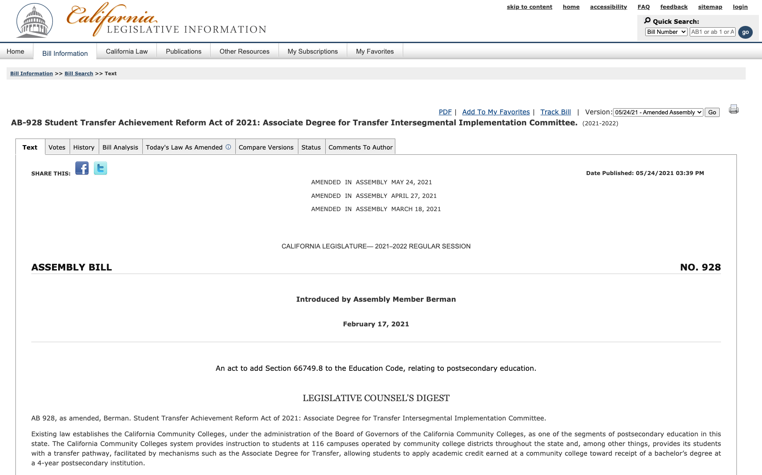
Staying Informed
California Legislature
Bill Search Site
s
Notes:
Wendy

Slide 17
Student-Centered Advocacy in the Hybrid World
Questions to consider regarding potential legislation:
How does it benefit students?
How might it create barriers for students?
What data shows the benefit for students?
What data shows a barrier for students?
What do students say?
What do faculty say?
What do system partners say?
Who is sponsoring the bill and why?
Notes:
Ginni et al
When advocating or taking positions you may want to consider questions such as these.

Slide 18
Student-Centered Advocacy in the Hybrid World – ASCCC
Focus on the “10+1”
Legislation and Advocacy Committee
Letters in Opposition or Support
Resolutions
Legislative Visits
Legislative Advocacy Day
Intersegmental Committee of Academic Senates (ICAS) Advocacy Day
Information to Local Legislative Liaisons
ASCCC President, Executive Director, Vice President legislative visits
Collaboration with system partners (including students!)
Notes:
Jeffrey, Christopher

Slide 19
Student-Centered Advocacy in the Hybrid World – FACCC
Lobbying Organization
Legislation and Advocacy Committee
Letters in Opposition or Support
Legislative Visits
Legislative and Advocacy Conference
ASCCC Legislative Advocacy Day
Collaboration with system partners (including students!)
Notes:
Wendy

Slide 20
Working with other Stakeholders and the Legislature
CCA/CCCI/CFT Unions – Representing faculty in the area of working conditions and compensation
CCCCO – Systemwide leadership and oversight, as well as advocacy on behalf of system priorities
SSCCC – statewide voice of students to pursue policies to improve student access, promote student success, engage and empower local student leaders, and enrich the collegiate experience
CCLC – support locally elected trustees and community college CEOs serve their students and communities by advocating on their behalf at the state and federal levels
Notes:
Christopher, Jeffrey

Slide 21
It’s a lot to keep up with… so let system partners help. Check positions on
ASCCC Legislative Positions
FACCC Legislative Positions
CFT Legislative Updates
CCA Legislation and Political Action
CCCCO Tracked Legislation
CCLC Legislative Actions
Notes:
Jeffrey, Christopher

Slide 22
Advocacy Tool Kit
Call/Email your representative
Ask others to join you
Do your research and be prepared
Meet with Representative
Follow up!
Send a thank you note
Notes:
Wendy

Slide 23
The Do’s and Don’ts of Advocating
Be prepared, honest, and respectful
Breathe
Be reliable
Select a spokesperson
Ask for support
Leave something behind
Notes:
Wendy

Slide 24
ASCCC and FACCC Advocacy Listserves
ASCCC Sign up for the ASCCC legislative liaison listserv by emailing info@asccc.org
FACCC
This is a new two-way listserv where you can post questions and have discussions about legislation
Send email to: FACCCadvocates+subscribe@googlegroups.com
You will receive an automatic email, follow link, click join
CCCCO
ADVOCATES@listserv.cccnext.net
Notes:
Wendy

Slide 25
ASCCC Legislative Liaisons
Each local academic senate may establish a legislative liaison – single faculty member or group of faculty
Responsibilities may include:
Attend local academic senate meetings; report regularly about legislation and legislative issues
Identify legislative issues of particular concerns
Monitor the ASCCC Legislative Updates page: https://www.asccc.org/legislative-updates
More information: https://www.asccc.org/liaisons or email info@asccc.org
Contact your local academic senate president
Notes:
Christopher, Jeffrey

Slide 26
Resources
AB 928 (Berman, 2021) – Student Transfer Achievement Reform Act of 2021: Associate Degree for Transfer Intersegmental Implementation Committee
AB 1111 (Berman, 2021) – Postsecondary education: common course numbering system.
California Budget 2021-22 – $10M for Common Course Numbering
LegiScan: https://legiscan.com
California Legislative Information: https://leginfo.legislature.ca.gov
ASCCC Legislative Liaisons: https://asccc.org/legislative-liaison
Notes:
Ginni

Slide 27
Discussion...
Thank You!
Notes:
Ginni

