Slide 1
Telling our Stories: Narratives of Student Learning
Dr. Natasha Jankowski
Director, National Institute for Learning Outcomes Assessment

Slide 2


NILOA
NILOA’s mission is to discover and disseminate effective use of assessment data to strengthen undergraduate education and support institutions in their assessment efforts.
● Surveys ● Web Scans ● Case Studies ● Focus Groups
● Occasional Papers ● Website ● Resources ● Newsletter ● Presentations ● Transparency Framework ● Featured Websites ● Accreditation Resources ● Assessment Event Calendar ● Assessment News ● Measuring Quality Inventory ● Policy Analysis ● Environmental Scan ● Degree Qualifications Profile ● Tuning
  www.learningoutcomesassessment.org
Notes:
Our background and purpose, where located and when founded, what we do –a bit about NILOA

Slide 3
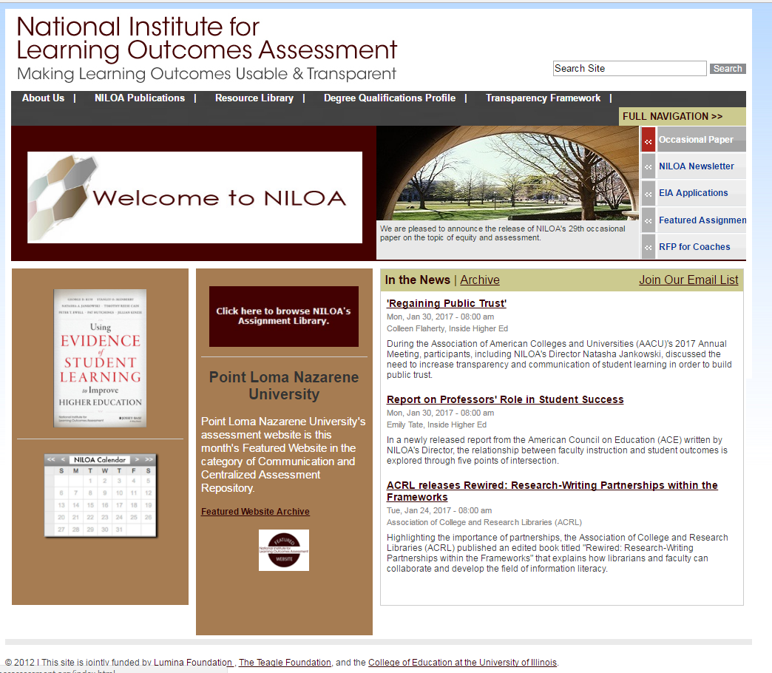

Slide 4
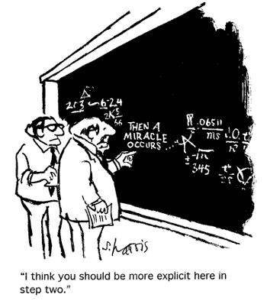
Do we even have a communication issue?

Slide 5
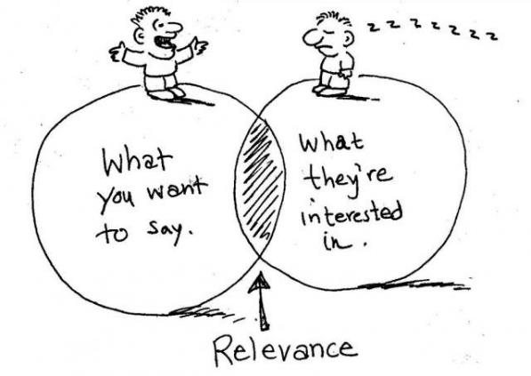
But we make things public!

Slide 6
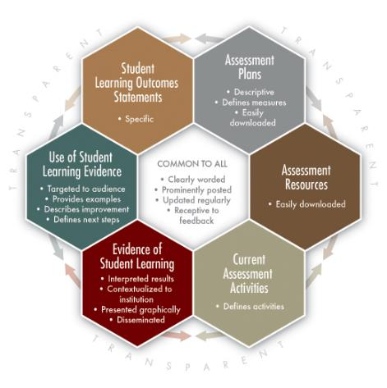
What about this?

Slide 7
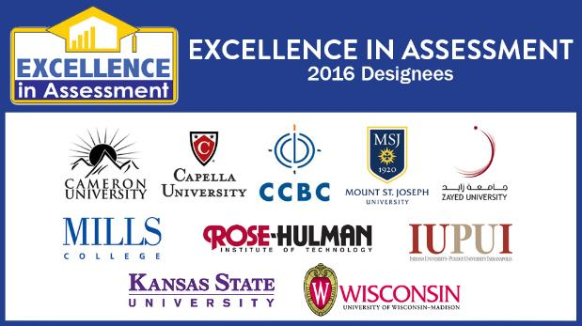
Inaugural Designees Announced August 2016
2017 application period now open!

Slide 8
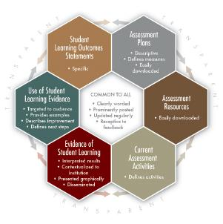
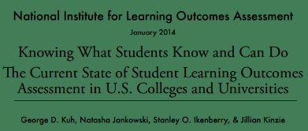
How does the NILOA Transparency Framework fit in?
Institutions more frequently report assessment results internally than to external audiences.
Notes:
However, doing good integrated assessment is only half the job. We need to be better at communicating what we’re doing, how we’re supporting it on our campuses, and what it all means to our stakeholders – both on-campus and off.
NILOA Report (January 2014): Knowing What Students Know and Can Do: The Current State of Student Learning Outcomes Assessment in US Colleges and Universities
http://www.learningoutcomeassessment.org/documents/2013%20Abridged%20Survey%20Report%20Final.pdf
In keeping with the original vision of the VSA to help institutions better tell their stories, therefore, the EIA Designations use a rubric developed from the NILOA Transparency Framework to evaluate campus applications, creating intention focus on communication of assessment processes and results.
Even those campuses that are engaged in intentionally aligned assessment of student learning struggle to tell their stories to the variety of stakeholders they are accountable to. While most campuses now make a practice of publicly stating what their learning outcomes are, they generally share assessment findings internally, and frequently only to faculty or assessment committees. Rarely are assessment plans or rationales shared even with students or alumni, much less with external stakeholders such as employers, institutions who accept students for continued study, state legislators, or the public. Put another way, campuses talk about assessment to themselves when they talk about it at all.
The National Institute for Learning Outcomes Assessment (NILOA) created the Transparency Framework “to help institutions evaluate the extent to which they are making evidence of student accomplishment readily accessible and potentially useful and meaningful to various audiences.” Based on a national review of campus assessment websites, the Transparency Framework consists of six components centered around a set of underlying principles common to all components (Figure 2). Guidance on the NILOA website includes key questions institutions can ask to help ensure they are making evidence of their assessment and student learning readily accessible and useful to both internal and external audiences.
Kuh, G. D., Jankowski, N., Ikenberry, S. O., & Kinzie, J. (2014). Knowing What Students Know and Can Do: The Current State of Student Learning Outcomes Assessment in US Colleges and Universities. Urbana, IL: University of Illinois and Indiana University, National Institute for Learning Outcomes Assessment (NILOA).
National Institute for Learning Outcomes Assessment. (2011). Transparency Framework. Urbana, IL: University of Illinois and Indiana University, National Institute for Learning Outcomes Assessment (NILOA). Retrieved from: http://www.learningoutcomesassessment.org/TransparencyFramework.htm

Slide 9

Transparency
Awareness of Learning Outcome Statements

Slide 10
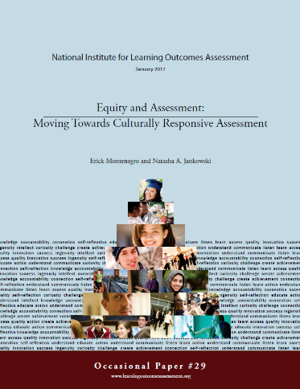
And students?

Slide 11


Starting Institution
Courses
Transfer Institution
Assignments
Co-Curriculum
Employment
CURRENT STUDENT EXPERIENCE OF HIGHER EDUCATION

Slide 12
Starting Institution
Courses
Transfer Institution
Assignments
Co-Curriculum
Employment
HOW WE WORK IN HIGHER EDUCATION

Slide 13
Starting Institution
Courses
Transfer Institution
Assignments
Co-Curriculum
Employment
HOW WE WORK IN HIGHER EDUCATION

Slide 14
Starting Institution
Courses
Transfer Institution
Assignments
Co-Curriculum
Employment
HOW WE WORK IN HIGHER EDUCATION

Slide 15
Assessment and Learning
Yet, we claim that assessment is about improving student learning
But what does that mean?
If we want to make the argument that our institutions are advancing student learning - first of all can we, and if we can, what are we arguing for?
How can we argue for the ways we go about assessing student learning?
Notes:
you ask a random grouping of people in this room what it means to assess and while the opening bit may have a different tone or focus to it, they will end with - improvement.

Slide 16
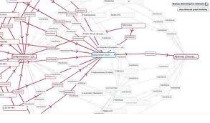
Causal Statements
The ability to make causal claims about our impact on students and their learning
Institutional structures and support + student = enhanced learning
Notes:
Mostly what we mean by closing the loop or using evidence of student learning to improve is causal in nature – we want to be able to make causal statements that our change in practice, behavior, course offerings, etc all lead directly to enhanced student learning
We are making causal claims about our impact on students
But this is hard to know

Slide 17
Difficulty of Causal Statements
Mobility of students
Untracked changes
Changes in courses add up to program level change
Lack of clarity on what even counts as a program
Life
Levels at which use occurs
Longer than a year cycle
Loosely coupled relationships
Notes:
Whole other issues of causality that are beyond the realm of considering because we can’t randomly assign students to courses, we can’t force faculty to teach exactly the same way and try out an intervention,
Issues of change management – most of these are related in some way to issues of change management and sometimes it is helpful to think of assessment from a change management perspective (loosely-coupled – org theory; or change management in organizations; systems thinking)
While this may seem messy, it is less messy and more complex. There are many moving parts, there is the co-curricular and the curricular, there is the life that happens as students are moving through institutions of higher education
Maybe what we need is a different way to think about it – a different way to tell or make the case that what we changed or did differently led to any increase in student learning – a different approach to get to impact or improvement

Slide 18
Theories of Change
Why do we think the changes we make will lead to better outcomes?
What is assumed in the changes we select as it relates to how students understand and navigate higher education?
Notes:
A good starting place is to engage in thinking about what is our theory of change – why is it that we believe that adding a course, changing the reading, increasing advising, adding a program, etc will have the desired impact of enhanced student learning?
What is the assumed mechanisms or levers of change?

Slide 19
Theory of Change (TOC)
A process of outlining causal pathways by specifying what is needed for goals to be achieved (Carman, 2012)
It requires articulating underlying assumptions which can be tested and measured (Jones, 2010)
A Theory of Change provides a roadmap outlining how one thinks or conceptualizes getting from point A to point B over time (Ployhart & Vandenburg, 2010)
Notes:
it changes the way of thinking about initiatives from what you are doing to what you want to achieve and starts there.

Slide 20
For instance…
Coverage and content
Opportunities and support
Intentional, coherent, aligned pathways
Within each of these is the belief about root causes – why students were not learning or not meeting the outcome and the mechanism by which the institution can help them succeed
Notes:
I covered the content in my course, therefore my students learned it – if they didn’t learn it then I need to add an assignment or a course and cover it again
We provide all our students with opportunities and a writing center, support services, etc and we have now extended the hours and increased staff, and this will help students
Now you have the pathway and pipeline – so if we create intentional, coherent, aligned pathways it will help students to see what we want and how to get there and then they will learn more – it is also a mechanism that is structurally useful to being able to make stronger causal arguments because outcomes are aligned and mapped throughout the curriculum
But that is what we believe…how do we get others to agree that it is what we are doing and not something else that is leading to enhanced student learning – first we have to track student learning over time, but really what we need to do is tell our theory of change story – we need to be able to justify the changes that were made as something that we believed would enhance student learning

Slide 21
Root Causes
A process of exploring not only that something happened, but why it happened the way that it did (Rooney & Heuvel, 2004)
Moves beyond surface-level problem identification and examines assumptions in order to prevent reoccurrences (Taitz, Genn, Brooks, Ross, Ryan, Shumack, Burrell, & Kennedy, 2010)

Slide 22
But…
Toulmin (2003)
Evidence Claim
Warrant
Warrants
Arguments
Notes:
Instead of outlining a theory of change, engaging in root cause analysis…we can think of warrant and arguments
What we are doing, is selecting a variety of evidence, which may change depending on the audience, and providing that in relation to a claim made about improvement of student learning. The warrant involves outlining and justifying why we think this change, for these students, at this institution, at this time, led to the improvement we are seeing in student learning. Or why we think it will.
What are we seeing in practice?

Slide 23
Evidence-based Storytelling
Evidence of student learning is used in support of claims or arguments about improvement and accountability told through stories to persuade a specific audience.
Need to tell our story and help students tell theirs.
Notes:
This is also a story to alert those on campus as to what good assessment practice looks like for this institution, what does use of student learning evidence look like here, what counts as evidence for decision-making here
Go over each bold piece briefly
It is a way to bring together improvement and accountability in a meaningful mechanism

Slide 24
What does good assessment look like for us here?
Why do we think that what we are doing, for these students, will lead to enhanced learning, at this time?

Slide 25
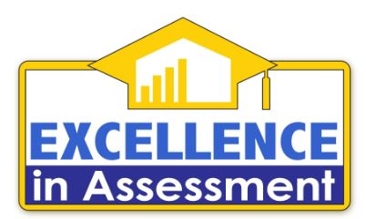
Excellence in Assessment Designations
National recognition program for campus assessment leaders
Evaluation based on the National Institute for Learning Outcomes Assessment (NILOA) Transparency Framework
Focus on campus-wide assessment – including student affairs & external stakeholders – and narrative
Joint project of the VSA, NILOA, and the Association of American Colleges & Universities (AAC&U)

Slide 26

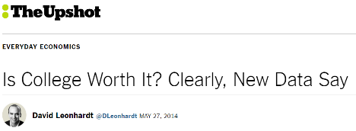
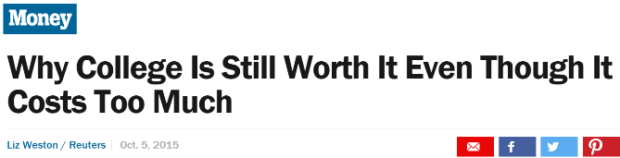
Why did we create the EIA Designations?
Notes:
The ability of a campus to clearly and convincingly communicate the learning outcomes of all their graduates, regardless of program of study, is paramount to the success of our students, institutions, and larger national economic and competitive priorities. Policymakers and external stakeholders are increasingly questioning the value of higher education experiences as a whole, focusing on labor market outcomes to hold certain types of programs or majors up as preferred. Institutions and the higher education industry as a whole have struggled to push back on these claims, citing the complexity of evaluating student learning across varied and disparate programs in easily comparable ways.
See for example: USA Today College (December 10, 2015). “Is college worth it? Goldman Sachs says not so much”: http://college.usatoday.com/2015/12/10/is-college-worth-it-goldman-sachs-says-not-so-much/; The New York Times TheUpshot (May 27, 2014). “Is College Worth It? Clearly, New Data Say”: http://www.nytimes.com/2014/05/27/upshot/is-college-worth-it-clearly-new-data-say.html?_r=0; and Money (October 5, 2015). “Why College is Still Worth It Even Though It Costs Too Much”: http://time.com/money/4061150/college-degree-worth-it/.
Carnevale, A.P., Cheah, B., & Hanson, A.R. (2015). The Economic Value of College Majors. Washington, DC: Georgetown University, Center on Education and the Workforce.

Slide 27
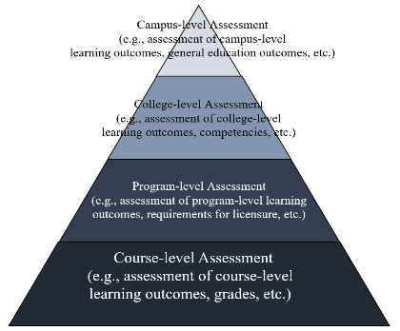
Why did we create the EIA Designations?
Faculty & instructional staff
Student Affairs staff
Students & Alumni
Accreditors, governing boards
Employers, subsequent institutions
Notes:
Despite these challenges, many campuses are successfully designing and implementing campus-wide assessment systems that provide evidence of the learning of all students. These systems are horizontally and vertically integrated to encompass learning both in and outside of the classroom, and are validated by participation and evaluation of external stakeholders, including alumni, employers, and schools their students subsequently attend for additional study. By incorporating all areas of campus, not just the academic experiences that occur in the classroom, institutions are able to confidently assert the competency of their students in areas of leadership and teamwork, essential outcomes for employers in today’s diverse workplaces., Building intentionally integrated layered systems that rest on the foundational work of faculty in the classroom, campuses are able to provide deep and rich evidence of students’ knowledge, skills, and abilities.
Hart Research Associates. (2015). Falling Short? College Learning and Career Success. Washington, DC: Association of American Colleges & Universities (AAC&U).
Deming, D.J. (2015). The Growing Importance of Social Skills in the Labor Market. Cambridge, MA: Harvard University and NBER.
Campus-level assessment is often thought of as an accountability or accreditation concern that is somewhat removed from the work of faculty teaching in specific programs or classes. Faculty may be disinvested from the administration of a campus-wide assessment instrument, at best seeing it as a benign requirement to appease external cries for accountability. The EIA program, however, understands that campus-level assessment builds from a foundation of faculty assessment of student learning, as an integrated component designed to serve as a “tip of the iceberg” indicator for the depth and breadth of student learning happening on our campuses (Figure 1).
Kuh, G. D., Jankowski, N., Ikenberry, S. O., & Kinzie, J. (2014). Knowing What Students Know and Can Do: The Current State of Student Learning Outcomes Assessment in US Colleges and Universities. Urbana, IL: University of Illinois and Indiana University, National Institute for Learning Outcomes Assessment (NILOA).
Campus-level assessment does not necessarily consist of use of an identical or standardized assessment instrument administered to all students, but represents a broader and deeper assessment plan that is integrated across departments and programs. An ideal campus-wide assessment plan would consist of aligned outcomes at the student-, course-, program-/major-, and degree-levels. What that looks like for any given campus may be varied and diverse, and recognizing the multiple right paths to demonstrating student outcomes is the goal of the EIA designations.
In this view, assessment activities occur at multiple levels where each level is related to and either builds from or supports the levels below and above it, creating a scaffold of evidence across all students. The nature and setting of assessment activities at each level may or may not be different, e.g., assessment of campus-level learning outcomes may occur within the context and setting of an individual capstone course or it may occur in a separate, proctored exam depending on the program and institution.
The results of the assessment at each level, however, need to be comparable across all students so results can be interpreted and used to identify the need for, and guide the implementation of, program and curricular improvements. Just as all students in an Accounting program need to pass a licensure exam to ensure that they have all learned the knowledge, skills, and abilities necessary to perform as a Certified Public Accountant, all students at an institution should be assessed with approaches that provide results comparable to each other to ensure all students have learned the core knowledge, skills, and abilities the institution has identified as necessary to earn a degree.
Ideally, scaffolding of learning outcomes occurs across courses and programs such that the assessment work from an individual course can link to and inform the assessment work of a program. This scaffolding allows for fewer assessment activities to occur at higher levels of the pyramid than at lower levels–the evidence built from beneath serves to support the evidence provided at the top. This explains, in part, why a single representative sample of campus-level assessment outcomes is one way to reliably represent the learning of all students on campus.

Slide 28




Why did we create the EIA Designations?
Notes:
One of the main goals of the EIA program is to create a national recognition for campuses that are successfully integrating assessment practices across campus to provide evidence of student learning outcomes that are representative of all students who attend their institution. There is currently no such recognition, which hinders our efforts in at least three areas.
First, if we can’t identify more than a handful of institutions that have become known for their assessment work, we limit the models available to campuses to consider. There is not one right way to implement a broad and deep assessment plan on all campuses, but rather many right ways. Not only does this limit our examples, it limits our ability to celebrate the work being done on campuses that contributes to student success. Assessment done well is integrated throughout the work of many campus faculty and staff; by offering a national recognition of those institutions doing exemplary work, the EIA designations create an opportunity to reward and celebrate those efforts.
Second, because we can’t universally identify campuses who are engaged in good assessment practice, we can’t connect individual institutions with other institutions who may be similarly situated to help foster learning and sharing of what works and what doesn’t. By explicitly recognizing that there are many models for effective assessment of student learning, the EIA designations serve as both celebration of the work these campuses have accomplished as well as guideposts for other campuses looking to improve their own evaluation of student learning. The EIA designations are open to all regionally accredited institutions and the goal is to identify a plethora of examples from across sectors and levels to share broadly. By actively seeking to identify those institutions who are doing this work, we will create a larger network of examples for other campuses to explore.
Third, the lack of a common, national recognition program for campus assessment limits our ability to engage with external stakeholders and hold up concrete examples of the good assessment work our campuses are engaged in. We are continually questioned about the value of higher education for our students, but lack a nationally recognized and respected means to rebut the claims that we are disorganized and muddled. While still respecting the diversity of what good assessment looks like in practice, the EIA designations provide a signal and a standard for external audiences to look to.

Slide 29
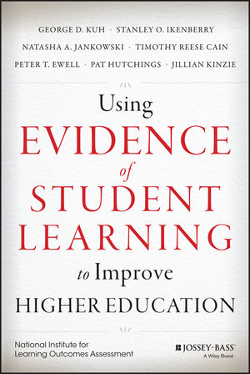
What resources are available?
What do you need?

Slide 30

Questions and discussion
Email: njankow2@illinois.edu
http://www.learningoutcomesassessment.org
www.assignmentlibrary.org
www.degreeprofile.org

