Slide 1
The 411 on Guided Pathways Friday, February 19, 2:00-3:00
Notes:
Ginni

Slide 2
Presenters
Ginni May, Vice President, ASCCC
Jake Kevari, Regional Board Member Inland Empire, RP Group; Moreno Valley College
Bri Hays, Vice President of Professional Development and Membership, RP Group; Cuyamaca College
Notes:
Ginni starts…

Slide 3
Description
Guided Pathways is a student-centered, equity-focused approach designed to increase the number of students meeting their educational goals by providing clearly defined programs with high-touch student support throughout the entire college experience. Guided Pathways is a framework that affects all faculty and students perhaps more than any other institutional initiative. Join this session to get the 411 on the Guided Pathways framework, to learn effective practices that keep students on their path and ensure learning for Guided Pathways Pillars III and IV, and to discover the role part-time faculty can play in a college’s Guided Pathways efforts.
Notes:
Ginni - briefly

Slide 4
Overview
Guided Pathways – What is it?
A Closer look at Pillars III and IV
Pillar III – Staying on the Path
Pillar IV – Ensuring Learning
What can part-time faculty do?
Notes:
Jake

Slide 5
Activity
Click on the link in the Chat to access the Padlet…
What does “Guided Pathways” mean to you and your students?
Notes:
Bri

Slide 6
A Brief Overview of Guided Pathways
All Hands on Deck!
Meta Majors
Program Maps
Guided Onboarding
Wrap-Around Student Services
Student-Centered Course Scheduling
6
Notes:
Ginni

Slide 7
A Brief Overview of Guided Pathways
Notes:
Ginni

Slide 8
A Brief Overview of Guided Pathways
Teaching and Learning
Guided Exploration and Progression
Academic and Student Support
Clear Pathways and Programs
An ASCCC visualization of Guided Pathways
Notes:
Ginni

Slide 9
A Brief Overview of Guided Pathways
Grew from “pay to play” programs
American Association of Community Colleges Pathways Project – 3+1 California Community Colleges participating
California Guided Pathways Project (some called it the Demonstration Project) – 20 colleges participating
Approved by the governor in the 2017-18 Budget Act - California Education Code §§88920-88922
Most recent – California Guided Pathways Demonstration Project : 2020-22 Cohort – 40 colleges participating?
Notes:
Ginni

Slide 10
A Brief Overview of Guided Pathways
Guided Pathways Award Program (actual title in Ed Code: California Community Colleges Grant Program)
$150 million over 5 years – 10% for CCCCO; 90% for CCCs
All funds must be spent by June 30, 2022
114 colleges participating – participation required only to receive funds
AB 19 (Santiago, 2017) – College Promise will only be awarded to students attending colleges that are part of Guided Pathways Award (Grant) Program
Notes:
Ginni

Slide 11
A Brief Overview of Guided Pathways
90% for CCCs = $135M
Year 1 – 25%
Year 2 – 30%
Year 3 – 25%
Year 4 – 10%
Year 5 – 10%
Notes:
Ginni

Slide 12
Things to Consider in Implementing Guided Pathways
Guided pathways represent a significant shift in the way we approach our work
Culture change takes time, and the guided pathways approach requires that we rethink the way we do things and design with the end (and the student experience) in mind (completion)
Leverage the student voice to inform guided pathways work

Slide 13
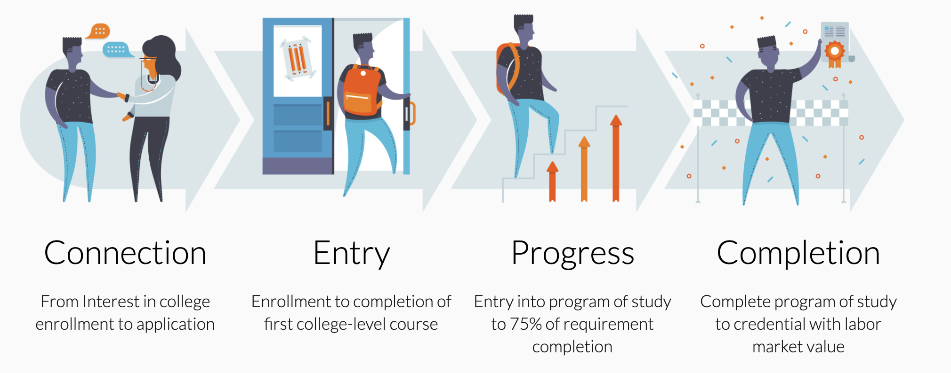
Completion by Design (CBD) – Loss/Momentum Framework
Source: Completion by Design – Loss/Momentum Framework

Slide 14
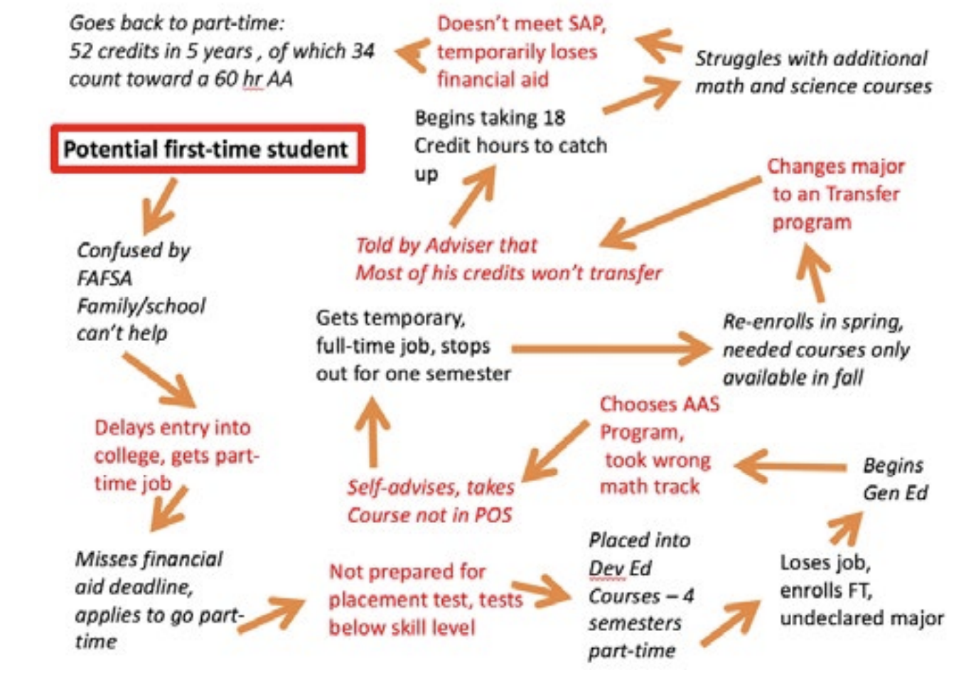
Practical Lessons Learned from CBD Colleges
VS.
Guilford Tech's Student Pathway before CBD
Source: Buidling Guided Pathways – Practical Lessons from Completion by Design Colleges

Slide 15
A Closer Look at Pillars III and IV
Pillar III – Stay on the Path
What resources and programs are available to help students stay on their chosen path?
Are there support resources in place to help students find their way back on the path?
Pillar IV – Ensure Learning
How do you know students are learning what is being taught?
How can course delivery be improved?
What options are available that provide the best learning opportunities?
Notes:
Ginni

Slide 16
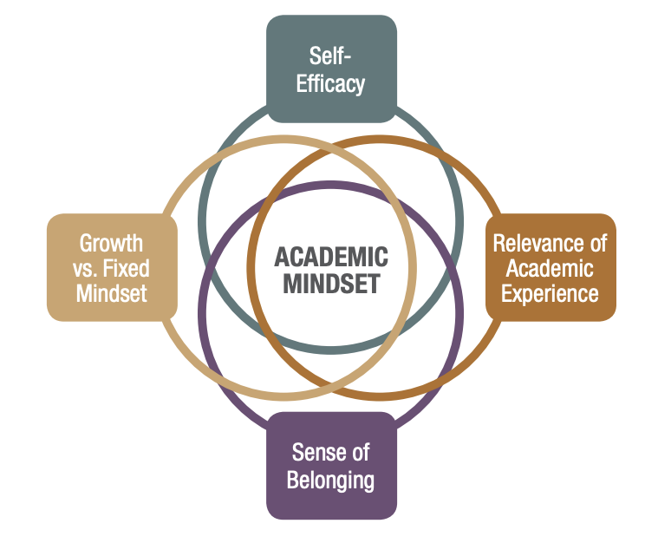
Pillars III & IV – Staying on the Path & Ensuring Learning
Early Alert Systems & Instructional Support (III)
Growth vs. fixed mindset
Self-efficacy
Relevance of academic experience
Sense of belonging
Instructional Co-Curricular Activities (IV)
Project-based learning
Intersection of learning outcomes with labor market and/or transfer curriculum
Source: A Mind at Work, Center for Community College Student Engagement
Notes:
1. Growth vs. fixed mindset: students’ perceptions of the potential for change in their intelligence.
2. Self-efficacy: students’ confidence in their ability to be successful in their coursework.
3. Relevance of academic experience: students’ views of whether their college work is preparing them for future success.
4. Sense of belonging: students’ perceptions of whether they are accepted members of their college community.

Slide 17
More on Pillar IV: Ensuring Students Are Learning
Expand culturally-responsive teaching and learning
Reflect on assessment approaches through the lens of implicit bias
Value and leverage students’ own social and cultural experiences and realities to provide validating learning opportunities
Connect student experiences inside and outside the classroom
Utilize an asset-based approach

Slide 18
What Can You Do as a Part-Time Faculty Member?
What are some strategies that can be implemented today to ensure students stay on their path?
What are some course activities and/or assignments that could be connected to the labor market and/or transfer curriculum to ensure learning?
How can colleges (we) be more student ready vs. asking if the students are ready for college (us)?
What are some strategies to emotionally guide students?
Click on the link in the Chat to access the Googledoc and share your responses…

Slide 19
Resources
Got questions for the ASCCC? Email info@asccc.org
Got questions for the RP Group? Click here: https://rpgroup.org/About-Us/Contact
ASCCC website: https://www.asccc.org
RP Group website: https://rpgroup.org
Thank you for joining us today!

