Slide 1
Art of Diplomacy
Andrew Delunas, Part Time Faculty, Gavilan College
Silvester Henderson, ASCCC At Large Representative
Newport Beach Marriot Hotel
900 Newport Center Drive Newport Beach, Ca 92660
February 21-23, 2019

Slide 2
Presentation Highlights
What is the definition of Diplomacy?
Academic Acumen – High Level Communication Skills- Diplomacy
Know the 10+1 Rules/Laws – Title V Section 53200
Institutional Practices and Differences: Participatory – Shared – Collegial Consultation
Communication Style “Heart of the Problem”
How to develop institutional skills for promoting “Cultural Inclusivity”?
Defining “Cultural Diplomacy”
Seven Steps for engaging in “Critical Conversations” via the Art of Cultural Diplomacy
Questions & Sharing

Slide 3
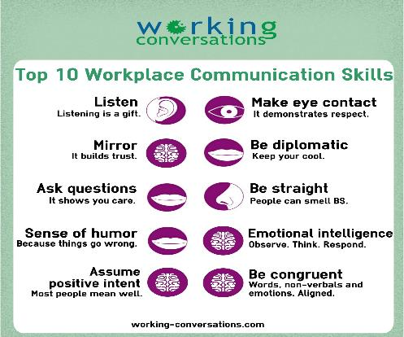
Academic Acumen – High Level Communication Skills- Diplomacy

Slide 4
Know the 10+1 Rules/Laws – Title V Section 53200
Curriculum, including establishing prerequisites
Degree and certificate requirements
Grading policy
Educational program development
Standards or policies regarding student preparation and success
College governance structures, as related to faculty roles
Faculty roles and involvement in accreditation processes
Policies for professional development activities
Processes for program review
Processes for institutional planning and budget development
Other academic and professional matters as mutually agreed upon.

Slide 5
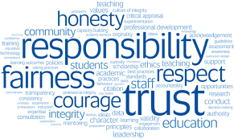
Institutional Practices and Differences
Participatory Governance | Shared Governance | Collegial Consultation
Sharing information without “authority”. Creates false imagery. Allows for varying interpretations. | Sharing information with consensus “authority”. Creates clarity. Clear roles and responsibilities. | Rely primarily upon Mutual agreement

Slide 6
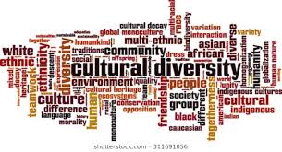
Communication Styles “Heart of the Problem”
Socialization practices & problem solving.
Barriers to conversations
Challenges surrounding institutional transformation.
Lack of Academic Inclusion for “ALL” – Barriers to Professional Resolutions
“If a participant in a conversation about quality in higher education refuses to
consider all these perspectives, then the conversation becomes an argument about positions rather than an opportunity for dialogue and learning”. (John Dew)
https://pdfs.semanticscholar.org/db03/5ff2284556f0a7d722a13353e4f0119b1048.pdf

Slide 7
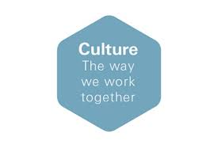
How to develop institutional skills for promoting “Cultural Inclusivity”?
Respect all forms of “Culturally Diverse” respectful communication.
Develop a clear understanding of “Intercultural Communication Styles,” both verbal and written.
Challenge your level of professional and personal space, and employment comfort .
Cultural Inclusion
The calls for more inclusive educational environments are not only concerned about widening participation but the calls are equally concerned about reorienting the mission, vision and values of educational institutions to better align them with core democratic principles. In this relationship, educational institutions have a valuable role to play in helping strengthen democracy.
https://www.universityworldnews.com/post.php?story=20161102112722844

Slide 8
Defining “Cultural Diplomacy” -
Cultural diplomacy is a type of public diplomacy and soft power that includes the "exchange of ideas, information, art, language and other aspects of culture among nations and their peoples in order to foster mutual understanding".^{[1]} The purpose of cultural diplomacy is for the people of a foreign nation to develop an understanding of the nation's ideals and institutions in an effort to build broad support for economic and political goals.^{[2]} In essence "cultural diplomacy reveals the soul of a nation", which in turn creates influence.^{[3]} Though often overlooked, cultural diplomacy can and does play an important role in achieving national security efforts.
https://en.wikipedia.org/wiki/Cultural_diplomacy
Notes:
At this point have a conversation. Can either go through our power point or we can have a discussion about how to have critical conversations with fellow faculty and administration

Slide 9
Seven Steps for engaging in “Critical Conversations” via the Art of Cultural Diplomacy
Get your mind set right – Before you even start the conversation, you need to identify where you’re stuck. Make sure you focus on the right issue by considering the following: What is the outcome you want from the conversation for yourself, for the relationship and, potentially, for the team/organization?
Make it safe – The first 30 seconds are likely to determine the outcome of your conversation. Create an environment where both of you feel comfortable to discuss the issue openly and honestly without feeling under attack.
Share concerns in a non-threatening way – Avoid controversy by leading with observations and facts rather than your interpretation of what you observed. Then, tentatively share your feelings, thoughts and assumptions.
Ask for their input – Ask the other person if they have a different view to you. The only limit to how strongly you express your own opinion should be your willingness to equally encourage others to challenge it.
Work towards a mutual purpose –You don’t have to be best friends with someone to respect them and work together towards a common goal. Think back to step one, you may need to share with them what you want for the relationship to build a mutual purpose and create new strategies to achieve it.
Decide a plan of action – How you end the conversation is just as important as how you start. Without deciding on the next steps, the conversation becomes meaningless. What will change as a result of speaking directly to your colleague about the problem?
Remain Respective and Culturally Diplomatic!
https://www.gra.uk.com/blog/6-steps-managing-difficult-conversations
Notes:
Emotions—heatrate should not increase, even keeled—discuss gender biases here
Path forward might be that you want to meet again, or clearly why the answer is the way it is.

Slide 10
Questions & Comments
Please feel free to contact each of us for more information.
Silvester Henderson Shenderson@losmedanos.edu
Andrew Delunas adelunas@gavilan.edu

