Slide 1
The Compton College Story Accreditation Institute Academic Senate for California Community Colleges February 24, 2018

Slide 2
History of Compton Community College District
The Compton Community College was established in 1927 as a component of the Compton Union High School District.
In 1950, voters approved a bond issue separating the college from the high school district.
Classes began on the new campus in fall 1956.
In the spring of 2004, the Chancellor of the California Community Colleges, as authorized under California Assembly Bill 61, appointed a Special Trustee and suspended the authority of the Board of Trustees of the Compton Community College District.

Slide 3
History of Compton Community College District
The Special Trustee has had sole authority over Compton Community College District’s assets, contracts, expenditures, facilities, funds, personnel, and property.
In the Spring of 2004, the Accrediting Commission for Community and Junior Colleges (ACCJC) conducted a visit to Compton Community College.
During this visit the Commission noted that Compton Community College was out of compliance with the Commission standards and on January 31, 2005 placed this institution on Show Cause.

Slide 4
History of Compton Community College District
On June 17, 2005, the Accrediting Commission or Community and Junior Colleges took action to terminate the accreditation of Compton Community College.
On June 30, 2006, Governor Arnold Schwarzenegger signed AB 318 (Dymally) into law, giving the Compton Community College District (CCCD) a $30 million loan for recovery and the opportunity to partner with a college in good standing with the ACCJC to offer accredited courses.

Slide 5
History of Compton Community College District
On August 21, 2006, the El Camino Community College District Board of Trustees and the Compton District Special Trustee approved a Memorandum of Understanding between the El Camino Community College District and the Compton District.
ACCJC and Compton Community College Communications Prior to August 2006 is available online at: http://www.district.compton.edu/history/communication.asp
On February 14, 2017, California Governor Brown; and the joint letter from Michael Cohen, Department of Finance, and Chancellor Eloy Oakley, issued letters returning the local authority to the Compton Community College District Board of Trustees.

Slide 6
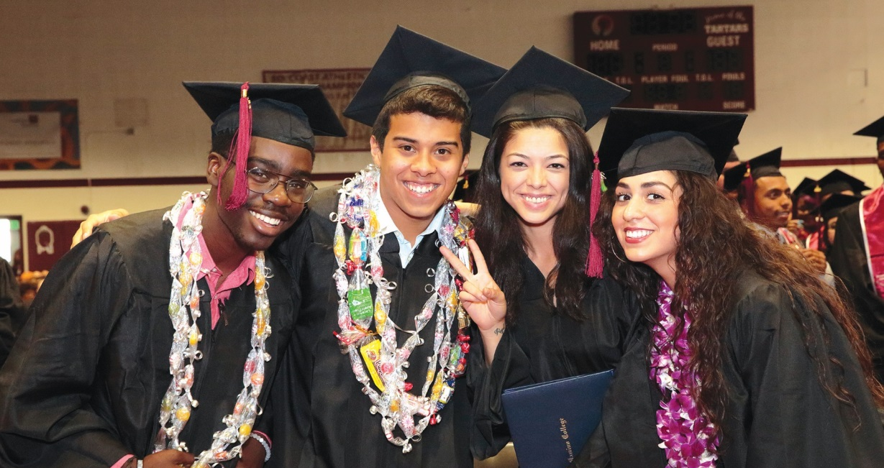
“Keeping the Doors Open”

Slide 7
Compton Community College District/ El Camino Community College District Partnership
California Assembly Bill 318 provided the framework for continued delivery of educational programs within the Compton District through a partnering college.
Primary intent of agreement is to assist the El Camino College Compton Center with recovery and eventual accreditation.
Academic Programs and Student Support Services under oversight of El Camino College.
President/CEO directs the educational programs and activities at Compton College. The President reports directly to the Superintendent/ President of El Camino College and as the CEO to the Compton District Board of Trustees.

Slide 8
Compton Community College District/ El Camino Community College District Partnership
Superintendent/President of El Camino College has oversight of Compton College.
Partnership Agreement between El Camino Community College District and Compton Community College District.
Latest Partnership Agreement was adopted by the Compton District Special Trustee and the El Camino Community College Board of Trustees in November 2016.

Slide 9
Compton College
El Camino College Compton Center, now known as Compton College was established in August 2006.
The Compton District encompasses an area of about 29 square miles, making educational services available to nearly 300,000 residents of Carson, Compton, Lynwood, North Long Beach, Paramount, and Watts-Willowbrook.
289 full and adjunct faculty members
574 degrees/certificates awarded in 2016-2017
In the 2016-2017 year, the Compton College enrollment was 12,403 students.

Slide 10
District by Ethnicity
Source: U.S. Census Bureau, American Community Survey, 2010-2014, S1903. http://factfinder.census.gov.
Notes:
Source: US Census Bureau, 2010 Census

Slide 11
Compton Center Enrollment Headcounts: 10-year Trend
Source: Chancellor’s Office
MIS Data (Data Mart)
* Winter Intersession not held in 2014, 2015 or 2016
Notes:
Unduplicated Headcounts
Source: Chancellor’s Office MIS Data (Data Mart)

Slide 12
Students by Ethnicity
Source: Chancellor’s Office MIS Data (Data Mart)

Slide 13
Accomplishments
In 2014-2015, 1,396 class sections were offered, an increase of 9 percent from 2006-2007.
From 2006 to 2017, the number of degrees awarded increased nearly 17 times over, going from 26 associate degrees to 447.
Since 2010-2011, the number of certificates awarded increased from 55 to 127.
The total number of transfer students increased from 128 in 2007 to 615 in 2016-2017.

Slide 14
Accomplishments
“Doors remained Open”
In November 2014, CCCD residents authorized the issuance of $100 million in General Obligation Bonds.
Completed the following Facilities Projects:
Library- Student Success Center – Approximately $25 million
Infrastructure Projects – Approximately $46.5 million
Parking Lot and Road Improvements
New Central Plant
Campuswide Lighting Project
Allied Health Building Project- Approximately $13.5 million
Football Field Renovation - Approximately $2.2 million

Slide 15
Number of Degrees and Certificates Awarded: 2011-2012 to 2016- 2017
Award Type | 2011-12 | 2012-13 | 2013-14 | 2014-15 | 2015-16 | 2016-17
Associate in Arts | 159 | 194 | 201 | 230 | 259 | 271
Associate in Science | 69 | 88 | 60 | 86 | 127 | 176
Certificates | 104 | 98 | 98 | 104 | 179 | 127
Total Awards | 332 | 380 | 359 | 420 | 565 | 574
Source: California Community College Chancellor’s Office MIS Data.

Slide 16
Compton College Programs
Instruction:
Establishment of an Early College High School in partnership with Compton Unified School District in Fall 2015.
Dual Enrollment classes offered on high school campuses across the Compton Community College District.
Partnership Agreement with local high schools district, Compton College and California State University, Dominguez Hills.
Transfer Pathway Partnership with CSU Dominguez Hills and HBCUs.
Establishment of a First Year Experience Program and Honors Transfer Program.
New Programs (Cosmetology)
Career Advancement Academy (Aerospace Fastener, Machine Tool Technology, and Welding)

Slide 17
Compton College Programs
Student Support:
New Student Day
Financial Aid Fairs
College Day for High School Seniors
Supplemental Instruction
Math and Science Center Services
Reading and Writing Center
Veterans’ Services
Financial literacy training through partnership with Operation HOPE
Scholarships and annual Academic Awards Tea
Student Life (Clubs, ASB, student leadership opportunities)
Health Center – Opened in February 2017
Tartar Support: Food Pantry – Opened Fall 2017
College Promise Agreements with Compton Unified School District (Fall 2018) and Lynwood Unified School District (Fall 2019)

Slide 18
Pathway to Accreditation
Eligibility Application was submitted on January 22, 2015 and approved by ACCJC on March 18, 2015.
Candidacy Application and Self-Evaluation Report was submitted to the Commission in January 2017 and visit was conducted March 6, 2017 through March 9, 2017.
Compton College achieved Initial Accreditation Status and Candidacy Status on June 7, 2017.
Submitted Quality Focus Essay- Special Report to ACCJC on November 22, 2017 for review and it was accepted at the Commission meeting on January 10-12, 2018.

Slide 19
Spring 2017 Comprehensive Evaluation & Visit
A Team Member’s Perspective:
More than just a college, Compton Center (now Compton College) is a community:
All around collegial atmosphere and dedication to students
Robust level of student engagement
Clear decision-making processes including transparent shared governance that includes all constituencies
Robust student learning and student service area outcomes assessment cycle that engages dialogue and reflects a culture of continuous improvement based on assessment results
Data-rich Environment
Comprehensive Integrated Planning
El Camino College Compton Center External Evaluation Team Report

Slide 20
NEXT STEP
Host community forums as it relates to the Compton College accreditation status and the next steps in the transition process (spring 2018).
Prepare and submit Substantive Change Proposal – “Change in Control of Compton College” from El Camino Community College District to Compton Community College District to ACCJC for review and approval by August 1, 2018.
ACCJC Substantive Change Committee reviews the Substantive Change Proposal – Change in Control document (Fall 2018).
Source: Compton College Accreditation and the Process Forward

Slide 21
NEXT STEP
As part of the substantive change process ACCJC requires a visit within six months of the change to verify that the CCCD has the human, physical, technology, and financial resources reported in the Substantive Change Proposal– Change in Control document.
Receive notification from ACCJC regarding Substantive Change Proposal – Change in Control (Fall 2018/Winter 2019).
Compton College offers summer term under the authority of CCCD (Summer 2019).
Partnership between ECCCD and CCCD is concluded (Summer 2019).
Source: Compton College Accreditation and the Process Forward

Slide 22
QUESTIONS?
Keith Curry
President/CEO
kcurry@elcamino.edu
Paul Flor
Academic Senate President
pflor@elcamino.edu
Amber Gillis
Accreditation Faculty Chair
agillis@elcamino.edu
Virginia “Ginni” May
Sacramento City College
mayv@scc.losrios.edu

