Slide 1
“The Diversity Conundrum: Diversity and Minimum Qualifications
Lisa Bell, Associate Faculty, West Valley College Katie Oesau, Associate Faculty. Yuba College Silvester Henderson, ASCCC At Large Senate Representative
ASCCC Part Time Institute - 2020
3425 Solano Avenue
Napa, California 94558
January 23-25, 2020
,

Slide 2
Presentation Highlights
Racial Diversity (Faculty of Color) versus Representative Diversity
“Mono-Cultural Faculty”, “Faculty of Diversity/Color” and Students
The Monoculture approach on “Faculty Hiring” and it’s Effects on “Student Learning and Growth”?
The Minimum Qualifications: Do they ensure more Faculty of Color are Hired and Retained? -The Conundrum (Difficulty)
Are “Hiring Biases” enhanced because we espouse (support) Color-blindness and Color-muteness ?
The Travel from “Inequality” to “Equity Mindedness” – The Three Steps – “Equity in Hiring”
Change from Within: Yuba College and Chico State Examples
Questions and Comments?

Slide 3
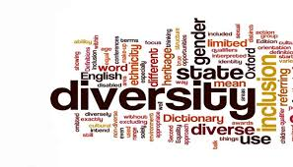
Race (faculty of color) versus representative diversity
University of Cambridge – “Race” is a protected characteristic that refers to an individual's race, color, nationality and ethnic or national origins.
National Education Association -“Representative Diversity” can be defined as the sum of the ways that people are both alike and different. The dimensions of diversity include race, ethnicity, gender, sexual orientation, language, culture, religion, mental and physical ability, class, and immigration status”

Slide 4
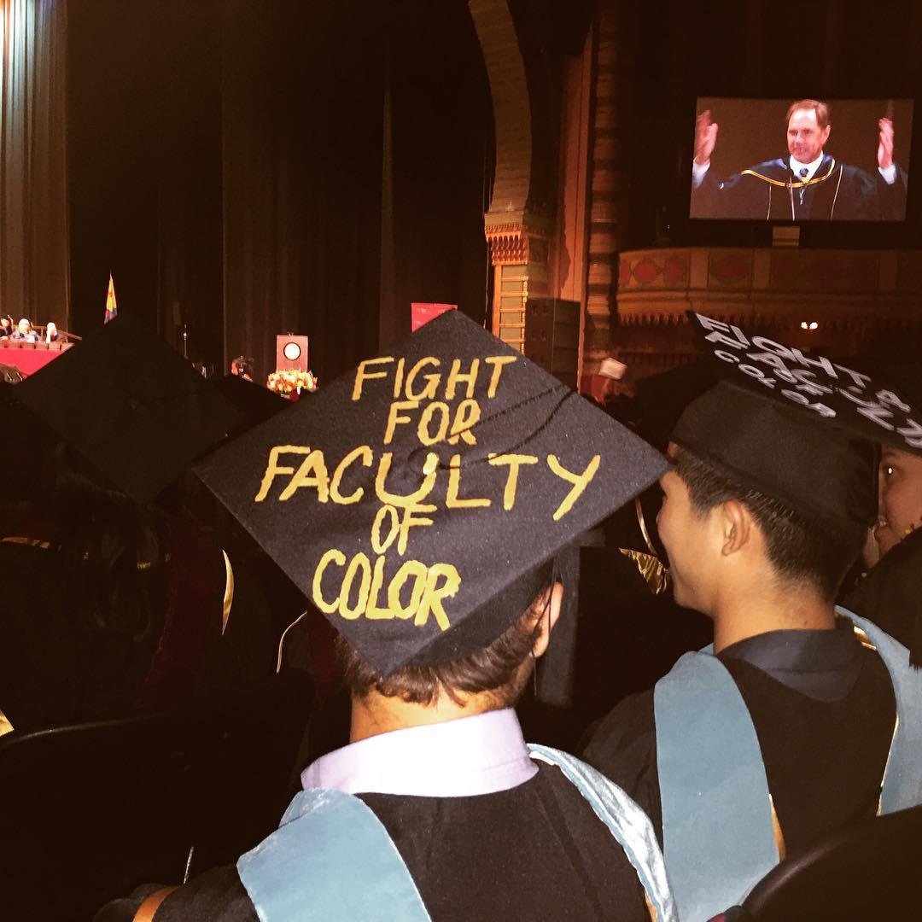
“Mono-Culture Faculty”, “Faculty of Diversity/Color” and Students
Mono-Culture Faculty
Faculty of Diversity/Color
Mono-culturalism is the policy or process of supporting, advocating, or allowing the expression of the culture of a single social or ethnic group. ...
https://en.wikipedia.org/wiki/Monoculturalism
A wide range of interests, backgrounds, experiences. Differences among groups of people and individuals based on ethnicity, race, socioeconomic status, gender, exceptionalities, language, religion, sexual orientation, and geographical area. Diversity of experiences, viewpoints, backgrounds, and life experiences.
https://sph.unc.edu/files/2013/07/define_diversity.pdf
Campaign for College Opportunity - 2018
Recently, a report published by the educational research non-profit Campaign for College Opportunity confirmed what many of us already knew — there just aren’t enough faculty and leaders of color. Focused on the California State University (CSU), University of California (UC), and California Community College systems (CCC), the recent study, Left Out: How Exclusion in California’s Colleges and Universities Hurts Our Values, Our Students, and Our Economy, found that the ratios of students of color to faculty of color are remarkably disproportionate:

Slide 5
“Mono-Culture Faculty”, “Faculty of Diversity/Color” and Students (continue)
In the CSU system, 75% of Cal State students are students of color and 62% of tenured faculty are white;
In the UC system, 74% of students are students of color and 70% of tenured faculty are white; and
In the CCC system, 73% of student are students of color and 61% of tenured faculty are white.
https://medium.com/national-center-for-institutional-diversity/want-to-retain-faculty-of-color-support-them-as-faculty-of-color-9e7154ed618f
Harvard Crimson (2017)
“The importance of faculty expands far beyond the classroom. Many students count faculty members as mentors, counselors, and advisers; it is only appropriate that the students who often do not feel that they belong can find someone to whom they can relate and who can assist them. The University should especially prioritize providing this support for students whose backgrounds are underrepresented in academia—it is crucial that students see themselves reflected in the individuals who have the greatest influences on their education”.
https://www.thecrimson.com/article/2017/4/26/editorial-diverse-faculty-tenure/

Slide 6
The Monoculture approach on “Faculty Hiring” and it’s Effects on “Student Learning and Growth”?
“The term monoculture is used in several fields to refer to a single homogeneous culture that de-emphasizes diversity. In the United States, a Western or White hegemonic culture has been emphasized. Under this monoculture perspective, dominant American cultural values, expectations, behaviors, and definitions are presumed to be superior to values of other cultures.
https://psychology.iresearchnet.com/counseling-psychology/multicultural-counseling/monocultural/
Student Learning – “Cultural Responsive Campus Culture”.
1.Students will be able to express ideas, identify behaviors, and actualize practices that promote social justice and equity.
2.Students will be able to articulate ideas and exhibit behaviors that cultivate teamwork, critical thought, and communication skills needed to function in a diverse workforce and global community.
3.Students will be able to demonstrate techniques and utilize tools to interrupt micro-aggressions and bias behaviors that adversely impact under-represented communities.
Student Learning – Monoculture Learning
“
“Minority groups internalize the mono-cultural worldview of the dominant group (i.e., assimilate), those groups come to see themselves through the perspective of the dominant group”

Slide 7
The Minimum Qualifications: Do they ensure more Faculty of Color are Hired and Retained? – The Conundrum (Difficulty)
The Two MQ’s
Possession of a Master’s Degree (or PhD) in the discipline, with those acceptable discipline titles determined by the Statewide Academic Senate;
…develop criteria that include a sensitivity to and an understanding of the diverse academic, socioeconomic, cultural, disability, and ethnic backgrounds of community college students.” This is an MQ! (California Education Code: §87360) – The Hidden MQ
The Four Main Questions - Discussion
Are the MQ’s Working? If not Why?
Why is the hiring of Diverse Faculty so difficult (Conundrum)
Does Diversity Training Eliminate Bias?
Should Associate Faculty help to improve hiring outcomes for diverse faculty by getting involved?

Slide 8
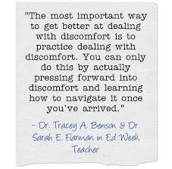
Are “Hiring Biases” enhanced because we espouse Color-blindness and Color-muteness ?
The Truth!
“Espousing (support) colorblindness assumes everyone has the same experience in America; this fails to recognize the societal implications of being a person of color, and discounts the history people of color have experienced in our society. Moreover, what does espousing colorblindness truly mean? Does "I treat everyone the same" mean "I treat everyone as if they are white?" Does it mean "I don't want to discuss what it means to be a person of color in our society?" Rather than increase equality, a philosophy of colorblindness bolsters the legacy of racism in our society. Racism and racial bias continue to result in disparate lifetime outcomes for students and people of color. Refusing to see, acknowledge, and fight against this legacy only further supports the normalization of whiteness at the expense of people of color”. (Dr. Tracey A. Benson Professor – University of North Carolina and Dr. Sarah E. Fiarman – Education Consultant)
http://blogs.edweek.org/teachers/classroom_qa_with_larry_ferlazzo/2019/09/author_interview_unconscious_bias_in_schools.html

Slide 9
The Travel from “Inequality” to “Equity Mindedness” – The Three Steps – “Equity in Hiring”
Change from Within
“Our method works because the faculty change themselves,” says Estela Mara Bensimon, the longtime director and founder of CUE. “By changing their conceptual frameworks, faculty and administrators are actively disrupting familiar hiring routines and uncovering the harmful effects of invisible forms of racism.”
Become an Equity Advocate
“As part of that learning process, CUE experts discussed how implicit bias often hinders the efforts of an otherwise well-intentioned institution to promote equity by reinforcing the status quo. For if a largely White faculty is recruiting in part by word of mouth, their networks might not be diverse. If members of the search committee evaluate, candidates based on traditional criteria, they might undervalue a scholar of color who uses a critical race theory framework or other alternative methodology. And if the institution isn’t stressing its commitment to embracing diversity in its job announcements and through its interviews, it might send the wrong signal to candidates from minorities groups.”
Faculty Driven The key to the Diversity Hiring initiative’s success is that it was driven not just by the administration’s goals, but also by the faculty’s desires. “If you want to get buy-in for developing a campus culture that’s more equitable, it has to come from both administration and faculty,” she says.
https://rossier.usc.edu/magazine/fall-winter-2017/hire-education/

Slide 10
Change from Within Yuba College and Chico State Examples
Yuba College:
Equity Committee
Individuals Instructors
Chico State:
Inclusive Teaching Academy
Diversity Certificate Program
Faculty Development Programs

Slide 11
Questions & Comments
Please feel free to contact each of us for more information.
Lisa Bell, Associate Faculty, West Valley College
lisa.bell@wvm.edu
Kathryn Oesau, Associate Faculty, Yuba College
koesau@yccd.edu
Silvester Henderson, ASCCC At Large Senate Representative shenderson@losmedanos.edu
THANK YOU FOR COMING

