Slide 1
The Economic Imperative: Diversity, Inclusion and California's Demographics Shifts Mayra Cruz, ASCCC Treasurer, CTELC Chair Dr. Olivia Herriford, Regional Director, Bay Area Community College Consortium Manuel Velez, ASCCC South Representative April 15, 2021 5:15 5:30 pm
Notes:
Session description:
In California, the demographics shift is a driver of social and economic change along with climate change, structural racism and gender discrimination, and the shifts in economic power. These elements are changing the nature of work. How do we respond to these changes? How do we build on the social and cultural capital of students in the community college system to ensure that the opportunities for success and economic mobility are equitable? How do we reimagine our curriculum, practices, student supports, and services to address the economic disparities and to meet workforce needs? This interactive session will provide an opportunity for participants to explore these questions and generate concrete actions to take back to local academic senates and colleges. Participants are encouraged to prepare for this session by reading this report.
https://www.capostsecondaryforall.org/initiatives/recovery-with-equity/

Slide 2
Participants will…
Explore these questions:
How do we respond to these changes- demographic shift, climate change, structural racism and gender discrimination, and the shifts in economic power?
How do we build on the social and cultural capital of students in the community college system to ensure that the opportunities for success and economic mobility are equitable?
How do we reimagine our curriculum, practices, student supports, and services to address the economic disparities and to meet workforce needs?
Generate concrete actions to take back to local academic senates and colleges.

Slide 3
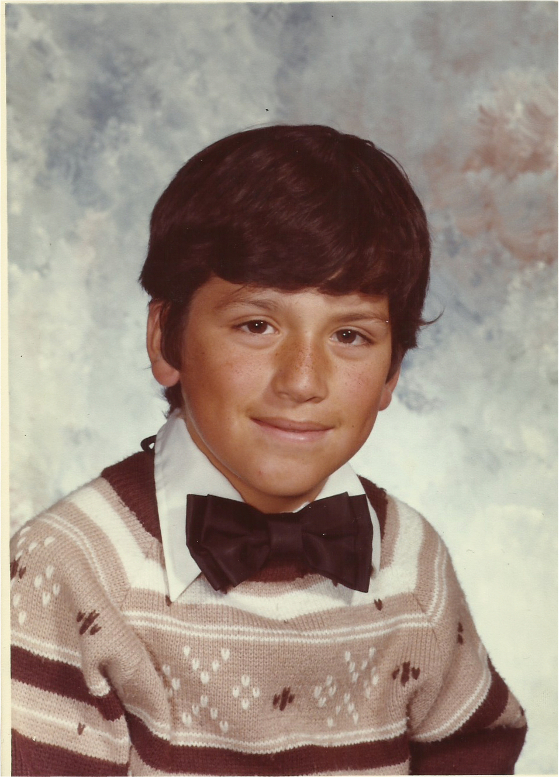
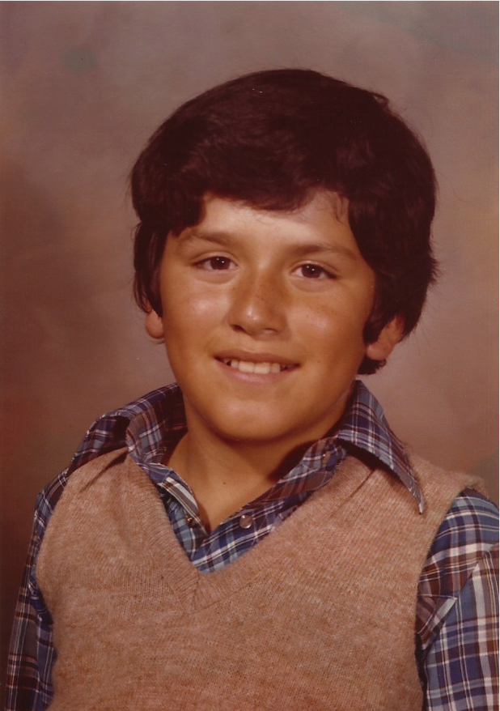
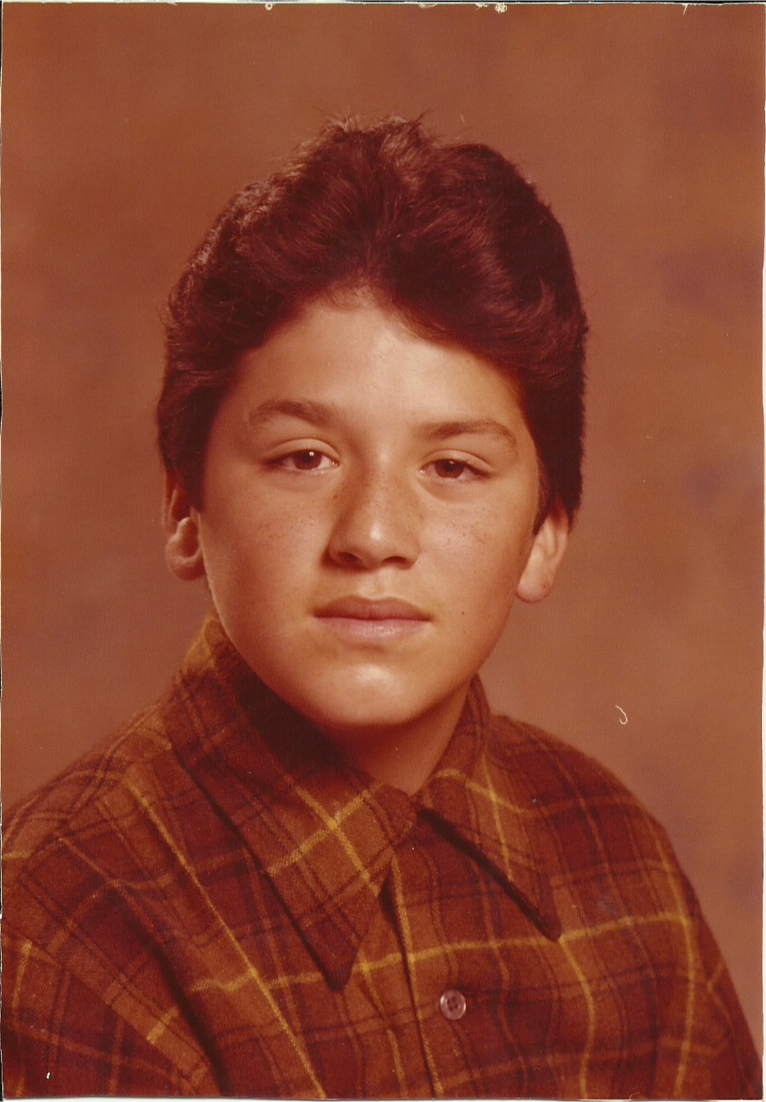
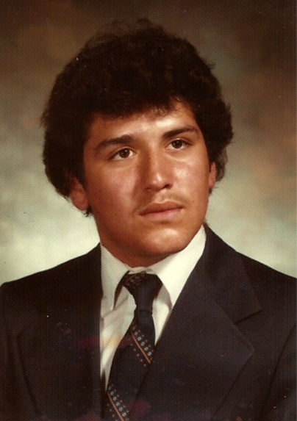
Counterstory: A Personal Journey to a Better Future
Working class upbringing (In 2019 the poverty rate for Latinos in the U.S. was 17.5 and for Blacks it was 18.8 compared to the national average of 10.5)
Child of Immigrants
Living in poverty
Struggles in secondary school (In 2018 the dropout rate for Black and Latino students exceeded the national average by as many as 6 percentage points)
Fitting in
Lower grades
A desire to continue my education (Between 1993 and 2018 Black and Latino enrollment in college increased by as much as 14 percentage points)
Financial Issues
Very few paths available
Finding myself in the community college (48% of Latino students and 36% of Black students attend public 2-year colleges)
Support in applying for admissions
Financial Aid Support
A sense of community

Slide 4
Three Aspects of the Economic Imperative
The Labor Shortage
The Skills Gap
The Education Gap/The Obligation Gap

Slide 5
Demographic Shifts
People of color will become a majority of the American working class in 2032
An aging workforce
California’s wealth gap continues to widen as the job market increasingly favors educated workers
Black and Latino families are over-represented at the lower levels

Slide 6
Climate Change
Impact the labor market and the nature of work
Jobs will be eliminated and jobs will be created
These shifts will require expanded (re)training programs

Slide 7
Structural Racism and Gender Discrimination
Continue to be fundamental forces in our economy
Structural racism shapes the status and power of people of color in the labor market
Interventions must ensure access to jobs for people of color, gender-oppressed people and those historically marginalized from good jobs

Slide 8
Shifts in Economic Power
Shifting power from people to firms
While the economy booms, the majority of working people struggle with rising economic insecurity and declining standards of living
What fuels an hourglass economy
Rebuilding the middle class with collaborative workforce development

Slide 9
Impact of Covid-19: New Normal
Recognize how work is changing and identify equitable interventions for change that benefit the most vulnerable students and skill-builders
The new world of work requires retooling and reskilling
Remote/hybrid education and jobs
Talent gaps in high-demand jobs continue to expand
More students need to work while they learn
The integration of CTE and transfer pathways can provide those equitable interventions
Example: Blue Collar AI

Slide 10
Demographic shifts
While demographic shifts point towards a growing community of students of color, data shows that the majority of those students continue to begin their post-secondary journey at the community college:
Facilitate financial aid and increase scholarship opportunities
Build and strengthen relationships with community organizations
Embrace the student community’s diverse ethnic identities through public art/signage that reflects their cultural and linguistic traits
Work to re-imagine CTE through innovation and new programs
Advocate for the increase in baccalaureate degrees
Pursue state and federal grants that focus on students of color
Share your ideas on how our individual colleges can address these shifts by posting them on our Padlet. Click on the following link to access it: https://padlet.com/ManuelJVelez/theeconomicimperative
Notes:
Padlet for activity-Click on the following link to access it: https://padlet.com/ManuelJVelez/theeconomicimperative

Slide 11
Resources
California Governor’s Council for Postsecondary Education. February 2021. Recovery with Equity:A Roadmap for Higher Education After the Pandemic.
https://www.capostsecondaryforall.org/initiatives/recovery-with-equity/
ReWork the Bay, Working Partnerships USA & Jobs with Justice San Francisco. May 2020. Understanding & Responding to the Changing Nature of Work in the Bay Area.
https://www.wpusa.org/research/changing-nature-of-work-in-the-bay-area/
Public Policy Institute of California. (January 2020). Income Inequality in California.
https://www.ppic.org/publication/income-inequality-in-california/#:~:text=A%20large%20wealth%20gap%20further%20exacerbates%20the%20income%20gap.&text=However%2C%20wealth%20is%20more%20unevenly,to%20just%202%25%20of%20Californians

Slide 12
For more information contact:
info@asccc.org
Mayra E. Cruz cruzmayra@deanza.edu
Dr. Olivia Herriford olivia@baccc.net
Manuel Velez mvelez@sdccd.edu

