Slide 1
The Power and Potential of Disaggregating SLO Assessment Data
Lisa Wang
Sr. Research & Planning Analyst
Irvine valley College
Jared Lessard
Research & Planning Analyst
Irvine Valley COllege

Slide 2
Overview
Intro
What is your level of experience using TracDat?
Why
Why is disaggregation useful?
What
What does disaggregated SLO data tell us?
How
What are the steps to disaggregate SLO data?
How can you disaggregate SLO data at your institution?
Objs.
Attendees will identify steps necessary to develop a process at their college.
Attendees will understand the benefits of disaggregating SLO data.

Slide 3
What is your level of experience using TracDat?
Level of Experience | Description
---- | What’s a TracDat?
A | Fundamental: I’m pretty sure I can log into TracDat…
B | Novice: I’ve logged in and taken a look around
C | Intermediate: I’ve logged in and entered some data before, but I get lost sometimes
D | Advanced: I know how to manage my personnel list(s) and create, update, and upload all sorts of information

Slide 4
What is your level of experience disaggregating SLOs?
What kinds of conversation around disaggregating SLOs have you had at your campus?

Slide 5
Why disaggregate SLO data? Seems Like a Lot of Effort!

Slide 6
Why disaggregate SLO data?
Notes:
Ask audience

Slide 7
Meaningful SLOs
“If faculty are unlikely to use assessments of learning other than grades, then they are unlikely to be able to assess, discuss, and improve the achievement of learning outcomes by students—not only within the courses but across courses in a program.”
Bailey, T. R., Smith Jaggars, S., Jenkins, D. (2015). Redesigning America’s Community College: A Clearer Path to Student Success.
“If we have to assess, let’s make it meaningful to improve student success.”
–IVC English faculty member
Notes:
To effectively assess learning outcomes at the college level, we want to examine the data in a new way—not just by demographic characteristics, but beyond the frequently implemented assessment method of grades, whether for assignments or exams. In a recent CCRC publication…
This is exactly the same line of thinking among the IVC English department. As one English faculty member stated…

Slide 8
ACCJC Standard 1B6
According to ACCJC Standard 1B6:
“The institution disaggregates and analyzes learning outcomes and achievement for subpopulations of students. When the institution identifies performance gaps, it implements strategies, which may include allocation or reallocation of human, fiscal and other resources, to mitigate those gaps and evaluates the efficacy of those strategies.”
Notes:
What categories should we be focusing on? Varies by local community?
“Proof of concept”

Slide 9
Student Equity
Student Equity Plan?
Disaggregating SLOs by Student Equity Plan subpopulations has potential to inform targeted interventions
By examining SLOs, can not only address WHO is disproportionately impacted, but also WHY
Which specific skills/abilities need additional help
Course Completion
→ Degree and Certificate Completion / Transfer
Notes:
Though not required in Student Equity Plans, disaggregating SLOs certainly ties into the course completion success indicator. In order to increase course completion among disproportionately impacted students, we need to assess at the course level which student populations are struggling. Increasing course completion among disproportionately impacted students is one of the essential factors colleges need to address in order to ultimately increase degree and certificate completion as well as transfers to four-year institutions.

Slide 10
Acceleration, Online, etc.
Are there differences in SLOs between students taking accelerated courses in transfer-level English and Math and students taking the traditional sequence?
Are there differences in SLOs between online versus face-to-face courses?
Other comparisons?

Slide 11
Irvine Valley College’s English Department
Departmental primary trait essay rubric
Unity / Focus
Development / Support / Elaboration
Coherence / Organization
Style
Conventions of Standard Written English
Conventions of Manuscript Citation and Format
Rating scale: 1 – 6, with 4 – 6 indicating “pass”
Notes:
So how is the English department conducting more meaningful course student learning outcomes? Years ago after extensive research and literature reviews, the English Dept developed a departmental primary trait essay rubric for diagnostic assessment purposes as part of a multiple measures assessment process. In 2012, the English department revised the original rubric so that it would focus on these six traits—unity/focus, etc. This rubric is used by the entire English department, with slight variations between English writing, creative writing, and literature rubrics.

Slide 12
Sample findings:

Slide 13
Sample findings:

Slide 14
Sample findings:

Slide 15
Sample findings:

Slide 16
Sample findings:

Slide 17
Sample findings:

Slide 18
Sample findings:

Slide 21
Asian students have relatively lower pass rates for “Style” and “Standard Written English Conventions” SLOs - ESL? - Focused Supplemental Instruction?

Slide 22
What does the process of disaggregating SLOs look like?

Slide 24
1. Request that rosters be loaded into TracDat

Slide 25
2. Researcher Loads Rosters

Slide 26
2. Researcher Loads Rosters

Slide 27
2. Researcher Loads Rosters

Slide 28
3. Uses TracDat to assign rosters to individual faculty members

Slide 29
4. Enter SLO assessment data

Slide 30
4. Enter SLO assessment data

Slide 31
5. Extracts rosters with SLO data

Slide 32
5. Extracts rosters with SLO data
Exports SLO data as CSV file

Slide 33
6. Merges SLO data with other data sources
Demographic data:
Ethnicity
Gender
Special population status (EOPS, Foster youth, Veteran, etc.)
Academic Outcomes
Grades in course
Grades in future courses in sequence
GPA
Units earned
Degree/Transfer

Slide 34
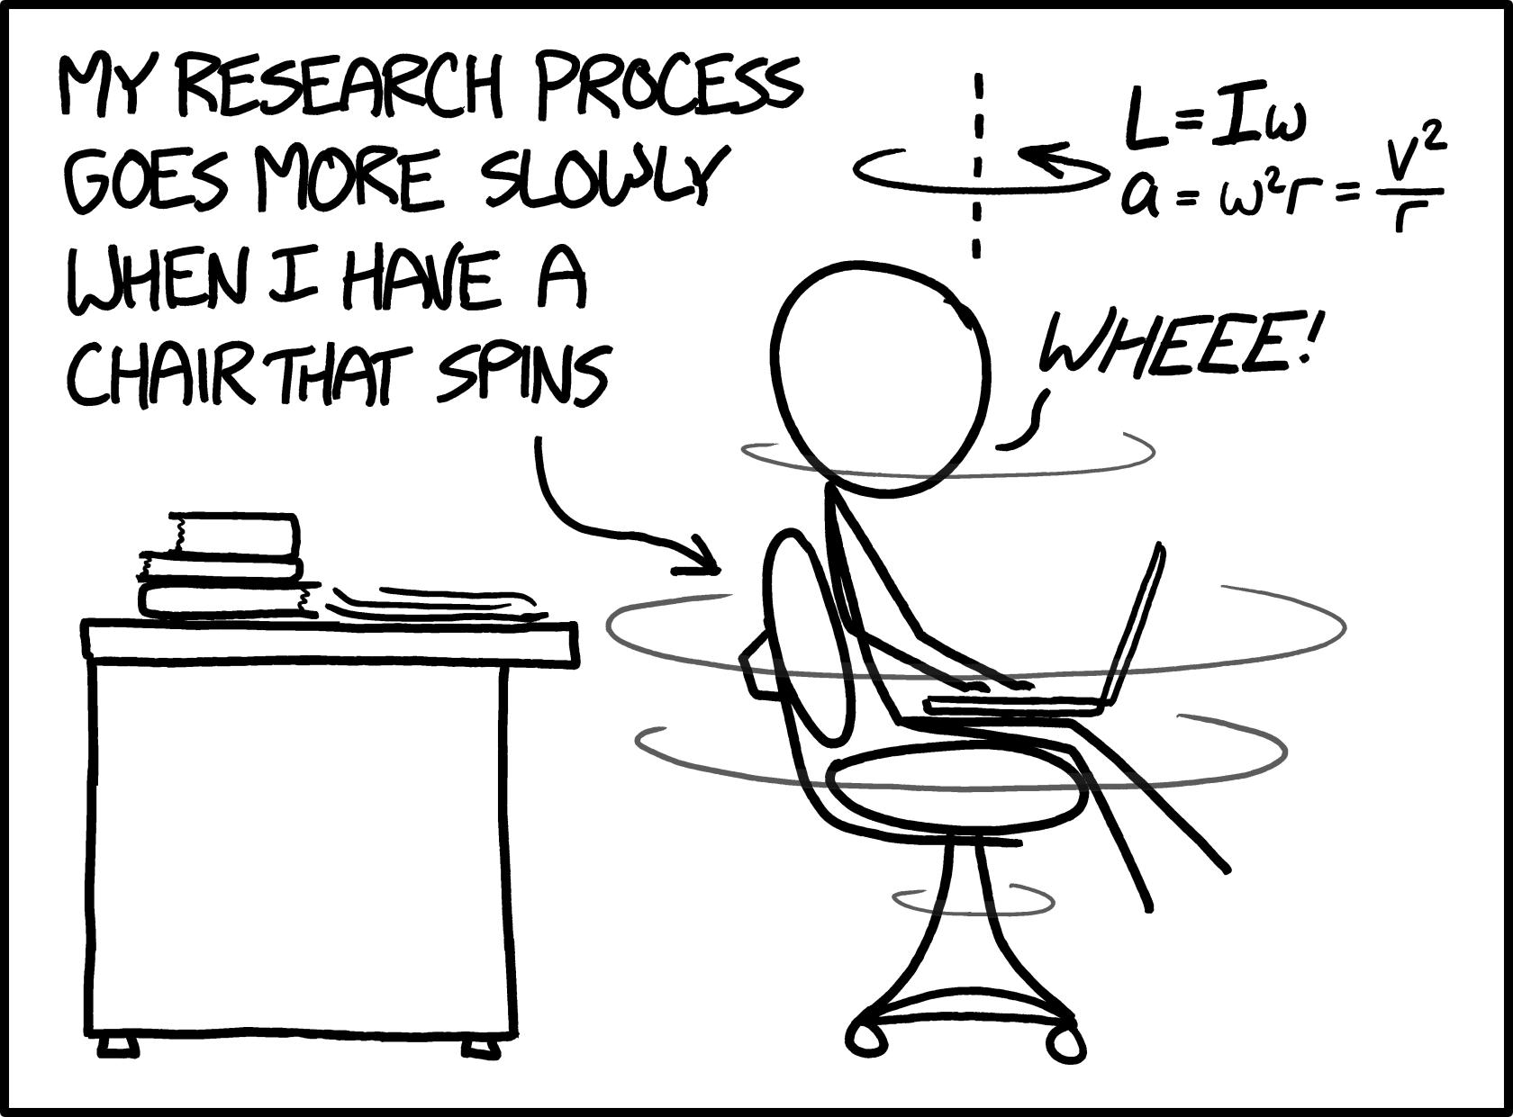
7. Conduct analyses on merged data set

Slide 35
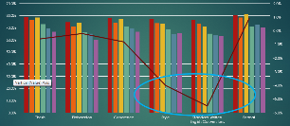
8. Shares disaggregated SLO data reports with faculty

Slide 36
The Six Steps to SLO Disaggregation
IVC
CCSF
CurricUNET Curriculum module, already has course SLOs
IT department uploads sections rosters (names/IDs) to CurricUNET
At the end of each semester, faculty input individual student SLO assessments for each course taught
Research receives unit level SLO assessments data export and matches with demographic data.
Disaggregated data presented back to faculty via Argos OLAP data cube
Faculty SLO Team performs analyzes, writes reports, and leads dialog
English department chair submits a research request form
Research uploads rubric and master roster files by Course ID
Department chair assigns tasks to faculty members
Faculty members input unitary SLO data
Export data from TracDat and merge with other data at the end of term
Generate reports & have dialogue
Notes:
How is CCSF doing it? Curricunet Administrator (Katherine Weiss) has established the system though the current the SLO Coordinators are Sherry Moralia and Craig Kleinman.
Include mapped up to higher level demo from CCSF as closer

