Slide 1

Training the Curriculum Committee – What Every Curriculum Committee Needs to Know
Facilitator - Diana Hurlbut – Irvine Valley College
Marie Boyd – Chaffey College
Toni Parsons – San Diego Mesa College

Slide 2

Learning Outcomes for This Session
Review recommended processes
for the efficient operation of
curriculum committees
(and for the sanity of the
curriculum chairs!).

Slide 3

What CC Members
Should Know….
Compliant CORs
Working Knowledge of the Brown Act
Computing Hours to Units
Know Where to Locate Title 5
Citations
Understanding how to manage local curriculum management database
Understanding of Local Curriculum Approval Process including CTE*
Working Knowledge of Pre-requisites
Working Knowledge of Repeatability
Familiarity with Local Board Policies and Administrative Procedures Regarding Curriculum
HOW TO DEVELOP THESE IN CC MEMBERS?

Slide 4
Suggestions for Training Opportunities
Visits from ASCCC
Local College Legal Counsel (Brown Act, etc.)
VPI/CEO sessions
Regional Consortium/Sector Navigator Representatives
Curriculum listserv
ASCCC Training Opportunities:
  Curriculum Institute
  Regional Curriculum Training
  Other ASCCC academies and institutes
  REMEMBER TO SHARE WITH FOLKS BACK ON CAMPUS

Slide 5

Affective Skills for
CC Members….
Fostering Teamwork
Managing Tensions
Reliable Purveyors of Information
Back to Peers
Reliable Meeting Attendees
Prepared for CC Meetings
Good Diplomats
Trustworthy Negotiators
Willingness to Help Colleagues and CC
Good listener
HOW TO DEVELOP THESE IN CC MEMBERS?

Slide 6

How To Train Curriculum Committee Members Regarding Affective Skills
Notes:
Local Professional Development
Training opportunities offered through local HR department
Local FLEX activities

Slide 7

Related Areas for CC Training….
Working Knowledge of Articulation
Working Knowledge of Financial Aid
Awareness of Impending Legislation
Familiarity of Local Program Review Process
Familiarity with Local Accreditation Status, Requirements and Processes
Familiarity with Local SLO processes and Requirements
HOW TO DEVELOP THESE IN CC MEMBERS?

Slide 8
Suggestions for Training in These Related Areas….
Representative from relevant departments on campus, i.e., Financial Aid Director
Presentations from Articulation Officer
Involvement from Faculty Senate
Updates from Legislative Advocate from Faculty Senate
Presentation from Program Review Committee Chair
Status Reports from Accreditation Liaison Officer

Slide 9
Tools For Curriculum Committees
Local Curriculum Handbook
Measurement Tools for CC Effectiveness (i.e., SWOT Analysis)
Support Staff – Curriculum Specialist; Technical Review Committee; Catalog/Schedule Coordinator
Curriculum Checklists
Curriculum Timelines and Calendars for Approvals
ASCCC publications
  Rostrum
  White papers
  The Course Outline of Record: A Curriculum Reference Guide

Slide 10
Tools For Curriculum Committees – Local Curriculum Handbooks
Reflects local need and demand regarding curriculum
Explains how curriculum aligns with the college’s mission
Serves as the logical repository for these locally-defined aspects of curriculum
Delineates between required Title 5 and local practices
Defines interplay between local Board Policies and Administrative Procedures and local practice
Quick guide to your college’s curriculum database management system

Slide 11
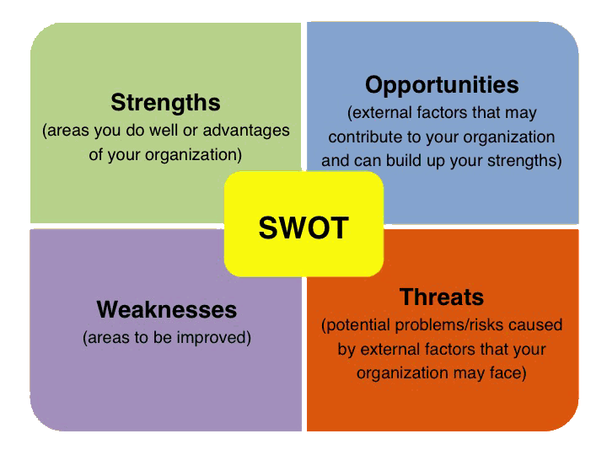
Tools For Curriculum Committees –Measurement Tools for CC Effectiveness

Slide 12
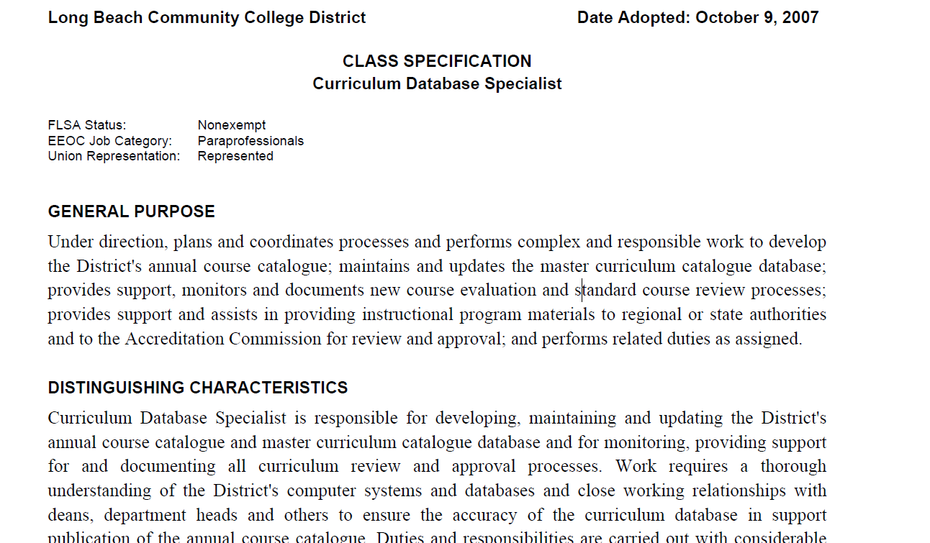
Tools For Curriculum Committees – Support Staffing – Curriculum Specialist

Slide 13
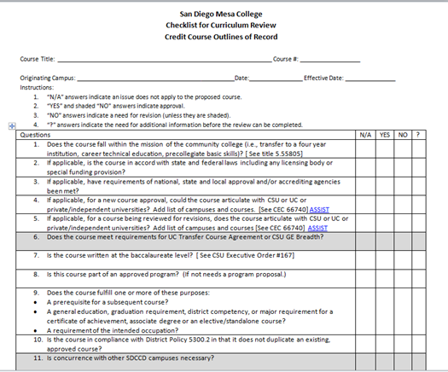
Tools For Curriculum Committees – Curriculum Timelines, Calendars & Checklists
Notes:
handouts

Slide 14
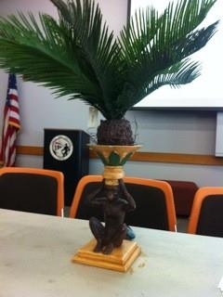
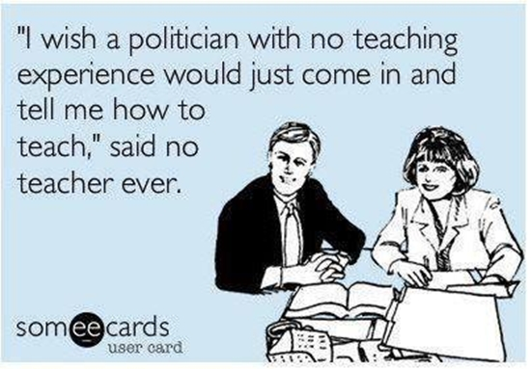

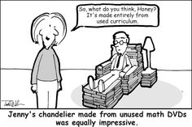
Tools For Curriculum Committees – Positive Climate
Curriculum Humor
Two deer walk into a bar with the new PCAH……
FOOD Works Too!

Slide 15
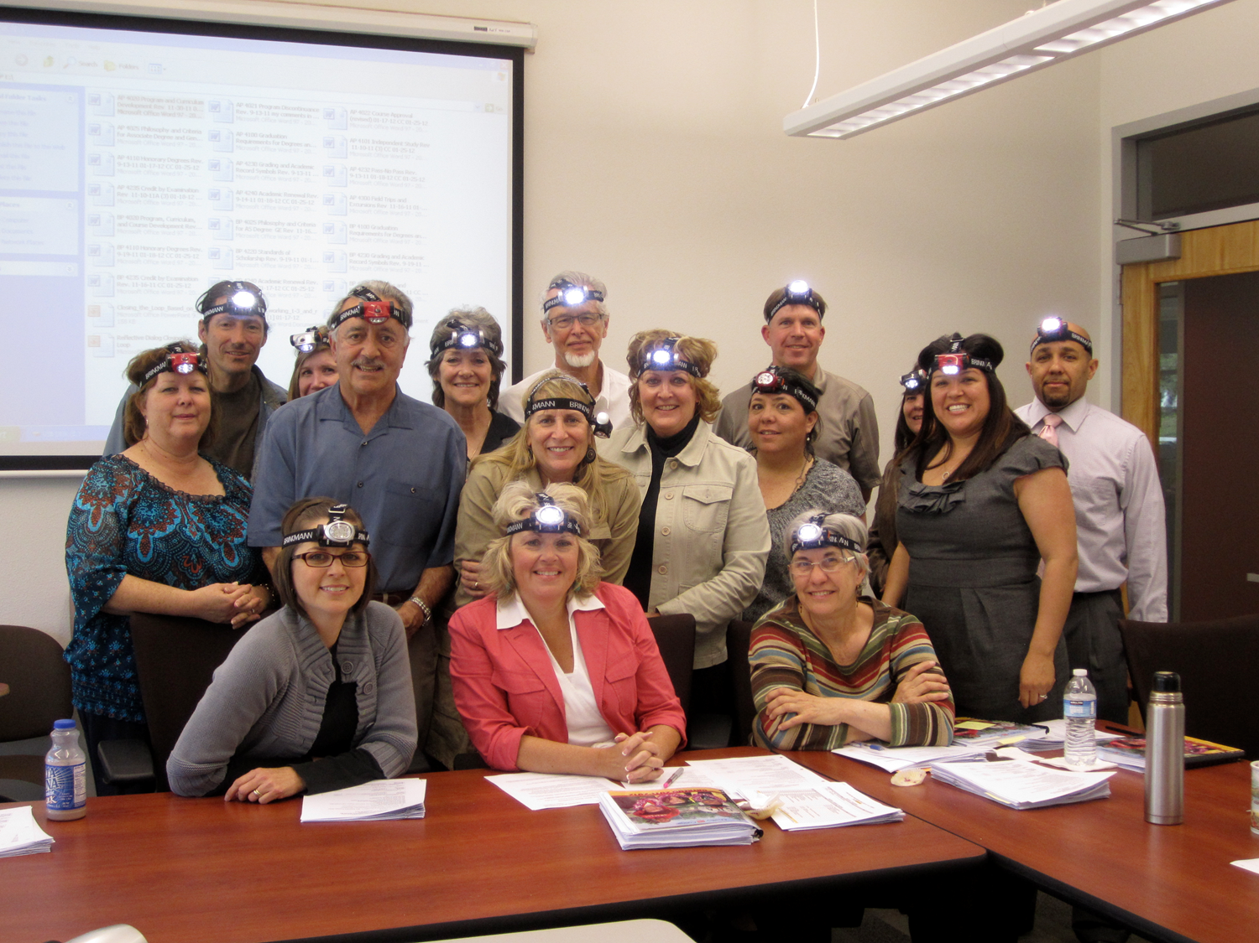
Tools For Curriculum Committees – Positive Climate

Slide 16
Questions?
Marie Boyd - marie.boyd@chaffey.edu
Diana Hurlbut – dhurlbut@ivc.edu
Toni Parsons - mparsons@sdccd.edu

