Slide 2
John Freitas, Los Angeles City College Leticia Hector, San Bernardino Valley College Michelle Sampat, Mt. San Antonio College
Training Curriculum Committees: Efficiency and Standards
2015 ASCCC Curriculum Institute Doubletree Anaheim-Orange County
July 9-11

Slide 3
Our Mission Today
Purview of the Curriculum Committee & Responsibilities of everyone involved in the local curriculum process
Curriculum Chair: How to Prepare & Lead Your Local Curriculum Committee
Importance of Technical Review & Working with Classified Staff
Important Resources
NOT!

Slide 4
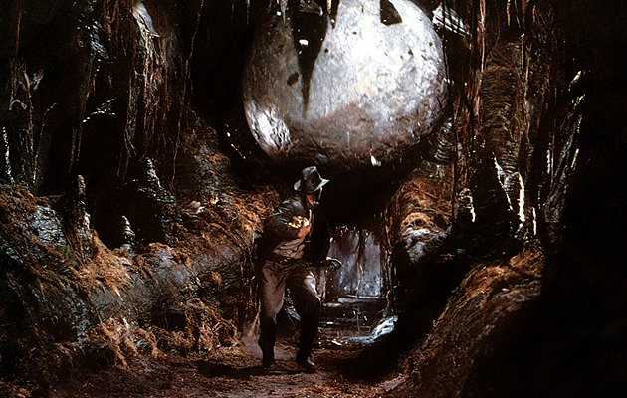
If Adventure Has A Name…
It Must Be…CURRICULUM!

Slide 5
Purview of the Curriculum Committee
Title 5 § 55002 gives curriculum committees the responsibility for recommending to the governing board in areas regarding curriculum, including new or modified course approval, grading policies, prerequisites, and others.
Education Code and Title 5 support the voice and authority of faculty in making recommendations in the areas of curriculum and instruction. However, making recommendations is not the same as making final decisions; that authority rests with the local governing board.

Slide 6
Curriculum Committee Are Subject to the Brown Act
All meetings must be open to anyone who wishes to attend.
The public must be allowed to make comments.
All items being voted on must be included on an agenda that is posted at least 72 hours prior to the meeting.
Only a single reading is reading is required but many colleges have two readings.
Action can only be taken on items listed for action.
Items listed for discussion or from public comments can only be acted on after a motion has passed to suspend the rules.

Slide 7
Composition of a Curriculum Committee (CC)
Composition of CC is a local issue.
Title 5 §55002 states that the curriculum committee “shall be either a committee of the academic senate or a committee that includes faculty and is otherwise comprised in a way that is mutually agreeable to the college and/or district administration and the academic senate.”
If it is a senate committee, then composition is solely at the discretion of the senate (Title 5 §53202)

Slide 8
Typical Composition of a Curriculum Committee:
CURRICULUM is like a MOVIE!
DON’T be an EXTRA
on the
CURRICULUM COMMITTEE… PLAY A MAJOR ROLE☺
The Curriculum Chair
Discipline Faculty
Classified Staff
Counselors
Articulation Officers
Student Representatives
Administrators

Slide 9
Roles & Responsibilities of Curriculum Committee Members: DISCIPLINE FACULTY
Regularly attend Curriculum Committee meetings
Engage in Curriculum Review
Revise courses
Write new courses
Pay attention to other curriculum as a whole & ensure that discipline courses are a “good fit” for students

Slide 10
Roles & Responsibilities of Curriculum Committee Members: CLASSIFIED STAFF
Strong support from classified staff is vital
Colleges often have classified staff who are Curriculum Specialists
Curriculum Specialists and other classified support staff have many responsibilities including (but not limited to):
Preparing submissions for the governing board
Inputting changes into your student enrollment system
Submitting changes to CCCCO
Producing your college catalog

Slide 11
Roles & Responsibilities of Curriculum Committee Members: COUNSELORS
Counselors play a crucial role – they bring professional expertise as well as a voice for the student to curriculum discussions
Responsibilities of Counselors on the Curriculum Committee include:
Articulate the counseling perspective
Help clarify student need and pathways to educational goal

Slide 12
Roles & Responsibilities of Curriculum Committee Members: ARTICULUATION OFFICER
Your Articulation Officer (AO) is an incredible resource of information for the curriculum chair and the curriculum committee.
If they aren’t already a member of your committee, they probably should be.
Roles of the AO:
Liaison to the CO, C-ID, CSU, UC, etc.
Balances existing articulation agreements with plans for course modifications
Assists in discussion of local CSU-GE & IGETC patterns
Establishes articulation agreements for new courses
Consult your A.O.!!!!!
Notes:
Your AO should be on your technical review committee

Slide 13
Roles & Responsibilities of Curriculum Committee Members: STUDENTS
Title 5 §51203.7 gives students the right to participate effectively in policy development, including curriculum.
The student perspective is essential to a Curriculum Committee. Students should:
Provide the students’ perspective on new and existing curriculum
Ask questions to ensure clarity from the students’ perspective

Slide 14
Roles & Responsibilities of Curriculum Committee Members: ADMINISTRATORS
Administrators often see issues such as resources or departmental conflicts that should be taken into consideration when discussing curriculum.
Administrators role includes:
Review curriculum for possible conflicts
Ensure courses are appropriate to the mission, are needed, legally compliant
Identify resources and other issues that may affect offering curriculum

Slide 15
So what about the Curriculum Chair?
What are the roles & Responsibilities of the Curriculum Chair?
Most importantly, how does the Curriculum Chair LEAD the committee members just mentioned?

Slide 16
Roles & Responsibilities of Curriculum Committee Members: CURRICULUM CHAIR
Provide training to new CC members
Guide Curriculum Review process (new, modified, or deleted courses, certificates and degrees).
Meet with discipline faculty
Assist in the development of new courses and/or programs
Facilitate technical review
Build the agenda
Prepare for the meeting
Chair the meeting
Watch for email messages from the ASCCC office regarding curriculum news
Liaison to Academic Senate, CIO, Program Review, Accreditation, Board of Trustees, etc.

Slide 17
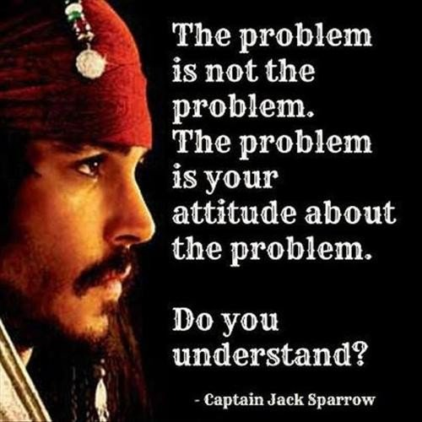
CURRICULUM CHAIR: Prepare & Lead Your Curriculum Committee
Establish positive relationships with CIO, AO, Curriculum Staff, Department Chairs & Academic Senate/Faculty
Learn as much as you can about regulations and current issues at the state level.
Prioritize meeting agenda items
Keep agenda moving & on schedule
Ensure all voices are heard
Control the turn taking
Be familiar with how to resolve and/or manage conflict
Remember you are the meeting facilitator
Remind the CC the important role they have to ensure we continue to provide our students with quality curriculum!

Slide 18
CURRICULUM CHAIR: Creating a Local Curriculum Handbook is Important!
Provides evidence of local adherence to state code and regulation
Provides a record of local policies and procedures
Can be used to provide local historical perspective/philosophies regarding curriculum matters
Provides an invaluable resource for faculty in the curriculum process

Slide 19
Importance of Technical Review & Working with Classified Staff
Establish a strong technical review (TR) process for effectiveness.
TR committee should focus on the things that tend to make CC meetings drag on (grammar, wording, formatting, codes, missing attachments etc.)
TR committee is chaired by the Curriculum Chair
Membership may include Curriculum Committee members.
Classified Staff can provide valuable support!

Slide 20
Technical Review Committee – Suggested Membership
Your Technical Review committee should include the following individuals:
Curriculum Chair
Articulation Officer
Librarian
Distance Education expert
CIO or designated dean
Curriculum specialist
Others may include your SLO coordinator, honors program director, learning disabilities specialist

Slide 21
Working together we can become …

Slide 22
IMPORTANT RESOURCES
ASCCC: http://www.asccc.org/home
CCC Curriculum: http://www.ccccurriculum.net
The Course Outline of Record: A Curriculum Reference Guide (ASCCC 2008)
Search Ed Code and Title 5 – www.oal.ca.gov
Program and Course Approval Handbook (PCAH, 5th edition)
CIO Manual, 1st Edition
FAQ http://www.ccccurriculum.net/faq/
C-ID http://www.c-id.net
ASSIST http://www.assist.org/
Chancellor’s Office http://www.cccco.edu
Join the ASCCC Curriculum listserv http://www.asccc.org/signup-newsletters

Slide 23
Feel Free to Contact Us!
John Freitas, ASCCC Curriculum Chair – freitaje@lacitycollege.edu
Leticia Hector, SBVC Curriculum Chair – lhector@valleycollege.edu
Michelle Sampat – msampat@mtsac.edu

