Slide 1
UC Transfer Initiative: Transfer Pathways
Denise Noldon, Ph. D., Interim Vice Chancellor CCC Chancellors Office
Shawn Brick, Associate Director UC Office of the President

Slide 2
Agenda
Transfer Context
UC Transfer Action Team Recommendations
UC Transfer Pathways
Ongoing Efforts & Next Steps

Slide 3
Applications: CA Resident CCC Transfers

Slide 4
Transfer Diversity
Most UC Transfers come from relatively few CCCs:
25% of CCC transfers come from 7 CCCs
50% of CCC transfers come from 19 CCCs
75% of CCC transfers come from 41 CCCs
All 112 CCCs sent at least 1 student to UC

Slide 5
5 Recommendations
1: Communications & Technology
2: Strengthen Partnerships
3: Streamline Admissions & Articulation
4: Expand Services on UC Campuses
5: Intersegmental Collaboration

Slide 6
Transfer Initiative: Actions to Date
Email to new CCC enrollees from President
Redesigned website with input from users
Presidential conversations on transfer
Transfer and technology
Transfer Pathways

Slide 7
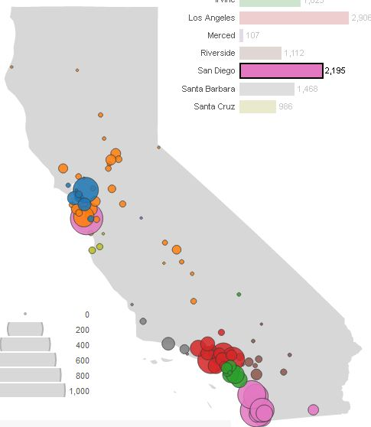
CCC Transfers Come From Across CA
Example: UC San Diego draws heavily from Southern California, but also from CCC’s across the state
Students need to be able to prepare broadly

Slide 8
What Transfer Pathways Are and Are Not
Is only advice to potential transfers
Is inclusive of all nine UC campus admission requirements
Is a set of recommendations that puts transfers on an equal par with UC freshmen
Is NOT necessarily a duplicate of the ADTs
Is NOT a mandate for campuses to change campus-specific curricula
Is NOT a guarantee of admission
May guarantee a comprehensive review

Slide 9
Ten Majors
Anthropology
Biochemistry
Biology
Cell Biology
Chemistry
Economics
Mathematics
Molecular Biology
Physics
Sociology

Slide 10
Twenty-One Majors
Anthropology
Biochemistry
Biology
Cell Biology
Chemistry
Economics
Mathematics
Molecular Biology
Physics
Sociology
Business
Communications
Computer Science
Electrical Engineering
English
Film
History
Mechanical Engineering
Philosophy
Political Science
Psychology
Two-thirds of CCC applicants

Slide 11
Message to Students
Although following a pathway doesn't guarantee admission to UC, it gives you a clear roadmap to prepare for your major and be well positioned to graduate on time from any UC campus.
The pathways guide students who want to make themselves competitive across the UC system; some campuses may want fewer courses for admission, but none will expect more.

Slide 12
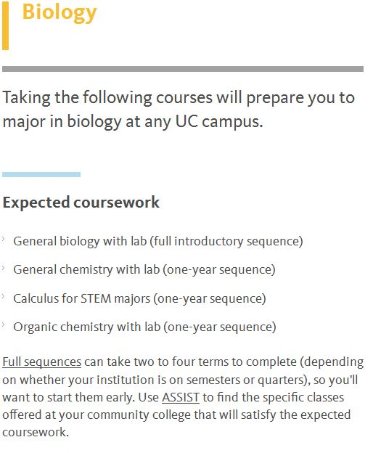
Highlights course expectations
Includes important caveats and details

Slide 13
Next Steps
Articulation
UC needs to ensure articulation is consistent across UC for the identified course expectations
General Education
Questions about how these mesh with IGETC
Training
Provide training materials for counselors and advisors across the state
Additional Faculty Engagement
ICAS, CCC-CSU review of TMCs, C-ID

Slide 15
California Community Colleges
More than one in five community college students in the United States attends a California Community College.

Slide 16
California Community Colleges
31% of University of California graduates started at a California Community College.

Slide 17
California Community Colleges
The University of California enrolls more community college students than any other similar institutions in the country

Slide 18
California Community Colleges
90% of UC transfers from a California Community College.
Two out of three transfer students who apply to a UC are admitted
UC Pathways are good for CCC transfer students!

Slide 19
California Community Colleges
Based on our success with Associate Degrees for Transfer, we are optimistic that our students will greatly benefit from UC Pathways!

Slide 20
The UC Pathways gives CCCs an opportunity to meet our goal of increasing transfer for our students with particular emphasis on the groups who have not historically transferred in numbers that reflect their percentage of the community college population.
California Community Colleges

Slide 21
Questions?

Slide 22
Thank You

