Slide 1
Connecting with the Heart for Transfer
Friday, October 8 at 11:00 a.m.—12:15 p.m.

Slide 2
Session Description
Learn about culturally responsive teaching and counseling support practices that increase persistence, retention, and transfer rates among students. This session will highlight successful, caring practices utilized by the Puente, Umoja, and the United Southeast Asian American academic programs.

Slide 3
Land Acknowledgement
We begin today by acknowledging that we are holding our gathering on the land of the Nisenan Nations, the location of the ASCCC Office on One Capitol Mall, Sacramento, and the Tongva Nations, where I am currently located in what is now called La Mirada. We recognize the sovereign people who have lived and continue to live here. We recognize the Nisenan and Tongva Nations and their spiritual connection to the ocean and the land as the first stewards and the traditional caretakers of these areas.
As we begin, we thank them for their strength, perseverance, and resistance. We also wish to acknowledge the other Indigenous Peoples who now call these areas their home, for their shared struggle to maintain their cultures, languages, worldview, and identities in our diverse cities.
Notes:
We invite you to research your area by texting this number (907 312 5085) with your city and state to see the Indigenous tribes and information about land acknowledgment or find your area at https://native-land.ca.
Touching the soul (Michelle):
Play indigenous music and open the space with heart acknowledging comunidad music/indigenous drums.

Slide 4
Recognition of Humanity
People of African ancestry are the descendants of African and Central West Africans who were enslaved for over 240 years only to be invited into third class citizenship for another 100 years.
In our verbal libation today, let us remember the place we are blessed to call home particularly the South, was plotted, and built by enslaved African ancestors through horrid conditions. Because they endured & survived, and because they fought and were resilient, we stand today. Let us be thankful for those hands, and all the hands who have done work and toiled the land that provides sustenance and the materials by which we live today.
And, in our work to be become higher humans, we always remember.
Notes:
We invite you to research your area by texting this number (907 312 5085) with your city and state to see the Indigenous tribes and information about land acknowledgment or find your area at https://native-land.ca.
Touching the soul (Michelle):
Play indigenous music and open the space with heart acknowledging comunidad music/indigenous drums.

Slide 5
Today, we will hear from . . .
Umoja Community Education Foundation, Executive Director Nzingha Dugas
Puente Project, Executive Director Julia Vergara
United Southeast Asian American Academic Program, Kami Thepphavong and Karen Crocket
Each will share . . .
Program history
Success and transfer data
What makes students feel cared for and connected
How to start your program on local campuses
Testimonials and Q&A
Notes:
Introductions (Michelle)
We will end today with OPP for participants share testimonials--if you were a teacher or student in one of these programs

Slide 6
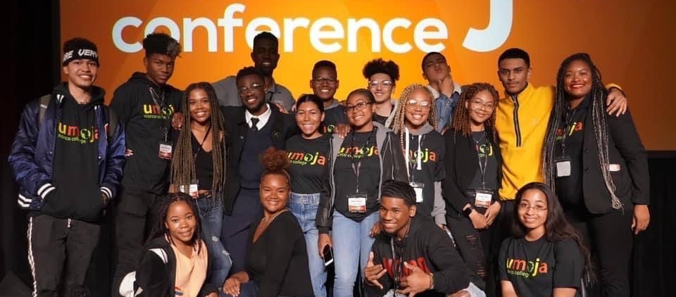
Umoja Community Education Foundation
Notes:
Program history
Success and transfer data
What makes students feel cared for and connected
How to start your program on local campuses

Slide 7
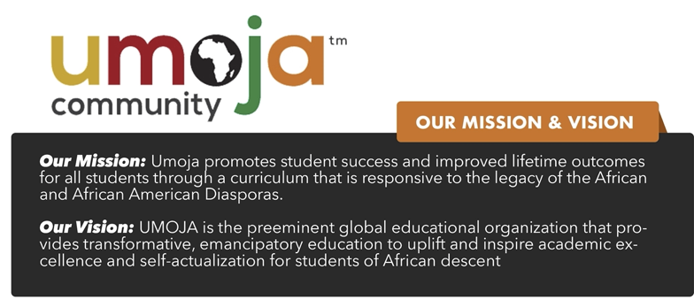
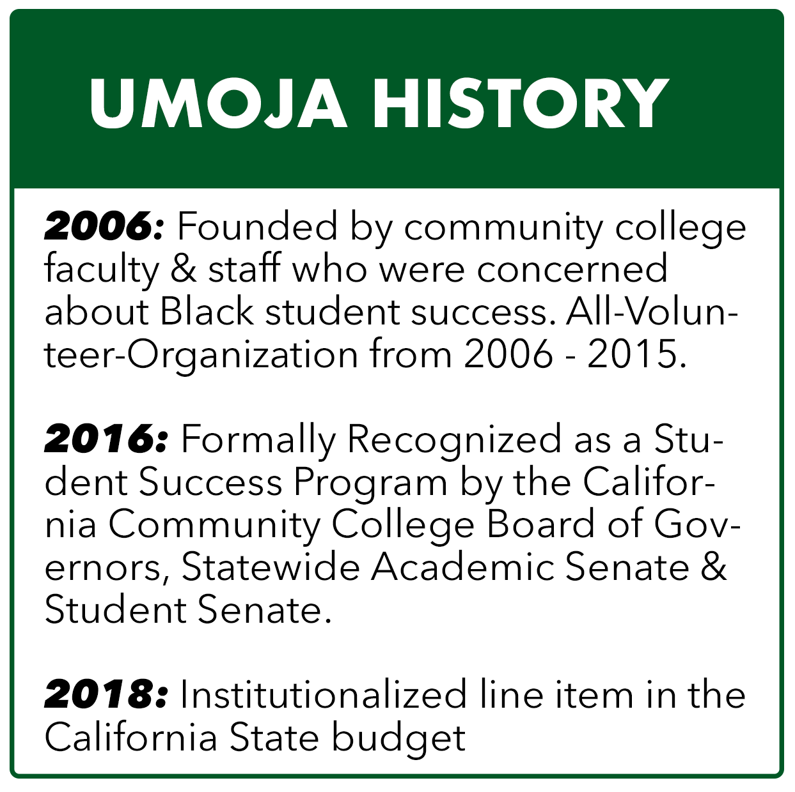


Slide 8
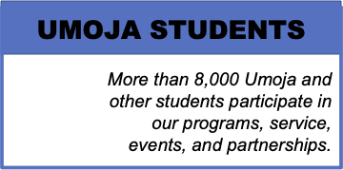
Umoja Student Demographics:
Historically Underserved
First Generation
Low Income
Formerly Incarcerated
Families
Faculty Professional Development:
Annual trainings, professional development and webinars for over 500 faculty, counselors and professional staff.

Slide 9

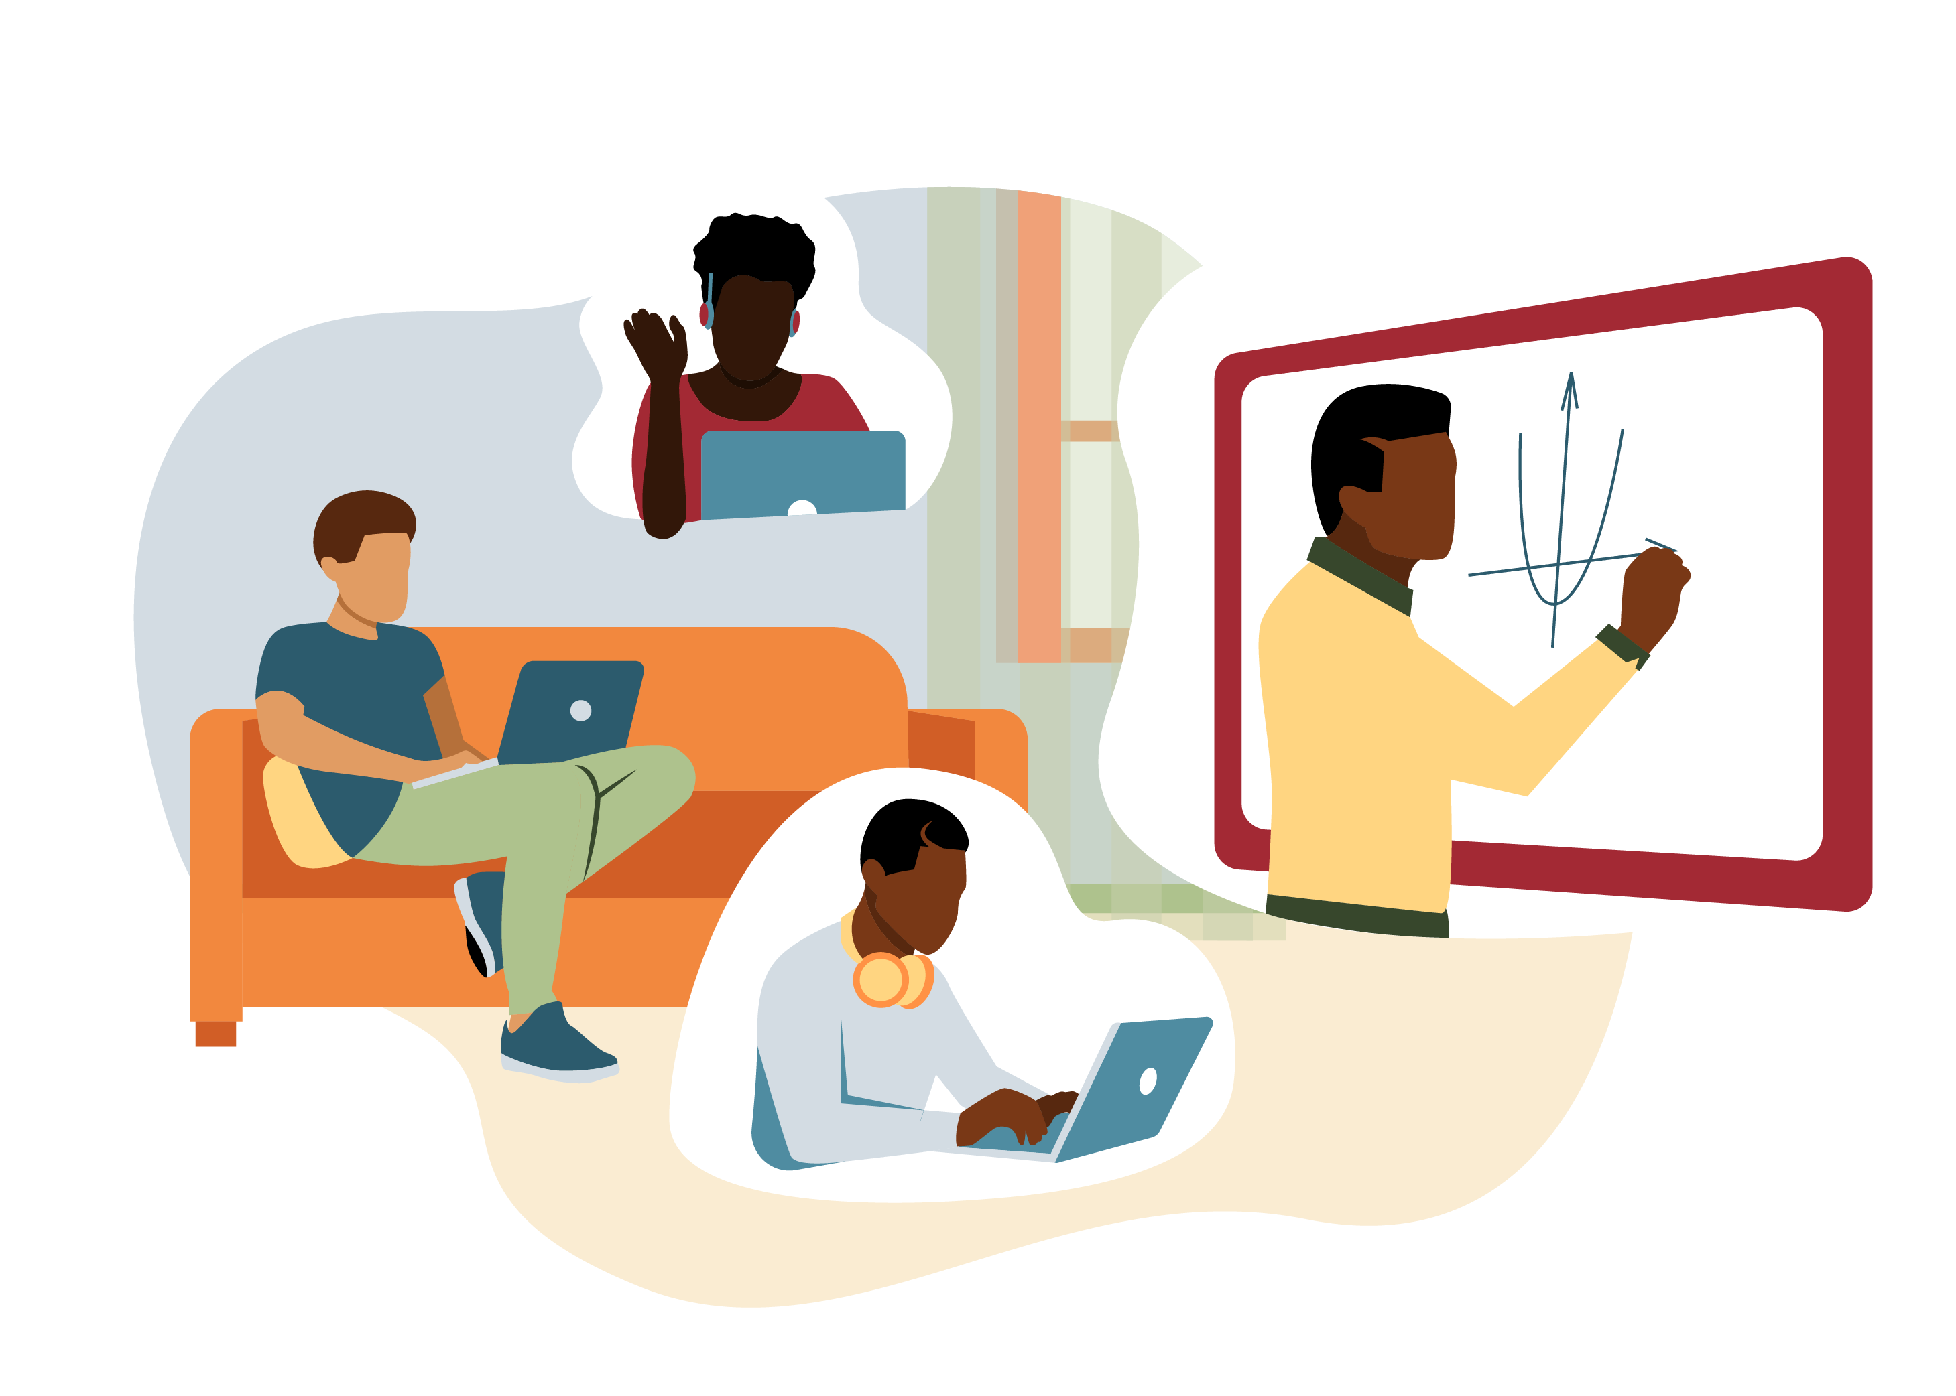
Program Structure
Student Cohorts and Learning Communities
Faculty & Staff Professional Development

Slide 10
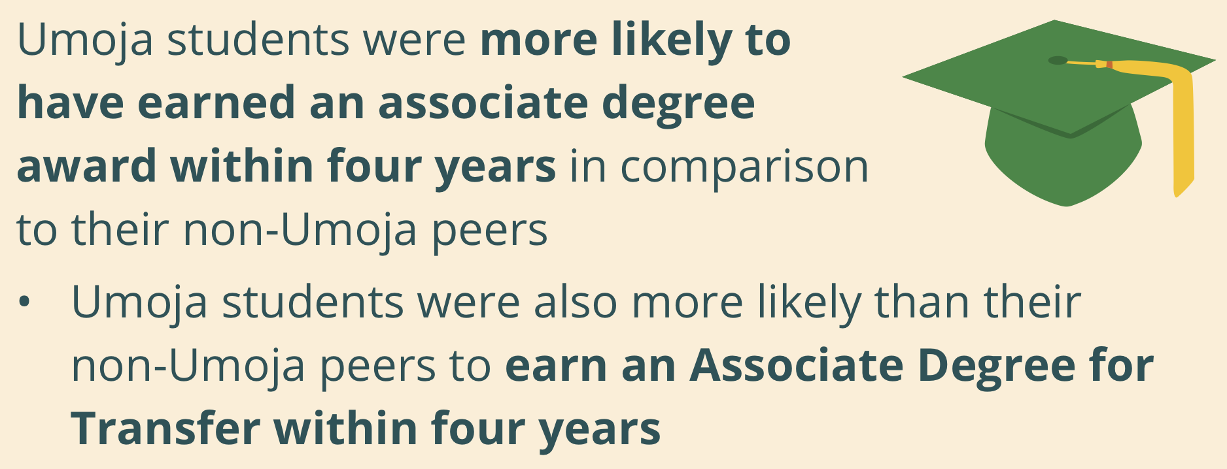
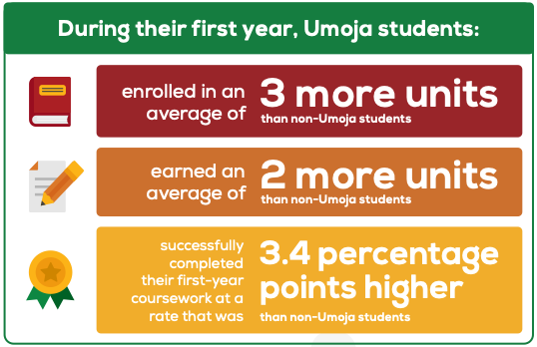
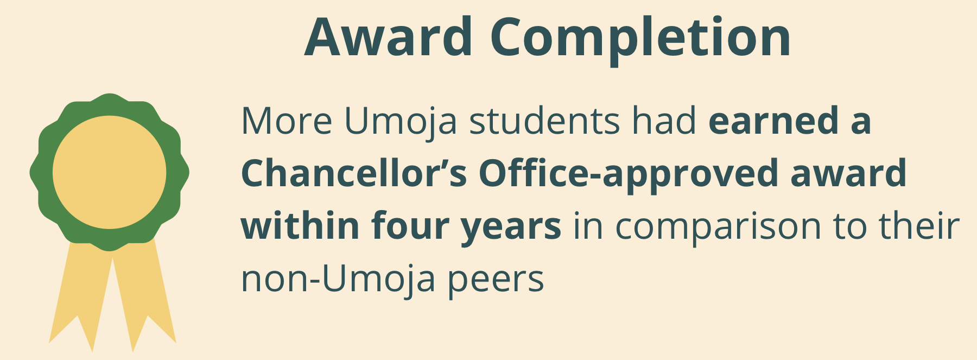
Umoja students succeed!
Reference: RP Group

Slide 11

Student Voices
In attending the Umoja Program it has inspired me in more ways than I can imagine. It has provided me with the opportunity of being introduced to the resources that will assist in my growth toward academic and college success. – Devonta Thomas, Sierra College
“I never thought my Umoja family was this big. I made new friends, reconnected with old ones, laughed so much and built myself up with a lot of knowledge. I am better prepared to share my knowledge and experience with my Umoja peers. The conference is an experience I am thankful, and I am excited for future Umoja events to occur.”
– Conference attendee
“Before Umoja, I was really isolated and didn’t assume any leadership roles. Umoja has revealed the leader in me and I’m grateful.”
– T. Patillo, Diablo Valley College

Slide 12
EQUITY DRIVEN PEDAGOGY:
THE PUENTE PROJECT MODEL

Slide 13
CONOCIMIENTO: GETTING TO KNOW YOU
Your name/nickname
A book you recently read
A mentor
One word that describes an aspect of your identity
Notes:
OPTIONAL

Slide 14
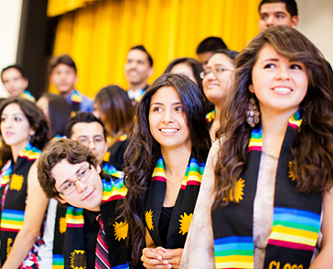
WORKSHOP GOALS
To share: Puente’s mission and model
To identify: examples of equity-minded Puente practices
To inform: Puente’s professional development program for higher education professionals

Slide 15
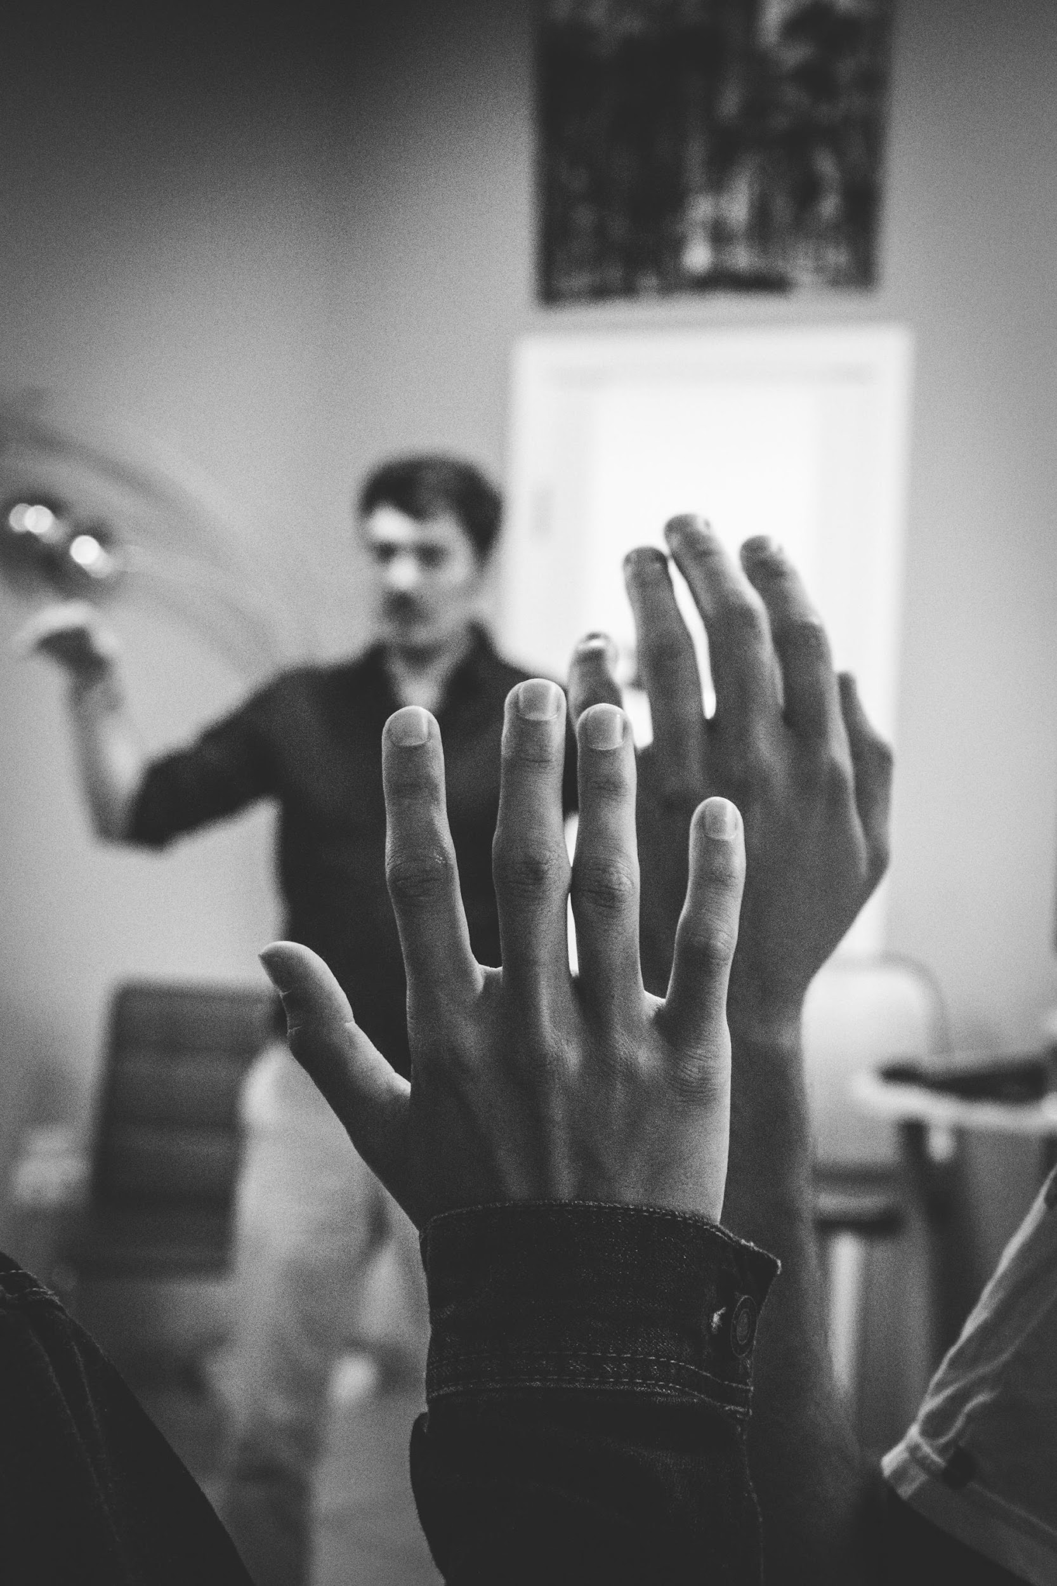
PUENTE HISTORY
Founded at Chabot College in 1981
Partnership between English and counseling faculty
Program design based on enrollment and completion patterns of first generation, underserved students

Slide 16
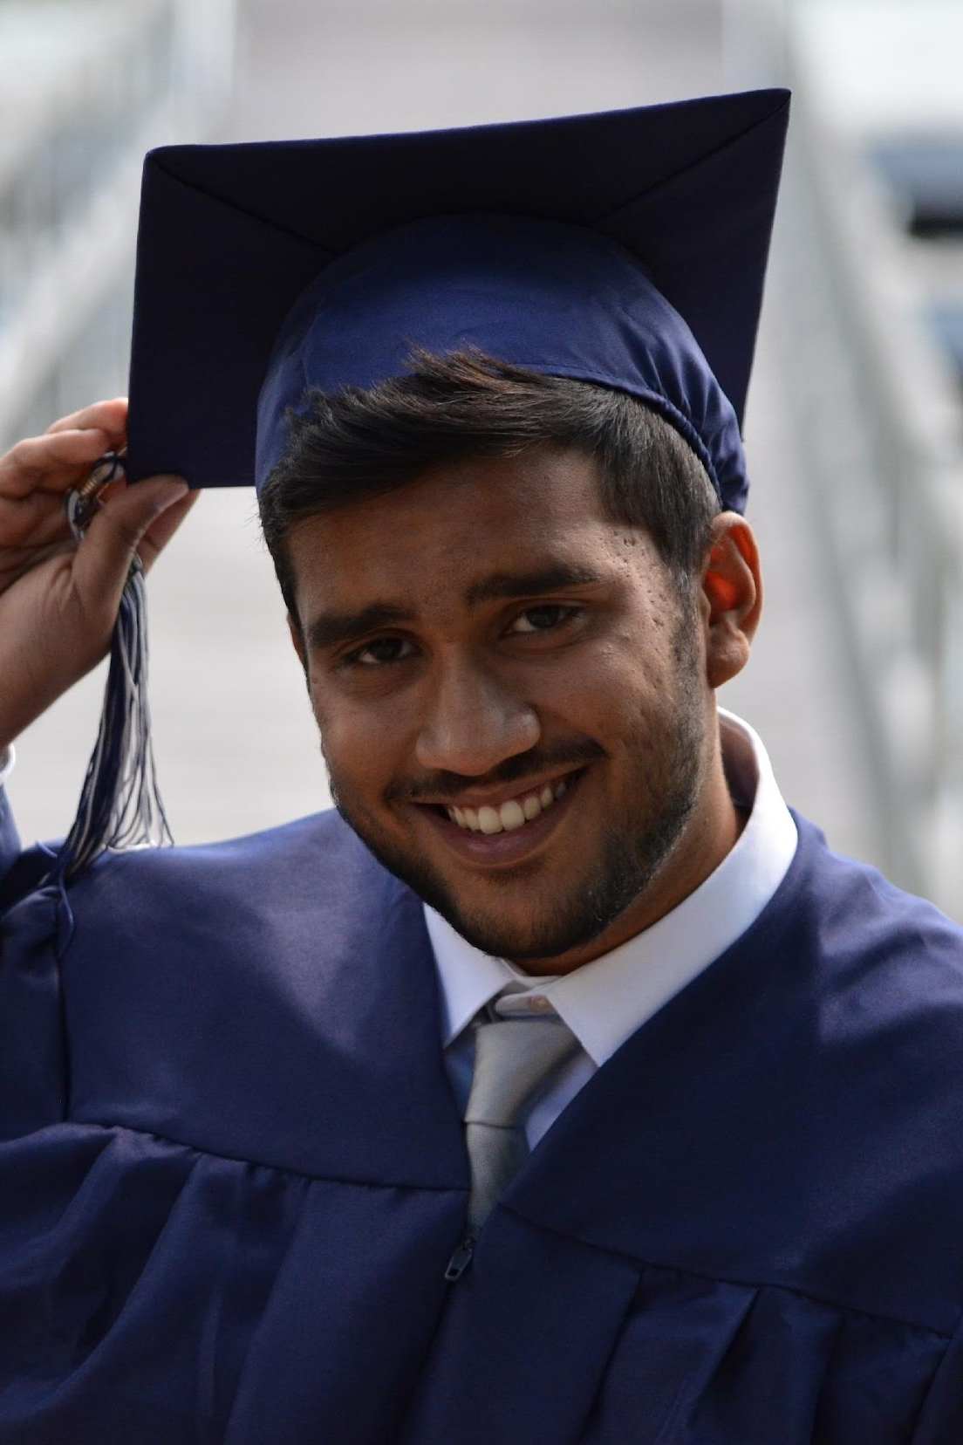
PROGRAM MISSION
To increase the number of educationally underserved students who enroll in four-year colleges and universities, earn college degrees and return to the community as mentors and leaders to future generations.

Slide 17

WHO WE SERVE
Puente is open to all students
84% first generation students
89% low income students
88% underrepresented students

Slide 18
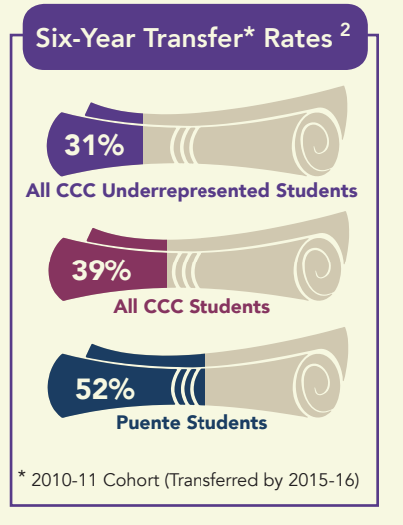
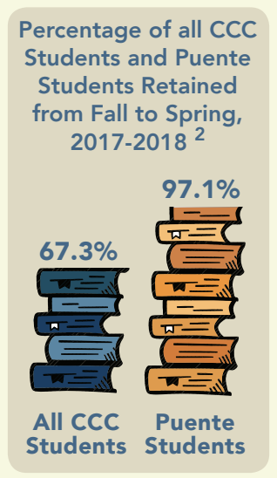
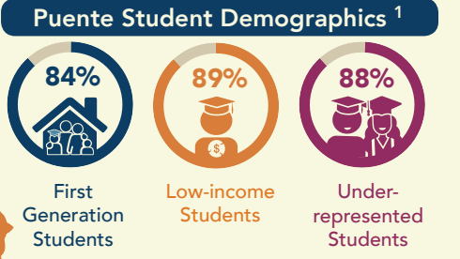
PUENTE BY THE NUMBERS

Slide 19

SMALL GROUP DISCUSSION
What support would have helped you to overcome the challenges?
How would the “educator-you” have supported the “student-you”?
What steps and actions can the student take to strengthen the likelihood of their success?
Notes:
This optional

Slide 20
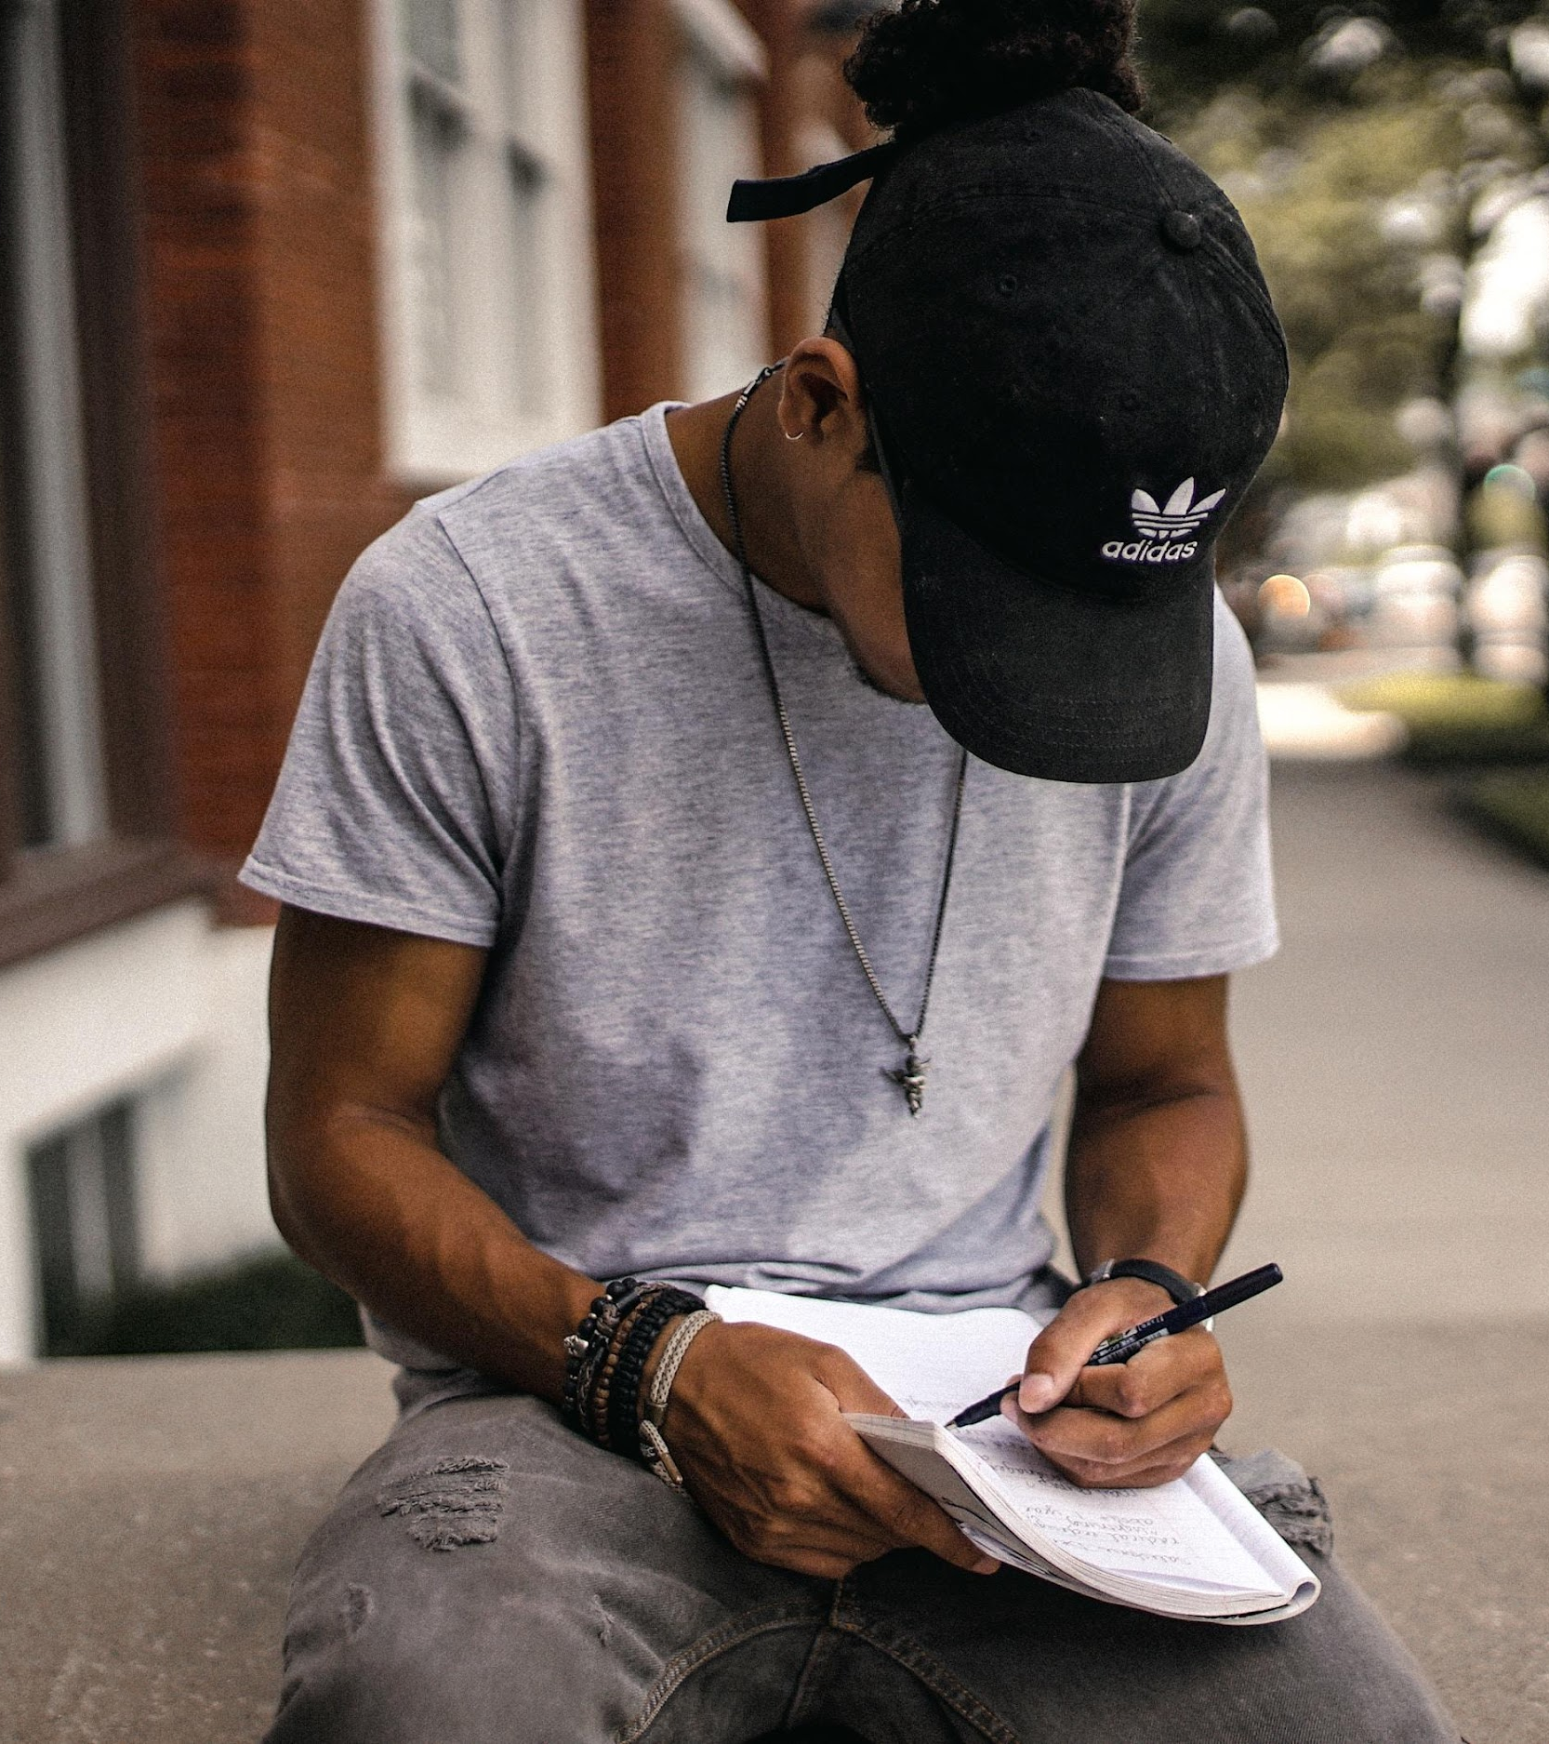
HALLMARKS OF PUENTE
rigorous, culturally responsive instruction
research-driven practices
intersegmental and interdisciplinary approach
ongoing faculty professional development
aligns with current initiatives: AB 705, Guided Pathways
pedagogy of “Cariño”
community Approach to closing the opportunity gap
mentoring as a strategy to create life opportunities and social capital
community of Practice
● student Leadership (local and statewide level)

Slide 21
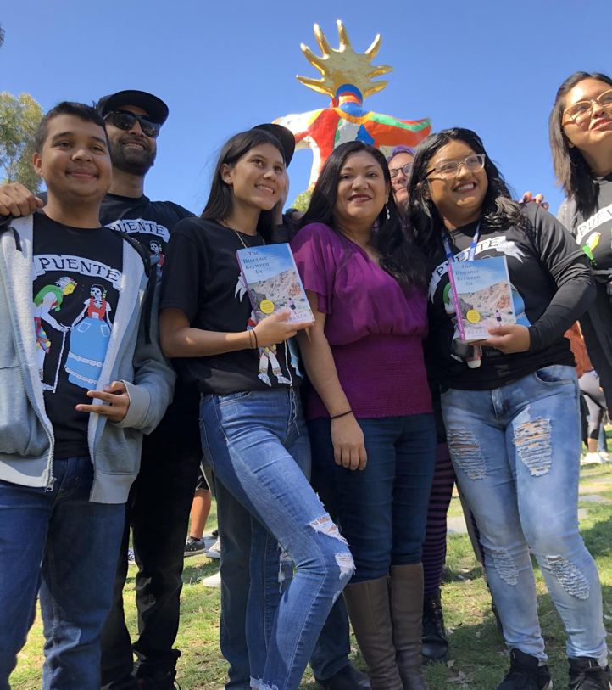
WHAT WE’VE LEARNED
• Rethinking Education must include Culturally Relevant Pedagogy and Training
• Closing the Opportunity Gap must include Cultural Pedagogy and Training
• Change must be made collectively as an institution rather than individually
• Bridging Student Services and Instruction
• CRT helps with the implementation of improving remedial courses
• A real attempt at “Improving Students’ Lives”

Slide 22
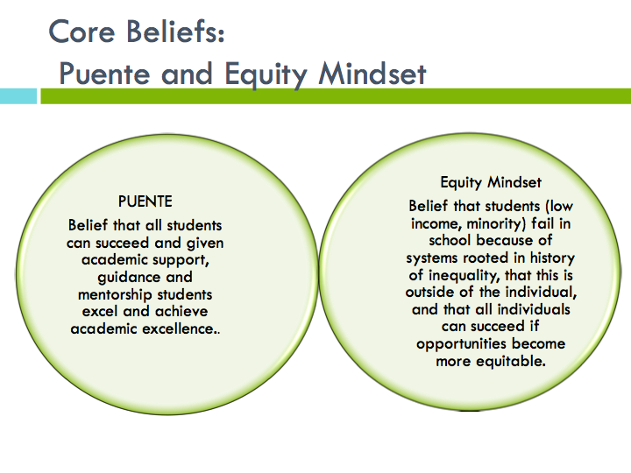

Slide 23
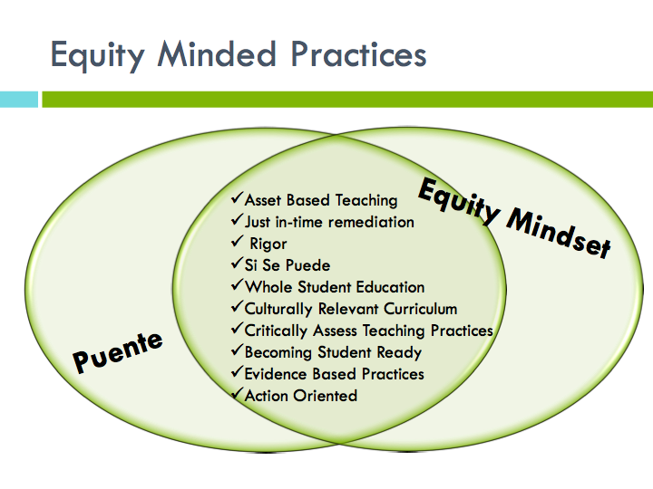

Slide 24
CULTURALLY RELEVANT PEDAGOGY
“A pedagogical framework that empowers student intellectually, socially, emotionally and politically by using cultural references to impart knowledge, skills and attitudes. Culturally relevant pedagogy involves fostering academic achievement, cultural competence and sociopolitical consciousness in students.”
(Thornton, 2014)

Slide 25

FACULTY EXPERIENCE
“Today’s workshop on culturally responsive teaching was so good and informational. The distinction between relevance and responsiveness is crucial. Also, it was instructive to think of “culture” in different ways. I really appreciated that Paula’s presentation talked about understanding that some students have dealt with real trauma, especially in the interactions with institutions, including educational institutions. ”
Javier Huerta
English Instructor , Chabot College
PUENTE SUMMER INSTITUTE 2019

Slide 26

“I loved my experience in PUENTE. I wasn't of Latina/o descent, but I appreciated the social consciousness I garnered. I don't know that I had any other experiences that allowed me to see the cultural lens and layers of my identity quite the way that it did in PUENTE allowing me to acknowledge and validate my own Pacific Islander identity and the community cultural wealth that I possessed. It allowed me to make friends and feel like I belonged to the campus. Thank you for all you do PUENTE."
Asena Filihia
Los Angeles Valley College
2007 Puente Alumni

Slide 27
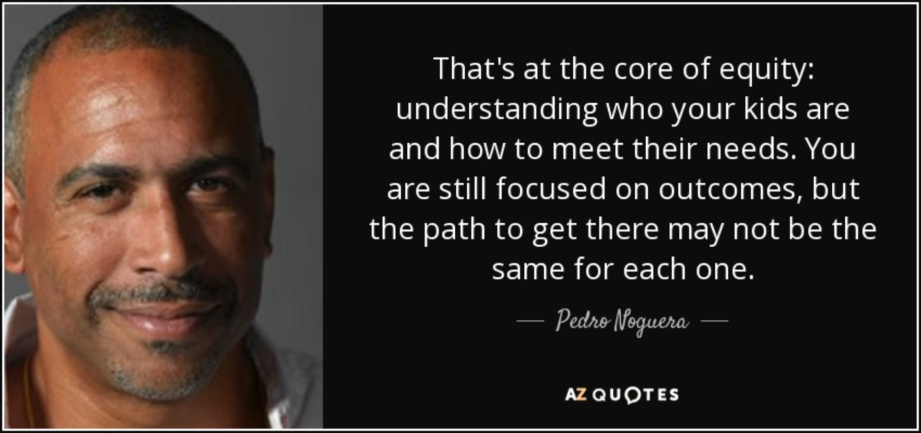

Slide 28
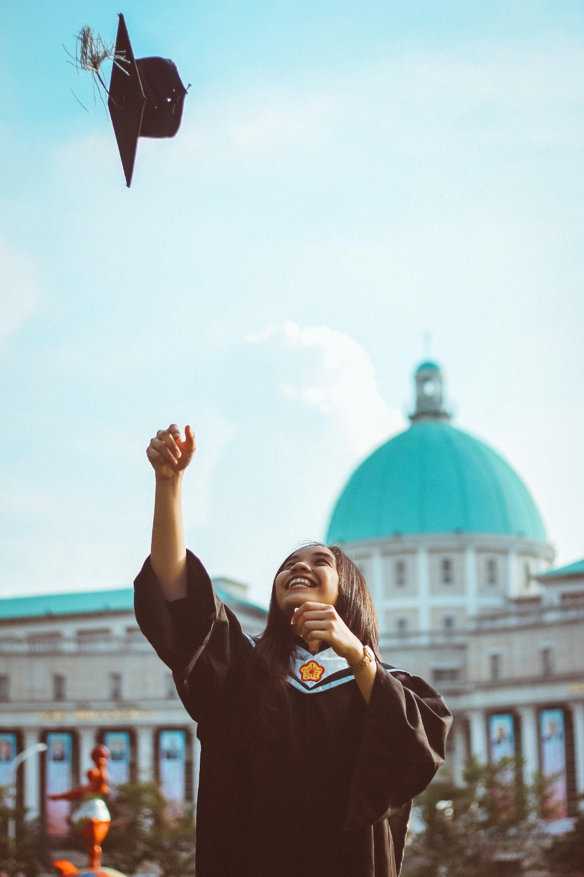

Slide 29
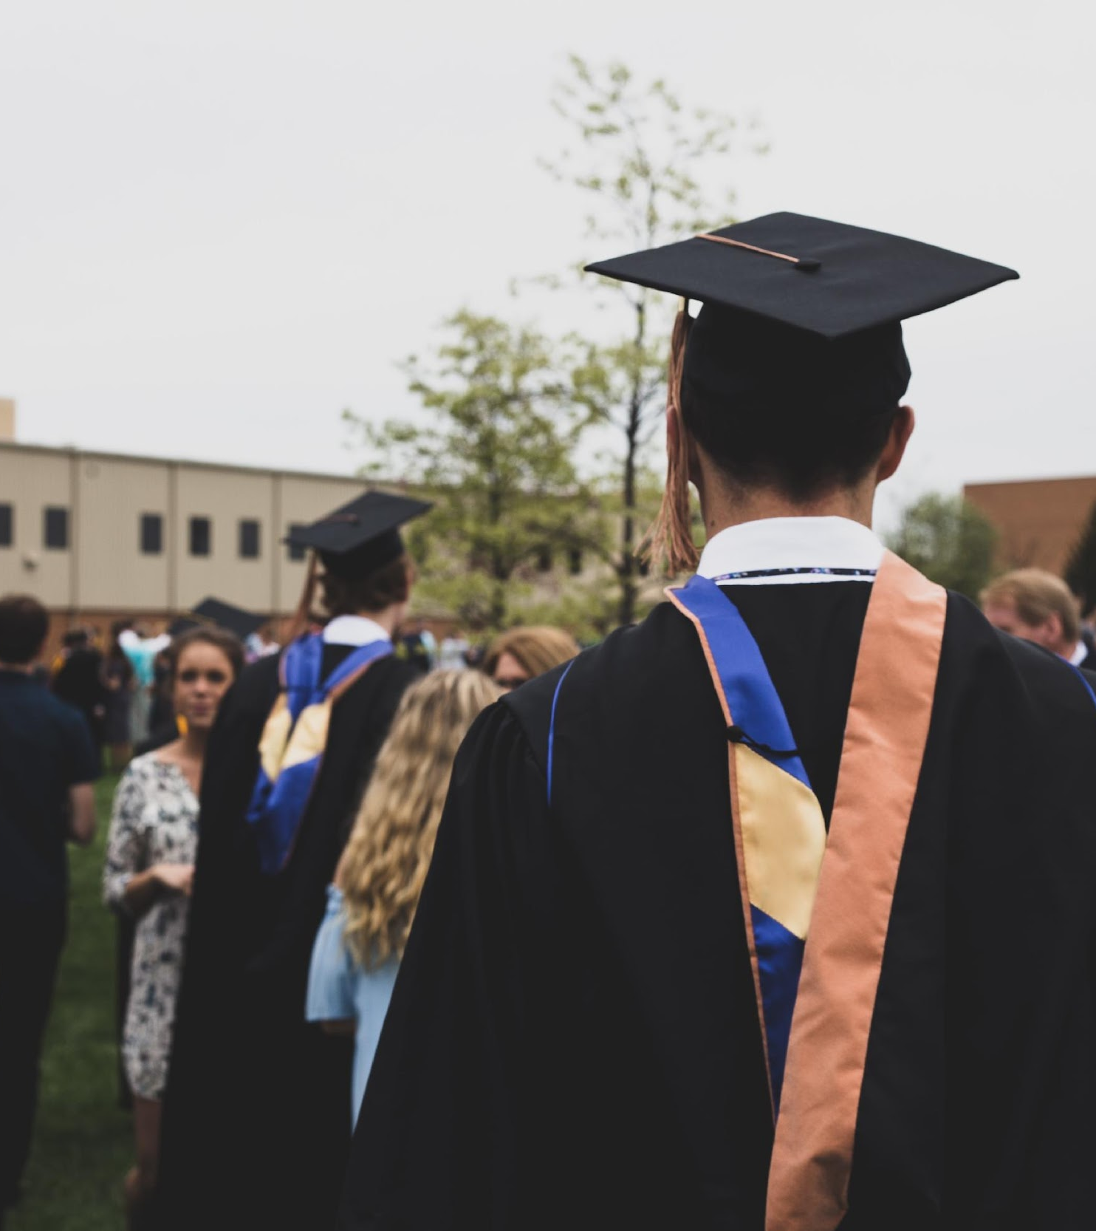
Thank you
Julia Vergara: julia.vergara@berkeley.edu

Slide 30
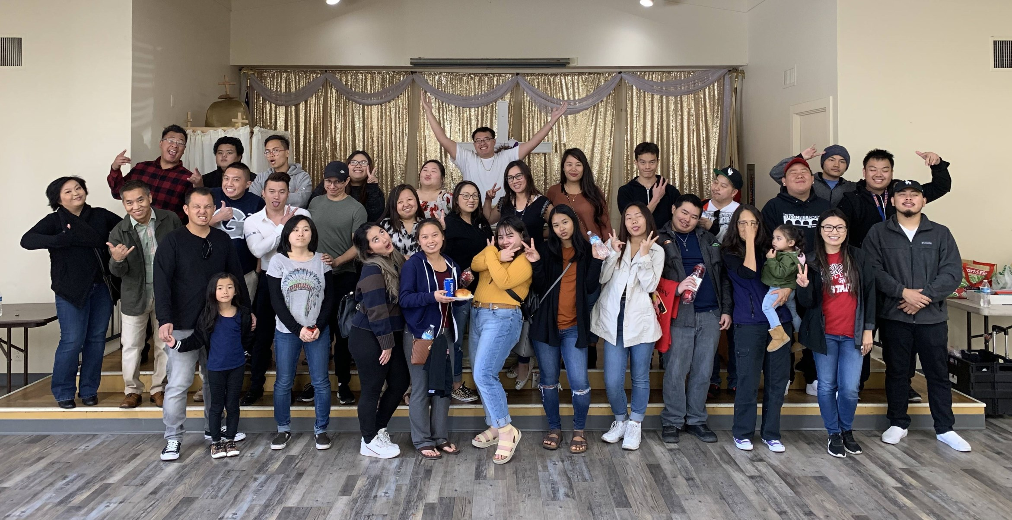

FRESNO CITY
COLLEGE
United Southeast Asian American Academic Program (USEAA)

Slide 31
USEAA Program:
  Founded in 1999: Inspired by PUENTE, USEAA was co-founded by Lee Herrick (English instructor) and Victor Yang (Academic Counselor) to meet the needs of our Southeast Asian American students.
  Mission: To provide comprehensive support services for program students to enhance their academic success and contribute to their social and cultural development.
  The focus is on the Southeast Asian American cultures and experiences; however, the program is open to all students.
USEAA Goals:
  To create and nurture a supportive learning community where students feel connected and have a sense of belonging on campus, so they can thrive.
  To increase the number of Southeast Asian students who transfer to four-year universities.
  To develop future leaders by providing program students with opportunities for civic engagement and volunteerism.

Slide 32
USEAA Program Data:
USEAA Program Benefits
CSU/UC Campus Visits
Motivational Guest Speakers and Community Service Opportunities
Designated
English 1A & 205, Asian American Studies, and Counseling Courses
Assigned Program Counselor
A Learning Community that fosters peer and faculty support
Mentoring Component
Access to P.A.S.S Services for Reading and Writing Skills
30 students per cohort
Higher Success Rate with English Course compared to Non-Program
5-Year Transfer Rate 33% vs. 24% FCC Overall
Persistence Rate 74-88% vs. 60% FCC Overall
Program students attempt and complete more semester units.
Average 8-10 units completed compared to 6 units FCC Overall
*Data from 2018 Program Review

Slide 33
USEAA Program Courses:
Culturally relevant materials and books
Intentional selection of topics for writing and class discussion
Guest Speakers (Community non-profits and agencies, Special Programs, CSU/UC, Private Universities, etc)
Embedded USEAA Peer-Assisted Study Sessions (PASS) Tutor
Fall Semester:
English 1A (Reading and Writing Composition) and 205 (Support Course)
Counseling 43 ( Group Dynamics and Self-Understanding)
Spring Semester:
English 3 (Critical Reading & Writing) *
Asian American 1 (Indo-Chinese Americans) *
Counseling 54 (Civic Responsibility and Leadership)
*Courses are optional

Slide 34

Thank You for Joining Us!
Program Contacts: (559) 443-8639 | www.fresnocitycollege.edu/useaa
kami.thepphavong@fresnocitycollege.edu (USEAA Counselor/Coordinator) karen.crocket@fresnocitycollege.edu (USEAA English Instructor) tchay.her@fresnocitycollege.edu (USEAA Program Counselor)
@fccuseaa

Slide 35
Thank you!
Any questions?
Contact ASCCC anytime at info@asccc.org

