Slide 1
Unblurring the Data for the Vision for Success Metrics
ASCCC Plenary
Spring 2019
Thursday April 11th, 2019
4:15 p.m. to 5:30 p.m. THIRD BREAKOUT SESSION
Alyssa T. Nguyen, Director of Research and Evaluation, The RP Group
Jeffrey Hernandez, East LA College, Guided Pathways Task Force
Carrie Roberson, ASCCC North Representative, Guided Pathways Task Force Chair
Notes:
ALL

Slide 2
TODAY!
Current legislation…
High stakes, ambitious goals
Process of local goal setting
Principles of DATA
Aligning goals- focus on the student!
Scenario
What now, what next?
Notes:
CARRIE

Slide 3
Opportunity: Here & Now!
Students are depending on California Community Colleges for education, career training, and social mobility.
The State of California is depending on California Community Colleges for economic improvement and to close the skill gap- with a focus on equity.
Notes:
CARRIE
Scrutiny of higher education and our responsibility

Slide 4
Notes:
CARRIE
STATE OF THE SYSTEM: existing and emerging community college policies and initiatives that impact students
CURRENT DYNAMIC- Chancellor Eloy Oakley and the CCCCO
Unprecedented time of fiscal support

Slide 5
Vision for Success Goals
Goal 4:
Goal 1:
Increase the percentage of exiting CTE students who report being employed in their field of study, from the statewide average of 60% to 69%--the average among the top 5th of colleges showing the strongest performance on this measure.
Increase by at least 20 percent the number of CCC students annually who acquire associates degrees, credentials, certificates, or specific skill sets that prepare them for an in-demand job.
Goal 2:
Goal 5:
Increase by 35 percent the number of CCC students system-wide transferring annually to a CSU or UC, necessary to meet the state’s needs for workers with baccalaureate degrees.
Reduce equity gaps by 40% across all of the previous measures through faster improvements among traditionally underrepresented students, closing the gap within 10 years.
Goal 3:
Goal 6:
Decrease the average number of units accumulated by CCC students earning associates degrees from approximately 87 to 79 total units—the average among the top 5th of colleges showing the strongest performance on this measure.
Reduce regional achievement gaps across the previous measures through faster improvements among colleges located in regions with the lowest educational attainment of adults, with the goal of closing the gap within 10 years.
Notes:
CARRIE
High stakes… ambitious goals

Slide 6
Why these goals?
Source: CCCCO Scorecard, https://scorecard.cccco.edu/scorecardrates.aspx?CollegeID=000#home
Notes:
ALYSSA
Completion rates have dismal in our system, with the last five years hovering around 48%!
Trends have pointed to the fact that less than half of our FT entering students (who completed at least 6 units and attempted Math or English within the first three years --- a proxy for a goal that looks like completion) complete with XXXX within six years!!
And this rate is for the overall student population --- look at what these rates are for our URM groups. AA and Hispanic students, have consistently and historically have had much lower rates of completion, displaying a clear equity gap in completion year after year.

Slide 7
Process for Local Goal Setting
Plan to Involve Board of Trustees
Review Baseline Data
and Report Goals Development Process
Review Existing
Plans and Priorities
Set Local Goals
Adopt and Report
Local Goals
Notes:
ALYSSA
AB1809 (SCFF requires local goal setting)
Will look different at 114 colleges…
*Areas of focus from college self assessment and workplan for initial GP funding
*Focus on desired outcomes through the process
BOT: Colleges lead the process and keep Trustees involved - Assures goals are aligned with district needs and priorities - Invite them to conversations with stakeholders
BASELINE DATA: Use the new Student Success Metrics available on the Launchboard Available early November
Completion Indicators (unduplicated by award)Completed associate degrees Completed CCCCO-approved certificates
Transfer Indicators (unduplicated) : Completed ADT degrees - Transfers to UC/CSU
REVIEW EXISTING:
Unit accumulation indicator Average units earned per completed associate degree
Workforce indicators Median annual earnings of exiting students - Change in median earnings of exiting students - Percent of exiting students earning a living wage- Number of exiting CTE students who report being employed in their field of study
Equity indicators All of the above indicators, disaggregated for those student groups identified as disproportionately impacted in your annual Equity Plan and for whom data is available in the Student Success Metrics
EXISTING GOALS: Are they measurable? - Do they align with the Vision for Success goals? - Compare to current baseline data
Community dialogue about college priorities - Community forums - Student focus groups - Standard consultative practices - Leverage existing processes and forums
LOCAL GOALS: Start with existing plans: Strategic Plan, Educational Master Plan
ADOPT/REPORT: Add goals to board agenda for formal adoption - Finalized goals - Timeline to achieve by 2021-22 - Explain how goals align with Vision for Success goals - Districts submit adopted local goals to Chancellor’s Office Required by May 31, 2019

Slide 8
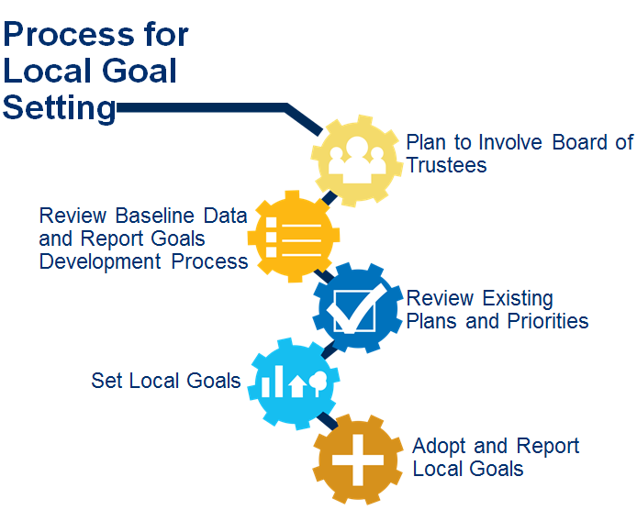
Unblurring the Data for the Vision for Success Metrics
But, are the data really telling the story of your college's student success?
Current legislation has directly or indirectly amplified the significance of accurate metrics to communicate success and progress in the California community colleges system and these efforts have created high stakes for correctly working with data associated with these mandates.
Colleges have the opportunity to provide a holistic picture of the realities, so come explore with us as we take a principled approach to explain what it all means and what needs to change.
Notes:
ALYSSA
Remember, doing things well! But…

Slide 9
Unblurring the Data for the Vision for Success Metrics
What do we want (and need!) from the data?
Presumably, we want to be informed about strategies or practices that can help us boost student success. However, with so many variables affecting education, it is important to begin by asking some questions.
An effective practice for figuring out what we want from data is to use guiding principles for our inquiry.
A 2010 white paper from the ASCCC titled Data 101: Guiding Principles for Faculty* is particularly relevant for learning “to engage the data with a critical and analytical eye in order to interpret and apply it appropriately.”
A White Paper by the Academic Senate Executive Committee with special thanks to Janet Fulks and David Morse
Notes:
JEFFREY

Slide 10
Unblurring the Data for the Vision for Success Metrics
First, give some thought to implications of the data on decisions or policies. Next, assess the usefulness of the data by considering the following principles:
Use longitudinal data when possible.
Use data in context.
Look for both direct and indirect data.
Do not oversimplify cause and effect of data.
Use appropriate levels of data for appropriate levels of decisions.
Perception is the reality within which people operate, and must be addressed.
Use of data should be transparent.
Consider carefully when to aggregate or disaggregate data.
Focus on data that is actionable.
Consider the implications and the “What if?”
Data 101: Guiding Principles for Faculty (2010) by the Academic Senate Executive Committee with special thanks to Janet Fulks and David Morse
Notes:
JEFFREY
Not a snapshot view
Data literacy
Variables, variables, variables…
Correlation vs. Causation
Begin with the end in mind
You say, I say…
Evidence based decision-making
Your expertise, please!
What’s next?
Yep- “what if!”

Slide 11
Unblurring the Data for the Vision for Success Metrics
Vision for Success | Unblurred | Use commitments by system as guiding principles
LOOKING AHEAD: GOALS FOR MEETING CALIFORNIA’S NEEDS achieve by 2022: • Increase by at least 20% CCC students annually who acquire associates degrees, credentials, certificates, or specific skill sets that prepare them for an in-demand job. • Increase by 35% CCC students transferring annually to UC/ CSU • decrease the average number of units accumulated by CCC, from 87 total units to 79 • Increase the percent of exiting CTE students who report being employed in their field of study, from 60% to 69% • Reduce equity gaps by 40 percent within 5 years and fully within 10 years. • Reduce regional achievement gaps within 10 years across all of the above measures through faster improvements among colleges located in regions with the lowest educational attainment of adults. | Is this work already happening at your college? Increased certificates and degrees? Increased Transfer? Decreased units? Career students employed in area of education? Reducing equity gaps? Addressing regional achievement gaps? | 1. Focus relentlessly on students’ end goals. More than just offering courses, colleges need to be offering pathways and providing supports until completion. 2. Always design and decide with the student in mind. 3. Pair high expectations with high support. Assessment and placement practices reformed so students are placed at the highest appropriate course level, with supports to succeed. 4. Foster the use of data, inquiry, and evidence. Data analysis should be a regular practice used for improving services at all levels, not a compliance activity. 5. Take ownership of goals and performance. Goals should be used to motivate and provide direction, not punish. 6.Enable action and thoughtful innovation. Moving the needle on student outcomes will require calculated risk, careful monitoring, and acceptance that failures; results should be tracked early and often. 7. Lead the work of partnering across systems. Working together to strengthen pathways for students and improve results.
HOW CAN YOUR COLLEGE ALIGN?
Notes:
JEFFREY

Slide 12
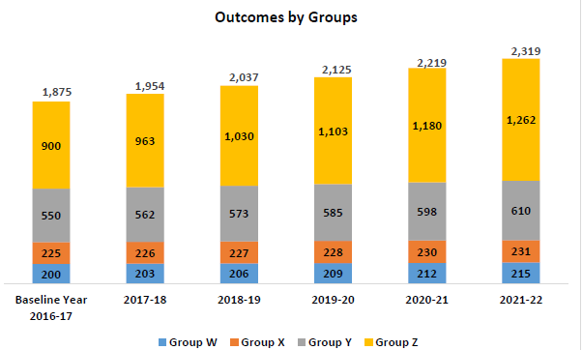
Unblurring the Data for the Vision for Success Metrics
Consider the following mock scenario for assessing how to close the equity gap
Vision for Success – Goal Setting Scenario
Source: ELAC Office of Institutional Effectiveness and Advancement
Updated 03/20/2019
Notes:
JEFFREY
Mock case study—with three decision choices:
* default of some change that some feel is too much but is still below VS
* most popular, very slight change
* equity minded, align fully with VS, raises questions
Present what is the target for disaggregated students to align w/VS

Slide 13
Unblurring the Data for the Vision for Success Metrics
What would advise this mock college on setting equity goals?
How might this apply to your college?
Who needs to be part of the conversation?
Does choosing a higher goal set mandate for equity improvement?
What are your initial thoughts on that?
Exercise:
start individual thoughts on index cards
share concepts with partner
add ideas to post-it notes for report out
Notes:
JEFFREY

Slide 14
ACTION PLANNING: Goal 3 - Transfers
Source: https://www.calpassplus.org/LaunchBoard/Student-Success-Metrics.aspx
Notes:
ALYSSA
Butte College
Average change in # of students transferring to a four year is 2% drop in the last three years.
Planning purposes – if this college set their goal to a 5% increase, how many students would they need to transfer in the 2017-2018 target year?
52 more students – that is the college would need to aim for transferring 1,092 students.
So how can the college get there – focused on a GP lens?

Slide 15
QUESTIONS to ask…
Who are our students?
What are our goals?
What data sources are needed to ensure progress on the Vision for success through Guided pathways redesign?
How will we ensure data literacy effectiveness of data on decision-making be assessed?
What are the implications of data on any decision or policy?
What unintended consequences might be considered?
Notes:
JEFFREY

Slide 16
ASCCC.ORG
info@asccc.org
~~~~
RP Group info@rpgroup.org
~~~~~
Vision Resource Center
Notes:
ALL
Discussion about partnerships, ongoing communication, and connection to ASCCC!

