Slide 1
Unique Challenges and Opportunities for Part Time Faculty of Color
Silvester Henderson, ASCCC At-Large Representative Don Hopkins, ASCCC Part-Time Committee, Folsom Lake College
Newport Beach Marriot Hotel
900 Newport Center Drive Newport Beach, Ca 92660
February 21-23, 2019
,

Slide 2
Presentation Highlights
What is the definition of “Part Time Faculty?
Racial Diversity (Faculty of Color) versus Representative Diversity.
Are Faculty of Color professionally marginalized? If so, how can this narrative be changed?
Should Part Time Faculty of Color support “Cultural Taxation” and serve on campus committees and campus governance structures, for the good of the institution and the students?
Could innovative “Ethno – Relativist” curricular structures improve intercultural sensitivity while creating academic employment for Part Time Faculty of Color? If so, how
Strategies for “Rethinking”, “Reshaping”, and “Redesigning” success for Part Time Faculty of Colors.
Questions and Comments?

Slide 3
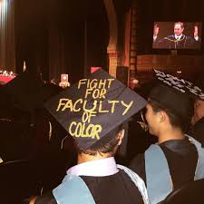
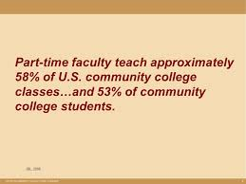
What is the definition of “Part Time Faculty?
California Code, Education Code - EDC § 87482.5
Notwithstanding any other law, a person who is employed to teach adult or community college classes for not more than 67 percent of the hours per week considered a full-time assignment for regular employees having comparable duties shall be classified as a temporary employee, and shall not become a contract employee under Section 87604 .
Discussion
https://codes.findlaw.com/ca/education-code/edc-sect-87482-5.html

Slide 4
What is “Representative Diversity” Race (faculty of color) versus representative diversity
University of Cambridge – “Race” is a protected characteristic that refers to an individual's race, colour, nationality and ethnic or national origins.
National Education Association -“Representative Diversity” can be defined as the sum of the ways that people are both alike and different. The dimensions of diversity include race, ethnicity, gender, sexual orientation, language, culture, religion, mental and physical ability, class, and immigration status”

Slide 5
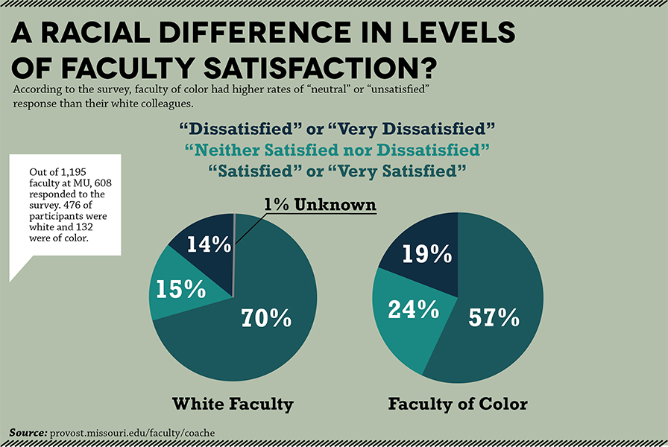
Are Faculty of Color professionally marginalized? If so, how can this narrative be changed?
Academic Realities
Professional Considerations
Employment Instability
Full Time Faculty – “Right of Schedule”
Office Space – Lack of Student “Privacy”
Cultural Mentorship Expectations”
Communication – (Dean – Department Chair)
Ask your Dean/Chair for a space to meet with students in “Private”
Express desire to offer additional involvement upon funding available
Support “Student Success” – (Advising, Counseling, Mentorship, Office Hours)
Know your Employment Contract!

Slide 6
Should Part Time Faculty of Color support “Cultural Taxation” and serve on campus committees and campus governance structures, for the good of the institution and the students?
“Cultural Taxation” is a term coined by Amado Padilla in 1994 as a way of describing the unique burden placed on ethnic minority faculty in carrying out their responsibility to service the university.
Amado Padilla - “Cultural Taxation” is the obligation to show good citizenship towards the institution by serving its needs for ethnic representation on committees, or to demonstrate knowledge and commitment to a cultural group, which, though it may bring accolades to the institution, is not usually rewarded by the institution on whose behalf the service was performed.
Discussion
https://www.calfac.org/magazine-article/cultural-taxation-faculty-color-academy

Slide 7
Could innovative “Ethno – Relativist” curricular structures improve intercultural sensitivity while creating academic employment for Part Time Faculty of Color? If so, how?
Curriculum -The term curriculum refers to the lessons and academic content taught in a school or in a specific course or program. In dictionaries, curriculum is often defined as the courses offered by a school, but it is rarely used in such a general sense in schools.
https://www.edglossary.org/curriculum/
Ethno-relativism - A belief that all groups, cultures, or subcultures are inherently equal. Based on deep and heart-felt respect for other.
https://prezi.com/cdg0mff5m0ua/ethnorelativism/
Discussion

Slide 8
Strategies for “Rethinking”, “Reshaping”, and “Redesigning” success for Part Time Faculty of Colors
“Rethink” – expand the curricular representation; offer to create innovative courses that promotes “Intercultural Sensitivity”.
“Reshape” – create new specialize courses that will bring positive exposure to your department and your college. Example: “The Cell Phone” (Stem – CTE & Humanity Faculty)
Redesign: - corporatize/own the same course/program at various community colleges and districts. Become an “Innovative Curricular Specialist & Expert”.
Create your own Academic Journey!
Remain Grateful!

Slide 9
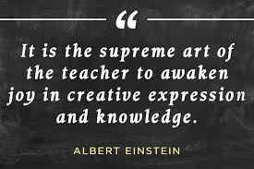
Questions & Comments
Please feel free to contact each of us for more information.
Silvester Henderson shenderson@losmedanos.edu Don Hopkins hopkind@flc.losrios.edu

