Slide 1
Open Educational Resources in California
Cheryl Aschenbach, Lassen College
Dan Crump, American River College
Dolores Davison, Foothill College

Slide 2
Outcomes
Attendees will become familiar with OER, the cool4ed.org website, and the AB 798 Textbook Affordability Act as means by which to lower textbook costs to students.

Slide 3
What is OER?
Open Education Resources Teaching and learning materials that are freely available online for everyone to use, whether you are an instructor, student, or self-learner.
Examples: course modules, syllabi, lectures, homework assignments, lab and classroom activities, pedagogical materials, games, simulations, and many more resources contained in digital media collections from around the world. (as defined by www.oercommons.org)
OER most often refers to open access textbooks and ancillary materials that are available at little or no cost to students

Slide 4
Why should OER matter to students?
How much are your textbooks costing students per semester/quarter?
Example
Introduction to Child Development
Commercial publishers hold a monopoly on the 2 primary textbooks for this course, with revised editions published every 3 years:
Developing Person, pub Worth, $197
The Developing Child, pub Bee & Boyd, $209
In the California Community Colleges alone, more than 1000 students enroll in this course EACH SEMESTER. A low cost OER alternative would save students $100 or more.

Slide 5
Why aren’t we using OER already?
Babson Study 2014 – nationwide survey of over 2,000 teaching faculty on awareness and adoption of OER: Teaching faculty at institutions of higher education remain largely unaware of open educational resources (OER), but the potential exists for much wider adoption, according to a new report from Babson Survey Research Group and Pearson.

Slide 6
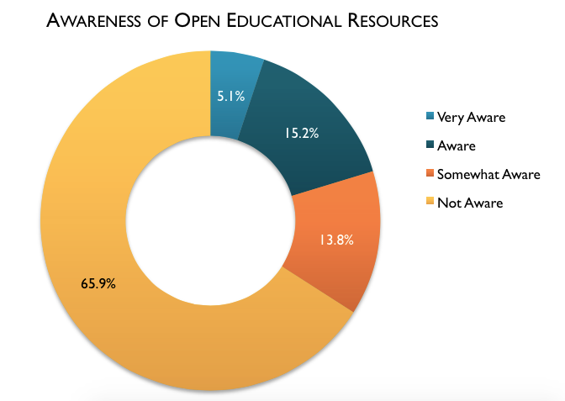
According to Babson Study, 66% of faculty are unaware of OER in general, while 75% are unaware when including a stricter definition of understanding the licensing issues
Source: Phil Hill, “OER Adoption: The Worst of Times and The Best of Times” (Oct 13, 2014) based on Babson Report 2014

Slide 8
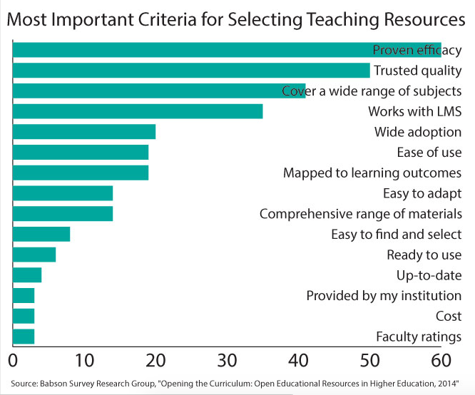

Slide 9
SB 1052/1053, CA-OER Council, and Open Source Digital Library
The California State Legislature passed and the Governor signed SB 1052 and SB 1053 (Steinberg, 2012) for the California public higher education systems to create an online library of open educational resources and open textbooks
SB 1052 authorized creation of CA-OER Council with the goal of identifying OER materials for 50 high impact courses across UC, CSU, and CCCs.
SB1053 authorized development of a CA Open Source Digital Library

Slide 10
What did SB1052 and 1053 do to change faculty awareness of OER in California?
Selected 50 high impact courses
Identified available free and open etextbooks
Created and administered a rigorous review process
Established COOL4Ed.org as a repository for free and open etextbooks and the reviews

Slide 11
California Digital Open Source Library
www.coolfored.org or www.cool4ed.org
COOLforEd = California Open Online Library for Education
See courses listed by C-ID number
Textbooks reviewed by faculty from all 3 systems
Some textbooks noted as highly recommended based on faculty reviews
Recommend additional OER etextbooks

Slide 12
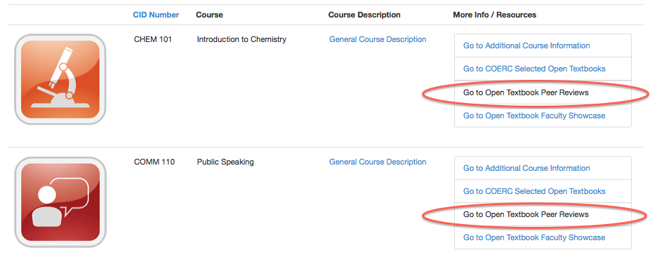
How can I find the reviews?
http://coolfored.org/courseshowcase.html

Slide 14
Cool4ed.org - Faculty Showcase

Slide 15
Where else can you find OER?
Campus libraries – you may find material in the etextbook selections as well as through database subscriptions
MERLOT (Multimedia Educational Resource for Learning and Online Teaching) - a curated collection of free and open online teaching, learning, and faculty development services contributed and used by an international education community. A program of the CSU: merlot.org

Slide 16
Where else can you find OER info?
OER Commons – Dynamic digital library and network oercommons.org
Community College Consortium for Open Educational Resources
Established 2007 by Foothill-DeAnza CCD
Mission: expand access to education by promoting
awareness and adoption of OER
http://oerconsortium.org/

Slide 17
What is next for OER in CA?
AB 798 (2015) – grants to implement OER in CSUs and CCCs.
OER funding for CCCs in Governor’s January budget
$5 million dollars proposed
Z-pathways
ASCCC Task Force on OER

Slide 18
AB798 (Bonilla, 2015)
College Textbook Affordability Act of 2015
Establishes the Open Educational Resources Adoption Incentive Program
Established to reduce costs to by encouraging faculty to accelerate the adoption of lower cost, high quality, open educational resources

Slide 19
AB798 (Bonilla, 2015)
Section 67423 of California Education Code, as amended by SB 798 (Bonilla, 2015) defines open education resources as “high-quality teaching, learning, and research resources that reside in the public domain or have been released under an intellectual property license, such as a Creative Commons license, that permits their free use and repurposing by others, and may include other resources that are legally available and free of cost to students. ‘Open educational resources’ include, but are not limited to, full courses, course materials, modules, textbooks, faculty-created content, streaming videos, tests, software, and any other tools, materials, or techniques used to support access to knowledge.”

Slide 20
AB798 (Bonilla, 2015)
Up to $3 million may be used in CSU and CCCs for the following:
Professional development for faculty; faculty may be compensated for PD
Professional development for staff whose work supports providing students with OER
OER curation activities
Curriculum modification
Technology support for OER adoption efforts

Slide 21
AB798 (Bonilla, 2015)
Requirements-Senate Role
Approve a local resolution to increase student access to high-quality OER and reduce cost of textbooks and supplies for students in course sections for which OER are to be adopted and
Approve a plan (in collaboration with students and campus administration) that shows the faculty’s commitment and readiness to use OER

Slide 22
AB798 (Bonilla, 2015)
Requirements-The Plan
Detail technological or staff support to increase adoption
Describe how the faculty will learn about COOLforEd.org and other OE resources
Include the number of academic departments involved and course sections where OER will be adopted
Define anticipated percentage of cost savings for students.
Describe ways existing faculty professional development plans will be used or enhanced
Describe how access to OER will be provided to students – where/how hard copies will be available
Plan must have support via signature from academic senates, students, and administrators

Slide 23
AB798 (Bonilla, 2015)
Requirements
Plans shall commit to at least 30% cost savings in at least 10 course sections and no more than 50 course sections
The grant request shall be equal to, or less than, the number of course sections in which EOR will be adopted and cost savings will be more than 30%, multiplied by $1,000 (max $50,000).

Slide 24
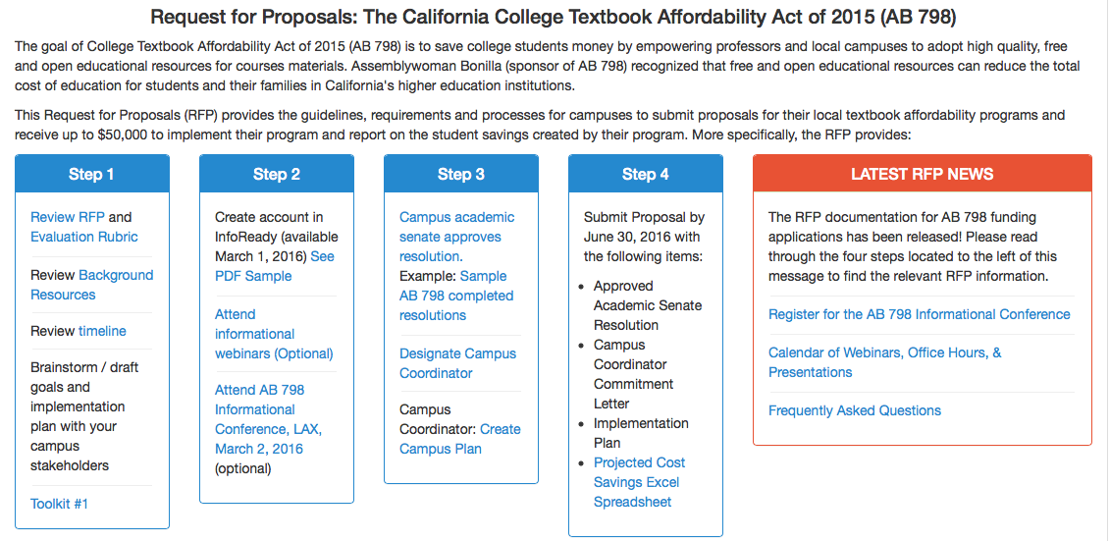
AB798 (Bonilla, 2015)
Requirements
RFP available at cool4ed.org
June 30, 2016 application deadline
Toolkits will be made available by COERC, as will webinars and other outreach and assistance efforts

Slide 25
Questions?
Cheryl Aschenbach
caschenbach@lassencollege.edu
Dan Crump
crumpd@arc.losrios.edu
Dolores Davison
davisondolores@fhda.edu
info@asccc.org
cool4ed@cdl.edu

