Slide 1
Using Noncredit Education to Support Students in English and Mathematics Pathways Friday, April 30 from 4:30 to 5:30 Janet Fulks - jfulks60@gmail.com Mary Legner - mm.legner@rcc.edu Virginia May - mayv@scc.losrios.edu Kimberley Stiemke - kstiemke@noce.edu

Slide 2
If you have one goal for your students in your courses, what would it be?
Please answer in the chat.
Notes:
Kimberley

Slide 3
What have your students told you is their main goal in your course?
Please answer in the chat.
Notes:
Kimberley

Slide 4
Description
How can we minimize the impact on students who are not prepared for placement in college level English and Mathematics? Repeating a course until you pass is not an option and many students just give up if they find they are missing discrete necessary skills. What better than to implement noncredit educational strategies that address specific skill mastery and can be completely on the students own time and at their pace. An innovative noncredit strategy eliminates financial aid and course repetition issues that can create barriers as students get the support they need. AB 705 requires all prepared students to be placed into college-level course work, but it also requires colleges to support students and help them reach their educational goals. How can we build confidence and deep learning that will create a strong platform for passing college-level English and Mathematics and help them employ these skills throughout their college career? Join this collaborative session for a lively discussion about how colleges have implemented Noncredit instruction into their English and mathematics pathways as part of their support options for students enrolling in college-level or transfer-level English, mathematics or English as second language courses.
Notes:
Mary

Slide 5
AB 705 or Education Code §78213
Maximize the probability that a student will enter and complete transfer-level coursework in English and mathematics within a one-year timeframe,
Use multiple measures including high school coursework, grades, GPA if available
Maximize the probability that students in ESL will complete degree and transfer-level requirements in English within a three-year timeframe
Ensures students are not placed into remedial education unless they are highly unlikely to succeed in transfer-level coursework
Close equity and achievement gaps
English and mathematics full implementation fall 2019
ESL full implementation fall 2021
Notes:
Ginni

Slide 6
AB 705 or Education Code §78213
Does not prohibit prerequisites
Does not prohibit pre-transfer level coursework
Ed Code §66010.4 requires colleges to provide remedial instruction for those that need it
Noncredit Coursework fits the bill!
Holistic approach to evaluating AB 705 implementation – many contributing variables
Notes:
Ginni

Slide 7
How can we maximize student success?
Build foundational level skills
Focus on skill attainment, not grades or units
Meet the students where they are
Provide low educational opportunities
Individualize Instruction and Tutoring
Work at your own pace
Provide a Stress-Free Learning Environment
Notes:
Ginni
English and Math Pathways and Noncredit Development -
While co-requisites are showing promise for some student populations, the data clearly shows that this is not the case for all student populations. Students, faculty, and administrators have voiced loud concerns regarding high-unit co-requisite coursework that may or may not address the skills students need. This webinar discusses no-unit coursework and customized time to learn skills relevant to success delivered through noncredit. Innovative ideas and strategies will be explored.

Slide 8
Access, Placement, Enrollment, Completion
Students receive course placement recommendations through college assessment processes – ACCESS
Students determine or choose the courses in which they will enroll – colleges cannot force students to enroll, but can prohibit enrollment
Students only have access to courses that are offered
Many do not need pre-transfer/remedial, but some still do
Completion
What is successful completion?
Notes:
Ginni – Answer in chat

Slide 9
Eligible Noncredit Courses: Ten Categories
English as a Second Language (ESL) *
Immigrant Education
Elementary and Secondary Basic Skills*
Health and Safety
Substantial Disabilities
Parenting
Home Economics
Courses for Older Adults
Short-term Vocational*
Workforce Preparation*
*Areas (1), (3), (9), (10) are eligible for Enhanced Funding if associated with an approved noncredit program.
Notes:
Ginni

Slide 10
Many adult students need basic skills and noncredit as a bridge to credit
Educational Attainment Highest level of education among people aged 25 years and older. NCES 2017
Notes:
Janet – NCES data nationwide and in California, many people have not yet completed a HS diploma or stopped at just the diploma level. This is more true for California than nationally my take, quite a few students may need basic skills and noncredit education as a bridge into credit

Slide 11
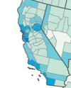
Applying these numbers to our curricular strategies
Notes:
Janet - Source: https://www.census.gov/content/dam/Census/library/publications/2021/acs/acsbr-009.pdf . These figures indicate the percentage of adults that have already achieved a bachelor’s degree or higher. Areas of low educational attainment have bridges to build.
In California we can see there are varying levels of educational attainment, and we should be aware of our student population and community needs

Slide 12
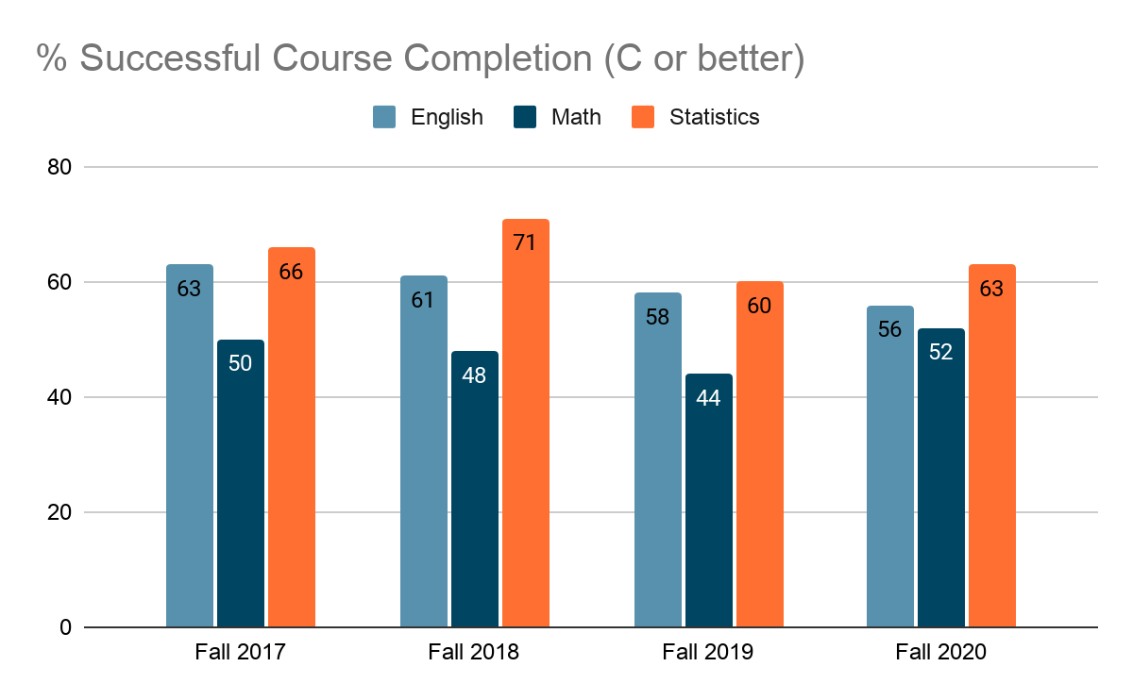
Local Perspective: Findings from LACCD
Notes:
Janet – LACCD has seen data shifts as a result of AB 705 implementation. If we dive a little deeper and disaggregate these data we see another picture.

Slide 13
Achievement Gaps Persist –WHY?
Notes:
Kimberley – To understand how to better support our students we must ask why do these gaps persist over time and even in the face of huge educational changes (e.g. Basic Skills initiative, AB 705, Guided Pathways)
From LACCD – what can we do to close gaps? First of all...
Work together
Avoid placing blame or pointing fingers
Stay focused on students and student needs
Share successes
Learn from challenges
Think creatively
Meet students where they are
Utilize guided self placement & onboarding tools to identify areas needing additional support
Explore additional support structures - think outside the box
Survey students!
Look at data from several viewpoints
Talk to students to identify their needs

Slide 14
How can noncredit help – student input
Notes:
Janet –student surveys to those that dropped courses in Fall 2019 (before COVID) in the LACCD (representing 9 colleges) revealed several areas where noncredit could better support student success

Slide 15
How do we learn? The controlling variable in credit is 16-18 weeks, why? The controlling variable for noncredit outcomes on the student’s timeline.
Notes:
Janet

Slide 16
Why Noncredit? Faculty Perspective
More freedom to tailor course to the student’s pace
Focus on skills attainment, not units
Courses have immediate impact on students’ lives and communities
Lower stress environment
Opportunity for students to repeat a course, practice skills, and become more proficient.
Notes:
Kimberley - Faculty have reported that noncredit provides the following advantages to students in the support courses
Providing more scaffolding

Slide 17
Student concerns about the impact of repeating courses
Financial aid
Confidence Killer
If a student retakes a course, they are not guaranteed to have the same instructor or content emphasis in the course they retake
Transfer level course appear on transcripts
May affect where they transfer
Time factor
Regulations on repeating
Notes:
Kimberley - There are problems with our current placement for those students not prepared or needing assurance or just needing a skills brush up. Failure is not a good start.

Slide 18
CREDIT VS. NONCREDIT
Degrees and Certificates of Achievement | Certificates of Completion or Competency
Unit bearing | Hour bearing
Designated lecture & lab hours | No lecture or lab designation
Grades (A-F or P/NP) | Grades dependent on district (P/SP/NP, A-F)
Transcript | Some schools transcript noncredit courses
Generated Apportionment | Generates apportionment CDCP or regular noncredit
Student fees apply | No student fees
Not repeatable | Repeatable
Notes:
Kimberley - A comparison of credit and noncredit platforms

Slide 19
Notes:
Mary - Samples of noncredit support - Ask people to add into chat if they have experience with these and have them submit their email for contact

Slide 20
Notes:
Mary - Possible advantages and disadvantages. Ask people to add into chat if they have experience with these

Slide 21
CERRITOS COLLEGE NONCREDIT contact Graciela Vasquez - gvasquez@Cerritos.edu
Skills Support Courses: Prep Math, College Readiness - Math Review Boot Camps, College English Skills, PreGED and GED, CTE skills attainment
Support Courses along the pathway
Intervention; skills development; supplemental support
Alignment of noncredit and credit ESL courses
Collaboration with noncredit and credit programs to develop contextualized basic skills courses
Cerritos Complete (College Promise)
Transitioning noncredit to credit
Providing a safety net
Notes:
Mary/Janet - Examples of noncredit support at Cerritos College (email in Resources on last slides) Not one way to do a noncredit pathway. Heavy student support weaved it. How the CO can support it is to include NC student journey and milestones in Vision for Success and GP metrics. That will incentivize colleges to include noncredit and adult ed into their pathways and maps Cerritos LCP – pilot Learning Career Pathways include noncredit support throughout math and English courses

Slide 22
GUIDED PATHWAYS
3 Weeks Noncredit Math Support + 15 Weeks Credit Statistics
18-Week Course Schedule
 | Monday | Tuesday | Wednesday | Thursday
8:00 | AED/MATH 112 Statistics (4 units) | AED/MATH 112 Statistics (4 units) | AED/MATH 112 Statistics (4 units) | AED/MATH 112 Statistics (4 units) | 8:00
8:15 |  |  |  |  | 8:15
8:30 |  |  |  |  | 8:30
8:45 |  |  |  |  | 8:45
9:00 |  |  |  |  | 9:00
9:15 |  |  |  |  | 9:15
9:30 | MATH SUPPORT Noncredit Support for Statistics | MATH SUPPORT Noncredit Support for Statistics | MATH SUPPORT Noncredit Support for Statistics | MATH SUPPORT Noncredit Support for Statistics | 9:30
9:45 |  |  |  |  | 9:45
10:00 |  |  |  |  | 10:00
10:15 |  |  |  |  | 10:15
10:30 | ENGL 100 (4 units) |  | ENGL 100 (4 units) |  | 10:30
10:45 |  |  |  |  | 10:45
 |  |  |  |  | 10:45
11:00 |  |  |  |  | 11:00
11:15 |  | GE Course |  | GE Course | 11:15
11:30 |  |  |  |  | 11:30
11:45 |  |  |  |  | 11:45
12:00 |  |  |  |  | 12:00
12:15 |  |  |  |  | 12:15
12:30 | ENG Support Noncredit Support for English |  | ENG Support Noncredit Support for English |  | 12:30
12:45 |  | COUNS 100 |  | COUNS 100 | 12:45
1:00 |  |  |  |  | 1:00
1:15 |  |  |  |  | 1:15
1:30 |  |  |  |  | 1:30
Noncredit Math
Math Support Statistics
Math Support College Algebra
Pre-Algebra
Prep Math – Basic Math Skills
Noncredit English
Pre College English Support
College English Skills
Notes:
Mary/Janet - Guided Pathways mapping to incorporate as a pre-semester Support – see Graciela at Cerritos

Slide 23
ENGLISH AS A SECOND LANGUAGE PATHWAY
ADULT SCHOOL
COLLEGE NONCREDIT
COLLEGE CREDIT
ESL
Low to Intermediate
NonCredit Transition Course
ESL Low Advanced
ESL 5/NonCredit Mirrored Course
High Advanced/Basic Comp
ESL 120 – Composition Beginning
ESL 152 – Composition Intermediate
ENG 100 – Freshman Comp
Notes:
Kimberley/Janet

Slide 24
Mt SAC - Use Of Data In Developing AIME Courses
Noncredit faculty worked with credit faculty to develop curriculum targeting areas of student need
Two noncredit math courses recently approved to address competencies needed in BSTEM and Statistics
Courses are offered several times per year
Direct instruction which includes intrusive (embedded) counseling and tutoring
Contact
Joe Davis, Adjunct Professor, Adult Basic Education jdavis4@mtsac.edu
Lesley Johnson, Director, Adult Basic Educationljohnson@mtsac.edu
Notes:
Mary-
Asked faculty what students need to know to be successful in English and math
Data showed that more students are taking stats so there was a need to develop a separate course

Slide 25
Summary of AIME Course Content
BS EPCS (English Preparation for College Success) | BS MPS (Math Preparation for Statistics Success) | BS MPSTM (Math preparations for BSTEM Success)
Close reading and critical analysis of texts Strategies for revision Thesis development Expository writing Argumentative writing | Ratios, fractions, decimals, percentages Measures of central tendency Measures of dispersion Dot plots, histograms, boxplots Probability Graphing skills Calculator Skills | Functions, function notation, graphing basic functions Factor and graph absolute value equations and inequalities Quadratic and other polynomial functions Properties of exponential functions, fractional exponents, radicals Systems of equations
Notes:
Mary

Slide 26
AIME English Enrollments and Transfer Level Success 2018-19
AIME English Enrollments and Transfer Level Success 2018-19
 | 2018-19 Total AIME Enrollment | Attempted ENGL 1A After Taking AIME* | % Attempted ENGL 1A After Taking AIME | Successful in ENGL 1A After Taking AIME | Success Rate of Students Who Took ENGL 1A After AIME
AIME English Students | 133 | 79 | 59% | 56 | 71%
*unduplicated number of students
Notes:
Mary

Slide 27
AIME Math Enrollments and Transfer Level Success 2018-19
AIME Math Enrollments and Transfer Level Success 2018-19
 | 2018-19 Total AIME Math Enrollment | Attempted Transfer Math After Taking AIME* | % Attempted Transfer Math After Taking AIME | Successful in Transfer Math After Taking AIME | Success Rate of Students Who Took Transfer Math After Taking AIME
AIME Math Students | 214 | 61 | 29% | 43 | 70%
*unduplicated number of students
Notes:
Mary

Slide 28
Resources
Noncredit Instruction: Opportunity and Challenge https://asccc.org/sites/default/files/Noncredit_Instruction.pdf
Questions?? Email info@asccc.org
ASCCC GP Canvas - https://tinyurl.com/CCC-GP2018
ASCCC Guided Pathways RESOURCES https://www.asccc.org/guided-pathways
ACCE website acceonline.org (Association of Community and Continuing Education)
Presentations: ​Utilization of Noncredit in Implementing AB 705 to Increase Success for All Students by ​Dr. Allison Tom-Miura, West LA College
Notes:
Ginni

Slide 29
Resources
Important Ed code components Education Code §55002-3, §55063, §55500, §55522, §66010.4 , §78213
ASCCC AB 705 resources
https://asccc.org/ab-705-resources
https://asccc.org/sites/default/files/AB-705-Regulations%20Approved%203.18.19.pdf
https://asccc.org/sites/default/files/AB-705-Regulations%20Summary%20Approved%203.18.19.pdf
Concurrent Supports https://asccc.org/sites/default/files/ConcurrentCurricularInnovation_Final.pdf
Notes:
Ginni

Slide 30
Resources
Postsecondary Enrollment Before, During, and Since the Great Recession https://www.census.gov/content/dam/Census/library/publications/2018/demo/P20-580.pdf
Bachelor’s Degree Attainment in the United States: 2005 to 2019https://www.census.gov/content/dam/Census/library/publications/2021/acs/acsbr-009.pdf
Notes:
Ginni

Slide 31
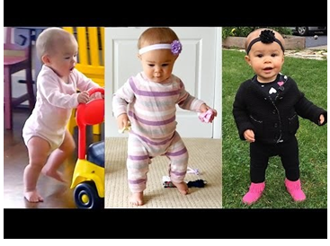
Newbi to Pro NonCredit to Transfer
https://www.youtube.com/watch?v=jOIgR4o9Iu8
Notes:
Kimberley - Think about watching a baby walk for the first time. Now, compare that process to learning mathematics.

Slide 32
Questions? Thank you!

