Slide 1
Should My College Seek WASC Accreditation?
Madelyn Arballo, Dean, Mt. San Antonio College
LE Foisa, Mt. San Antonio College
Valentina Purtell, Provost, North Orange Continuing Education
John Freitas, ASCCC Treasurer (Facilitator)
February 23, 2018
ASCCC Accreditation Institute

Slide 2
What is WASC?
The Western Association of Schools and Colleges (WASC) is one of six regional accrediting association in the United States.
WASC has three commissions:
Accrediting Commission for Schools – ACS
Post-secondary – Adult Education – ROP
Accrediting Commission for Community and Junior Colleges (ACCJC)
Accrediting Commission for Senior Colleges and Universities
Noncredit Programs
Notes:
Tami

Slide 3
Why WASC?
Validates program; transcripts for Cal Grant
Provides access to scholarships
Ensures UC a-g coursework approval
Helps secure resources, including faculty positions
Facilitates transfer of credits
Ensures NCAA course approval
Fosters ongoing improvement

Slide 4
WASC Accreditation Process
School self-evaluation based on school’s mission, Institutional Level Outcomes, and WASC criteria resulting in the writing of a Self-Study Report
Peer review accomplished by a 3 ½ day visit by a committee
Implementation of the schoolwide Action Plan that addresses key issues identified by the school and Visiting Committee
Notes:
Tami

Slide 5
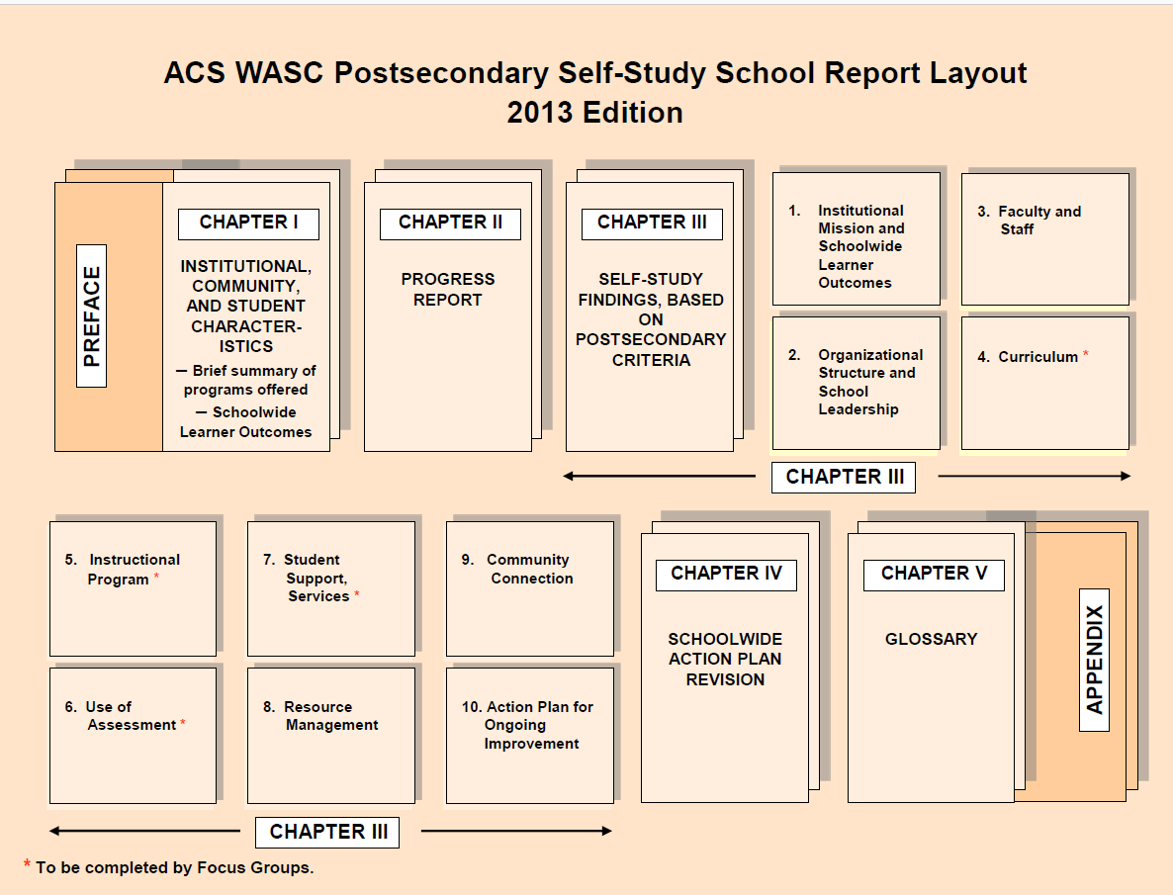

Slide 6
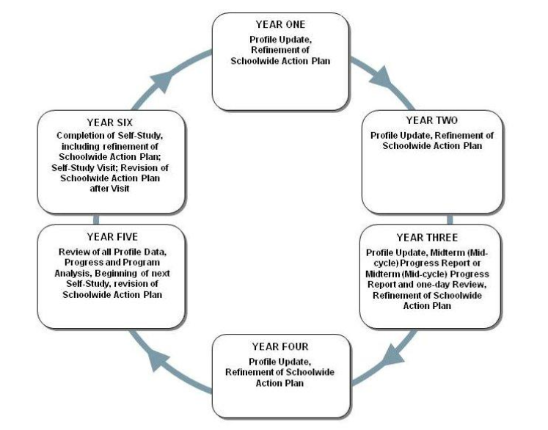
Notes:
Tami

Slide 7
Expected Outcomes of the WASC Process
The involvement and collaboration of stakeholders
The clarification of the school’s mission and Institutional Level Outcomes/ (ILOs)
The assessment of the actual student program and its impact on student learning with respect to the mission, ILOs, and WASC Criteria
The review and update of a schoolwide Action Plan
Accountability system for monitoring the implementation of the Action Plan
Notes:
#4 Action plan that that develops programmatic plans to address identified key issues.

Slide 8
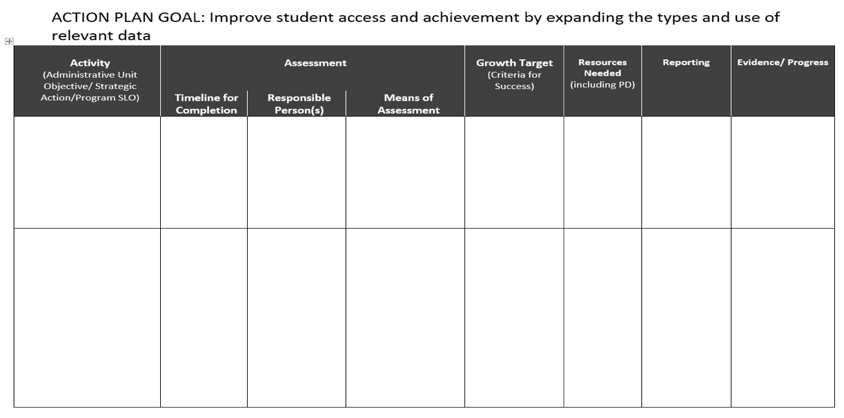
WASC ACTION PLAN TEMPLATE – SAMPLE

Slide 9
Possible Commission Actions
Six-year accreditation status with a mid-cycle progress report
Six-year accreditation status with a 1-2 day site review
Two-year accreditation status with a 2 site visit in 2 years
One-year probationary accreditation status, with a 2-day visit in one year
Accreditation status withheld

Slide 10
Focus on the institution
Focus on the classroom
An "event"
Compliance, regulations
Prove who we are
Engagement at the event
Evidence justifies report
Ongoing annual update of action plan
Evaluative, school-wide improvement
Prove what we found/improve
Engagement includes everyone
Evidence identifies areas of strength and improvement

Slide 11
Alignment of WASC ACS Indicators and College Instructional Design/Accountability Efforts
College Program Review
ACS Indicator 4.2: The school regularly reviews curriculum to accuracy and relevancy of the content.
ACS Indicator 5.1: The school provides high-level instruction with appropriate breadth, depth, rigor, and sequencing for all courses and programs
ACS Indicator 7.1: The school provides sufficient student support services that enhance the learning environment and encourage the achievement of School Wide Learning Outcomes

Slide 12
Connection to Statewide Accountability
ACS Criterion 6: Use of Assessment
Use multiple sources
Disaggregate and draw conclusions
Revise curriculum
Develop instructional programs

Slide 13
Work Smarter, Not Harder
WIOA | AEBG | SWP | Integrated Plan
Reportable Individuals –Participants | Reportable Individuals Participants | Enrollments in CTE Courses | Access
Measurable Skills Gains | Improved Basic Skills and Occupational Skills Gains | Skill Builder Gains | ESL/Basic Skills Completion Retention
Credential Attainment | Completion of High School Diploma, Post-Secondary Certificates, Degrees, or Training Programs | Completion of Noncredit and Credit Locally Approved and CO Approved CTE Certificates, AA/AS, Applied BA, and Third-Party Providers | Degree and Certificate Completion
Employment and Median Earnings, 2nd and 4th Quarter | Employment and Median Earnings, 2nd and 4th Quarter | Employment and Median Earnings, 2nd and 4th Quarter for Completers and Skill Builders
 | Transition to Post-Secondary | Transfer to a Four-Year Institution | Transfer
Disaggregate Data by Equity Indicators

Slide 14
Integrating WASC Action Plan into College/ District Plans

Slide 15
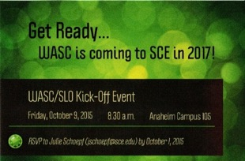
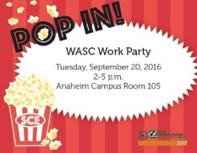
WASC ACS Accreditation NOCE Style: Timeline
October 2014: WASC Work Begins
Provost’s Cabinet, initial planning
August 2015: Construction of Websites
Project management, virtual evidence room
September 2015: SCE Opening Day
Recruited 122 faculty, staff, students, and District staff for focus groups
Writers and facilitators teambuilding training
October 2015: WASC Kick-Off Event
October 2015 - June 2016: Data Collection
Draft criterion, strengths, and key issues

Slide 16
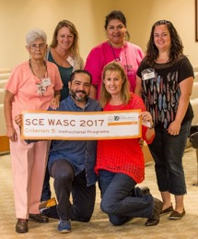
Timeline Continued
March 2016: Anaheim Campus Display
Faces of SCE display welcoming students
Student focused photo display in Provost’s Office
May 2016: Student Photo Project
Photos of students at SCE Centers
June 2016: Staff Photos
I Love SCE selfie photos collected for staff section of evidence room
Management Team photos taken for new temporary website
Fall 2016: SCE WASC Team Presence at Events
Passport to SCE welcome event for the Chancellor
Spring Coffee with the Board of Trustees and Chancellor
New faculty orientation
Campus visits to distribute WASC promotional item

Slide 17
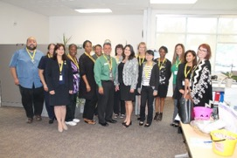
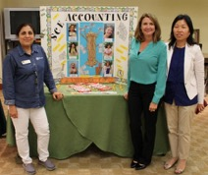
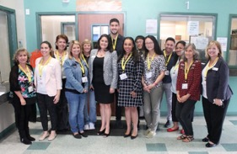
Timeline Continued
June 2016: WASC Self-Study Draft to Provost’s Cabinet
Summer edits
WASC writing seminars
September 2016: Draft Conclusions, Recommendations
Provost’s Cabinet WASC Work Party
Draft Action Plan
October 2016: Pre-Visit with WASC Team Visiting Chair

Slide 18
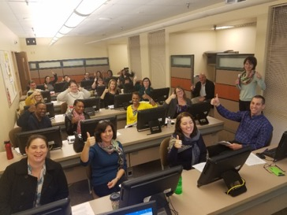
Final Steps
November 2016: Self-Study Draft to Board of Trustees
SCE stakeholders
SCE staff, faculty, student leaders
December 2016: Final Review of Self-Study by Focus Groups
January 2017: WASC Team Completes Final Editing of Self-Study
January 10, 2017:
Provost’s Cabinet approved
final Self-Study
January 24, 2017:
Submit final Self-Study
to Board of Trustees for approval
March 2017:
March 19 – 22, 2017
WASC Team Visit

Slide 19
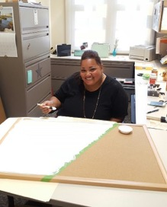
Team Visit Preparation
Continue classroom data collection for ILO
Continue to involve staff and student leaders in process
Finish student photo project at each campus
Update Mission, Vision, & SLO posters
Distribute WASC glossary to all staff
Provide Focus Group trainings
Activate “Countdown to WASC” campaign
Continue building evidence room
Finalize schedule with WASC Team Visiting Chair

Slide 20
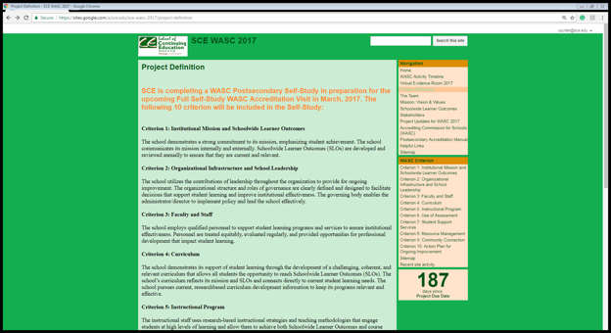
Virtual Evidence Room
Self-Study Report
Focus Groups
SCE Programs & Departments
SCE Committees & Workgroups
NOCCCD Committees
Student Learning Outcomes
WASC Project Management Website

Slide 21
Mt. SAC WASC Self-Study Process
April 30, 2018 – WASC Visit

Slide 22
Program Teams Discussion, Evidence & Questions
Criterion Focus Groups Discussion, Answers & Requests
Program Teams Discussion & Evidence
Criterion Focus Groups Final Analysis & Summary
Writing Team
Self-study communication flow
 | Program Teams Departments: ABE, ESL, EOA, STV Community and Contract Education SCE Division
 | Criterion Focus Groups 4: Curriculum 5: Instructional Programs 6: Use of Assessment 7: Student Support Services
 | Writing Team Faculty, management, and classified

Slide 23
Faculty Leadership in WASC
Involved at all stages of WASC process
Emergence of faculty leaders
Formation of faculty PLC
CRAFT
Co-chairs of criterion focus groups
Critical to completing curriculum and instruction sections
Program team
Criterion focus group
Writing team
Building faculty leaders
Influential in merging SLOs and ILOs

Slide 24
School-wide Learner Outcomes & ILOs
PLC: Need for new assessment schedule
Vote for ILO
Map SLO to ILO
Noncredit Professional Development Day

Slide 25
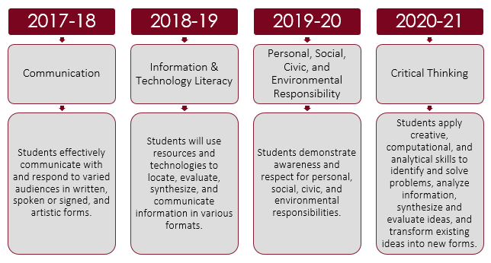
Assessment Schedule Based on ILO Vote

Slide 26
Example of ILO Mapped to SLO

Slide 27
On the Road to Accreditation
Program Teams begin to meet
Criterion Focus Group Chair Training
SCE Advisory Group Retreat
Kick-off Event
September 2, 2016
September 26, 2016
October 18, 2016
November 4, 2016
Teams Begin to Write Self-Study Report
Criterion Focus Groups begin to meet
Finalize Self-Study Report Draft
Finish Self-Study Report Draft & Circulate
December 15, 2017
November 3, 2017
April 3, 2017
November 14, 2016
Submit Self-Study Report Draft to Mt. SAC Board
Mt. SAC Board Approval of Self-Study Report
Submit Self-Study Report to ACS WASC
ACS WASC Team Visit
January 23, 2018
February 28, 2018
March 5, 2018
April 30, 2018

Slide 28
Resources
ACS Website: www.acswasc.org
NOCE Self-Study Report: https://noce.edu/application/files/6814/8893/0530/2017_SCE_WASC_Report.jpg
MT. SAC self-study report Mt. SAC SCE Self-Study 2018

Slide 29
Questions?
Valentina Purtell, vpurtell@noce.edu
L.E. Foisia, lfoisia@mtsac.edu
Madelyn Arballo, marballo@mtsac.edu
John Freitas, freitaje@lacitycollege.edu
Thank you!

