Slide 1
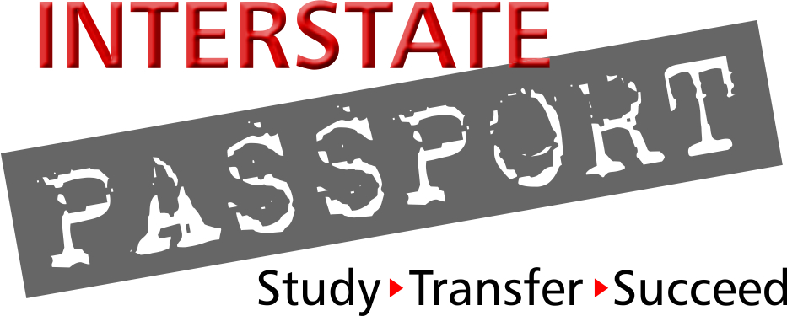
Introducing the Interstate Passport: A New Learning Outcomes Based Transfer Framework
2016 Academic Senate Curriculum Institute
Academic Senate for California Community Colleges
July 8, 2016
Dolores Davison Secretary, Academic Senate for California Community Colleges Professor & Chair, Depts. Of History & Women’s Studies, Foothill College
Thomas Krabacher Professor of Geography, CSU Sacramento
CA Passport State Facilitator
Chair, Passport Natural Sciences PLO/PC Team
Bob Turner Passport State Coordinator
Retired Asst. Vice Chancellor, Oregon Univ. System
Emeritus Professor of Biology, Western Oregon Univ.
Paul Wickline Theatre Dept. Chair, Academic Senate President, College of the Canyons
Passport Creative Expression PLO/PC Team

Slide 2
Opportunity: California Community College Subaward
Test Passport Application Process
$25,000 for each of 2 institutions
Apply by September 2016

Slide 3
Origin of the Interstate Passport
Q at WICHE region meeting of 2-year academic leaders:
”Isn’t there something that can be done about credit loss/adding credits when students transfer?
---- and transfer across state lines?”

Slide 4
Answer: Interstate Passport Initiative GOAL ----
Reduce unnecessary repetition of academic work after students transfer.
Improve graduation rates
Shorten time to degree
Save students money
… keep a focus on ensuring quality
while streamlining path to graduation ...

Slide 5
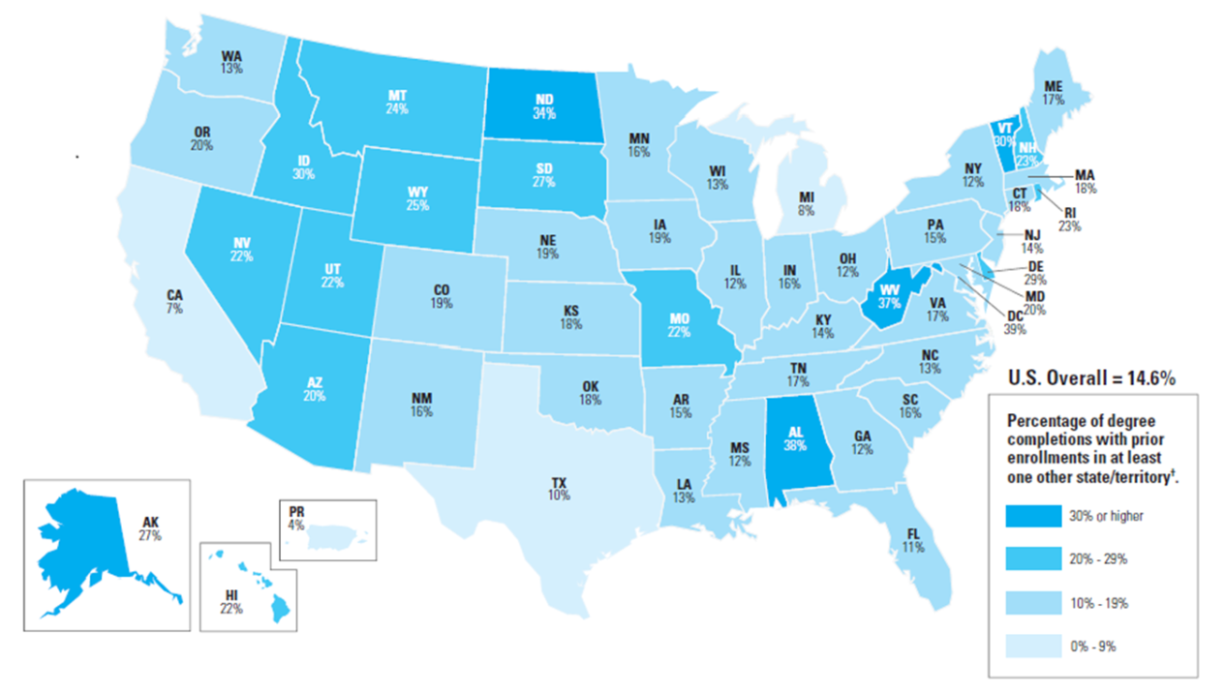
The Reality behind the Question ----
Students “swirl”
0-9% (2)
10-19% (28)
20-29% (13)
>30% (6)
State Avg = 20%
2. Credit Loss is an issue Attewell and Monaghan found:
Only 58% of transfers bring 90% or more of their credits
About 14% of transfers lose more than 90% of their credits
Remaining 28% lose between 10% & 89% of their credits
1.2 years $9,000

Slide 6
The Reality behind the Question ----
From Tables 5, 7, 14 in Jenkins, D. & Fink, J. (2016) Tracking Transfer: New Measures of Institutional and State Effectiveness in Helping Community College Students Attain Bachelor’s Degrees New York, NY: Columbia University, Teachers College, Community College Research Center

Slide 7
What if we could meet this goal….
With a focus on what students learn (LOs)?
With students attaining a definite benchmark?
With individual institutional faculty defining the curriculum they use to bring students to proficiency with the LOs?
With no need to monitor our articulation partners’ curriculum changes?
………..(and vice versa?)
With annual academic progress reports on the transfer students we send out
------ and we take in?

Slide 8
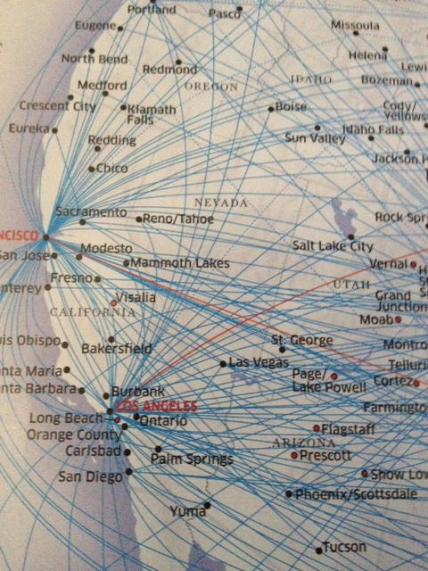
Interstate Passport Design Decisions
Passport is Interstate
Ubiquitous Academic Program: General Education
Course-to-Course Interstate
Transfer Agreements
Focus is on Learning Outcomes
Cross-Border Match
Design Principles
Honor Institutional Individuality
Designed by those who will operationalize
Faculty, Registrars, Institutional Researchers, and Academic Advisors

Slide 9
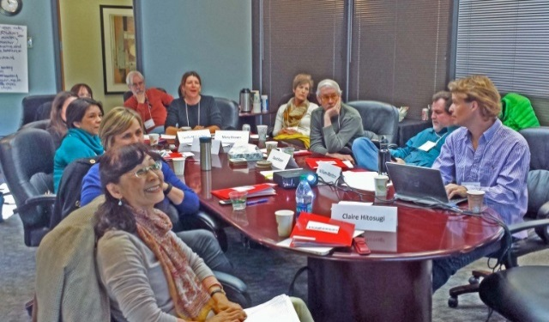
Components of Passport
Developed by…
Passport LDGE Areas (LEAP ELOs/WICHE study) PSFs/staff
Passport Learning Outcomes in each area FACULTY TEAM
Transfer-Level Proficiency Criteria per PLO FACULTY TEAM
Passport Blocks Learning experiences; address all PLOs INST. FACULTY
www.wiche.edu/passport/passport-framework
Tracking System Student Academic Progress REGISTRARS/IR
Application and MOA
Passport Review Board (PSFs)
Funded by: Carnegie Corporation of New York – 2011-2014
Bill & Melinda Gates Foundation and Lumina Foundation – 2014-2016
First in the World, Department of Education – 2015-2019

Slide 10
1. Passport 9 GE Areas – from LEAP ELOs and WICHE research
Human
Society
and the
Individual
Knowledge of
Concepts
Natural
Sciences
Human
Cultures
Teamwork and
Value
Systems
Crosscutting
Skills
Creative
Expression
Critical
Thinking
Oral
Communi- cation
Written
Communi- cation
Foundational Skills
Quantitative
Literacy

Slide 11
2. Passport Learning Outcomes and 3. Proficiency Criteria
2. Passport Learning Outcome (PLO):
Statement of what student must know and/or be able to do to attain LDGE proficiency in each Knowledge/Skill area
e.g., problem setting (Critical Thinking): Identify a problem or question and its component parts.
3. Transfer–Level Passport Proficiency Criteria:
An assignment currently used for students to show transfer- level proficiency with the PLO. EXAMPLE – NOT REQUIRED
e.g., problem setting (Critical Thinking):
For a Business Ethics Case Study: Student will identify the decisions a corporation might consider about producing snack foods made with trans fats

Slide 12
4. Passport Block Derived from Passport Learning Outcomes Unique to each institution PASSPORT BLOCK
www.wiche.edu/passport/passport-framework

Slide 13
Every Passport institution’s faculty
has constructed a LDGE Passport Block
One way to think of a Passport Block ……
Passport Block

Slide 14
Every Passport Block contains the same 9 LDGE Knowledge and Skills areas
CE
SI
NS
CT
OC
QL
CE
W
C
SI
NS
CT
OC
W
C
QL
Passport Block
Passport Block
PLOs for any one of the Knowledge and Skills areas are the same at every Passport institution

Slide 15
4. Passport Block
A. Faculty at each Passport institution decide courses that THEY use to impart proficiency with same consensus PLOs in all 9 areas
CE
SI
NS
CE
CT
OC
SI
NS
W
C
QL
CT
OC
QL
W
C
Passport Block
Passport Block
C. Student does not
have to take PB courses
at receiving institution to complete LDGE
B. Student completes LDGE with PB courses
at sending institution
DO NOT OPEN
Passport Block
Passport Block

Slide 16
Passport Block - Address same PLOs at every institution - Unique to each institution At LCCC ----
AS in Health Sciences (one option)
9 courses, 29 credits, sequenced in 4 semesters

Slide 17
The Interstate Passport
Requires TRUST that each Passport institution’s Passport Block adequately prepares Passport student to continue their academic career at any other Passport institution
DO NOT OPEN
Passport Block
Passport Block
Supported by ACADEMIC PROGRESS TRACKING SYSTEM monitors Passport students after transfer

Slide 18
5. Tracking Academic Progress Developed by Registrars and Institutional Researchers
NSC “Passport Verify” Every Passport institution
Award Passport, record Passport on transcript, send NSC list
Academic Progress Tracking (“APT”) Report from NSC Annual Individualized to each sending institution
Submit grades to NSC 1st two term after transfer
(Passport and non-Passport) transfer students
Native students for two terms after earning Passport
Aggregated report to PRB
Spring 2017 – NSC automated

Slide 19
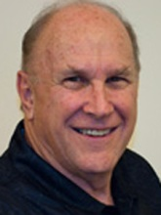
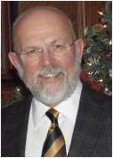
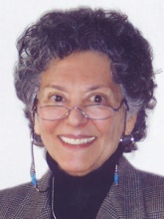
Participants in 16 States Develop and Test Passport: Phase 3 of 3
DEVELOPED the Passport Learning Outcomes, Proficiency Criteria & Tracking System
TESTING the block construction process
State Facilitators:
MAPPING assignments to PLOs - Pilot study
CA
HI
ND
OR
SD
UT
WY
AR
ID
IN
KY
OH
VA
CO
MT
NM

Slide 20
Passport Differences from Typical Articulation Agreements
Typical articulation agreements…
Designed to make transfer easy
Count courses and credits
Trust that course syllabi mean equivalent courses
Require detailed study of syllabi if transferable courses changed by any articulation partner
Assume that students are successful at the new school
The Interstate Passport…
Designed to make transfer successful—no repeat of academic work
Based on faculty shared consensus on PLOs they wrote
Trust that PLO proficiency is attained no matter the course
No need to examine transferable course changes
Tracks student progress and shares progress data

Slide 21
We do meet the Passport goal….
With a focus on what students learn (LOs)? PLOs
With students attaining a definite benchmark? PASSPORT
With individual institutional faculty defining the curriculum they use to bring students to proficiency with the LOs? PASSPORT BLOCK
With no need to monitor our articulation partners’ curriculum changes? ………..(and vice versa?) CONSENSUS PLOs, UNIQUE PASSPORT BLOCKS
With annual academic progress reports on the transfer students we send out? ------ and we take in? PASSPORT VERIFY, ACADEMIC PROGRESS REPORTS

Slide 22
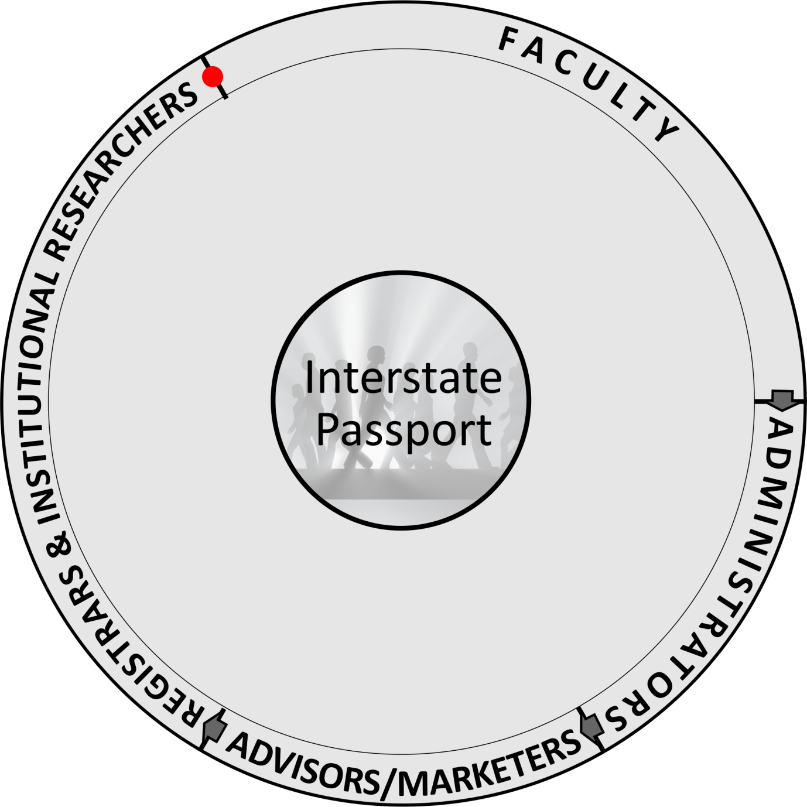
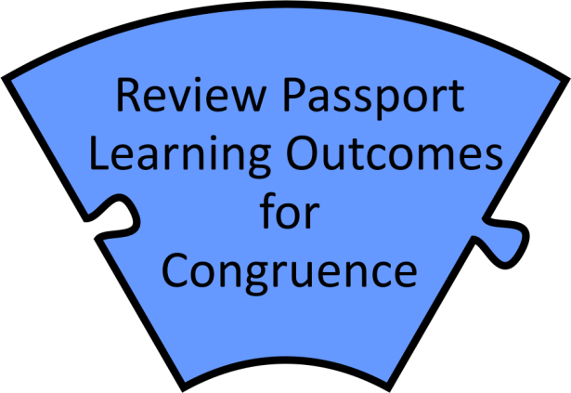
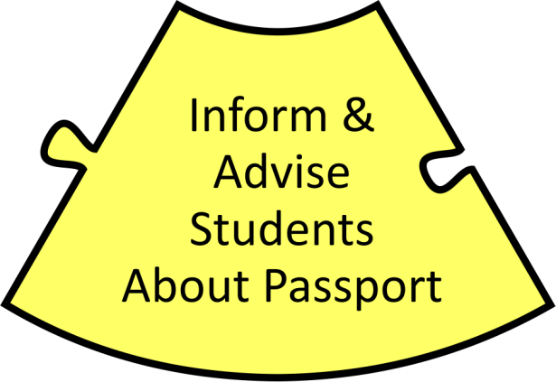
Join the Interstate Passport Network! by…
Apply for
Passport
Status/
Sign MOA

Slide 23
Opportunity: California Community College Subaward
Test Passport Application Process
Map PLOs to campus LOs –
Construct institution’s Passport Block
Understand/identify steps to implement
Passport Verify
Passport Academic Progress Tracking
Student awareness of Passport
Write case study
$25,000 for each of 2 institutions
Apply by September 2016
Bob Turner - bturner@wiche.edu; Dolores Davison - davisondolores@fhda.edu;
Paul Wickline - Paul.Wickline@canyons.edu; Tom Krabacker - tsk@csus.edu;

Slide 24
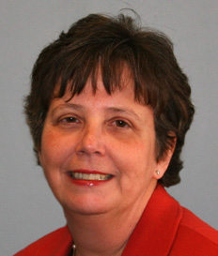
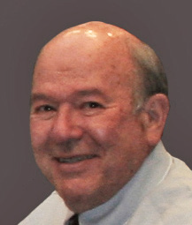
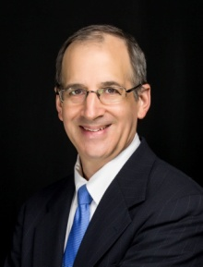
Interstate Passport Webinar Series: Summer 2016
Introducing the Interstate Passport: A New Transfer Framework Based On Learning Outcomes
Join us for an overview of the Interstate Passport, a new framework for block transfer of lower division general education based on learning outcomes. Find out who developed it and why, how it works, and how it benefits students and institutions. This webinar may be of particular interest to faculty, deans and provosts interested in issues of transfer and outcomes-based education.
Date: June 21st , 2016 12pm MDT
Presenter: Robert “Bob” Turner, Passport State Coordinator
Click here for archived version of this webinar!
The Interstate Passport: An Overview for Registrars and Institutional Researchers
Along with faculty, academic advisors, administrators and others, registrars and institutional researchers have been critical players in the development of the Interstate Passport, a new framework for block transfer of lower division general education. Learn about the important role registrars and institutional researchers now play in the successful implementation of the Passport at their institution.
Date: July 27th , 2016 12pm MDT
Presenters: Pat Shea, Academic Leaderships Initiatives, WICHE
Roland Squire, Passport Registrar Expert, USHE, WICHE
Michael Torrens, Director, Analysis Assessment and Accreditation, Utah State University
Click here to register for this webinar!
Interstate Passport: The Role of Transfer-Level Proficiency Criteria in the New Framework
In the Interstate Passport, Proficiency Criteria are examples of assignments faculty currently use for students to show proficiency with the Passport Learning Outcomes (PLOs). Find out how these sample lists were created by faculty, why they are assignments that are not required of Passport participant faculty, and why they are examples and not exhaustive lists. Learn about the role of the PC in creating a common understanding about faculty expectations for student achievement of the PLOs at the transfer level.
Date: August, 24th 2016 12pm MDT
Presenter: Terry Underwood, Passport Proficiency Specialist
Click here to register.
Focusing on Student Mobility and Transfer: A National View
What does student transfer look like for today's colleges and universities? Learn about the latest research on student mobility from the National Student Clearinghouse and how it can help you to increase both access and success.
Date: September 29th, 2016 11am MDT
Presenter: Doug Shapiro, Executive Research Director, National Student Clearinghouse
Click here to register for this webinar!

Slide 25
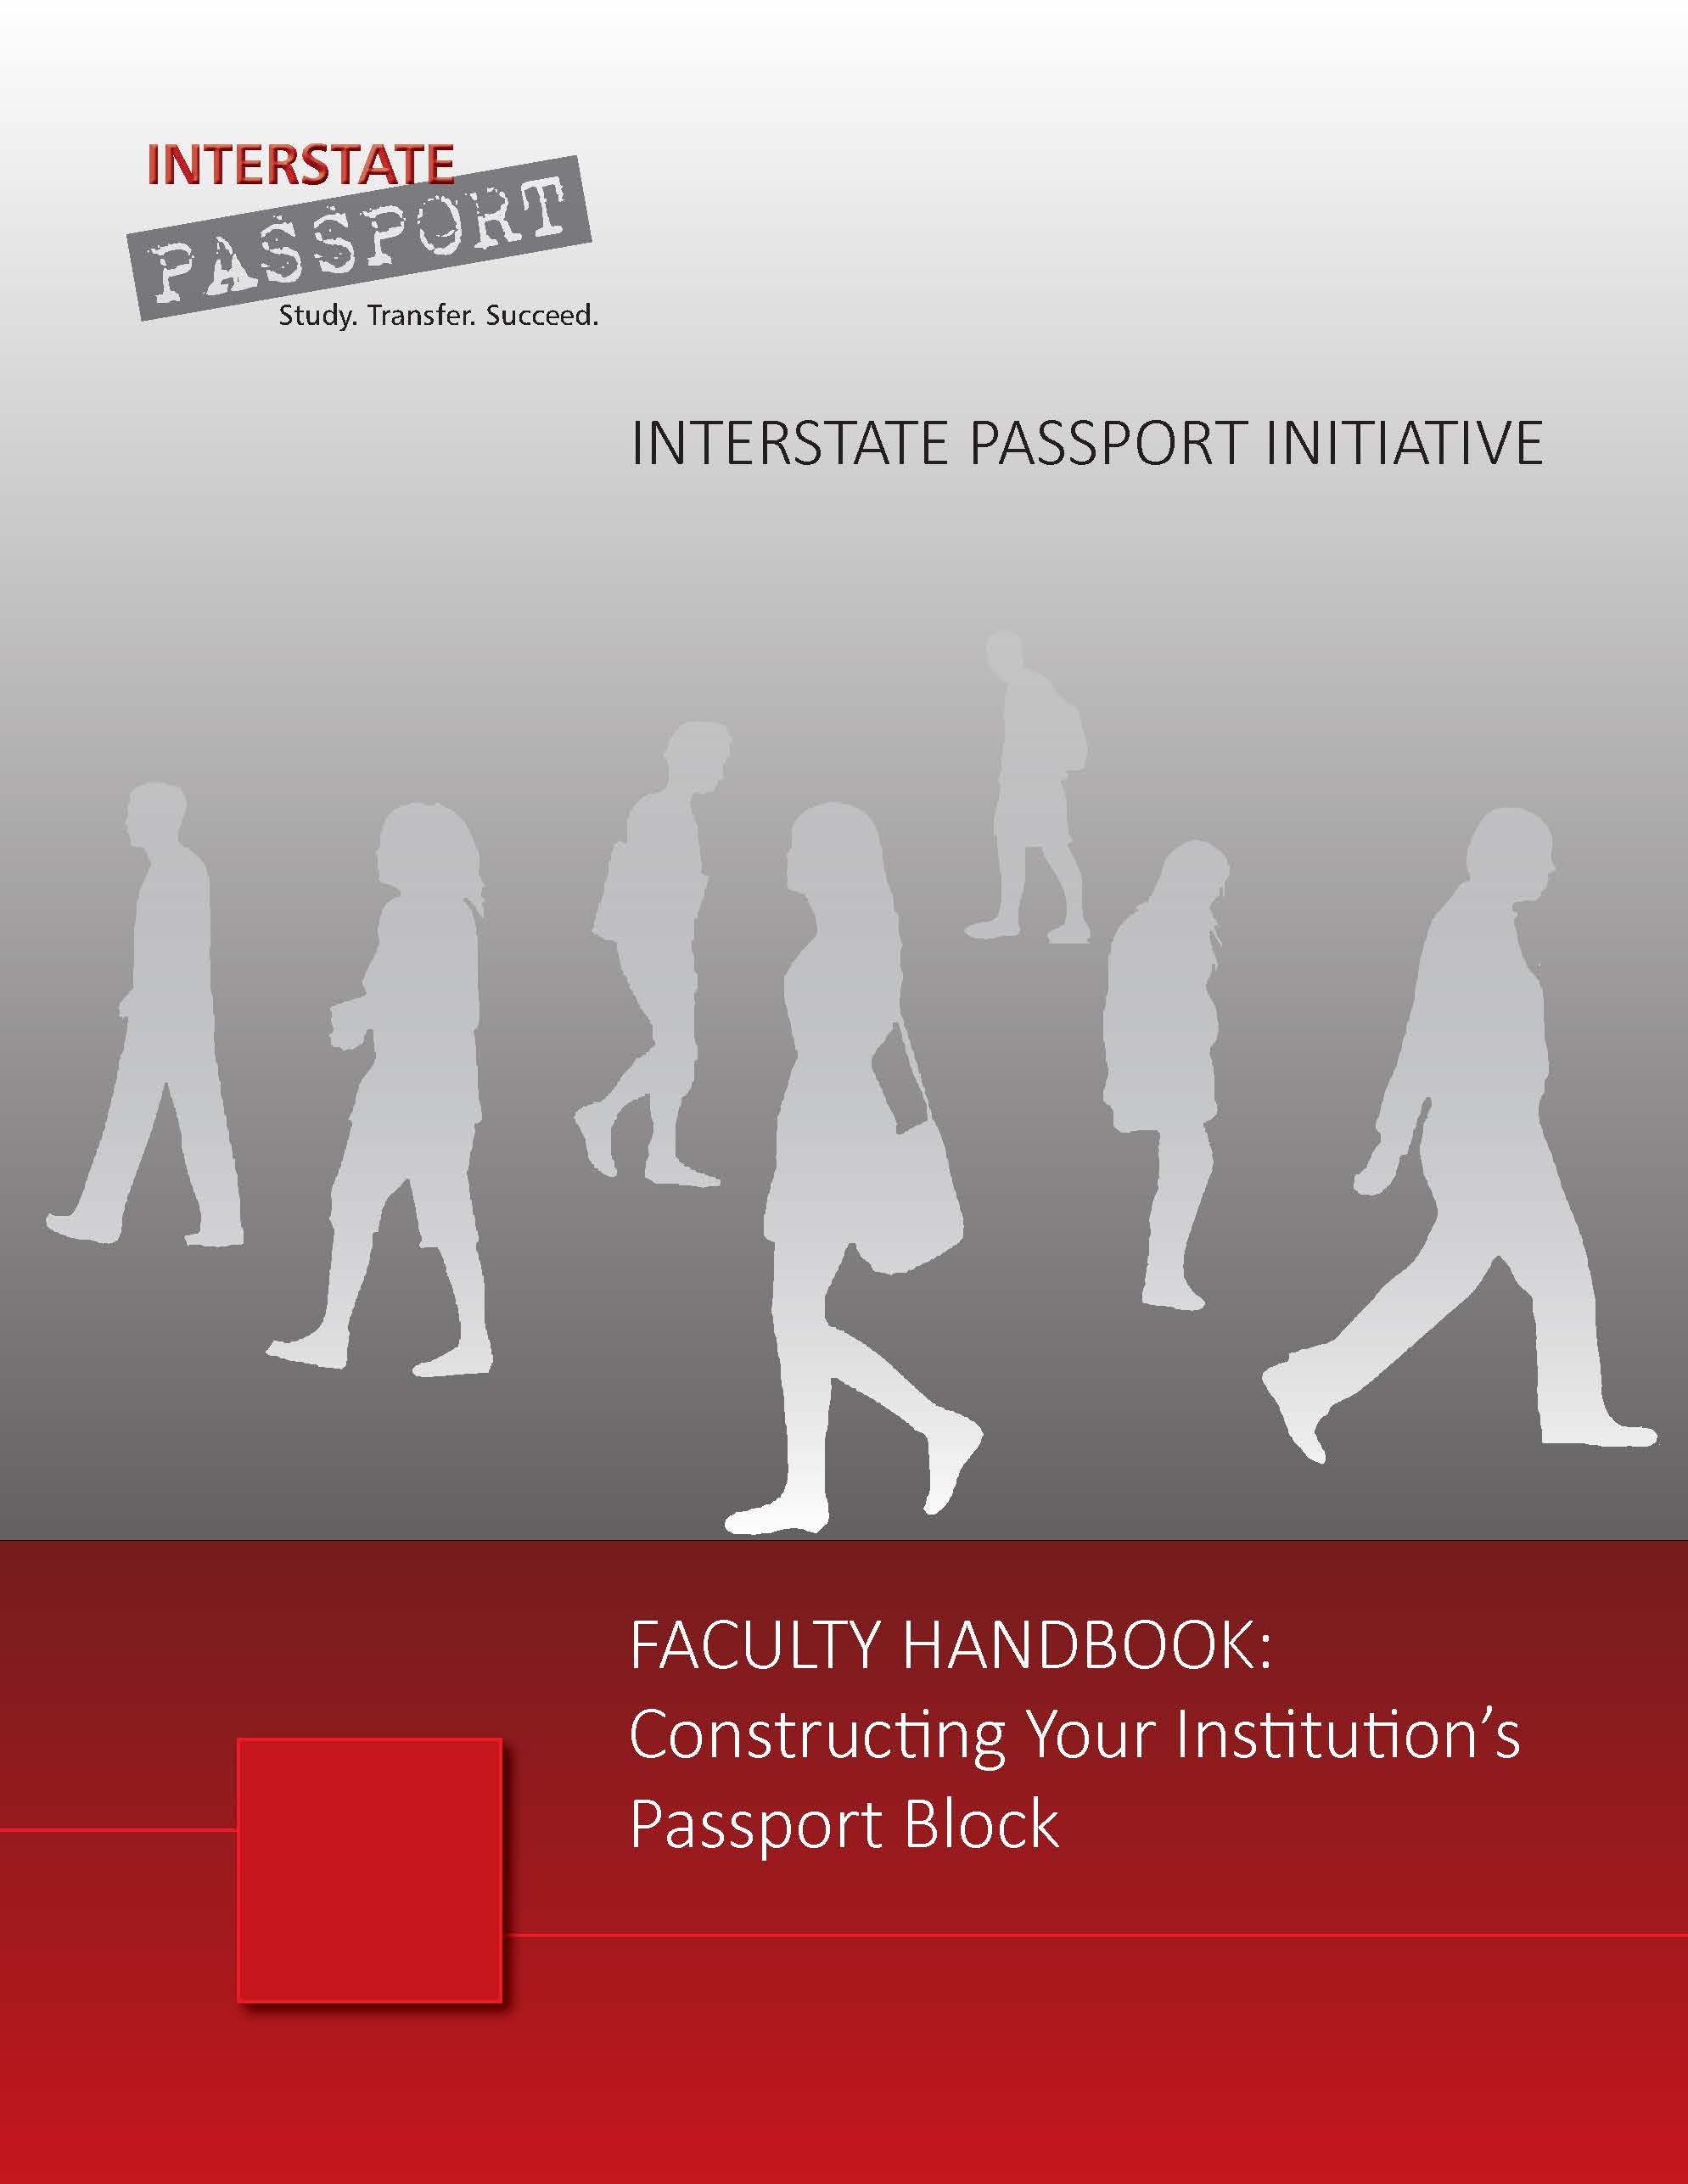
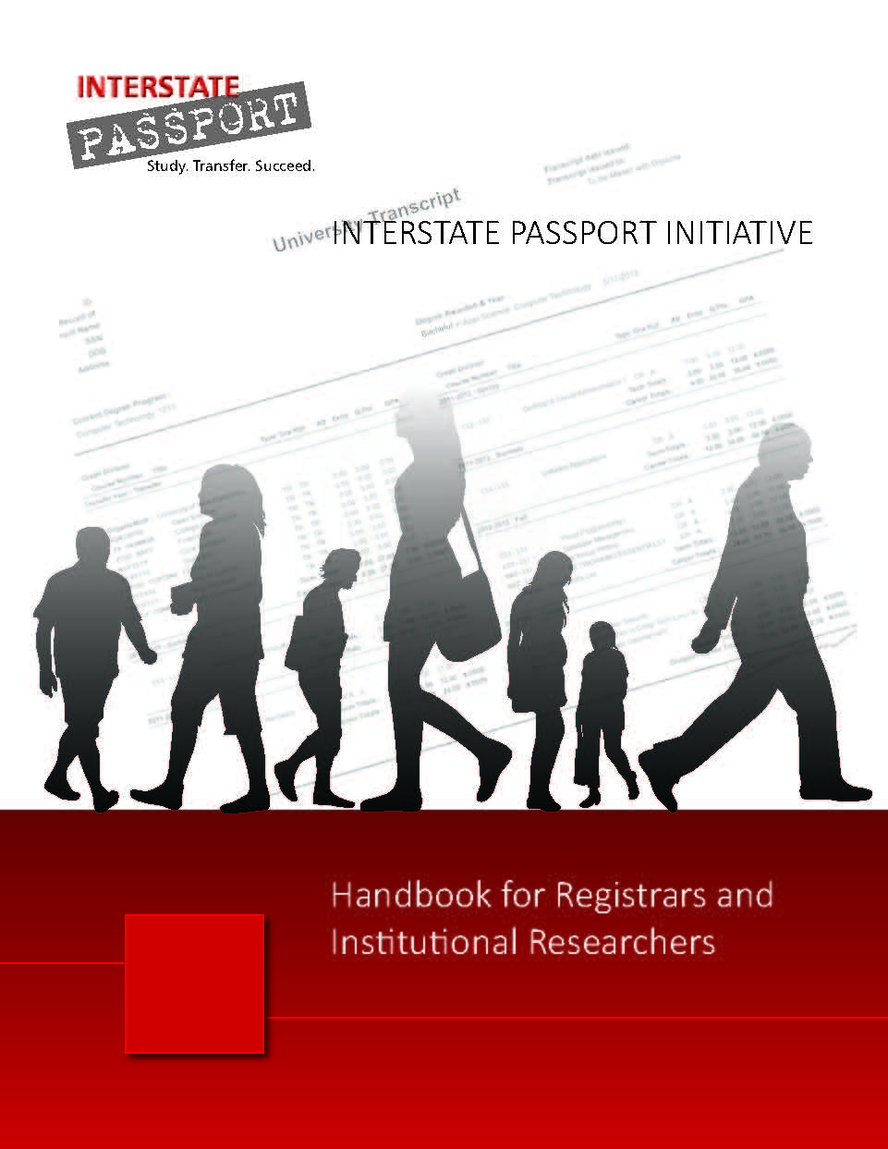
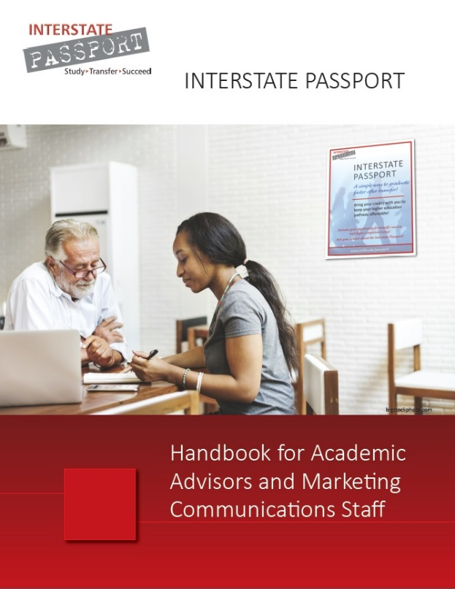
Resources
www.wiche.edu/passport

Slide 26
Contact us ……
www.wiche.edu/passport
INTERSTATE PASSPORT
Pat Shea, Director, Academic Leadership Initiatives: pshea@wiche.edu
Jane Sherman, Passport Tri-Region Coordinator: jsherman@wiche.edu
Bob Turner, Passport State Coordinator: bturner@wiche.edu

Slide 27
Passport Quality Assurance
Minimum grade of C
Academic Progress Tracking students after transfer
FITW #1: Automated and Conducted by NSC
Pilot Study: Mapping critical assignments to PLOs
FITW #2: CO, MT, NM and NCHEMS
Evaluation Research Study of Passport impact
FITW #3: Education & Employment Research Center, School of Management & Labor Relations, Rutgers University
PRB monitoring of Passport efficacy

Slide 28
The Interstate Passport
Is a Lower-Division General Education Interstate “articulation agreement”
Uses learning outcomes to expedite interstate transfer
Is NOT a replacement of General Education program at any institution
Is NOT a replacement of internal state transfer initiatives
May prove useful tool for efficient transfer within state

Slide 29
Benefits of the Passport
(for Students, Institutions, and States)
Institutions: C. Map to Passport Learning Outcomes
Greater curricular flexibility
Reduces articulation renegotiation as courses/disciplines evolve
Eliminates negotiation of course-by-course or course-based block transfer with new partners
Institutions & States: Student success initiative tracking data
Passport and non-Passport transfer students
Academic performance
Persistence, completers, time to degree

Slide 30
Benefits of the Passport
(for Students, Institutions, and States)
Students: Decrease repetition of academic work
A milestone more motivation to complete
less time to degree lower cost
less debt lower foregone earnings
Institutions: A. Improves performance metrics
Increases “completers” for both sending and receiving institutions
B. No course-by-course GE articulation
Less resource to sort through syllabi to articulate courses
Easier to maintain state transfer/articulation websites

Slide 31
Why Become a Passport Institution?
Facilitates transfer across state lines and within states
Eliminates a major obstacle to transfer student success
Eliminates necessity for review of lower-division GE course changes in articulation agreements
Focuses on quality for positive impact on completion
Based on what students should learn and be able to apply
Generates data on academic success after transfer
Provides data for use in continuous self-improvement

Slide 32
Why Become a Passport Institution?
Adapt to higher education’s changing landscape
Embraces unique assessments determined by each department/program/institution
Includes non-course-based educational experiences
Authority to issue an Interstate Passport
Recognize student achievement
Use as a recruiting tool

Slide 33
Passport Implementation Timeline
Spring/Summer 2016: Faculty construct their institution’s unique Passport Block
July 1, 2016: Institutions can apply to join Passport
Fall 2016: First term that students can earn Passport
End Fall 2016: Institutions first report Passport Verify to NSC
Spring 2017: First term Passport students can transfer Institutions first report Academic Progress data to NSC
End Fall 2017: Passport students’ grades for 2nd term after transfer
Five years FREE for first 100

Slide 34
Passport Questions
We hope you see how the Passport works…
For students at your institution
Preparing to transfer
When received at the next institution?
For the staff and faculty
Helping students earn the Passport and transfer
Helping students get started at the receiving school
What can we clarify? Expand on?

Slide 35
Discussion
What do you see that the Passport does?
What doesn’t it do?

Slide 36
Thank you!
http://www.wiche.edu/passport/phase-ii-passport-state-facilitators
Dolores Davison: davisondolores@foothill.edu
Thomas Krabacher: tsk@csus.edu
Bob Turner: bturner@wiche.edu]
Paul Wickline: Paul.Wickline@canyons.edu

