Slide 1
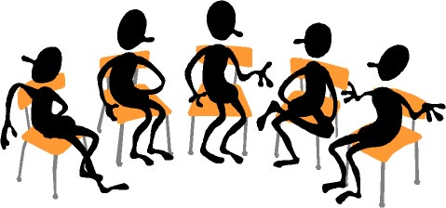
Working Together: Community Building on Campus
Presented at the ASCCC Instructional Design and Innovation Institute – March 17, 2017
4:15 PM – 5:30 PM San Jose Marriott
Organized by Howard Blumenfeld, Steve Chiolis, Marty Nash, and Marsha Vernoga

Slide 2
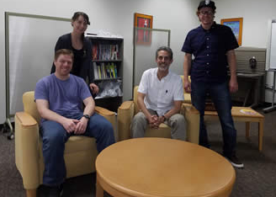

Slide 3
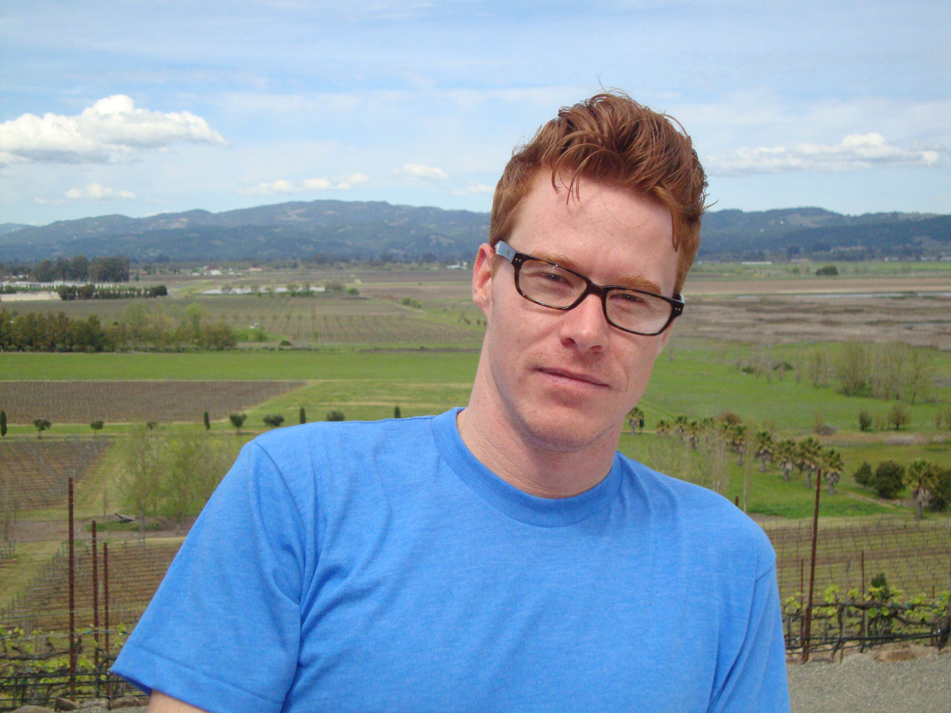
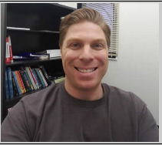
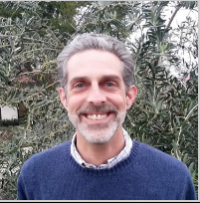
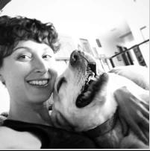
Who are we?
Marty Nash
Howard Blumenfeld
Steve Chiolis
Marsha Vernoga
Notes:
Just brief introductions – we will get into more details later

Slide 4
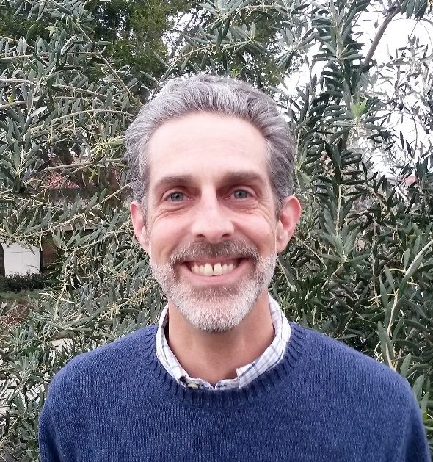
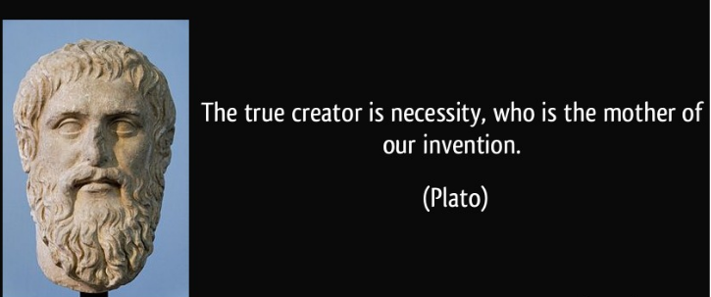
Introduction & Brief History (Steve Chiolis)
Notes:
Steve could talk about how he got to know Marsha through this experience.

Slide 5
Introduction & Brief History (Steve Chiolis)
Working Together & Campus Climate: Nourishing the Innovators
Creativity & Innovation Initiative
Teachers Teaching Teachers (TTT)
Hallway Conversations: Reclaiming & Sharing Our Stories
Grassroots Organization
Never Mind the Silos, Here's a Community
Notes:
Steve could talk about how he got to know Marsha through this experience.

Slide 6
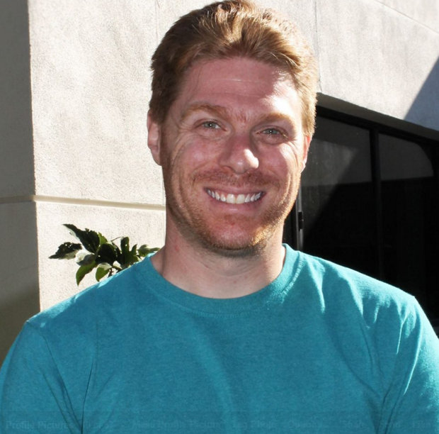
The “Working Together” Model (Howard Blumenfeld)
Number of Organizers
Monthly Organizer Meetings
Website
FLEX Day Presentations, Town Hall & Small Group Conversations
Spinoffs from Working Together
These experiences led me to become Professional Development Coordinator
Notes:
For “spinoffs” talk about the Teaching Institute, Active Listening Workshops for Faculty & Students, Post-Election Conversation groups, Community Ed Classes in Civic Engagement, in Division discussions on policies concerning student athletes and other campus representatives.

Slide 7
The “Working Together” Model (Howard Blumenfeld)
“Working Together” conversations are often starting points for other collaborations on campus.
The Teaching Institute
Post-Election Conversation Facebook Group
Community Education Classes in Civic Engagement
Division Meeting Discussions about Student Athletes & Other Campus Representatives
Active Listening Workshops for Faculty & Staff
Notes:
Changes the environment in which we teach dramatically

Slide 8
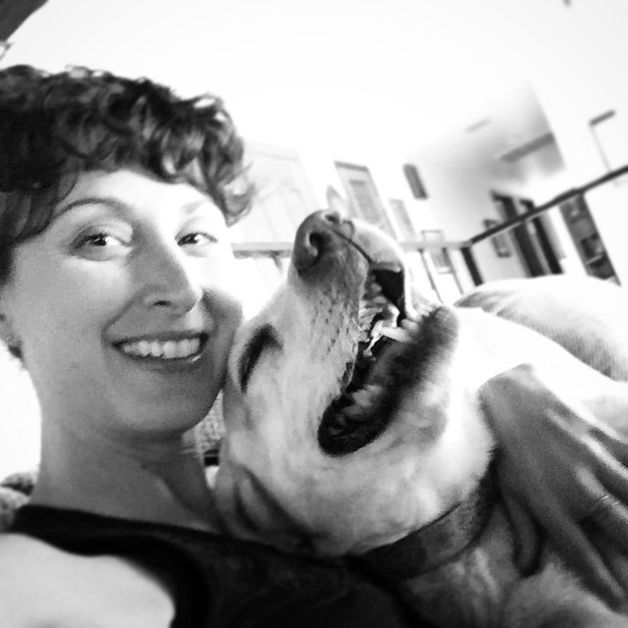
Moderating Small Group Conversations (Marsha Vernoga)
Working in teams of two
Conversation starters and opening videos
Navigating the flow of conversation
Reflecting on small group conversations at organizer meetings
How this experience helped me get out of my bubble

Slide 9
The Selection of Topics (Marty Nash)
Selecting topics for larger group seminars
Selecting topics for monthly small group conversations
Topics that emerge naturally during conversations
Trending topics (Post-Election Conversation)
How “Working Together” affected me
Notes:
Make a slide of example topics.

Slide 10
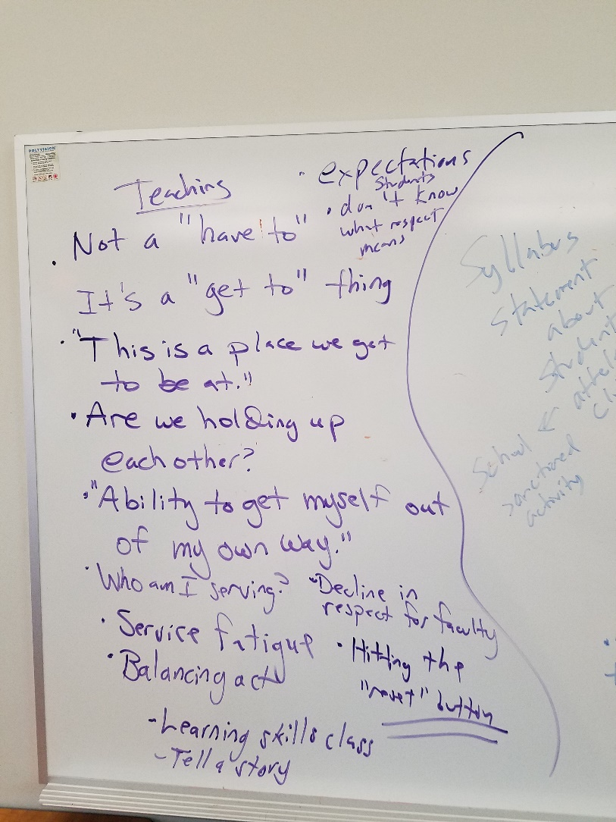
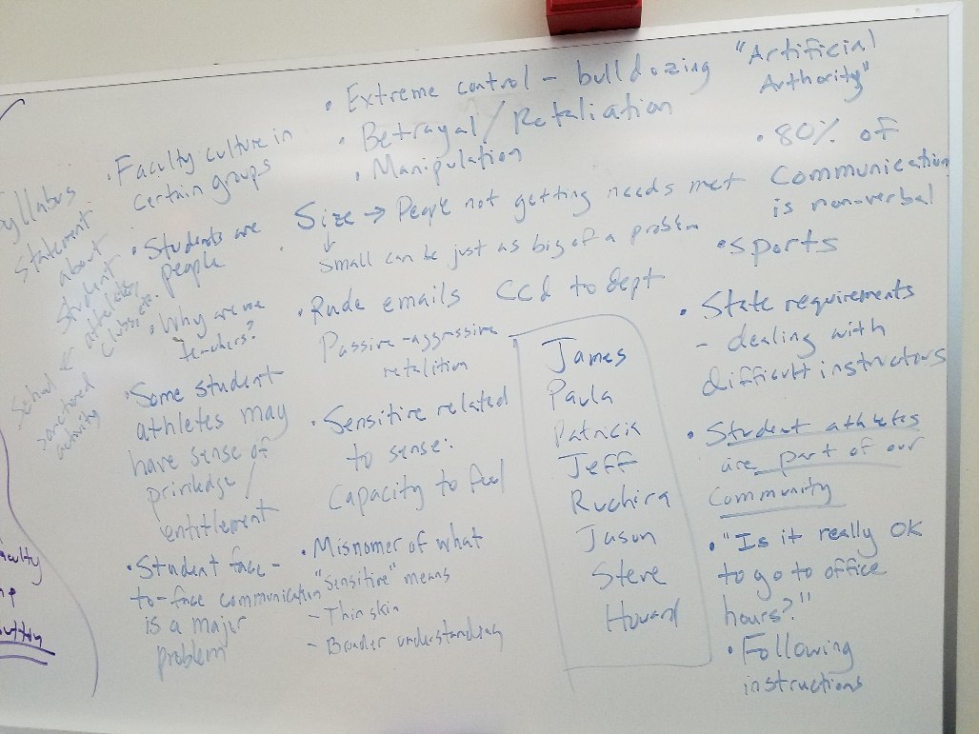
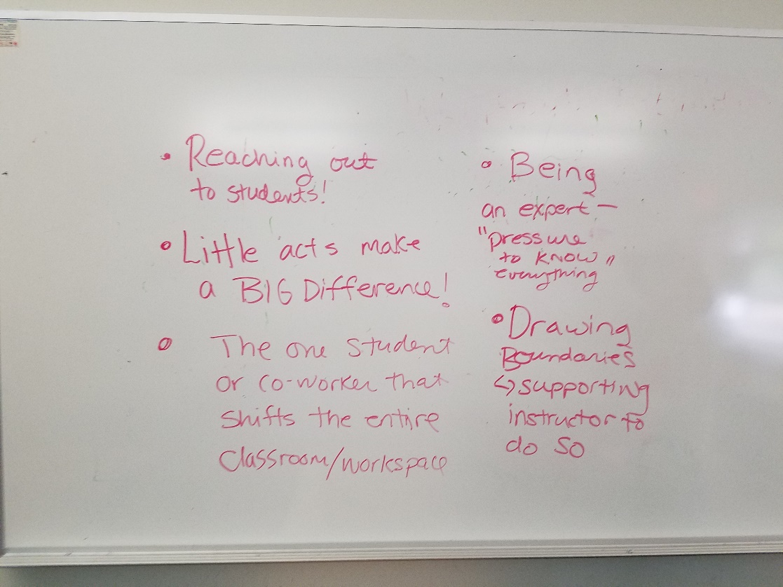
The Selection of Topics (Marty Nash)

Slide 11
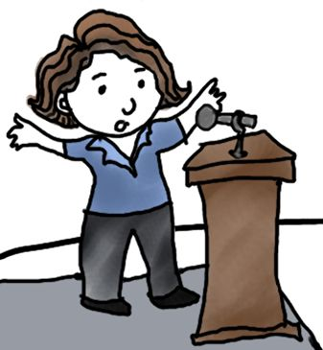
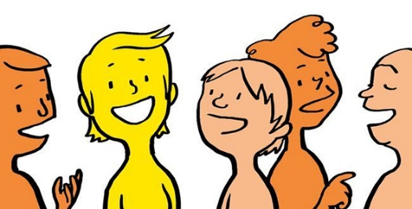
Testimonials
Notes:
Put testimonials on two slides

Slide 12
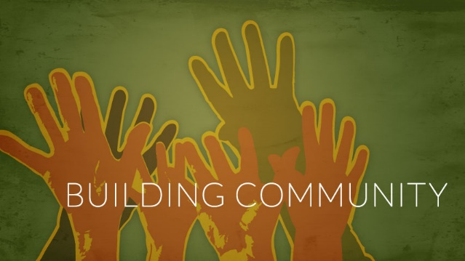
Sample Working Together Session

Slide 13
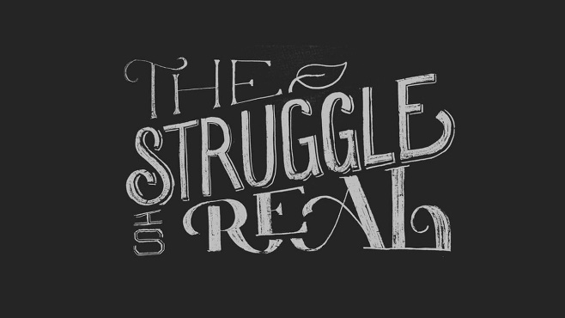
Vulnerability

Slide 14
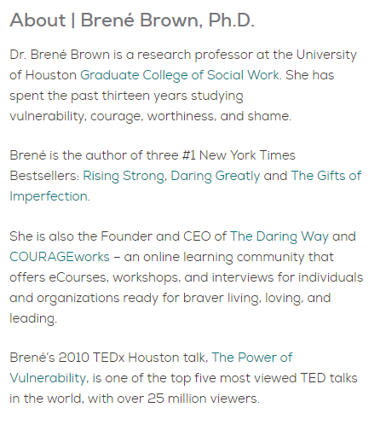
Embracing Vulnerability
Notes:
Cut off video at 3:49

Slide 15
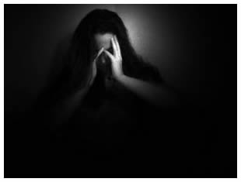
Tales of Vulnerability
Two of us will share our own personal experiences with vulnerability in our academic lives.

Slide 16
Sometimes it Can’t Wait (Steve Chiolis)
Instant Active Listening
When the rules don’t seem to apply
Did I handle this correctly?
Notes:
Steve could talk about how he got to know Marsha through this experience.

Slide 17
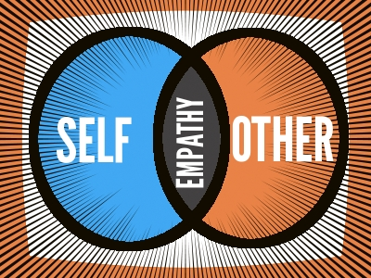
Apathy into Empathy (Marsha Vernoga)
I stand for compassion. Will you stand with me?
Is it possible to turn apathy into empathy?
So, I question...Are these conversations helping or hindering the issues at heart?

Slide 18
Small Group Conversations
Following our anecdotes at larger events we typically launch into small group conversations
Our smaller “Working Together” sessions occur monthly in a small group setting. We typically have 2-4 small groups each month to accommodate different availabilities

Slide 19
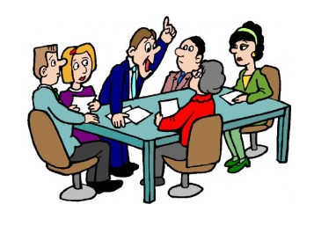
Small Group Conversations
We will split up into 2-4 small groups right now, each led by a moderator.
Once in our groups we will do introductions and then answer some questions.

Slide 20
Questions to answer in groups
Think of a time in your teaching (working with others) when you felt exposed, didn’t know what to do. How did you react?
Have you ever felt absolutely foolish in the classroom? Tell us about it.
How do we support each other during moments of vulnerability?
Notes:
When we break up into groups, each of us will have a marker and a few pieces of large post-it notes to write on. We should split up into the four different corners of the room. Groups should ideally be split up by our designated time slots.

Slide 21
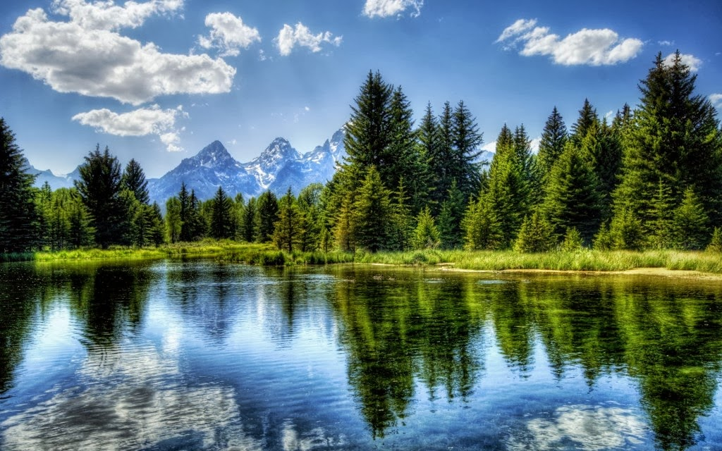
Large Group Reflections
Typically following small group discussions in a larger event like this one we would reconvene for large group discussion of main themes and topics that emerged during discussion.
Some of these themes could guide our selection of topics for future “Working Together” sessions.

Slide 22
How to start a “Working Together” group at your campus
We recommend selecting between 4-6 faculty and staff to serve as organizers.
Solicit feedback from campus constituent groups to determine trending topics to discuss
Some topics we have discussed so far include vulnerability, work/life balance, sensitive situations, body language, the dilemma of Sisyphus, reflections & resolutions, education in a post-election culture, and email etiquette

Slide 23
How to start a “Working Together” group at your campus
Set up small group conversations at times that are convenient for your constituent groups.
Participate in Professional Development Days with activities that encourage collaboration

Slide 24
Help to Get You Started
You can contact any of us for assistance in setting up your “Working Together” campus group or to arrange for a campus visit to help you get started.
You can visit our campus “Working Together” website at http://laspositascollege.edu/staffdevelopment/workingtogether.php

Slide 25
Contact Information
Howard Blumenfeld, 925-424-1342, hblumenfeld@laspositascollege.edu
Steve Chiolis, 925-424-1000 x2969, schiolis@laspositascollege.edu
Marty Nash, 925-424-1245, mnash@laspositascollege.edu
Marsha Vernoga, 925-424-1278, mvernoga@laspositascollege.edu

Slide 26
Q&A
Time permitting, we will take some questions.
Thank you for participating in our “Working Together” Session

